Slide 1
AN UNUSUAL CAUSE OF OCULAR SURFACE DISCOMFORT: GUNTHER'S DISEASE
Abdullah ILHAN, MD
Yilmaz TURAN, MD

Slide 2
Purpose:
We aimed to present a case of GUNTHER'S DISEASE [ Congenital erythropoietic porphyria (CEP) ] complaining about dermal and ocular surface problems.

Slide 3
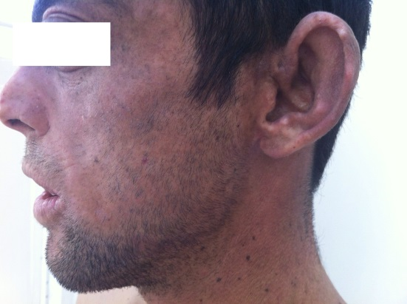
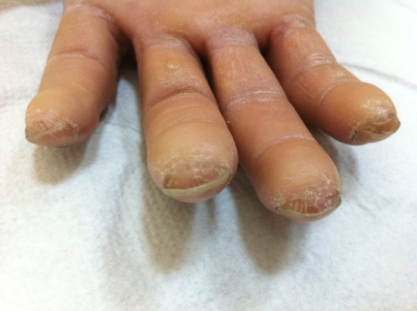
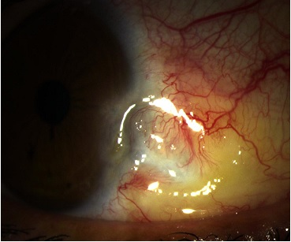
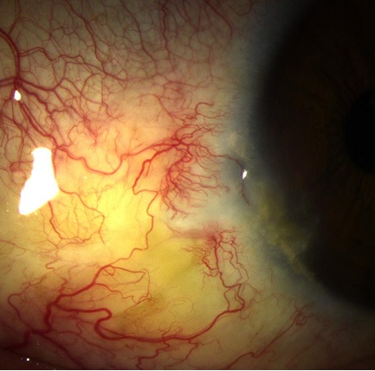
Material and Method:
A 20-year-old male complaining about
stinging and gritty sensation in both eyes
tissue loss on auriculs, nose and hands
hypertrichosis on face
scarring on face, neck and upper extremity.
Further physical examinations and CT-scan revealed
Hepatosplenomegaly
Bilateral corneal dellen formation
Limbal neovascularization
Pre-diagnosis was Congenital Erythropoietic Porphyria

Slide 4
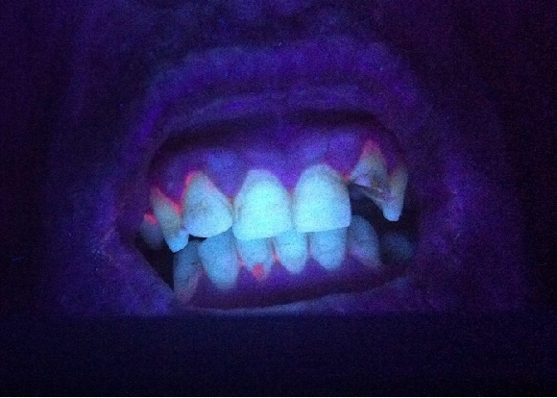
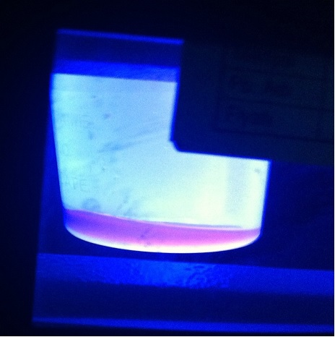
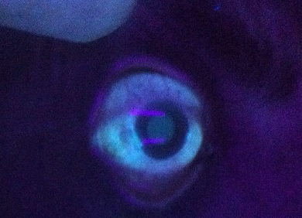
Results:
Teeth and urine showed characteristic pink-red fluorescence when exposed to long wave ultra violet light under Wood’s lamp.
Haemolytic anemia, increased porphyrin metobolytes in plasma and urine, increased bilirubin and LDH
Genetic confirmation (We detected a rare mutation in the intron region of 10th chromosome.)
Photographic, biochemical and genetic results were compatible with CEP

Slide 5
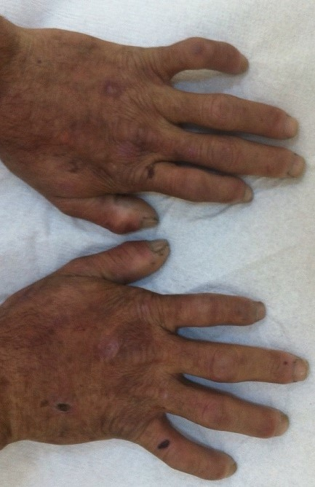
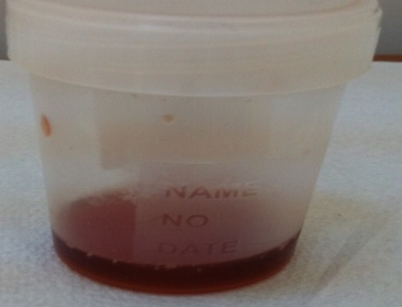
Conclusion:
CEP is a very rare cause of ocular surface discomfort.
Deficient and impaired activity of uroporphyrinogen III synthase (UROS)
Increased levels of type 1 isomers of porphyrin in plasma, urine and feces
Increased levels of bilirubin and LDH, Haemolytic anemia
Hepatosplenomegaly, Eerythrodontia, Hypertrichosis
Reddish-colored urine and pink-reddish fluorescence of urine, teeth, and bones under wood light illumination
Ocular surface pathologies (dellen, scar, neovascularization, symblepharon, lagophthalmos, hyperkeratotic plaque etc. )
Cutaneous manifestations like hypo-hyperpigmentations, scarring, milia, acral photomutilations and loss of tissues
CEP patients must be managed thoroughly for all possible clinical manifestations and guided through genetic councelling. Strict ophthalmologic follow-ups will prevent vision-threatening complications.

