Slide 1
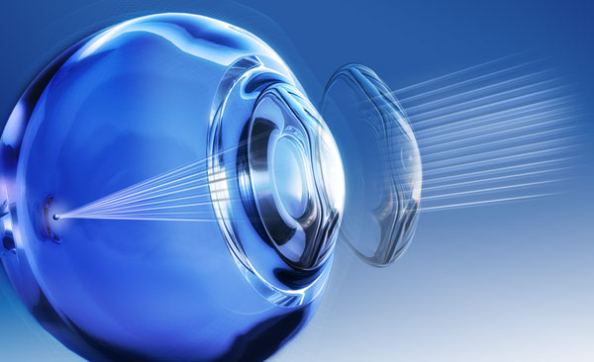
OCULAR SURFACE CHANGES IN CONTACT LENSES WITH DIFFERENT SURFACE MORPHOLOGY
ARSLAN N., KOSKER M., DOGAN A.S., ACAR M., GURDAL C.
Ministry of Health, Diskapi Yildirim Beyazit Training and Research Hospital, Ankara, TURKEY

Slide 2
PURPOSE
To determine the effect of plasma surface technology & different contact lens manufacturing techniques on ocular surface & dry eye tests.

Slide 3
Material & Method
Inclusion criteria:
Contact lens users for more
than 4 months
Exclusion criteria:
Patients having any systemic disease
Ocular disease
Patients underwent any ocular surgeries
The individuals were classified
86 individuals using contact lenses treated with plasma surface technology (Group 1)
84 individuals using non coated contact lenses (group 2)
All individuals underwent full ophthalmologic examination including dry eye tests; tear break up time (TBUT) (1=>10, 2=<10), Schirmer test I (1=>5mm, 2=<5mm)
Ocular Surface disease Index (OSDI) quetionnaire was asked from all individuals
Corneal topography, meibography, non invasive tear analysis (NIFBUT).
Performing the tests after applying the contact lens for at least 2 hours
The data were compared in both groups using SPSS statistical analysis program version 20 using Chi-square, Mann-Whitney U, Spearman’s RHO

Slide 4
Results
There was no statistically significant difference in schirmer 1, TBUT, OSDI & NIFBUT between the 2 groups as shown in the table.
Meibography results were similar in groups
According to Spearman’s RHO test there was a weak negatife relation between the duration of contact lens use & both schirmer & TBUT ( r=0,254, p=0,01 & r=0,213, p=0,05 respectively). Whereas there was a weak positive relation with OSDI (r=0,37, p=<0,001)
No relation was found between the duration of use &both NIFBUT & miebography.
 | Group 1 (Plasma coated) | Group2 (non caoted) | P*
Age (Year) | 24,39±10,06 | 23,08±8,88 | 0.955
Duration (month) | 13,37±22,25 | 12,12±16,33 | 0.83
Gender male/female | 18(21%) / 68 (79%) | 29(34,5) / 55 (65,5%) | 0,07
TOTAL(n) | 86 (50,6%) | 84 (49,4%)
*Mann-Whitney Test
 | Group 1 (Plasma coated) |  | Group 2 (Non-coated)
 | 1 | 2 | 1 | 2 | P*
Schirmer n(%) | 86 (100 ) | 0 (0 ) | 82 (97,6 ) | 2 (2,4 ) | 0,151
TBUT n(%) | 82 ( 95,3) | 4 (4,7 ) | 80 (95,2) | 4 ( 4,8) | 0,973
OSDI n(%) | 83(96,5) | 3 (3,5) | 76 (90,5) | 8 (9,5) | 0,111
NIFBUT n(%) | 23 ( 69,7) | 10 ( 30,3) | 21( 70) | 9 ( 30) | 0,979
*chi- square

Slide 5
Conclusion
No relation was detected between plasma surface technology in preventing dry eye symptoms.
Significant correlation was found between the duration of contact lens use & each of TBUT, schirmer, OSDI score results
Meibography test results is not affected by lens type.

