Slide 1
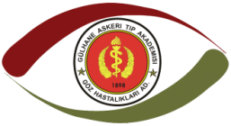

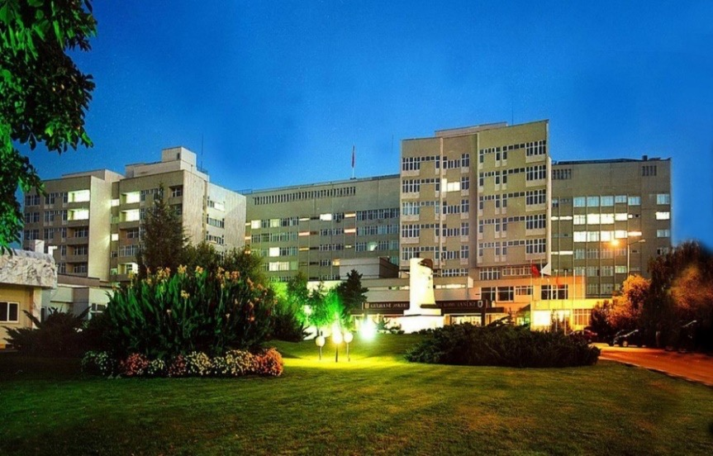
A NOVEL SURGICAL PROCEDURE TO CORRECT HIGH ASTIGMATISM WITH MINIMUM TISSUE ABLATION
Salih Altun MD
Uzeyir Erdem MD, Altay Aslan Yeşim MD, Abdullah Ilhan MD, Fatih Mehmet Mutlu MD
Cornea & Refractive Surgery Dept. of GMMF
ANKARA TURKEY

Slide 2
Purpose
The aim of this study is to evaluate the safety and efficacy of our new ablation protocol developed to gain maximum correction in high astigmatic patients with minimum tissue ablation.

Slide 3
Material and Method:
NIDEK Advanced Vision Excimer Laser System (NAVEX) by the same surgeon. Ablation plans were made using the NIDEK EC-5000 CX II excimer laser and Final Fit 1.11 treatment planning software were used.
In addition to the demographic data of the patients, refractive and topographic values, corrected and uncorrected visual acuities and ablation depths were recorded.

Slide 4
Results
43 eyes of 23 patients were included.
Mean preoperative spherical refractive value was -3.1±2.4(5.75-6) diopters and cylinderical refractive value was -3.1±2.4(5.75-6) diopters.
Mean preoperative central corneal thickness was 547±26(493-590) microns.
Preoperative mean uncorrected visual acuity (snellen chart) was 0.3±0.2(0.05-0.7) and corrected visual acuity was 0.8±0.2(0.4-1.0).
Preoperative maximum corneal ablation depth plan that Final Fit software have automatically calculated was 47±36(19-143) microns.
Postoperative 1st month results were analysed. Mean spherical refractive value was -0.07±1.7(5-5) diopters and cylinderical refractive value was -1.1±1.6(3-6.25) diopters.
Mean central corneal thickness was 491±52(379-559) microns.
Mean uncorrected visual acuity was 0.8±0.3(0.2-1.2) and corrected visual acuity was 0.9±0.2(0.5-1.2).
Maximum corneal ablation depth that we executed was 47±36(19-143)

Slide 5
Conclusion
Our study suggest that high astigmatic patients with low central corneal thickness can gain considerable visual improvement with this multi-point mini ablation technique.

