Slide 1


Contact lens wearers’ attitudes and needs: similarities and differences
Evie Roussopoulou Michelle Rose Johnson & Johnson Vision Care Inc.
1 of 3
Background
Results
Fitting the most appropriate contact lens (CL) from the start is critical when it comes to new lens wearers. Research shows that 1 out of 4 new wearers drop out and of those who do, nearly half (47%) do so in the first 2 months of wear.¹
To better identify the most appropriate CL for each patient, Eye Care Practitioners (ECPs) generally ask and evaluate different aspects of the patients’ lifestyle.
ECPs would benefit from a wider understanding of the needs and attitudes of CL wearers. A market research survey was conducted to understand similarities and differences between CL wearer needs.
397 soft CL wearers (daily disposable or two-weekly/ monthly replacement) were recruited.
CL wearers have many common attitudes (Figure 1). Their top needs are:
60% want to keep their eyes healthy now and for the future,
48% want their eyes to feel comfortable throughout the day,
43% want their eyes to stay comfortable and healthy no matter how intense their day is.
Lens Attribute Importance
% Say Critically Important
Methods
On-line survey conducted in August 2014 in the US via 10-minute on-line interviews with 18-50 year old soft CL wearers.
Sample was representative of the population.
Respondents were asked questions around lifestyle (hours/ days of wear, time spend in different environments) and experience with contact lenses.
A t-test was used to determine if differences between groups are statistically significant at the 90% to 95% confidence level.
Latent class analysis was used to identify customer groups based on their behaviors/attitudes and served as the foundation for a customer classification algorithm
Figure 1: Percentage of respondents who strongly agreed with those statements as the most important
©JJVCI, 2015. All rights reserved
Poster first presented at BCLA Conference 2015.

Slide 2
Contact lens wearers’ attitudes and needs: similarities and differences
Evie Roussopoulou Michelle Rose Johnson & Johnson Vision Care Inc.
2 of 3
Results (continued)
Discomfort Prone
28%
Demanding Environments
43%
The survey classified CL wearers in three groups based on their needs (Figure 2).
Wearers prone to discomfort and irritation
Wearers who experience everyday demanding environments
Wearers who are eye health focused and wear their CLs many days per week
Differences were noted between wearer groups (Table 1 and Figure 3)
Healthy Intense Wear
29%
Figure 2: Research identified 3 main patient groups (n=397 CL wearers)
Lens Wearer Attitudes (% strongly agree/ agree) | Discomfort Prone | Demanding Environment | Health Focused
My eyes frequently feel dry or uncomfortable while wearing my CLs throughout the day. | 63%_{A} | 38% | 30%
My eyes feel sensitive while wearing my CLs | 62%_{A} | 33% | 26%
I spend > 8 hours per day in front of a digital screen | 62% | 75%_{A} | 55%
My eye health is so important to me that I am willing to pay more to go to someone I can trust, for the best products | 46% | 48% | 66%_{a}
I want to keep my eyes healthy now and for the future | 91% | 89% | 98%_{a}
Lens Wearing Attitudes by Needs Group
(% strongly agreed)
Discomfort Prone
Demanding Environments
Healthy Intense Wear
5+ days and want healthy eyes today /future
Time on Digital/ a/c
Eye Sensitivity & Discomfort
*Statements statistically significant at 90%
Figure 3: Significant differences in wearing attitudes exist between Needs Groups. N=397 CL wearers.
Table 1: Statistically significant differences in attitudes between the three CL wearer groups, respondents who strongly agreed/ agreed with different attitudes (n=397 CL wearers)
A– indicates differences significant at 95% confidence interval
a – indicates differences significant at 90% confidence interval
©JJVCI, 2015. All rights reserved
Poster first presented at BCLA Conference 2015.

Slide 3
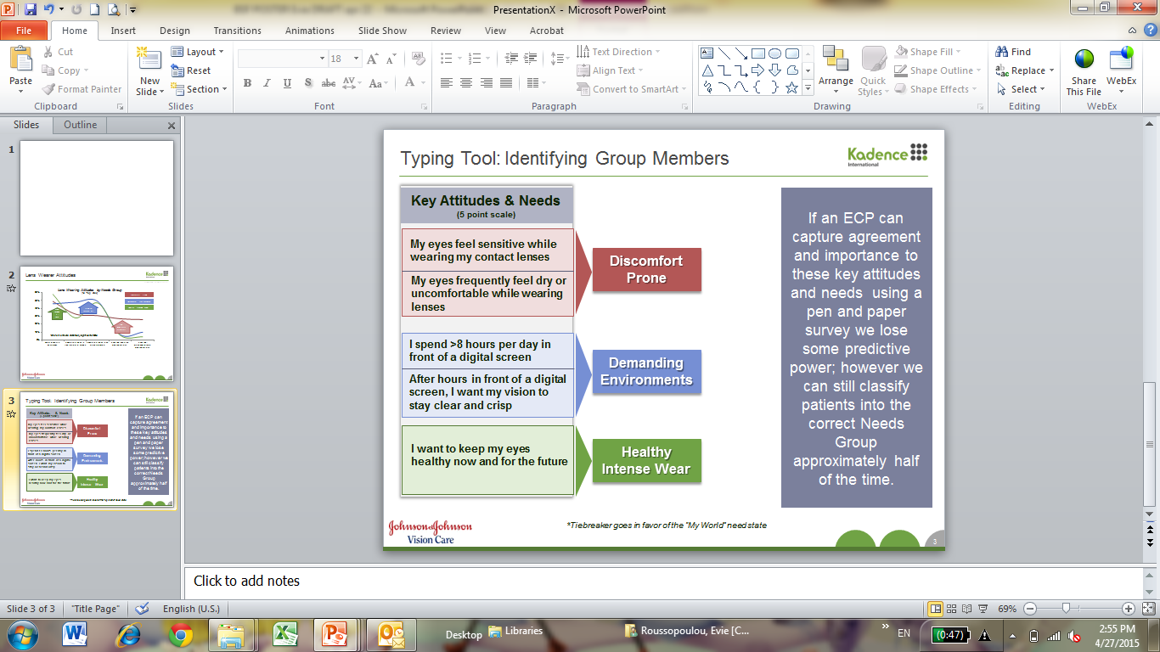
Contact lens wearers’ attitudes and needs: similarities and differences
Evie Roussopoulou Michelle Rose Johnson & Johnson Vision Care Inc.
3 of 3
Discussion
Conclusions
Patients needs overlap as most patients want comfort, vision and health.
However, there are distinct prevailing needs.
By asking a small number of key questions & inputting the answers into a sophisticated algorithm, we can correctly identify the prevailing need and which group a wearer belongs to 80% of the time.
By identifying the prevailing need, an ECP can better fit the right lens to the patient from the start.
The research showed that there are differences in wearing attitudes between CL wearers.
Three main groups of patients with key distinctive need were identified.
With a few questions, ECPs can identify which group the patient will likely belong to, and select a contact lens that will take these needs into consideration.
REFERENCES
Sulley A, Young G and Hunt C. Factors in the success of new contact lens wearer retention. Poster presentation at American Academy of Optometry Annual Meeting 2014. Optom Vis Sci 2014 E-abstract 145020
CORRESPONDENCE
Johnson & Johnson Vision Care, Inc. 7500 Centurion Parkway, Suite 100/ D-ACAF, Jacksonville, FL 32256, USA
Email: eroussop@its.jnj.com
ACKNOWLEDGEMENT
This work was sponsored by JJVCI
Figure 4: Predictive questions of the need groups
©JJVCI, 2015. All rights reserved
Poster first presented at BCLA Conference 2015.

