Slide 1

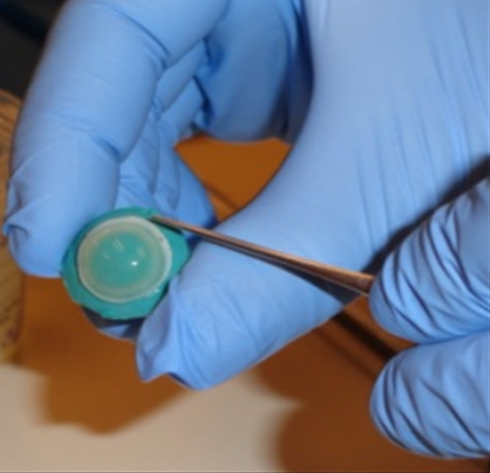

Coefficient of friction comparison of worn daily disposable silicone hydrogel contact lenses to human corneal tissue Samuele Tosatti¹ Tawnya Wilson² Kristy Canavan² Rudolf Aeschlimann¹ Ryan Butterfield³ Kathrine Osborn Lorenz² 1-SuSoS 2-Johnson & Johnson Vision Care, Inc. 3-MaxisIT
1 of 5
Introduction
A contact lens (CL) with higher lubricity (coefficient of friction, CoF) is thought to be less detectable to the wearer and to cause less irritation.¹ It is also suggested that a CL with lubricity similar to that of the human cornea may help in maintaining comfort¹. Hence, the need to use a human cornea CoF value as a comparator has been suggested.²
The purpose of this post hoc evaluation was to compare the CoF of 1-DAY ACUVUE® TruEye® (narafilcon A) contact lenses removed from manufacturer packaging and post 10-hours of wear to previously published fresh human corneal tissue values.³
Methods
In vitro CoF was measured on 13 narafilcon A CL’s directly after removal from packaging.
Ex vivo CoF was measured on 10 narafilcon A CL’s post daily disposable wear on either eye by 10 subjects for 12 (±2) hours. All ex vivo CoF measurements were conducted immediately after lens removal.
Ten (10) fresh human corneas (Fig 1) were supplied within 8 hours (range 2.17 - 7.48 hours) of donor death to enucleation.³ CoF was then measured within 9 hours of donor death (range 3.30 – 8.48 hours).
Figure 1: Fresh human cornea specimen

Slide 2
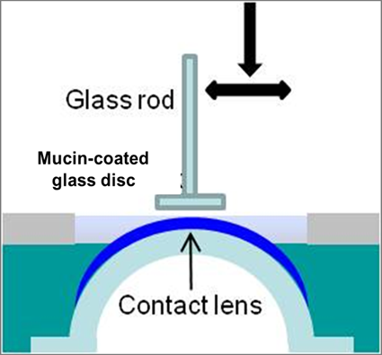
Coefficient of friction comparison of worn daily disposable silicone hydrogel contact lenses to human corneal tissue Samuele Tosatti¹ Tawnya Wilson² Kristy Canavan² Rudolf Aeschlimann¹ Ryan Butterfield³ Kathrine Osborn Lorenz² 1-SuSoS 2-Johnson & Johnson Vision Care, Inc. 3-MaxisIT
2 of 5
Methods (continued)
All CoF testing was conducted utilizing the Basalt Must Micro-Tribometer (Fig 2) in Tear Like Fluid (TLF-PBS) (300 – 310 mOsm/kg) solution according to the methodology outlined by Roba et al⁴.
The applied normal force varied between 0.25 and 4.0 mN with a measured stroke length of 1.0 mm at normal speed of 0.1 mm/s. A mucin coated hydrophobized glass counter surface was used for all measurements.
CoF values were recorded for 0, 50, and 100 cycles for the CL’s and at 0 cycles for the human corneas.
Additional CL observations included monocular LogMAR visual acuity (VA).
CL CoF values were analysed using a linear mixed model to calculate least square (LS) mean differences for within cycles and time points, respectively. The statistical equivalence margin was set at 0.05.
Pairwise comparisons between CL’s at 100 cycles and the cornea (0 cycles) were conducted using t-tests on LS Means. All statistical analyses were carried out using SAS 9.4 (Cary, NC, 2014).
Figure 2: Graphical representation of micro-tribometer set-up⁴

Slide 3
Coefficient of friction comparison of worn daily disposable silicone hydrogel contact lenses to human corneal tissue Samuele Tosatti¹ Tawnya Wilson² Kristy Canavan² Rudolf Aeschlimann¹ Ryan Butterfield³ Kathrine Osborn Lorenz² 1-SuSoS 2-Johnson & Johnson Vision Care, Inc. 3-MaxisIT
3 of 5
Results
The narafilcon A subject population (n = 10) included experienced CL wearers between the ages of 18 and less than 40 years old of which 70.0% were female and 70% were Caucasian. The mean age of the cohort was 29 (±4 SD) years.
The power ranges of the ex vivo (worn) narafilcon A lenses were -1.00 to -4.00 in 0.25D steps. The power of the in vitro (out of package) narafilcon A lenses was -1.00.
The CoF average for the human cornea is not statistically different from narafilcon A in vitro (out of packaging) lenses (p = 0.051) or from ex vivo (worn) lenses (p=0.513). (Fig 3)
Figure 3 : Mean CoF values for the fresh human cornea, in vitro narafilcon A (1-DAY ACUVUE® TruEye®) lenses, and ex vivo narafilcon A lenses.

Slide 4
Coefficient of friction comparison of worn daily disposable silicone hydrogel contact lenses to human corneal tissue Samuele Tosatti¹ Tawnya Wilson² Kristy Canavan² Rudolf Aeschlimann¹ Ryan Butterfield³ Kathrine Osborn Lorenz² 1-SuSoS 2-Johnson & Johnson Vision Care, Inc. 3-MaxisIT
4 of 5
Results (continued)
CoF values of ex vivo (worn) narafilcon A lenses demonstrated statistical equivalency to in vitro (out of the package) lenses measured at all cycles (0, 50, 100). (Table 1)
The CL mean LogMAR VA -0.15 (SD=0.056) on fitting and -0.15 (SD=0.080) after 12+2 hours wear.
The mean CL wear time was 13:21 hours (10:47 min and 16:13 max).
CoF Analysis Out of Packing CL’s, Cycles |  | CoF Analysis 12 ± 2 Hours Worn CL’s, Cycles |  | LSMeans Differences | Standard Error | p-values | 95% CI’s | Statistical Equivalence
in vitro | 0 | ex vivo | 0 | -0.01470 | 0.003889 | 0.0077 | (-0.02679, -0.00261) | Yes (Equivalent)
in vitro | 50 | ex vivo | 50 | -0.00803 | 0.003889 | 0.4626 | (-0.02012, 0.00406) | Yes (Equivalent)
in vitro | 100 | ex vivo | 100 | -0.00850 | 0.003889 | 0.3846 | (-0.02059, 0.00359) | Yes (Equivalent)
Table 1: Statistical comparison of in vitro and ex vivo narafilcon A (1-DAY ACUVUE® TruEye®) CoF at 0, 50 & 100 cycles

Slide 5
Coefficient of friction comparison of worn daily disposable silicone hydrogel contact lenses to human corneal tissue Samuele Tosatti¹ Tawnya Wilson² Kristy Canavan² Rudolf Aeschlimann¹ Ryan Butterfield³ Kathrine Osborn Lorenz² 1-SuSoS 2-Johnson & Johnson Vision Care, Inc. 3-MaxisIT
5 of 5
Discussion
REFERENCES
1. Young G. Exploring the Relationship Between Materials and Ocular Health and Comfort. Contact Lens Spectrum 2007. http://www.clspectrum.com/articleviewer.aspx?articleid=100428.
2. Ross G, Nasso M, Franklin V, Lydon F, Tighe B. Silicone hydrogels: trends in products and properties. BCLA 2005.
3. Wilson T, Aeschlimann R, Tosatti S, Toubouti Y, Kakkassery J, Lorenz KO. Coefficient of Friction of Human Corneal Tissue. Optom Vis Sci 2013;90:E-abstract 130742.
4. Roba M, Duncan EG, Hill GA, Spencer ND, Tosatti SGP. Friction measurements on contact lenses in their operating environment. Tribol Lett 2011;44:387-397.
5. Subbaraman LN, Jones LW. Measuring friction and lubricity of soft contact lenses: a review. Contact Lens Spectrum 2013. http://www.clspectrum.com/articleviewer.aspx?articleID=108560
6. Veys J, Meyler J. Do new daily disposable lenses improve patient comfort. Optician 2006;6046(231):34-36.
7. Fonn D. The Clinical Relevance of Contact Lens Lubricity. Contact Lens Spectrum 2013. http://www.clspectrum.com/articleviewer.aspx?articleID=108559
8. Morgan P, Chamberlin P, Moody K, Maldonado-Codina C. Ocular physiology and comfort in neophyte subjects fitted with daily disposable silicone hydrogel contact lenses. CLAE 2013;36(3):118-125.
CORRESPONDENCE
Tawnya Wilson, Johnson & Johnson Vision Care, Inc. (JJVCI)
7500 Centurion Parkway Jacksonville, FL 32256
Email: twilson@its.jnj.com or kcanavan@its.jnj.com
1-DAY ACUVUE® TruEye® is a registered trademark of Johnson & Johnson Vision Care, Inc.
CL comfort is subject to change during wear, indicating the importance of maintaining surface lubricity.^{1,2,5} Immediate ex vivo CoF measurements (end of CL wear period) provide valuable information on possible changes in lubricity which may influence comfort.
Polyvinylpyrrolidone (PVP) containing CLs have been measured to have lower CoF values than materials that do not contain PVP.^{2,4} PVP addition has been shown to support high comfort levels.⁶ PVP mimics the physical behavior of the tear film mucin layer covering the cornea and palpebral eyelid and has been used to help maintain CL lubricity.^{4,7}
1-DAY ACUVUE® TruEye® (narafilcon A) with HYDRACLEAR® 1 contains PVP and likely contributes to the lens’ ability to maintain lubricity with sustained visual performance after 12 (±2) hours’ wear.
This post-hoc evaluation demonstrated 1-DAY ACUVUE® TruEye® lubricity value (CoF) measured out of the package is maintained throughout the wear period and is comparable to that of the human cornea. This low CoF helps to minimize the interaction between the contact lens and the eye, which may help explain why 1-DAY ACUVUE® TruEye® has been clinically shown to be equivalent to the natural eye after 1 year of wear in key measures of ocular physiology like papillary response and corneal integrity.⁸

