Slide 1
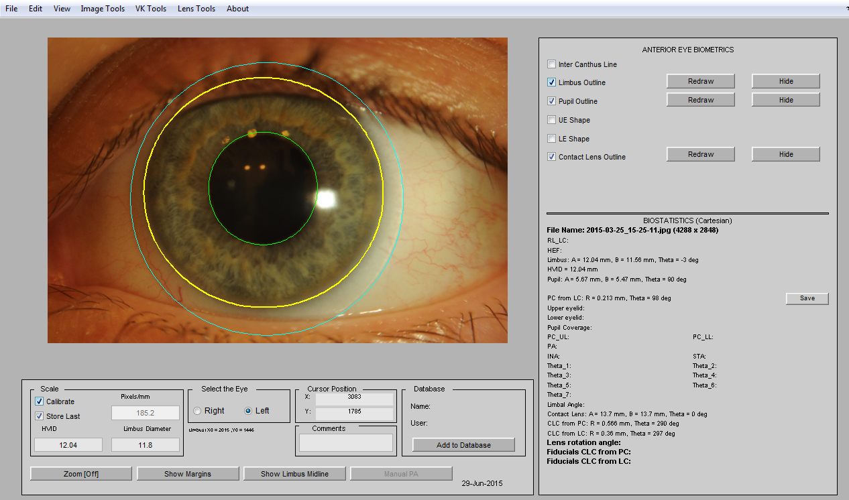

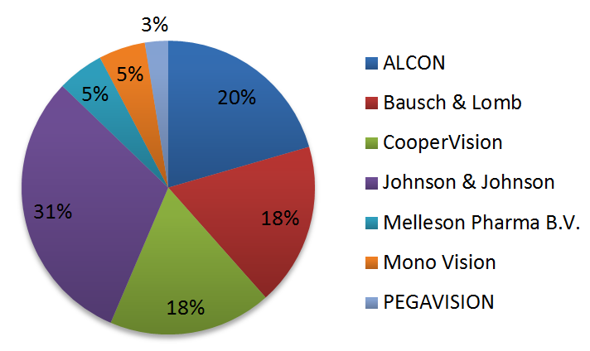
Purpose
To gain knowledge about contact lens related habits among young regular wearers, to assess the lens prescription method and to evaluate the correctness of contact lens fit.
Methods
39 students – regular contact lens wearers – (30F and 9M) from universities in Wroclaw, aged between 19 and 27 years, were recruited for the study. They all attended consultation for which they were asked to come with their habitual corrections. First, background information on contact lens wear related habits was gathered and a review of general eye health history was conducted. This was followed by a slit-lamp based contact lens fitting assessment. Finally, a general inspection of adnexa, eyelid margins, tarsal conjunctiva, and conjunctival and limbal redness was conducted. Photographic evidence was made for subsequent estimation of contact lens centration.
32 out of 39 subjects indicated that they wore lenses for more than 12 hours per day, 6 indicated a 6-12 hour daily wear while only one subject fell in the 2-6 hour daily wear category.
46% and 13% of wearers specified prescriptions from an ophthalmologist and an optometrist, respectively while 41% of subjects admitted to self-prescribing.
30 out of 39 subjects admitted to over 12 month period between control visits while 4 and 5 subjects pointed to a 6-12 month and less than 6 month period, respectively.
58% of subjects showed an incorrect contact lens fit (in terms of centration or mobility) while respectively 42% of subjects showed an adequate fit.
This data were contrasted against the collected habitual statistics leading to 12 inadequate and 4 adequate fits in case of self-prescription and to 12 inadequate and 11 adequate fits in case of lenses being prescribed by a professional.
Finally, 7 subjects (18%) showed clear evidence of corneal neovascularisation.
Assessing soft contact lens fit and habits in a population of young regular contact lens wearers – a Polish perspective
 | Incorrect lens fit | Correct lens fit
ECP-prescribed | 12 | 11
Self-prescribed | 12 | 4
D. Robert Iskander*, Marta Góra
Biomedical Signal Processing Group
Department of Biomedical Engineering
Wroclaw University of Technology, Poland
*E-mail: robert.iskander@pwr.edu.pl
INTRODUCTION
FIGURE 1 – An example of estimating contact lens centration with i-Metrics©
CONCLUSION
There has been anecdotal evidence that many young adults in Poland self-prescribe soft contact lenses. The easily available contact lens products through both Internet providers as well as grocery shops and drugstores coinciding with the absence of professional eye care, particularly outside the main cities, provides basis for the rather alarming state of affairs. The project is a pilot fragment of a longitudinal study undertaken at Wroclaw University of Technology that aims at assessing the habits of young adult contact lens wearers in Poland.
Results
At the time of consultation 8% of subjects wore hydrogel lenses while 92% wore silicon hydrogel lenses;
76% wore monthly lenses while 19% and 5% wore fortnightly and daily lenses, respectively;
90% had spherical lenses and 10% wore toric lenses.
In general, the awareness of the participants of the basic lens parameters, the principles of correct use, need of lens exchange and maintaining a high level of hygiene was not satisfactory. Unregulated access to contact lenses in Poland showed an alarmingly high proportion of younger adults that self-prescribed the lenses. In the absence of professional contact lens care, the products offered of the shelf should include information on correct contact lens usage.
references
[1] TH Bui, HD Cavanagh, DM Robertson. Patient Compliance During Contact Lens Wear: Perceptions. Eye & Contact Lens, 36(6): 334-339, 2010.
[2] CW McMonnies. Improving patient education and attitudes toward compliance with instructions for contact lens use. Contact Lens & Anterior Eye, 34(5):241-248, 2011.
[3] H Wagner, K Richdale, GL Mitchell, DY Lam, ME Jansen, BT Kinoshita, L Sorbara, RL Chalmers. Age, behavior, environment, and health factors in the soft contact lens risk survey,” Optometry & Vision Science, 91(3):252-261, 2014.

