Slide 1
Non-invasive assessment of corneal and conjunctival deterioration in soft contact lens users using anterior segment optical coherence tomography
Ismail Ersan, Sedat Arikan, Selcuk Kara, Baran Gencer, Asiye Koklu, Hasan Ali Tufan Canakkale Onsekiz Mart University, Faculty of Medicine,
Department of Ophthalmology, Canakkale , Turkey

Slide 2
PURPOSE: To evaluate the corneal and bulbar conjunctival thicknesses of soft contact lens (SCL) wearers using anterior segment optical coherence tomography (AS-OCT).
METHODS
Subjects with dryness symptoms, tear breakup times shorter than 5 seconds, Schirmer I test results shorter than 10mm/5 min, positive corneal fluorescein staining, and chronic eye drop use were excluded.
Epithelial and overall thicknesses of the cornea and conjunctiva were measured using a Cirrus HD-OCT 4000 (Carl Zeiss Meditec, Dublin, CA, USA) (Figure 1).

Slide 3
RESULTS
The soft contact lens group included 30 subjects with a mean spherical equivalent refraction of -2.69±1.19 diopters; the spectacles group included 30 subjects with a mean spherical equivalent refraction of -2.70±1.63 diopters; the emmetropia group included 30 subjects with a mean spherical equivalent refraction of 0.00±0.31 diopters.
Corneal thickness measurements are shown in Table 1.
Conjunctival thickness measurements are shown in Table 2.

Slide 4
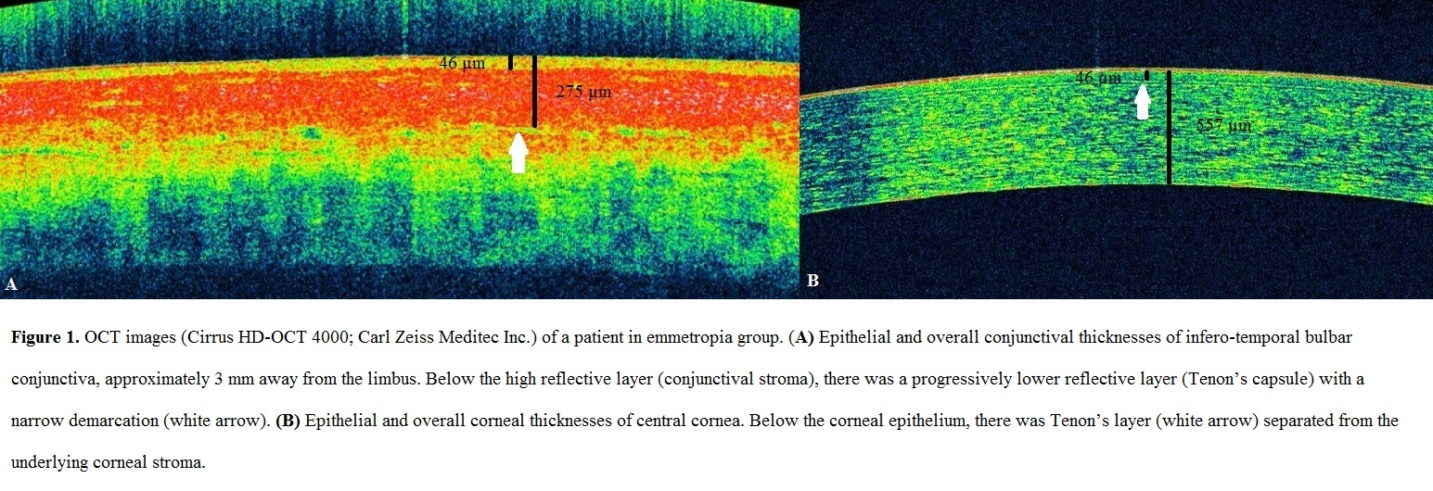
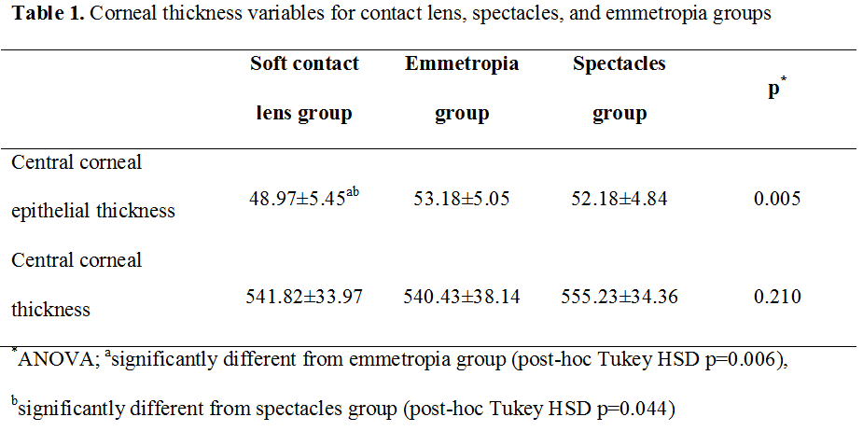
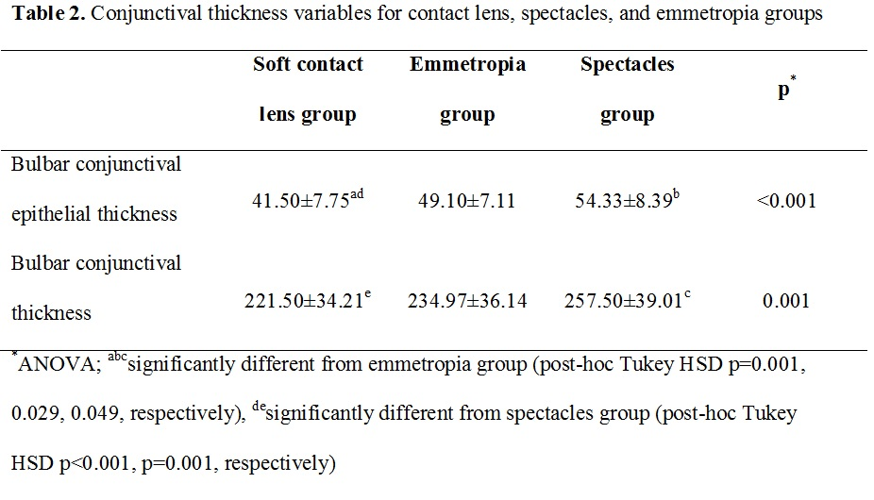

Slide 5
DISCUSSION
Our result is important in terms of showing that epithelial thinning in SCL wearers is only associated with the contact lens usage, not with refractive error.
To our knowledge, this is the first OCT study evaluating conjunctival epithelial thickness in contact lens wearers.
We believe that thinning of the conjunctival epithelium in contact lens wearers may be due to mechanically induced impairment of the epithelial metabolism caused by the release of inflammatory mediators as a result of constant subclinical irritation by the lens.
To our knowledge, the responses of the cornea and conjunctiva to contact lens wear have not been evaluated in a single study. According to our results, contact lens wear caused thinning of the corneal and conjunctival epithelium, and bulbar conjunctiva.
Further studies using AS-OCT on larger patient cohorts wearing different contact lens materials and designs for myopia and hypermetropia are required to detect ocular involvement in contact lens wearers.

