Slide 1
CO Q10 AND VITAMIN E COMBINATION IN SEVERE POST-ADENOVIRAL CORNEAL OPACITIES
Nuray Akyol, MD
TOBB ETU Hospital Ophthalmology Dept
ANKARA - TÜRKİYE

Slide 2
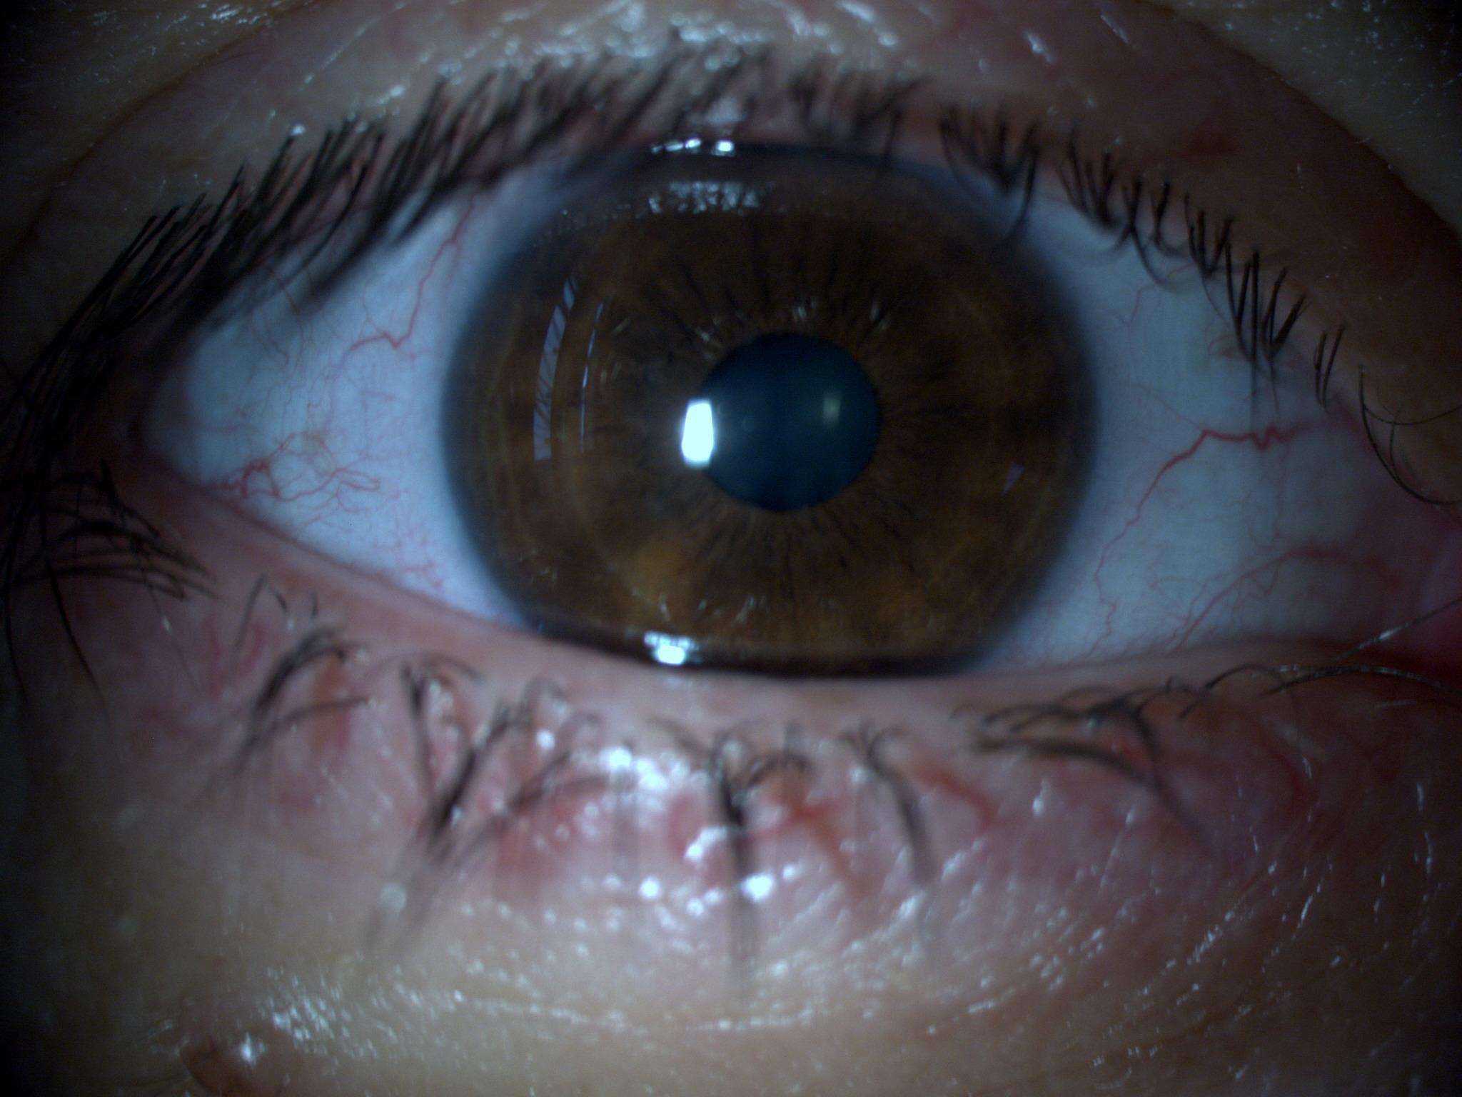
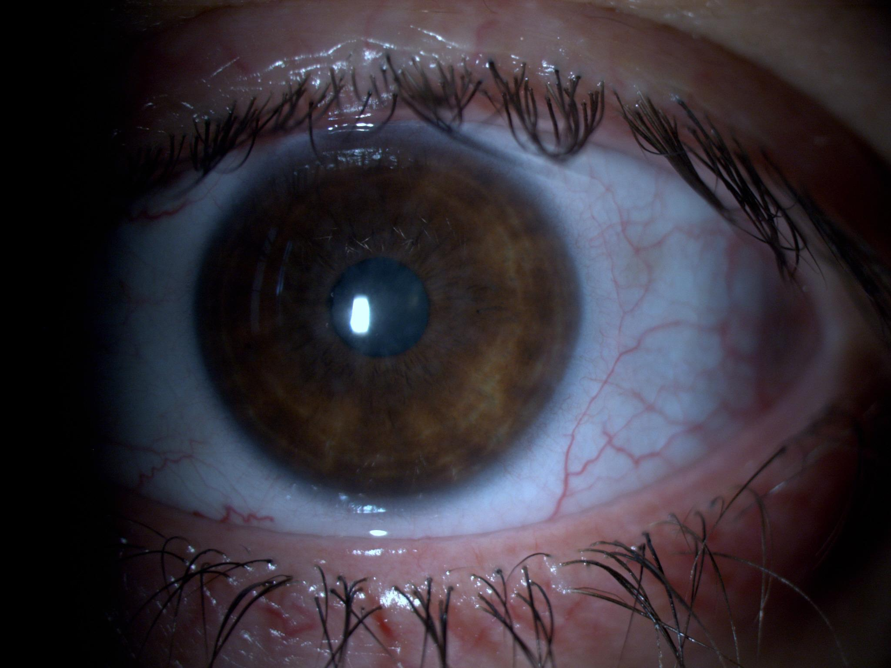
A 28 year old young lady with adenoviral keratoconjonctivitis is presented.
Korneal opacities were rare in her right eye(Figure 1), but very intense and annoying in left eye(Figure 2).
Visual acuities at her first visit were 0.9 and 0.3
Figure 1. Right eye at first visit
Figure 2. Left eye at first visit

Slide 3
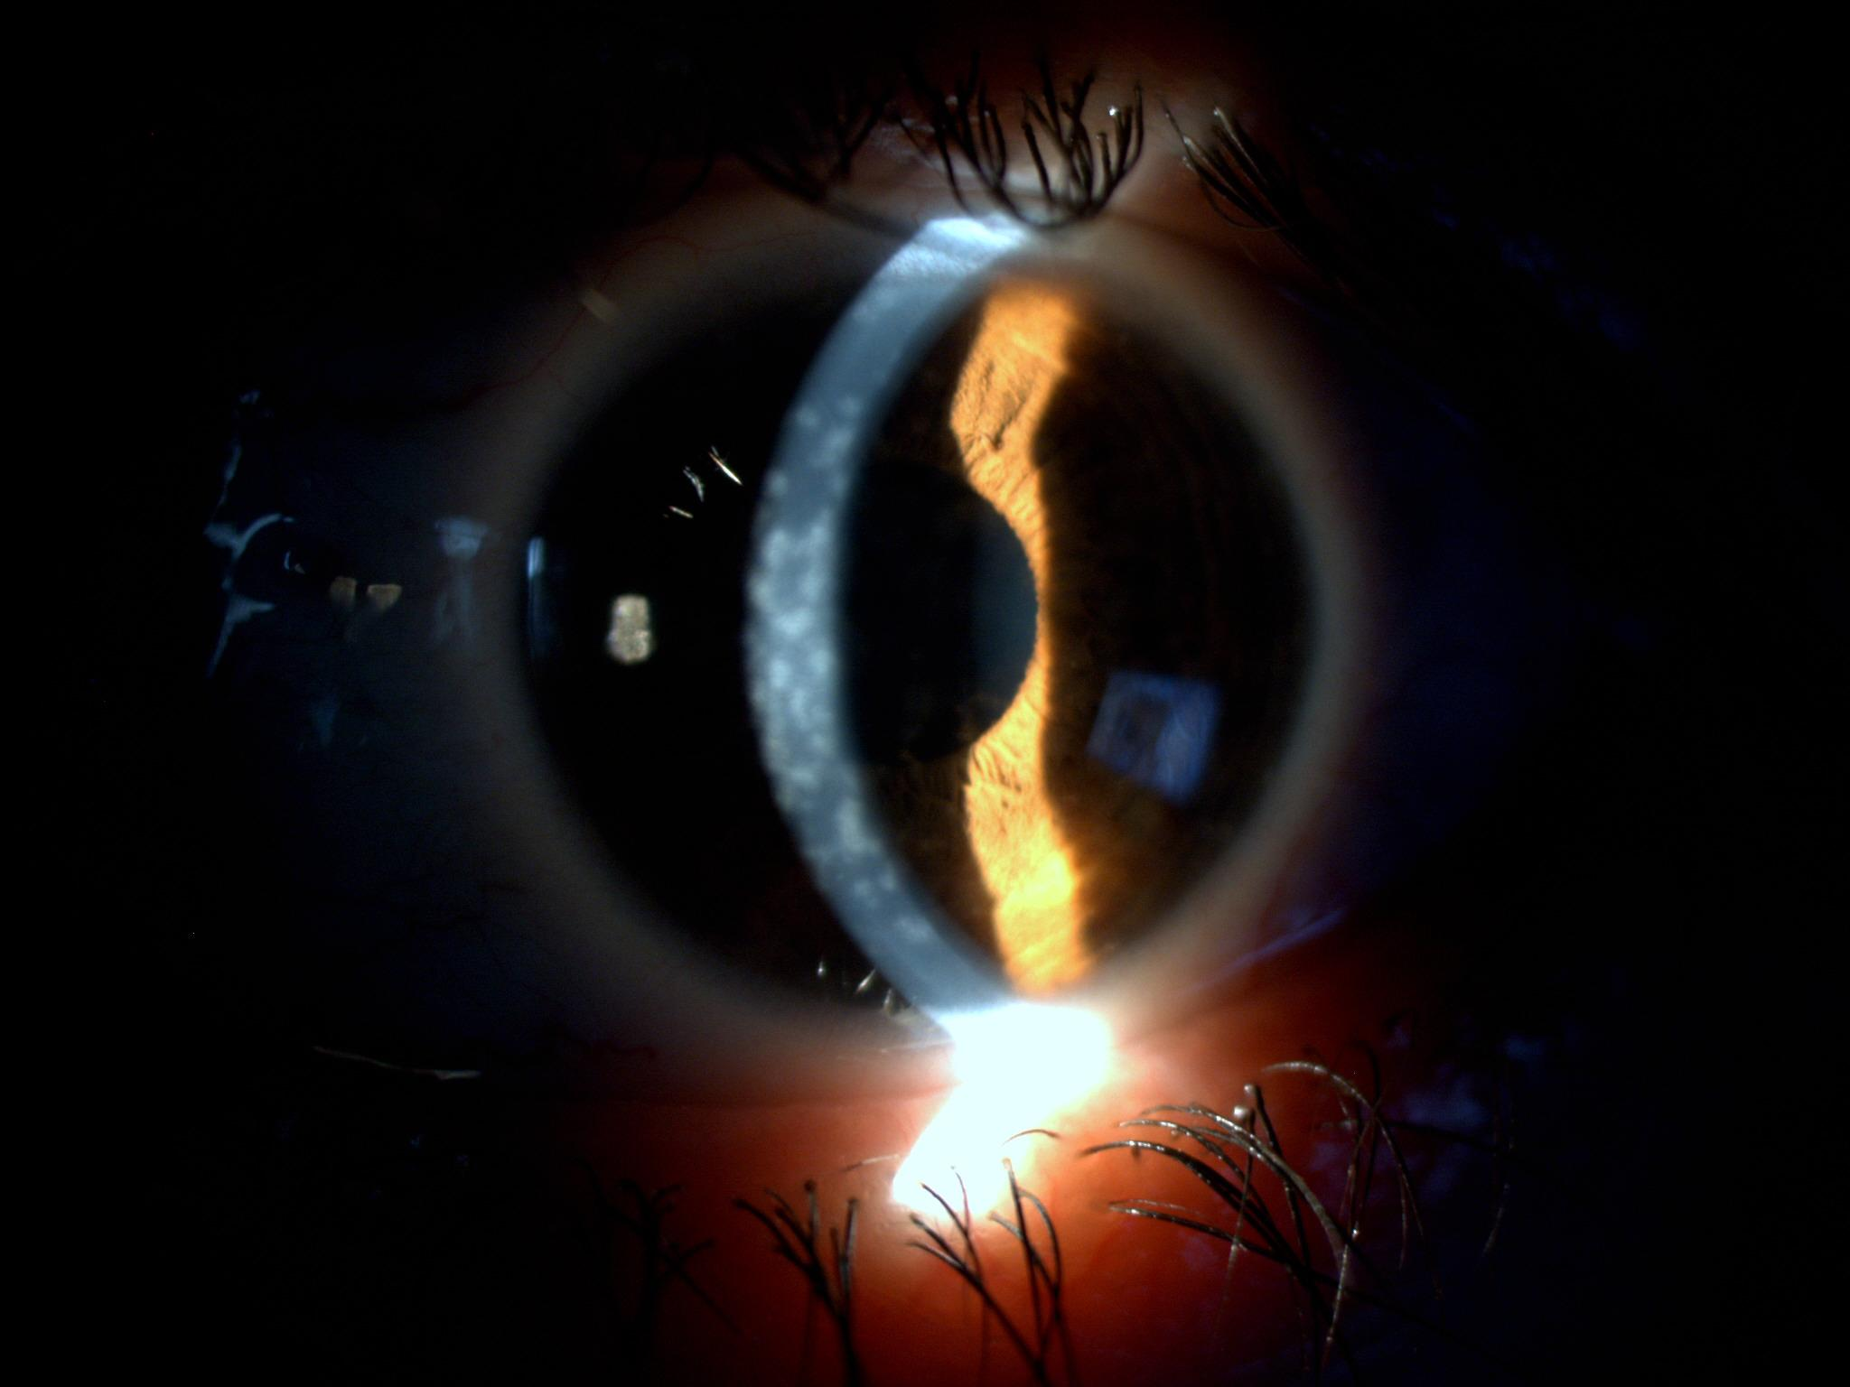
Just after acute phase of the infection resolve, fluoromethalon 0.1% drops were used bid for two months and once a day for one month.
Right eye healed quickly, with very fade and sparse opacities and 1.0 vision.
At the end of three months VA was 0.4 in left eye and we started cyclosporin-A drops tid plus alternate-day fluoromethalon.
After 6 months of treatment, opacities were there in the left cornea with nearly no change(Figure 3).
Just after acute phase of the infection resolve, fluoromethalon 0.1% drops were used bid for two months and once a day for one month.
Right eye healed quickly, with very fade and sparse opacities and 1.0 vision.
At the end of three months VA was 0.4 in left eye and we started cyclosporin-A drops tid plus alternate-day fluoromethalon.
After 6 months of treatment, opacities were there in the left cornea with nearly no change(Figure 3).
Figure 3. Left eye at 6 months

Slide 4
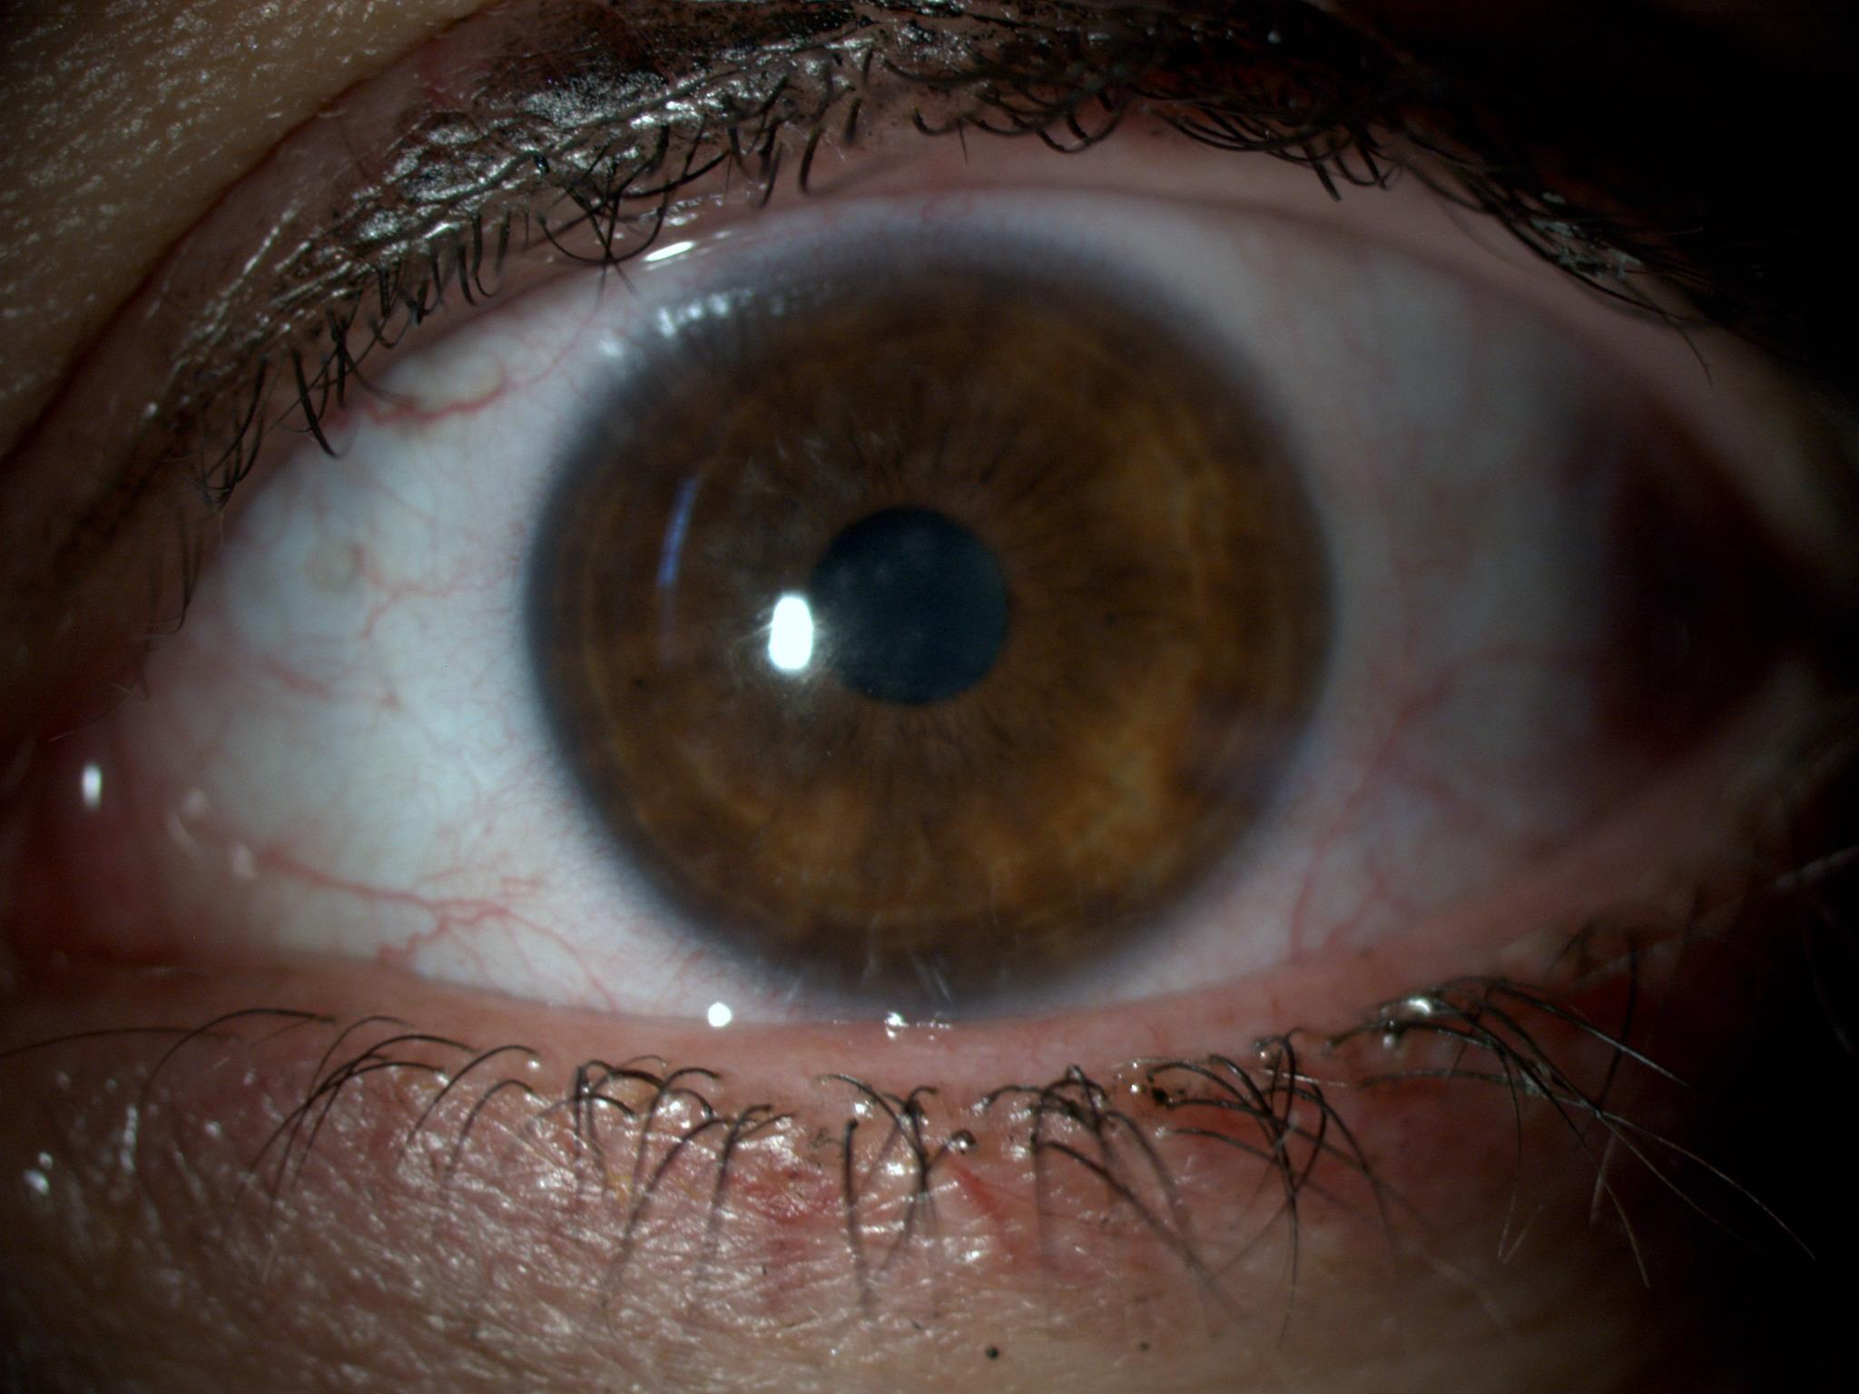
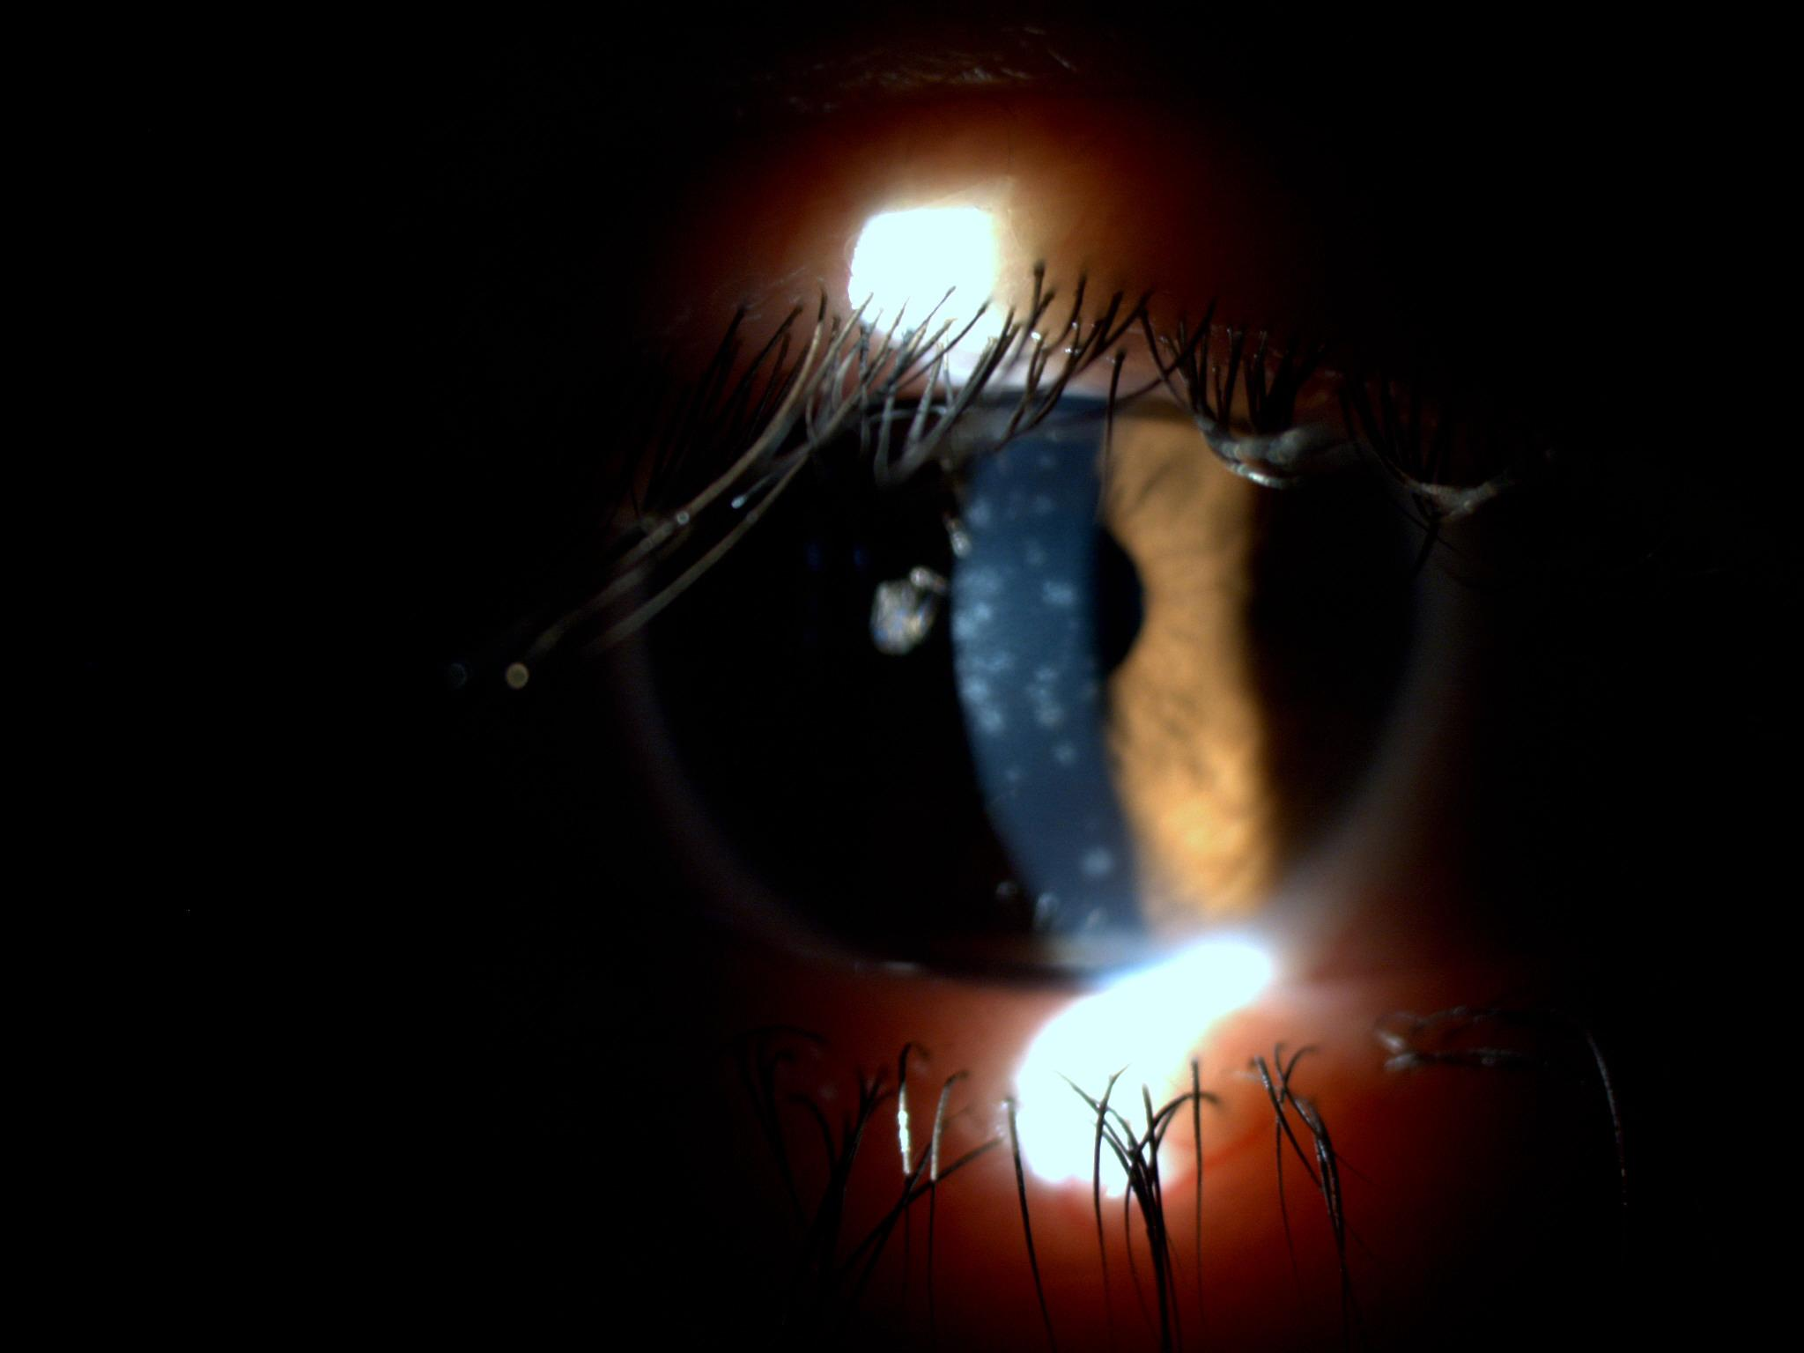
We added Co Q10 and Vitamin E TPGS in hypromellose solution(Visudrop TM) bid to the treatment regimen.
The opacities seemed to be fader and more scattered(Figure 4 and 5) at the end of the 1 month and VA in left eye was 0.7.
Figure 4 and 5. Left eye at 7 months

Slide 5
This paper is only an early report and it is necessary to compare treatment modalities in larger series of severe post-adenoviral corneal opacities.

