Slide 1


Corneal Biomechanical Parameters and Intraocular Pressure Measurements USING Ocular Response Analyzer (ORA) with and without Contact Lens: Initial Results
Tolga KOCATURK, Sinan BEKMEZ, Faruk BALICA, Imran Kurt OMURLU, Harun CAKMAK, Volkan DAYANIR
Adnan Menderes University Faculty of Medicine
Department of Ophthalmology
Aydin, TURKEY

Slide 2
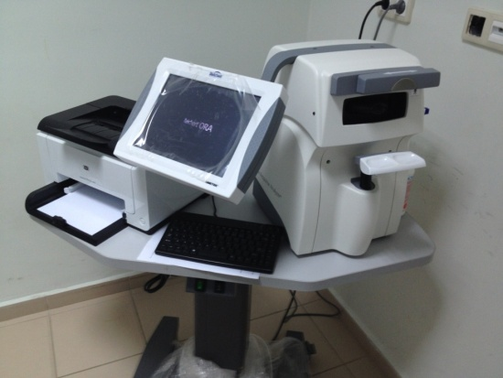
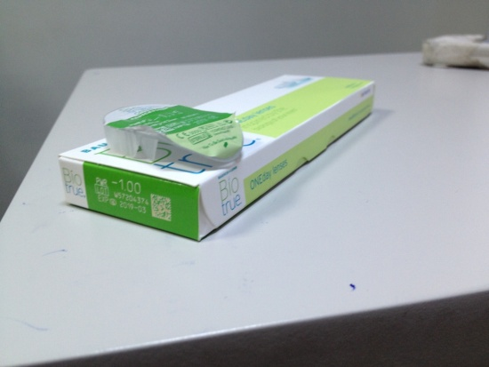
INTRODUCTION
We aimed to compare the corneal biomechanical parameters (corneal hysteresis-CH, corneal resistance factor-CRF) and intraocular pressure (IOP) measurements (Goldmann-correlated IOP-IOPg, corneal-compensated IOP-IOPcc) before and after contact lens (CL) application using Ocular Response Analyzer (ORA)

Slide 3
MATERIALS and METHODS
30 eyes of 30 healthy individuals (15 females and 15 males) were included in this prospective, randomized study
All measurements taken by ORA were compared before and 15 minutes after the CL (-1.00 DS, Biotrue ONEday-nesofilcon A, Bausch&Lomb, Rochester, USA, 78% water, 42 Dk/t, 8.6 mm base curve, 14.2 mm diameter, center thickness 0.10 mm) application
Patients with glaucoma, any corneal pathologies, systemic diseases (diabetes mellitus, hypertension, autoimmune diseases, etc.) and history of previous ocular surgery ocular surgery were not included in the study.
Only one eye was chosen randomly in each individual
Data were analyzed using the paired sample t-test

Slide 4
RESULTS
The mean ages of women and men were 37.4±12.2 and 35.6±16.1, respectively (P=0.734)
The measurements made with CL were lower than those without CL. However, it showed no statistically significant difference.
 | With Contact Lens | Without Contact Lens | P value
CH | 10.3±1.4 (range, 7.6-13.6) | 10.7±1.6 (range, 8.3-16.4) | 0.135
CRF | 10.4±1.5 (range, 7.2-13.0) | 10.5±1.8 (range, 7.3-16.0) | 0.782
IOP g | 14.5±3.3 (range, 7.7-21.4) | 14.8±3.2 (range, 8.4-23.1) | 0.270
IOPcc | 14.8±2.9 (range, 9.1-20.8) | 14.9±2.6 (range, 10.9-21.0) | 0.636
CH: corneal hysteresis, CRF: corneal resistance factor, IOPg: Goldmann-correlated intraocular pressure, IOPcc: corneal-compensated intraocular pressure

Slide 5
DISCUSSION
Fırat et al. showed that CL did not effect IOP measurements in non-contact tonometer ¹
However, Ogbuehi et al. showed that CL use results in significantly different IOP measurements based on IOP measurement technique ²
Cankaya et al. showed that corneal biomechanical parameters may be different in subjects with and without contact lens usage ³
1. Fırat PG, The influence of soft contact lenses on the intraocular pressure measurement. Eye(Lond) 2012;26:278-82.
2. Ogbuehi KC, The influence of lens power and center thickness on the intraocular pressure measured through soft lenses: A comparison of two non-contact tonometers. Cont Lens Anterior Eye 2012;35:118-28.
3. Cankaya AB1, Beyazyildiz E, Ileri D, Ozturk F. The effect of contact lens usage on corneal biomechanical parameters in myopic patients. Cornea. 2012 Jul;31(7):764-9. doi: 10.1097/ICO.0b013e3182248239.

Slide 6
CONCLUSION
Although lower values were found with CLs, there was no statistically significant difference between CH, CRF, IOPg and IOPcc with and without CLs by ORA
Thank you,

