Slide 1


CLINICAL STUDY OF THE SURFACE TENSION OF TEAR FILM IN CHILDREN AND ADOLESCTNTS WEARING SOFT CONTAC LENSES
LESHCHENKO I. (1), OKONENKO T.(2)
Medical - Biological Postgraduate institute, Moscow, RUSSIAN FEDERATION;
(2) Novgorod State University, Veleky Novgorod, RUSSIAN FEDERATION

Slide 2
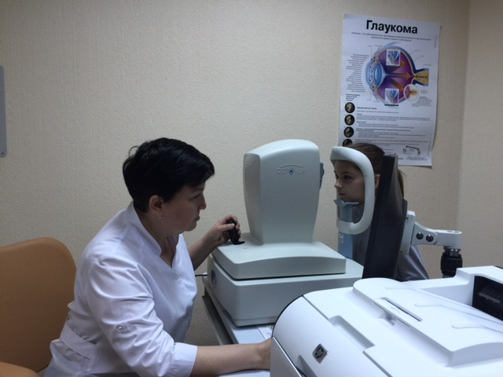
Materials and Methods
Today it has been proved that long-term and safe use of any contact lenses (CLs) is only possible with a normally functioning lacrimal apparatus, as vision correction with contact lenses is one of the reasons contributing to the development of secondary dry eye syndrome (DES).
The clinical studies enrolled 55 subjects.
Both groups were matched by age and sex.
All children had history of allergies and chronic diseases, but were not under a continuous follow-up.
The experimental group comprised 34 users of soft contact lenses aged from 10 to 18 years old (mean age 14,6 ± 0,38), of which 28 were girls and 7 were boys.
The mean period of wearing SCLs was 2 years and 6 months (max 5 years, min 1,0 year). All adolescents visited an ophthalmologist to check their visual acuity and assess their anterior eye surface.
The control group included 17 adolescents (13 girls, 4 boys) aged from 13 to 18 years old (mean age 14,5 ± 0,5).
RTVue Optovue -100SA)
using corneal module CAM-L

Slide 3
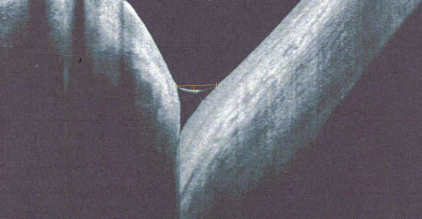
OCT-Meniscometry
Study objective : to identify abnormalities in the anterior eye surface in adolescents using soft contact lenses, based on OCT-meniscometry.
Method for determining morphometric parameters of the tear meniscus formed
between the edge of the lower eyelid and the cornea.
The surface tension coefficient for the tear fluid (α) was calculated using O. Lobanova's formula:
α = pgh³/8x
where:
p — density of lacrimal fluid (1000 kg/m³);
g — acceleration of gravity (9.8 m/s²)
h — meniscus chord (meniscus height in our case);
x — meniscus curvature
(meniscus radius, r in our case).
The OCT-meniscometry sensitivity is estimated to be 97.5%.

Slide 4
The Results
In the group of SCL users, there was a tendency to an increase in the tear meniscus height.
Its values ranged from 148 to 841 µm. The mean tear meniscus height was 344,46 ± 22,47 µm, which is typical of conditions accompanied by increased tear production). The differences between the two groups were statistically significant (p < 0,001).
The curvature size of the tear meniscus, characterizing physical properties of lacrimal fluid and corneal surface, averaged 25,94±1,72 µm in the control group, with its normal limits ranging from 7.0 to 50.0 µm.
The tear meniscus radius averaged 33,22±1,74 µm in users of soft contact lenses. These max and min values were 11 and 75 µm, respectively.
The differences between these parameters in both groups were also statistically significant (p < 0,05).
Coefficient α characterizing the strength of interaction between the tear fluid and the ocular surface in non-users of SLCs amounted to 0,72×10⁻³ ± 1,23×10⁻³ N/m.
Coefficient α increased significantly and amounted to 4,38×10⁻³±1,08 10⁻³ in SCL users.

Slide 5
Conclusion
Thus, the use of contact lenses by adolescents for 2 to 3 years did not result in the development of secondary dry eye syndrome.
The OCT-meniscometry performed and the studies of the surface tension of tear fluid confirmed the absence of significant changes in the quality characteristics of the tear film in the presence of quantitative changes.

