Slide 1

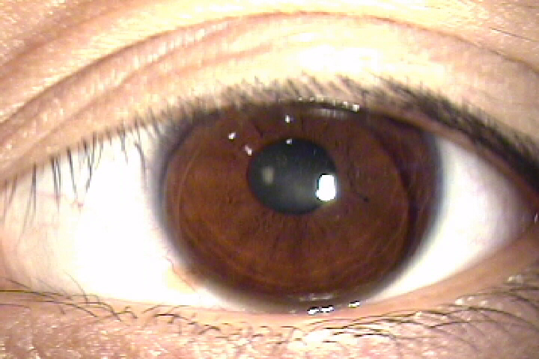
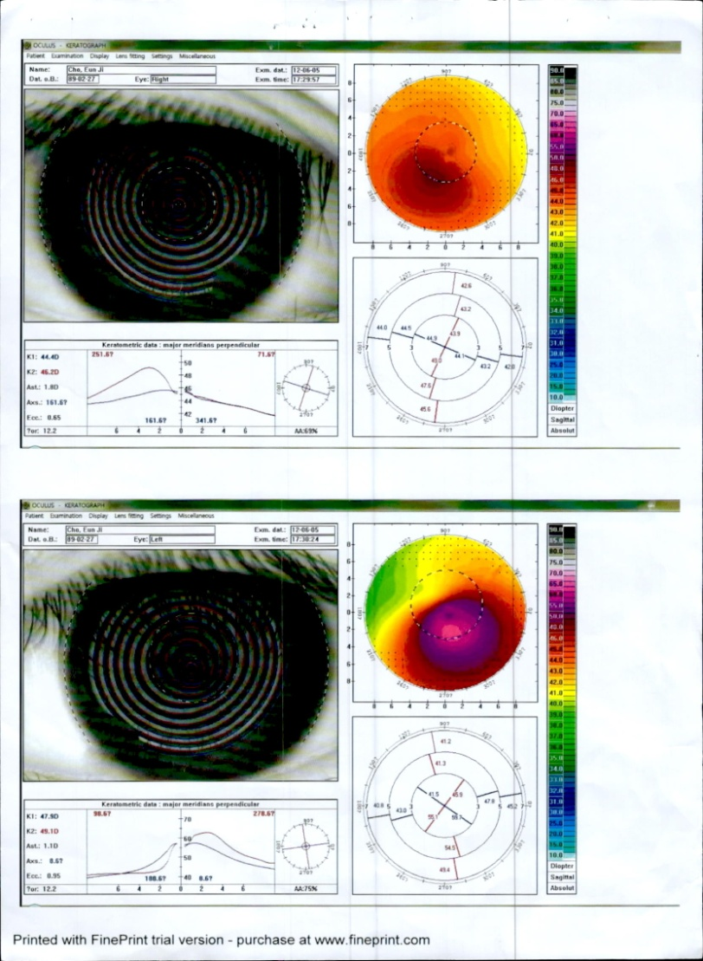
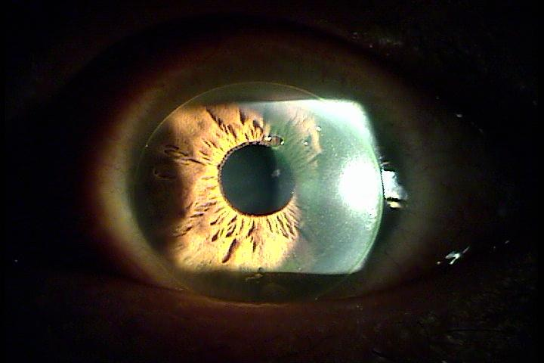
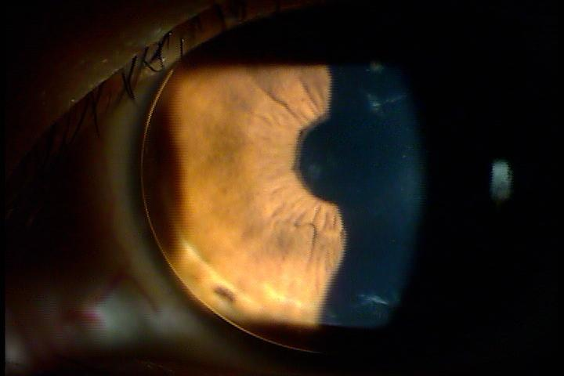
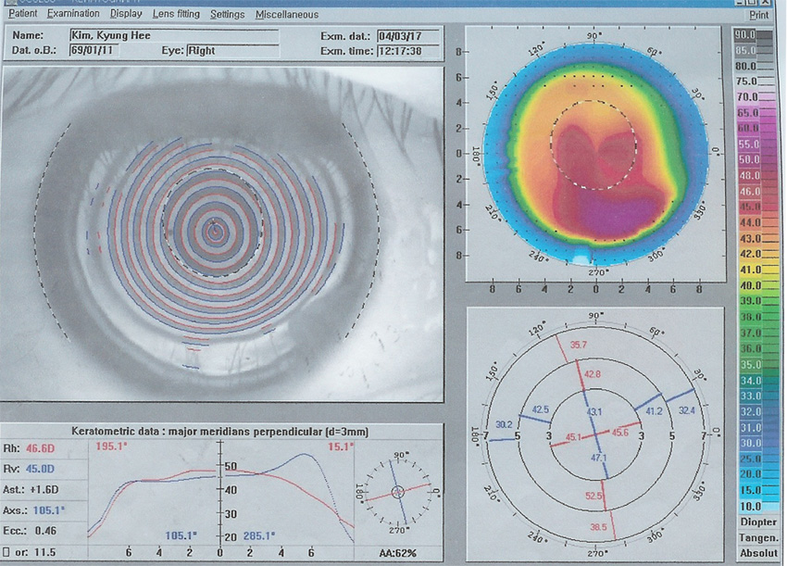
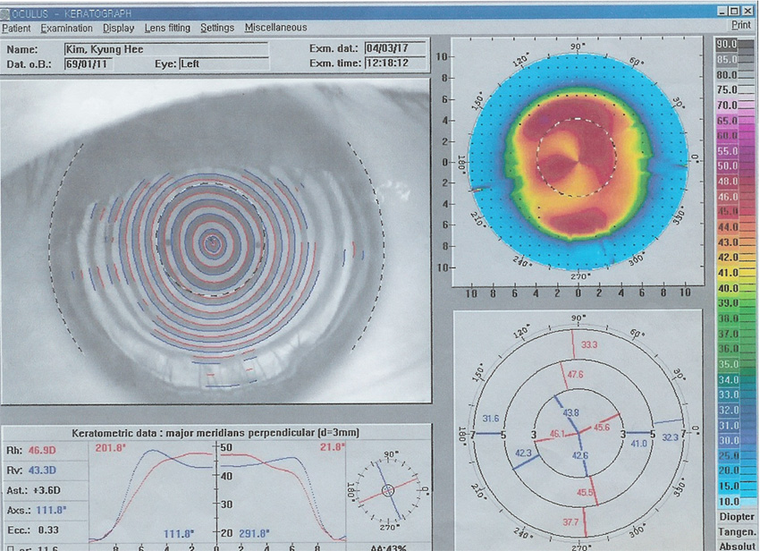
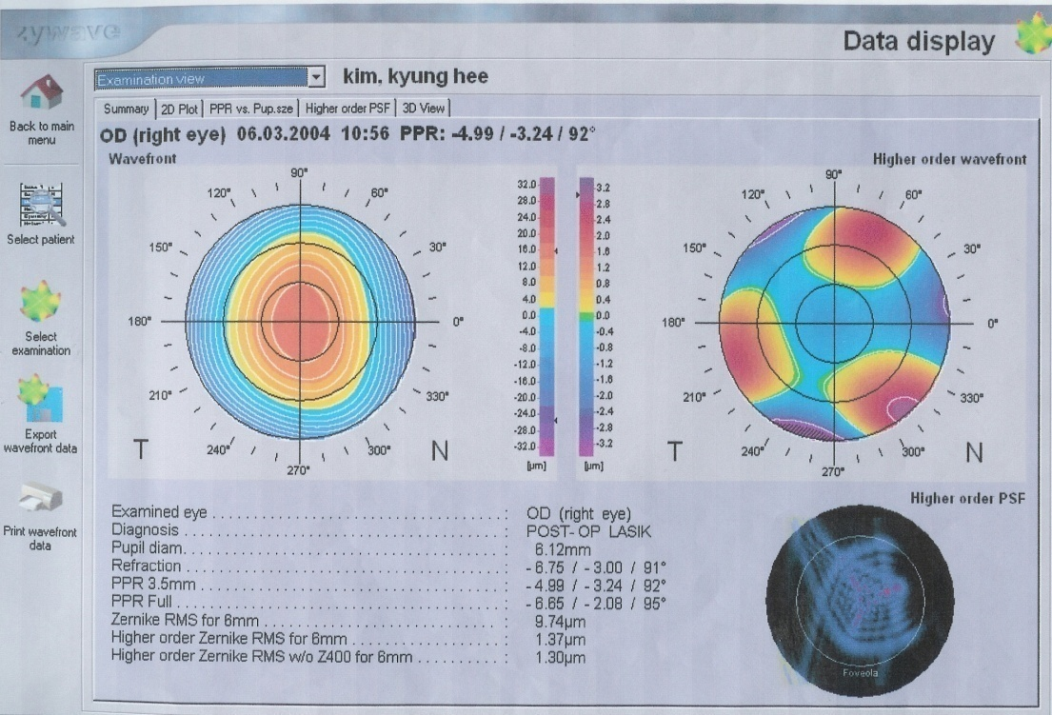
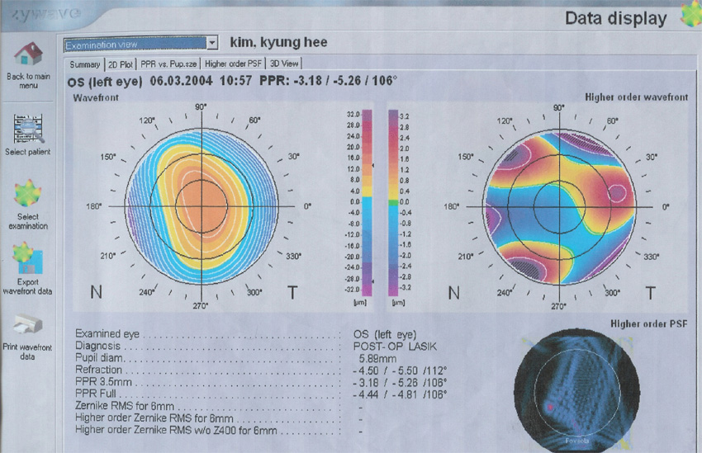
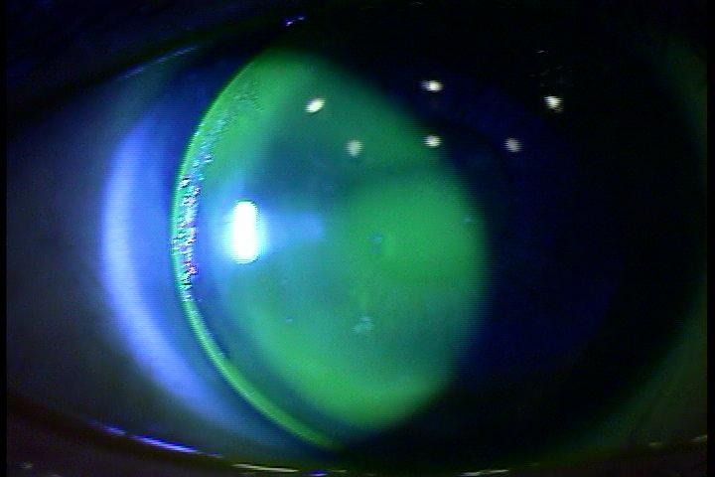
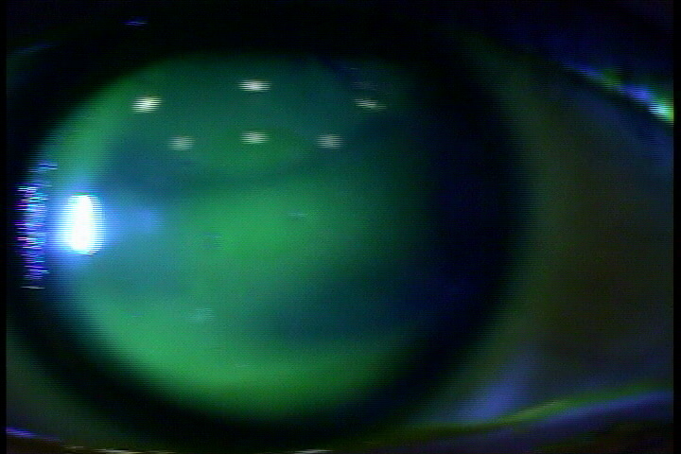
Visual Rehabilitation With Rigid Gas Permeable Contact Lens In Korean Patients With Keratoconus
Seung Hyuck Lee, M.D., Ph.D.
Yonsei Plus Eye Center, Sungnam, Korea
Introduction
Keratoconus is a noninflammatory disease of the cornea in which the cornea becomes progressively thinner, more distorted, and steeper in curvature. It is a chronic condition with a long duration that affects a patient’s quality of life. Spectacles are useful in the early stages, but with advanced case, spectacles play a very limited role and contact lenses become necessary for improving the vision. The lens of choice is corneal rigid gas permeable (RGP) lens and if the patient develops discomfort or intolerance, then one can go in for soft toric lenses,silicone hydrogel or scleral lenses.
Purpose
To investigate the safety and effectivenss of several contact lens including scleral lens and aspheric RGP lens
in korean patients with keratoconus for visual rehabilitation.
Material and Methods
Twelve eyes of 7 patients with keratoconus were included. Best corrected visual acuity and mean K, corneal astigmatism by corneal topography, and spherical equivalent by auto refractor were evaluated at baseline, and 6 months postoperatively
Results
The data is very encouraging with least incidence of ocular compliation and patiet's satisfaction.
Case 1.
F/23. 2011.Nov
R : 710/9.6/Achievement e8/-9.50
L : 700/9.6/Achievement e8/-10.00 (inferior decenter) -> L : 700/9.6/ A8 -> 660/10.20/A10
Case 2
F/36. 2006.June
.
Manifest refraction : R :- sph 6.75 – cyl 3.00 Ax 91° (20/20)
L :- sph 4.50 – cyl 5.50 Ax 112° (20/25)
fitting with Contex AS - 20 H C.L (Contex Co, CA).
Fig.1 Topography and ORB scan show increased central steepening with severe posterior elevation map in both eye .
B
Fig.2 Topographic findings show
keratectatic findings(OU)
Fig.4 Slit lamp photograph after aspheric RGP lens fitting
Fig.3 Zywave shows distorted PSF
before RGP C.L.
OD OS
Fig.5 Right & left contact lens fluorescein fitting pattern
with of AS 20H
Conclusion
Several Rigid gas permeable contact lens for keratoconus patients appear to be safe and promising treatment modality with less risk of ocular complicaiton including corneal ulcer, discomfort. Though the fitting takes longer chair time, with the availability of newer materials and designs, it is possible to fit many keratoconic patients and improve the visual acuity.

