Slide 1
Therapeutic scleral lens to manage severe ocular surface burns
MB MEKKI, S YAHIAOUI, O Titah
Ibn Al Haythem Center
Algiers
ECLSO 2015
Financial disclosure:
MB MEKKI is local representative of Microlens* a scleral lens manufacturar

Slide 2
Summary
To demonstrate thespectacular effect of therapeutic scleral lensin healing severe ocular burns.
4 eyes with severe ocular burns grade 4 of Roper Hall scale or grade 6 of Dua scale with : complete limbal stem cell deficiency with limbal ischemia at 360°, corneal anaesthesia and resistant to medical treatment for more than 2 weeks without healing tendancy, presenting large complete corneal and limbal ulcer, fitted with therapeutic scleral lens ( Microlens*, The Netherlands ) for continuous daily wear and filled with saline solution and daily control with fluid exchange.
All eyes had complete re-epithelialisationin 1 to 3 weeks under therapeutic scleral lens alone. The healing process began from peripheral conjunctival epithelial cells.

Slide 3
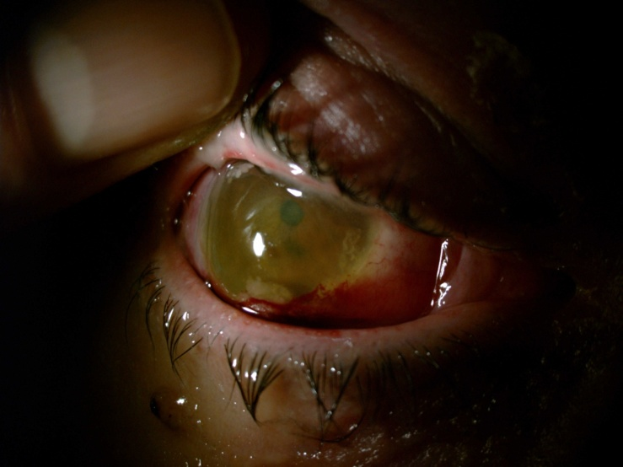
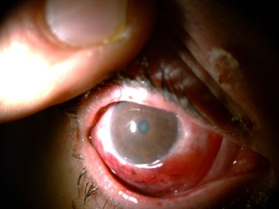
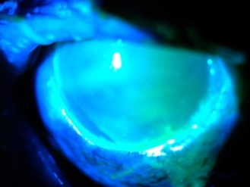
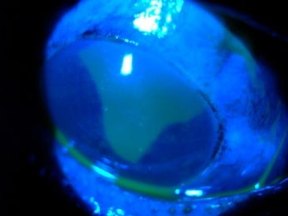
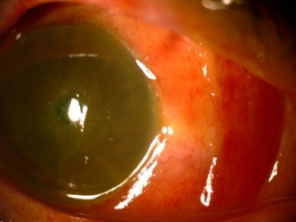
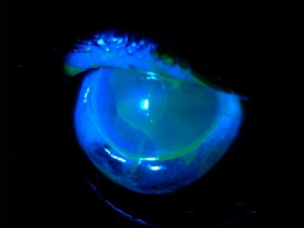
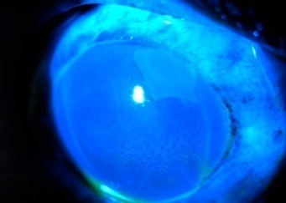
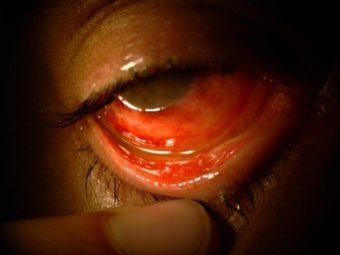
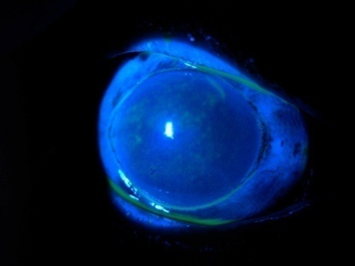
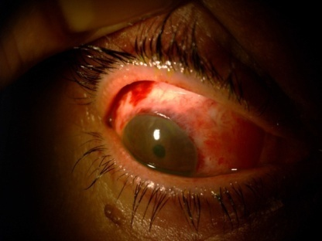
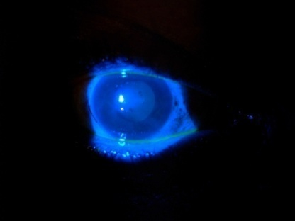
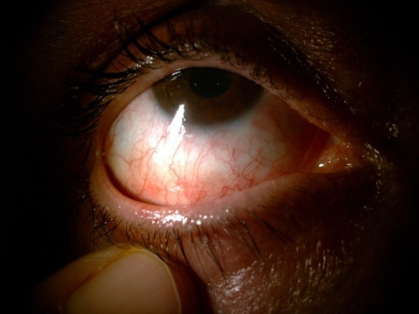
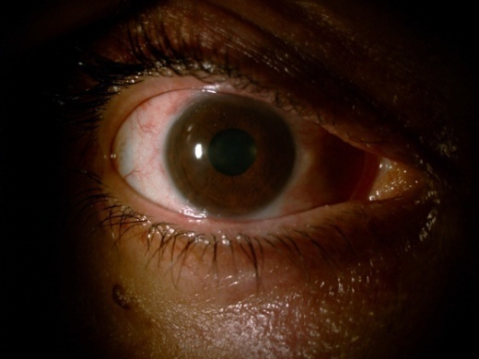
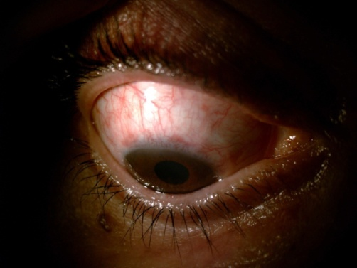
Case report 1 : Scleral lens to rescue severe ocular thermal burn
50 years old female. Severe face and chest thermal burn. Referred to our center 15 days after accident ( failure of usual treatment).
D 0
D 1
D 4
D 2
D 5
No corneal epithelium, limbal ischemia, symblepharon begining
D 6
D 7 : fluo -
D 30
D 30
D 30

Slide 4
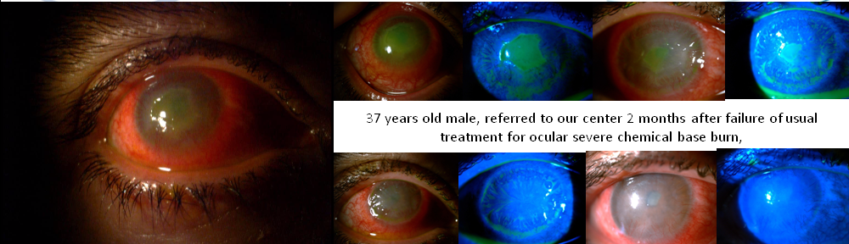
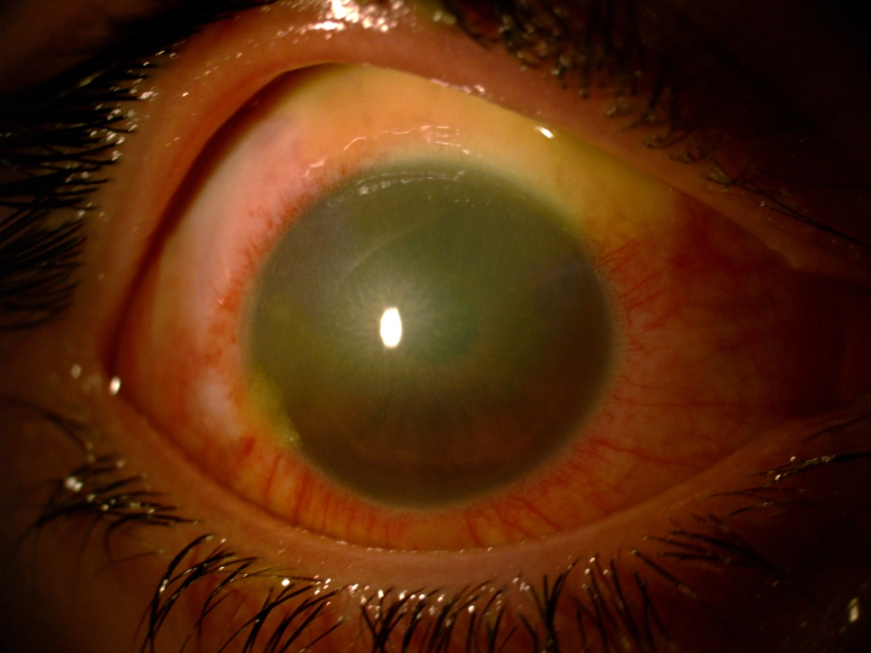
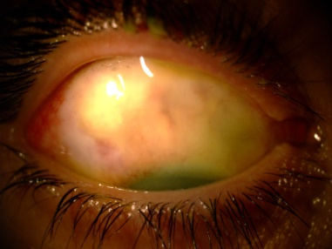
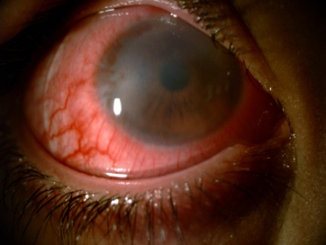
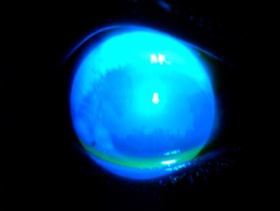
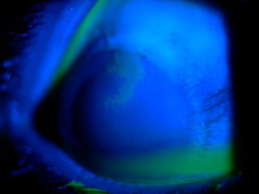
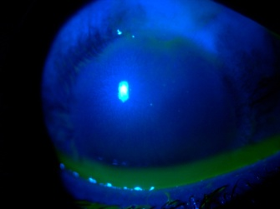
Cases Report 2 : Scleral lens to rescue severe ocular chemical burn
D 0
D 1
D 3
37 years old male, referred to our center 2 months after failure of usual treatment for severe ocular chemical alkali burn ( lime )
D 5
D 7
Despite quick corneal epithelial healing ( 7 days ), ocular surface remained ill, spontaneous ulcer occurred after removing scleral lens, limbal neovascularization appeared secondary in both cases.
D 1
D 2
D 15
Case report 3 :12 years old female, referred to our center 15 days after failure of usual treatment for severe ocular alkali burn ( cement )
D 2
D 3
D 7

Slide 5
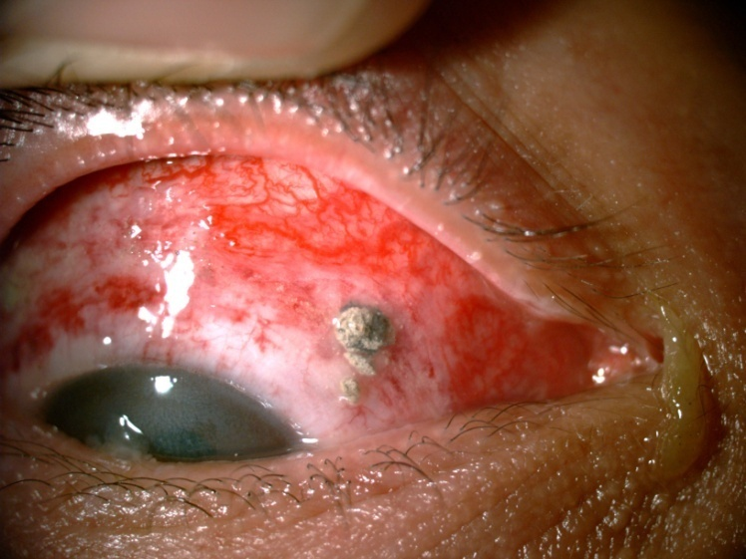
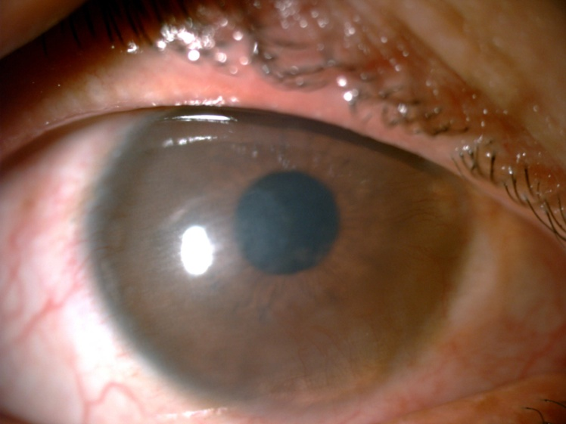
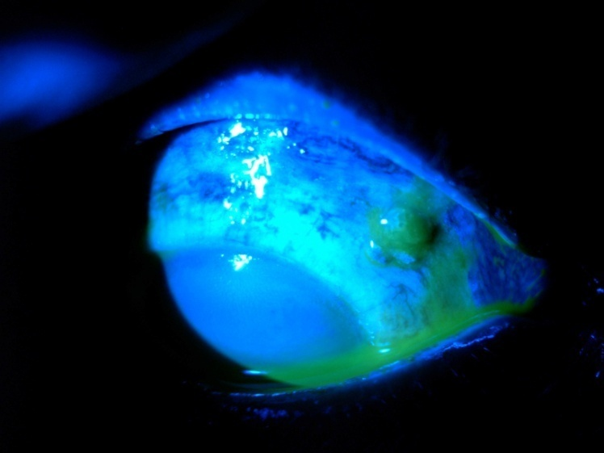
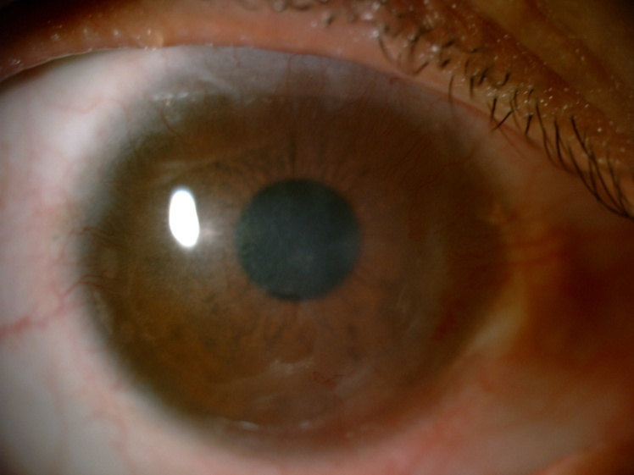
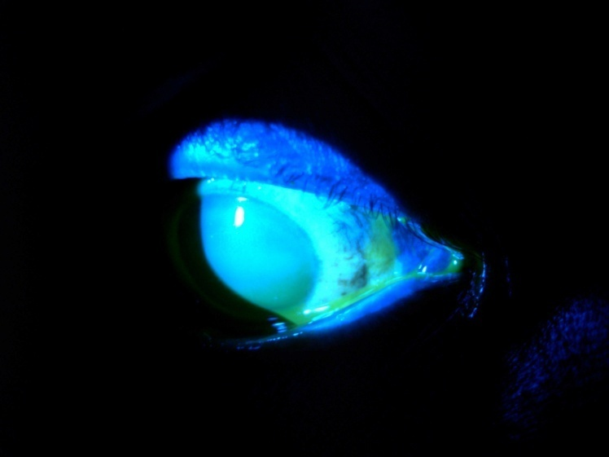
Case N 4 :
Male, 27 years old
Severe alkali burn ( cement )
With solid cement after 15 days in the superior nasal conjunctiva !!!
Spectacular evolution after scleral lens wear
D 0
D 15
D 0
M 6
D 0

Slide 6
Conclusion
Therapeutic scleral lens is magic solution to manage severe ocular burns and may be used as first therapeutic weapon. Theses cases show that epithelial stem cells are presents in all ocular surface not only limbus.

