Slide 1

Dacryoadenitis Associated with Contact Lens-Related Acanthamoeba Keratitis
SENGOR T¹, YUZBASIOGLU E¹, AYDIN KURNA S², IRKEC M³, ALTUN A², YALCIN NG¹
1: Bilim University, Department of Ophthalmology, Florence Nightingale Hospital, Istanbul, Turkey
2: Fatih Sultan Mehmet Education and Research Hospital, Clinic of Ophthalmology, Istanbul, Turkey
3: Hacettepe University, Department of Ophthalmology, Ankara, Turkey

Slide 2

INTRODUCTION
PURPOSE
The present report, supporting our previous study, discusses a new case of dacryoadenitis associated with Acanthamoeba keratitis (AK) in a contact lens wearer and aims to call attention to dacryoadenitis and also extraocular muscle inflammation which may often accompany this infection.
Acanthamoeba keratitis (AK) is a vision-threatening infection caused by a free-living, pathogenic amoeba. The corneal infection was first recognized in 1973, and the main risk factor was found to be contact lens wear.^{1,2,3,4} Characteristic symptoms and signs of AK include severe ocular pain, epithelial ulcers, and ring-like stromal infiltrate; however, various clinical manifestations of intraocular and periocular inflammation or infection, including dacryoadenitis, may also occur ^{5,6,7,8,9,10.}
Dacryoadenitis is not a common disease, and it may be an infectious or inflammatory condition with temporal upper eyelid swelling, pain, and sometimes, discharge. During clinical examination with eversion of the eyelid, the palpebral portion of the lacrimal gland as a site of inflammation can be visualized. Patients with infectious dacryoadenitis commonly have a fever and malaise, while those with the inflammation generally complain of pain as a major symptom. Infectious dacryoadenitis is most commonly caused by bacteria, but it may occur due to infections by some viruses and, rarely, fungi.^{11,12}
In the literature, we encountered only 2 reports of dacryoadenitis associated with AK. Tomita et al, in their retrospective study, reported an incidence of 38% for dacryoadenitis associated with AK.⁹ In our previous study, 2 out of 4 eyes (50%) developed dacryoadenitis simultaneously with AK.¹⁰
In this article, by presenting a new case of dacryoadenitis associated with AK and, in addition, an extraocular muscle inflammation, we aimed to strengthen that dacryoadenitis can be seen frequently with AK and also to draw attention to another site of involvement (extraocular muscles) which, to our knowledge, was not previously reported.

Slide 3
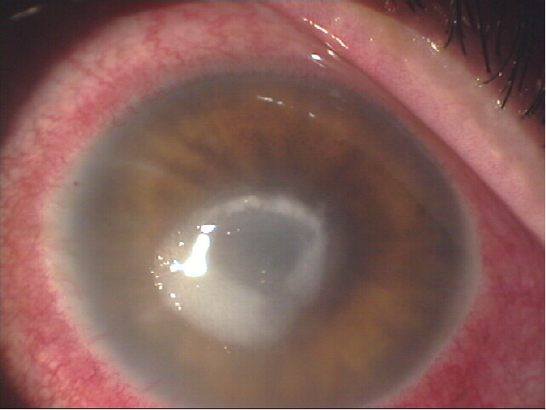
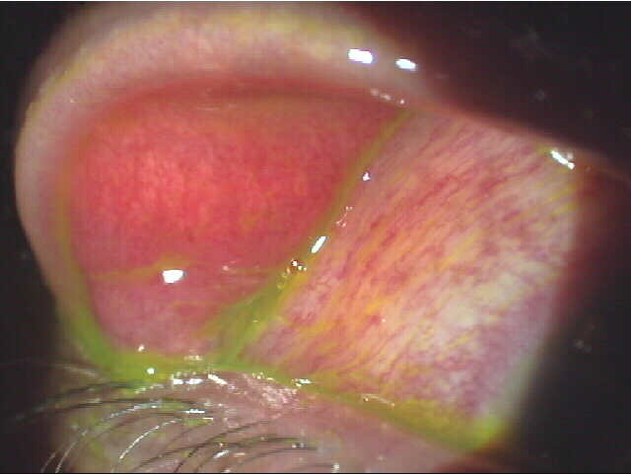
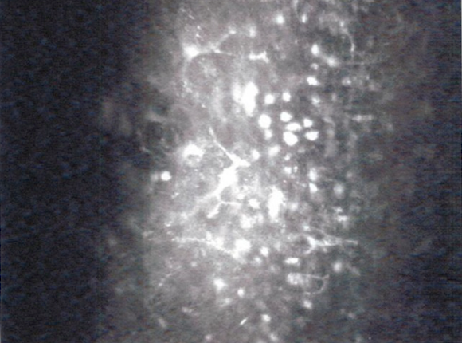
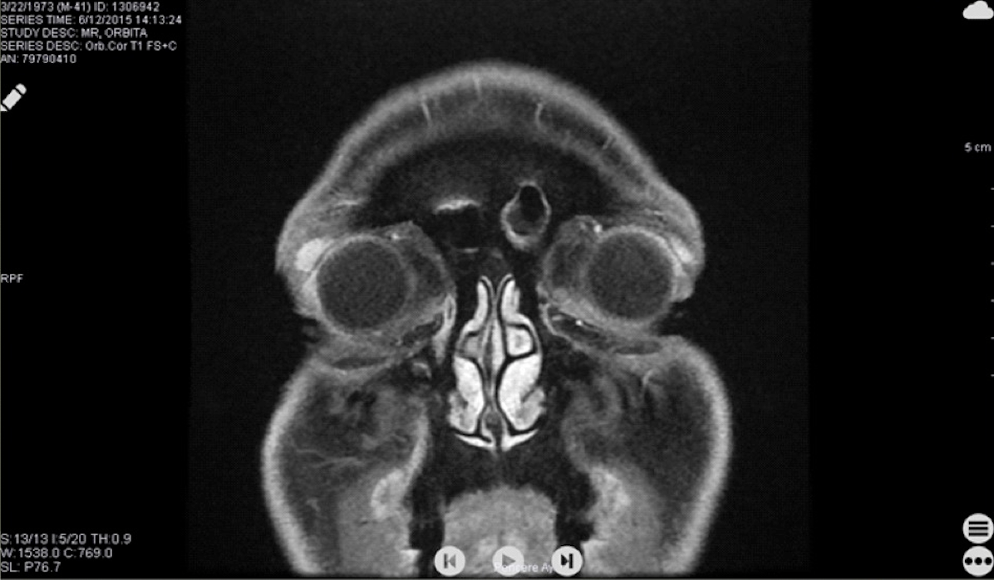
CASE
A forty-one-year-old male, contact lens wearer, attended our clinic with the complaints of vision disturbance, hyperemia, and pain in his right eye. He was describing 2 different types of pain: one, as stinging sensation (hundreds of needles in the eye) and the other, with dull quality increasing in the mornings. His history revealed that 1.5 month ago, he had been diagnosed with allergic conjunctivitis in another clinic and had used steroid eye drops for 15 days, but his complaints had worsened despite the treatment. When his contact lens usage habits were asked, it was learned that he was using silicone hydrogel lenses for about 10 years on an extended basis (up to 1 week), was not taking his lenses off in the shower or the swimming pool, and was using them without ophthalmologist’s supervision.
Biomicroscopic examination of the right eye revealed eyelid edema, conjunctival hyperemia with chemosis, ring infiltration in the cornea, linear stromal infiltrate consistent with radial neuritis on the upper temporal quadrant, and an epithelial defect of 4x5 mm in size in the central area (picture 1). There was also swelling and redness of the lacrimal gland (picture 2). No abnormal findings concerning the left eye were observed.
Picture 1
DIAGNOSIS
Picture 2
Although corneal swab and culture results were negative, Acanthamoeba cysts and trophozoites were detected by confocal microscopy¹³ (picture 3). Magnetic resonance imaging (MRI) demonstrated right lacrimal gland enlargement with edematous changes consistent with inflammation, supporting the diagnosis of dacryoadenitis. There were also thickening and edema of the right superior oblique muscle and a slight thickening of the lateral rectus muscle (picture 4).
We used the leukocyte scintigraphy technique with Tc-99m-labelled leucocytes in the fourth month of clinical period to determine whether an infection or inflammation is taking place in the lacrimal gland. The result was that the activity around the eyes was within a normal range.¹⁷
TREATMENT
Picture 3
The treatment used consisted of topical 0.1% propamidine isethionate - every hour; moxifloxacin - 6x2; fortified-gentamicin - 6x2; multi-purpose contact lens solution (polyquaternium, polyhexamethilene biguanide) – every hour; oral itraconazole 100 mg - 1x2.^{14,15,16} In the following 3 months, a decrease in the epithelial opening and shrinkage in the ulcer were observed, vascularization progressed from the lower temporal area, and a vascularized leucoma formed. After four months of treatment, keratitis and dacryoadenitis regressed, and the dull pain decreased. After 6 months of treatment, the visual acuity of the right eye improved (20/100), corneal epithelial defect closed totally, leaving a vascularized leucoma, and dacryoadenitis healed in parallel with the AK.
Picture 4

Slide 4
DISCUSSION
Acanthamoeba, which is one of the most common protozoa in soil and fresh water, can cause a rare but serious infection of the cornea that is frequently related with contact lens wear.^{1,2,3,4} It is also known that AK is associated with serious periocular inflammations and extraocular infections including severe anterior or posterior scleritis, anterior uveitis, glaucoma, eyelid edema, reactive pseudoptosis, and also dacryoadenitis.^{7,8,9,10}
The incidence of dacryoadenitis associated with AK was reported to be 38% by Tomita et al in their retrospective study, while in our previous study, we estimated an incidence of 50% - 2 out of 4 eyes with AK in 4 patients. Although we thought that the relatively high incidence of dacryoadenitis (50%) in our previous study can be explained by the small number of subjects, the new case presented in this article may emphasize that dacryoadenitis can be seen together with AK in this high frequency. In addition, extraocular muscle involvement as seen in the right superior oblique and lateral rectus muscle of our case gives attention to another site of inflammation. On the other hand, the two different types of pain expressed by the patient: as stinging sensation, and, another, with dull quality increasing in the mornings, may be related to radial neuritis and dacryoadenitis, respectively. Moreover, the muscle involvement may have some role in this dual feeling of the pain.
Although bacteria are known to cause dacryoadenitis mainly by retrograde infection of the drainage duct and, also sepsis or another systemic infection may lead to hematogenous spread of infection, the mechanisms involved in the development of dacryoadenitis associated with AK are not clear.^{9,10,11,12} Dacryoadenitis may be caused by direct invasion of Acanthamoeba organisms in the lacrimal gland or may be secondary to inflammation extending from the corneal lesion. In a previous study, it was reported that Acanthamoeba microorganisms could not be shown in biopsy samples, but there was moderate lymphocyte infiltration in the lacrimal gland lobules like in Sjögren syndrome, but dissimilarly, the lobular architecture was intact in patients with AK ^{9,}
We were not able to obtain biopsy samples, thus, we could not evaluate the eventual invasion of the lacrimal gland by trophozoites, but we used the leukocyte scintigraphy technique with Tc-99m-labelled leukocytes in the fourth month of the clinical period to determine whether an infection or inflammation is taking place in the lacrimal gland. The result was that the activity around the eyes was within a normal range. The negative result for infection may be explained by the late period of infection or may support the findings on MRI demonstrating an edematous enlargement of the lacrimal gland consistent with inflammation. Additionally, the improvement of lacrimal gland swelling in conjunction with symptoms of keratitis indicates the inflammatory nature of dacryoadenitis.

Slide 5
REFFERENCES
CONCLUSION
The present and our previous reports suggest that dacryoadenitis associated with contact lens-related AK may be encountered more frequently than expected and previously known; therefore, the evaluation of the lacrimal gland in presence of AK might be beneficial to better understand the exact clinical picture and course of that specific keratitis and dacryoadenitis. Moreover, the dual character of the pain which may be explained by the periocular inflammation along with radial keratoneuritis provides a wider perspective on the complex pathophysiology of the disease. In addition, extraocular muscle inflammation observed in the present case draw attention to a new site of involvement in AK.
Nagington JW, Watson PG, Playfair TJ, McGill J, Hones BR and Steele ADM. Amoebic infection of the eye. Lancet 1974; 2: 1537-1540.
Auran JD, Starr MB, Jakobiec FA. Acanthamoeba keratitis. A review of the literature. Cornea. 1987;6(1):2-26.
Cohen EJ, Buchanan HW, Laughrea PA, Adams CP, Galentine PG, Visvesvara GS, Folberg R, Arentsen JJ, Laibson PR. Diagnosis and management of Acanthamoeba keratitis. Am J Ophthalmol. 1985 Sep 15;100(3):389-95.
Abbasoğlu O, Orhan M, İrkeç M, Yıldırım C, Kıratlı C, Kıratlı H. Akantomoeba keratiti. Kontakt lense bağlı ciddi bir potansiyel komplikasyon. Kandemir H (Ed): III. Ulusal Türk Medikal Kontakt Lens Kong Bült 1991; 104-7.
Moore MB, McCulley JP, Kaufman HE, Robin JB. Radial keratoneuritis as a presenting sign in Acanthamoeba keratitis. Ophthalmology. 1986 Oct;93(10):1310-5.
Theodore FH, Jakobiec FA, Juechter KB, Ma P, Troutman RC, Pang PM, Iwamoto T. The diagnostic value of a ring infiltrate in acanthamoebic keratitis. Ophthalmology. 1985 Nov;92(11):1471-9.
Mannis MJ, Tamaru R, Roth AM, Burns M, Thirkill C. Acanthamoeba sclerokeratitis. Determining diagnostic criteria. Arch Ophthalmol. 1986 Sep;104(9):1313-7.
Jones DB, Visvesvara GS, Robinson NM. Acanthamoeba polyphaga keratitis and Acenthamoeba uveitis associated with fatal meningoencephalitis. Trans Ophthalmol Soc U K. 1975 Jul;95(2):221-32.
Tomita M, Shimmura S, Tsubota K, Shimazaki J. Dacryoadenitis associated with Acanthamoeba keratitis. Arch Ophthalmol. 2006 Sep;124(9):1239-42.
Sengor T, Kurna SA, Altun A, Irkec M, Aki SF, Aksoy S. Contact Lens-Related Acanthamoeba Keratitis and Accompanying Dacryoadenitis. Eye Contact Lens. 2015 Jul;41(4):204-9.
Jordan DR. Dacryoadenitis, dacryocystitis, and canalixulitis. Chapter 43 . In: Cornea: Fundamentals, Diagnosis and Management Krachmer JH, Mannis MJ, Holland EJ (Eds).. Elsevier Mosby.: 541-2.
Boruchoff SA, Boruchoff SE. Infections of the lacrimal system. Infect Dis Clin. North Am. 1992;6:925-932.
Cavanagh HD, Petroll WM, Alizadeh H, He YG, McCulley JP, Jester JV. Clinical and diagnostic use of in vivo confocal microscopy in patients with corneal disease. Ophthalmology. 1993 Oct;100(10):1444-54.
Varga JH, Wolf TC, Jensen HG, Parmley VC, Rowsey JJ. Combined treatment of Acanthamoeba keratitis with propamidine, neomycin, and polyhexamethylene biguanide. Am J Ophthalmol. 1993 Apr 15;115(4):466-70.
Ishibashi Y, Matsumoto Y, Kabata T, et al. Oral itraconazole and topical miconazole with debridement for Acanthamoeba keratitis. Am J Ophthalmol. 1990 Feb 15
Awwad ST1, Petroll WM, McCulley JP, Cavanagh HD. Updates in Acanthamoeba keratitis.Eye Contact Lens. 2007 Jan;33(1):1-8.
Datz FL. The current status of radionuclide infection imaging. In: Freeman LM, ed. Nuclear Medicine Annual. New York, NY: Raven Press, Ltd; 1993. General overview.

