Slide 1
Evoluation of Treatment Options Practiced for Keratoconus Before Surgery with Patients’ History and Clinical Data
SENGOR T1, AYDIN KURNA S2, ALTUN A2, OFLAZ A2, SENGUL A1, KOKCEN K2
1: Bilim University, Department of Ophthalmology, Florence Nightingale Hospital, Istanbul, Turkey
2: Fatih Sultan Mehmet Education and Research Hospital, Clinic of Ophthalmology, Istanbul, Turkey

Slide 2
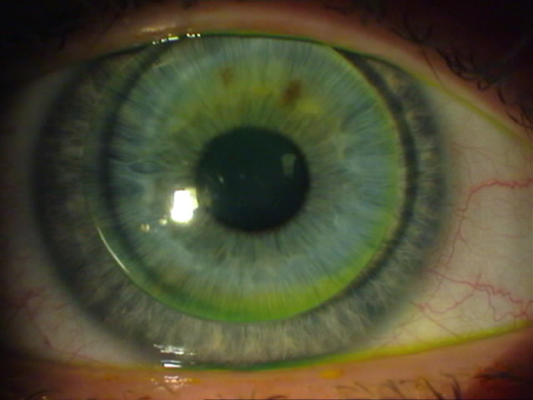
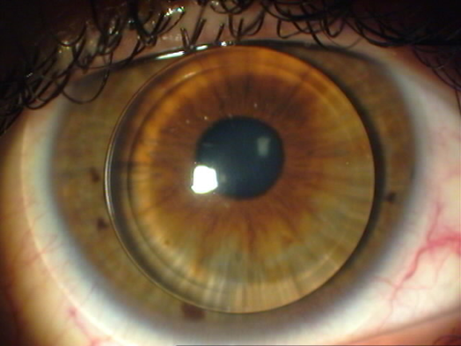
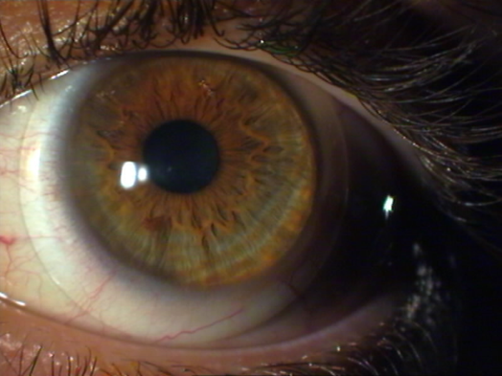
PURPOSE
To evaluate treatment options practiced for the patients with keratoconus before surgery with their psychological, social and clinical data, retrospectively.
MATERIALS & METHODS
We investigated 208 eyes of 104 patients ; that had the diagnosis of keratoconus, with their history, reaction against disease, treatment options recommended, clinical properties, and treatment options preferred with the rate of success. All cases received the diagnosis of keratoconus based on their refractive history, retinoscopic, biomicroscopic and corneal topographic findings.
After informing them sufficiently, all patients received glasses and contact lens (CL) options (soft, rigid, hybrid, piggy-back, scleral) according to their individual properties
Demographic variables are as follows;
Mean age: 32.29±10.46; 38 (36%) women and 66 (63,7%) men.
.

Slide 3
RESULS
All cases had asymetric keratoconus bilaterally. One-hundred-sixty-four eyes with more advanced keratoconus received refractive correction with glasses and CL. The cases that weared CL unilaterally received glasses or CL for the other eye according to their refractive error.
Glasses were performed for 12 cases. Rigid gas permeable (20 Rose K, 18 Orbiflex K, 23 Conflex KE), soft (5 Toris K, 9 Torik), hybrid, and scleral CLs were performed for 61, 14, 5, and 8 cases respectively. Four cases referred for surgery. The most frequently asked questions were: Is there a definitive treatment? Is the surgery better solution instead of dealing with CL?
In all patients with keratoconus, 35% with unsuccessful CL experience, 30% without CL experience were adviced to go surgery (keratoplasty, intrastromal ring) by other clinics. These patients (with total 65%) attended our clinic to interrogate their suggestions and find the most suitable treatment option. Thirty-five percent of the patients with keratoconus received the diagnosis in our clinic and were treated by glasses and CL.
Ninety-six percent of the patients that used rigid gas permeable CL successfully, but 4 cases preferred surgery because of hypersensitivity, failure in motivation and hydrops. Eighty-nine percent of the patients that were wearing rigid gas permeable CL resume their treatment in spite of uncomfortable sense, but 17 cases (28 eyes) needed piggy-back CL for a while (3-10 months) or permanently. Taking in to account of contact lenses, 85,5% of our patients resume their treatment with contact lenses, together with glasses and CLs the success rate rise to 96,2% .
Most of the patients had moderate keratoconus (mean K value: 45-52 D). The patients that had better than 5/10 visual acuity with glasses and rigid gas permeable CL (Conflex KE, Rose K, Orbiflex K) were 25% and 90% respectively. The cases that had more advanced keratoconus received hybrid (5 eyes of 5 cases), scleral (11 eyes of 8 cases) CLs, and 86% of the eyes reached better than 5/10 visual acuity..

Slide 4
Table 1: Snellen and logMAR visual acuities according to the groups with glasses and contact lenses
Snellen |  |  |  |  | Logmar
 |  | VisualAcuity With glasses | VisualAcuity With CL |  |  | VisualAcuity With Glasses | VisualAcuity With CL
 | n | Mean±SD (Median) | Mean±SD (Median) | ²p | n | Mean±SD (Median) | Mean±SD (Median) | ²p
Group 1(Scleral Lens) | 8 | 0,49±0,34 (0,4) | 0,74±0,15 (0,75) | 0,042* | 8 | 0,44±0,42 (0,4) | 0,16±0,1 (0,16) | 0,043*
Group 2(RGP Lens) | 75 | 0,38±0,23 (0,3) | 0,78±0,1 (0,8) | 0,001** | 75 | 0,51±0,31 (0,5) | 0,12±0,09 (0,1) | 0,001**
Group 3(Soft Lens) | 25 | 0,65±0,16 (0,7) | 0,85±0,07 (0,9) | 0,001** | 25 | 0,21±0,12 (0,22) | 0,05±0,07 (0) | 0,001**
Group 4(Pigyback Lens) | 29 | 0,35±0,2 (0,3) | 0,79±0,1 (0,8) | 0,001** | 29 | 0,56±0,34 (0,5) | 0,11±0,09 (0,1) | 0,001**
Group 5(Hybrid Lens) | 11 | 0,45±0,35 (0,5) | 0,76±0,1 (0,8) | 0,012* | 11 | 0,55±0,5 (0,3) | 0,15±0,08 (0,1) | 0,012*
Group 6(Glasses) | 25 | 0,73±0,23 (0,8) | 0,81±0,12 (0,8) | 0,168 | 25 | 0,2±0,3 (0,1) | 0,11±0,1 (0,1) | 0,218
Group 7(Surgery) | 1 | 1 | 0,8 | - | 2 | 0,50±0,71 (0,3) | 0,10±0,0 (0,1) | 0,655
¹p |  | 0,001** | 0,011* |  |  | 0,001** | 0,009**
Kruskall-Wallis Test ²Wilcoxon Signed Ranks Test *p<0.05 **p<0.01
 | K1 | K2 | Mean K
 | Mean±SD (Median) | Mean±SD (Median) | Mean±SD (Median)
Group 1(Scleral Lens) | 50,74±9,06 (48,13) | 52,27±9,89 (47,94) | 53,27±11,72 (47,56)
Group 2(RGP Lens) | 47,10±3,63 (46) | 48,69±4,69 (47,62) | 47,94±3,75 (47,2)
Group 3(Soft Lens) | 45,26±3,31 (44,44) | 46,29±3,75 (45,19) | 45,76±3,24 (44,73)
Group 4(Pigyback Lens) | 49,16±5,53 (47,62) | 49,5±6,24 (47,5) | 49,19±5,47 (47,35)
Group 5(Hybrid Lens) | 50,7±4,48 (49,81) | 48,34±4,86 (48,12) | 49,19±4,28 (48,81)
Group 6(Glasses) | 45,09±2,62 (44,87) | 44,86±1,87 (44,75) | 45,05±1,3 (45,25)
Group 7(Surgery) | 42±0 (42) | 45,87±0 (45,87) | 44±0 (44)
p | 0,001** | 0,002** | 0,001**
Table 2: K1, K2 and mean K values according to the groups.
Kruskall-Wallis Test **p<0.01

Slide 5
DISCUSSION
Keratoconus is a non-inflammatory disease of the cornea characterized by thinning of the corneal stroma that may or may not lead to irregular astigmatism and subsequent decrease in visual acuity. It typically commences at puberty and progresses to the mid 30s at which time progression slows and often stops (1-4). The main goal of treatment of keratoconus has changed over the last few years from that focused mainly on improvement of visual acuity to an array of newer modalities focused on the prevention of progression of the disease such as corneal collagen cross-linking (5).
In the very early stages, spectacles are an option, especially for patients who achieve 20/40 or better vision. However, spectacles do not correct irregular astigmatism, and rigid gas permeable contact lenses provide better correction in such cases.The main difficulty is finding the best suitable contact lens for irregular corneal surface, which is sometimes impossible in advanced keratoconus. To accomplish this problem, many techniques and different contact lens designs are described by ophthalmologists in recent years (6). Complaints of uncomfortness and red eye due to irritation. can be corrected with by using soft and hard lenses together in a piggyback modality as a combination system (7).
Contact lenses are an effective and minimal invasive treatment option for keratoconus fom mild to advanced stages. It is usually thought that surgery is the satisfying and keratoplasty is the main treatment option in advanced keratoconus. Smiddy et al have shown that approximately 70% patients who present for surgical consideration with keratoplasty for keratoconus can be maintained successfully on contact lenses (8). 85,5% of our patients resume their treatment with contact lenses.
CONCLUSION
Most of the patients with keratoconus from mild to advanced stage may benefit from glasses and contact lenses. Especially with the advantage of various material and design, contact lenses might be an effective and safe option for keratoconus that should be performed before surgery.
REFERENCES
Duke-Elder S, Leigh AG. Keratoconus. In: System of Ophthalmology, Vol. VIII. Part Diseases of the Outer Eye, Cornea and Sclera. London: Henry Kimpton, 1965:964e74.
2. Krachmer JH, Feder RS, Belin MW. Keratoconus and related non-inflammatory corneal thinning disorders. Surv Ophthalmol 1984;28:293e322.
3. Lawless M, Coster DJ, Phillips AJ, et al. Keratoconus: diagnosis and management. Aust NZ J Ophthalmol 1989;17:33e60.
4. Rabinowitz YS. Keratoconus. Surv Ophthalmol 1998;42:297e319.
5. Raiskup F, Spoerl E. Corneal cross-linking with hypo-osmolar riboflavin solution in thin keratoconic corneas. Am J Ophthalmol. 2011 Jul;152(1):28-32.e1.
6. Buyru Özkurt Y, S¸engör T, Kurna S, et al. Rose K contact lens fitting for keratoconus. International Ophthalmology. 2008;28:395–398.
7. Sengor T, Aydin Kurna S, Aki S, et al.High Dk piggyback contact lens system for contact lens-intolerant keratoconus patients. Clinical Ophthalmology 2011; 5(1):331-5
8.Smiddy WE, Hamburg TR, Kracher GP, et al. Keratoconus. Contact lens or keratoplasty? Ophthalmology 1988;95:487e92.

