Slide 1
Eclso 2015 – Izmir – Turkey
New concepts on the choice of artificial tears in contact lens wearers.
Mannucci L. - University of Padova – Italy
Purpose : to value the differences between pre- and post-lens tear film in contact lens wearers for selecting the right artificial tears.
Materials and methods: we studied the dynamics of tear film in soft contact lens wearers during the blinking, using the Newton theorem on the friction of the fluids between two or more parallel planes.
Results
Pre-lens tear film: the differential gradient of velocity (shear rate) of the eyelid (0.14 m/s.) v/s contact lens (0.009 m/s.) was evident. Tear film viscosity decreased during the blinking.
Post-lens tear film:
1) the force (shear stress) suffered few modifications ( ~ = τ ).
2) on the contrary, the differential gradient of velocity (shear rate) decreased ( < γ).
3) consequently, by the Newton formula (η = viscosity = τ/γ = shear stress/shear rate), if the
“share rate “ decreases, the value of the ratio, that is viscosity, increases.
This condition favoured the corneal oxidative stress too.

Slide 2
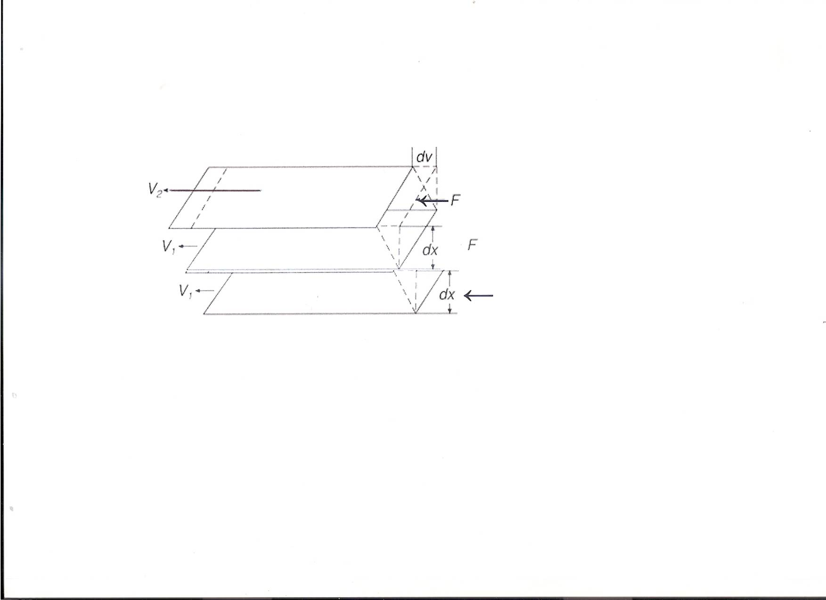
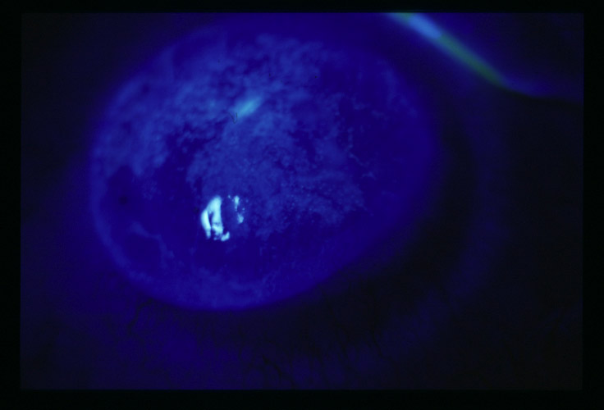
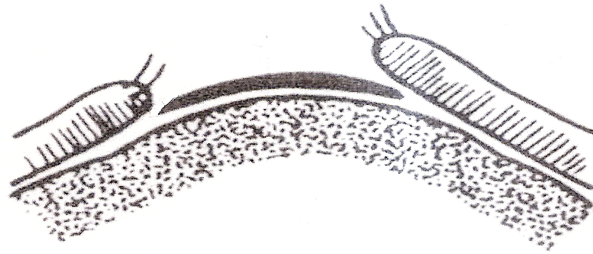
Pre-lens tear viscoelastic film
Differential gradient of force and velocity (shear rate)
between eyelid (0.085 ms.) and contact lens (0.009 ms.) is evident.
Non-newtonian artificial tears can reduce their viscosity,
avoiding an excessive friction on the cornea epithelium.
Post-lens tear viscoelastic film
The contact lens surface damps and uniforms
the force on post-lens layer, blocking pseudoplastic
effect.
Furthermore, velocity of the contact lens surface
is very low (0,009 ms.), only just superior to velocity
of the cornea surface (0.003 ms.).
So, shear rate becomes ineffective, and viscoelastic
artificial tears maintain unvaried the viscosity,
and they can be dangerous for cornea epithelium.
pre-lens ↓ tear film
0.14 m/s.
EYELID
post-lens ⁭ tear film
pre-lens tear film thickness
0.009 m/s.
CONTACT LENS
0.003 m/s.
post-lens tear film thickness
CORNEA SURFACE
1) the force (shear stress) suffered few
modifications ( ~ = τ ).
2) on the contrary, the differential gradient
of velocity (shear rate) decreased ( < γ).
3) consequently, by the Newton formula
(η = viscosity = τ/γ = shear stress/shear rate),
if the “share rate “ decreases, the value of the ratio,
that is viscosity, increases.

Slide 3
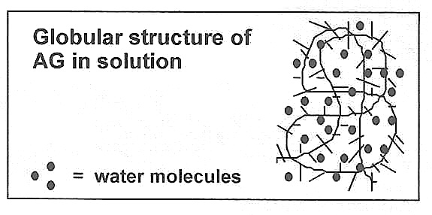
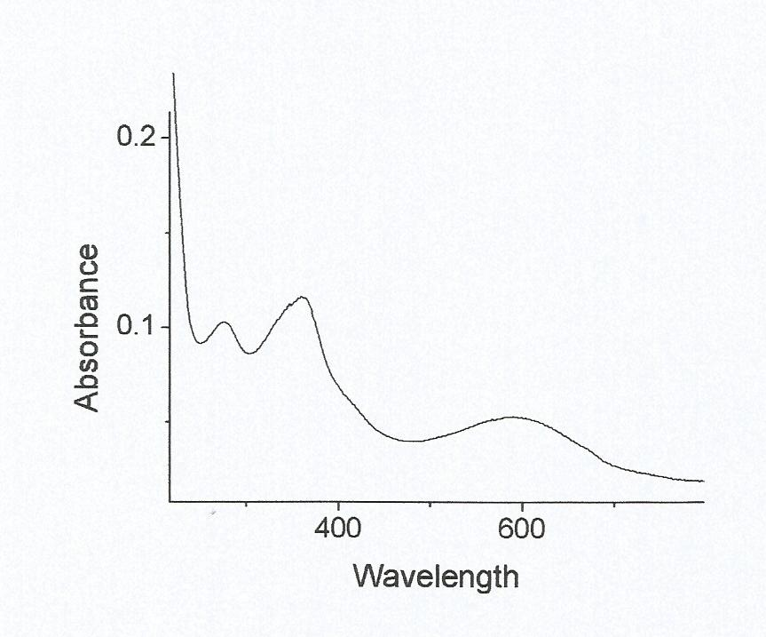
Conclusions
Pre-lens tear film follows the rule: it maintains its pseudoplasticity, and its viscosity decreases during the blinking, avoiding an excessive friction on the cornea.
Post-lens tear film: by the Newton theorem, its viscosity increases, dangerous condition for corneal epithelium.
For these reasons, it is opportune to avoid the use of viscous artificial tears in contact lens wearers.
The right artificial tears, in contact lens wearers, have to have absent viscosity
(as Arabinogalactan ® showed in preclinical phase) and anti-oxidative properties
(as Spirulina ® ).

