Slide 1
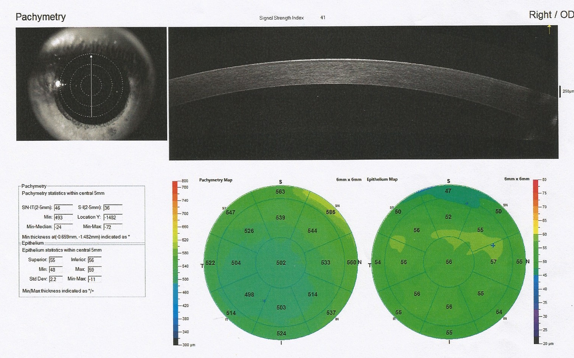
Alterations in corneal epithelial thickness (CET) in patients with congenital myogenic eyelid ptosis
Aysun Sanal Dogan, Mutlu Acar, Mustafa Kosker, Nese Arslan, Canan Gurdal
Ministry of Health, Diskapi Yildirim Beyazit Training and Research Hospital, Ankara, TURKEY

Slide 2
Purpose:
In ptotic eyes, upper eyelid is in close contact with superior sectors of the cornea. This may mechanically affect the corneal layers.
Aim of this study is to investigate these changes objectively by means of corneal epithelial thickness (CET) maps in pachymetry scans of OCT measurements.

Slide 3
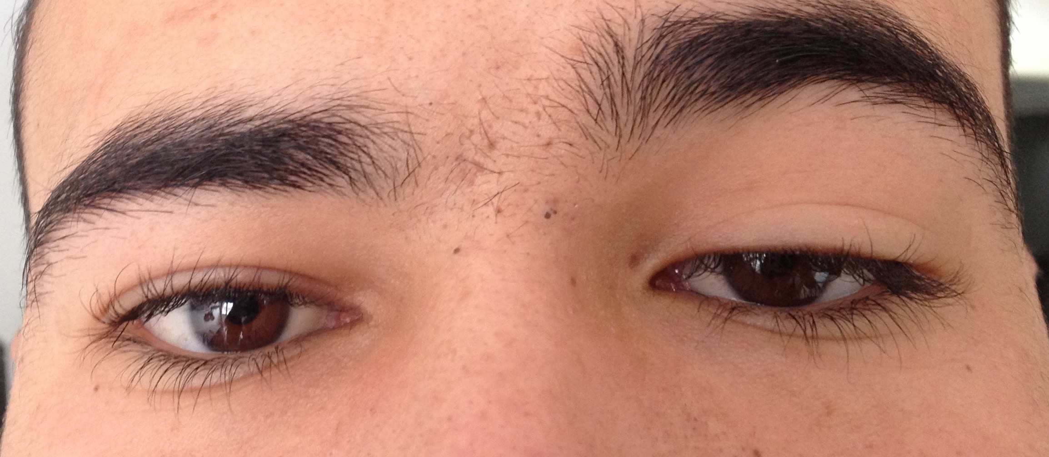
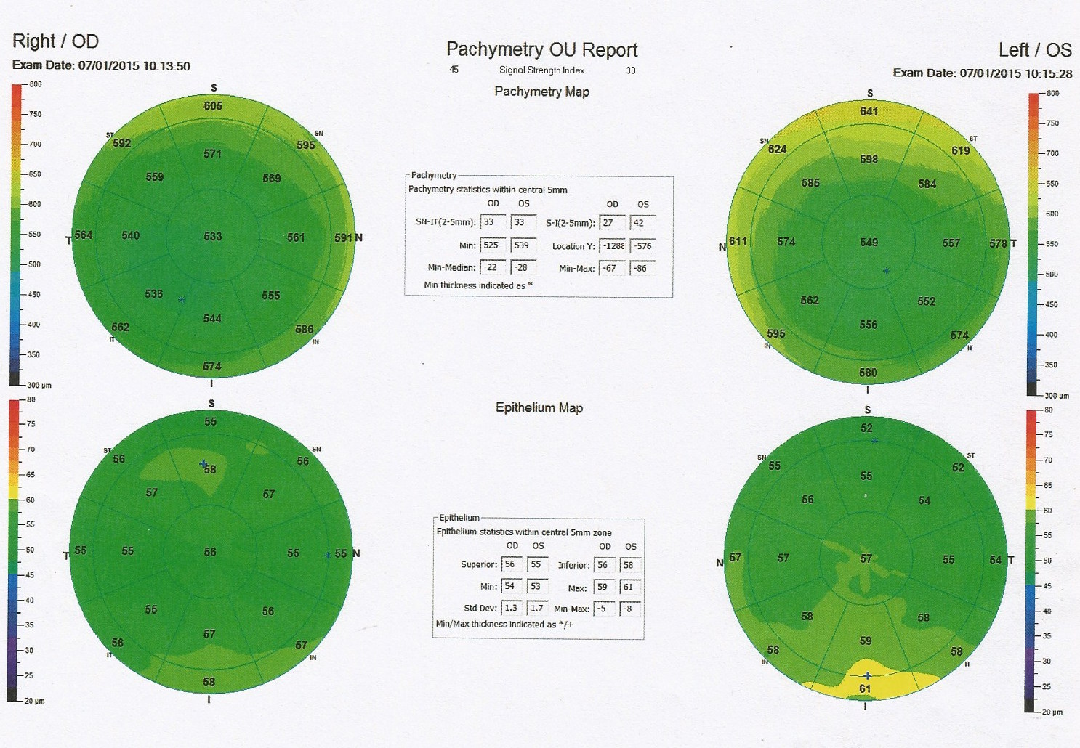
Materials and methods:
13 Ptotic eyes of congenital myogenic eyelid ptosis patients
13 Control eyes which were randomly selected
OCT Pachymetry scans (RTVue-XR, Optovue Inc., USA) were taken from 26 eyes.
Three measurements of each eye were performed and the scan with the highest signal strength index was selected for the analysis.

Slide 4
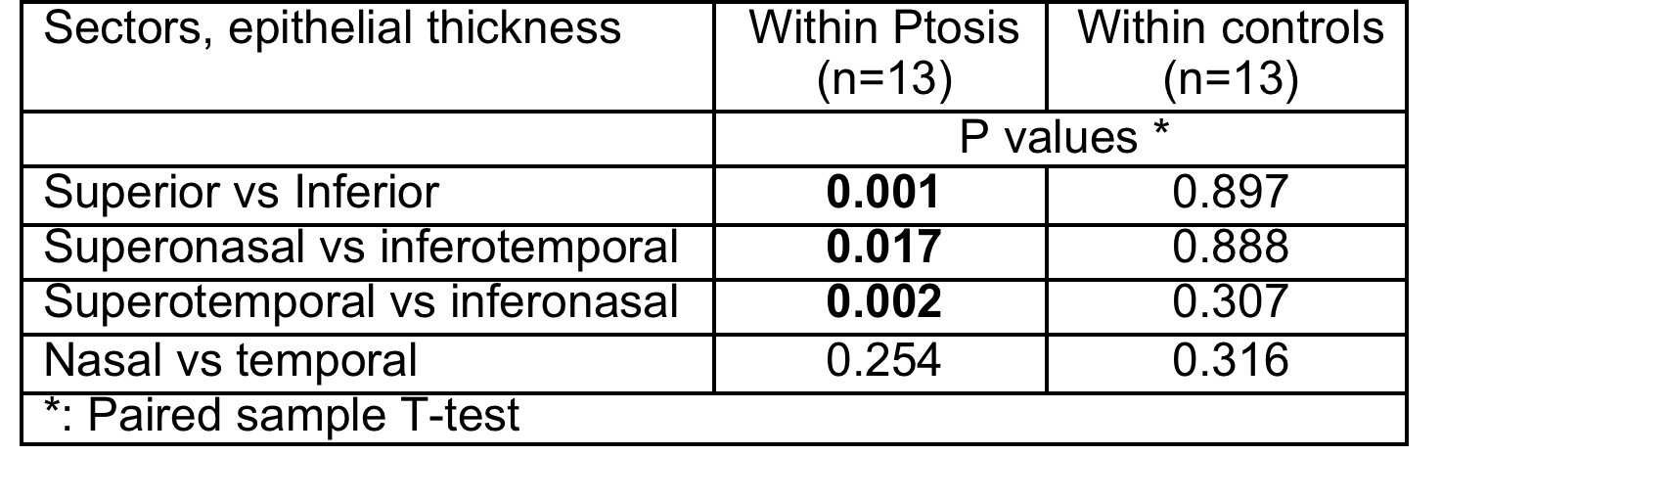
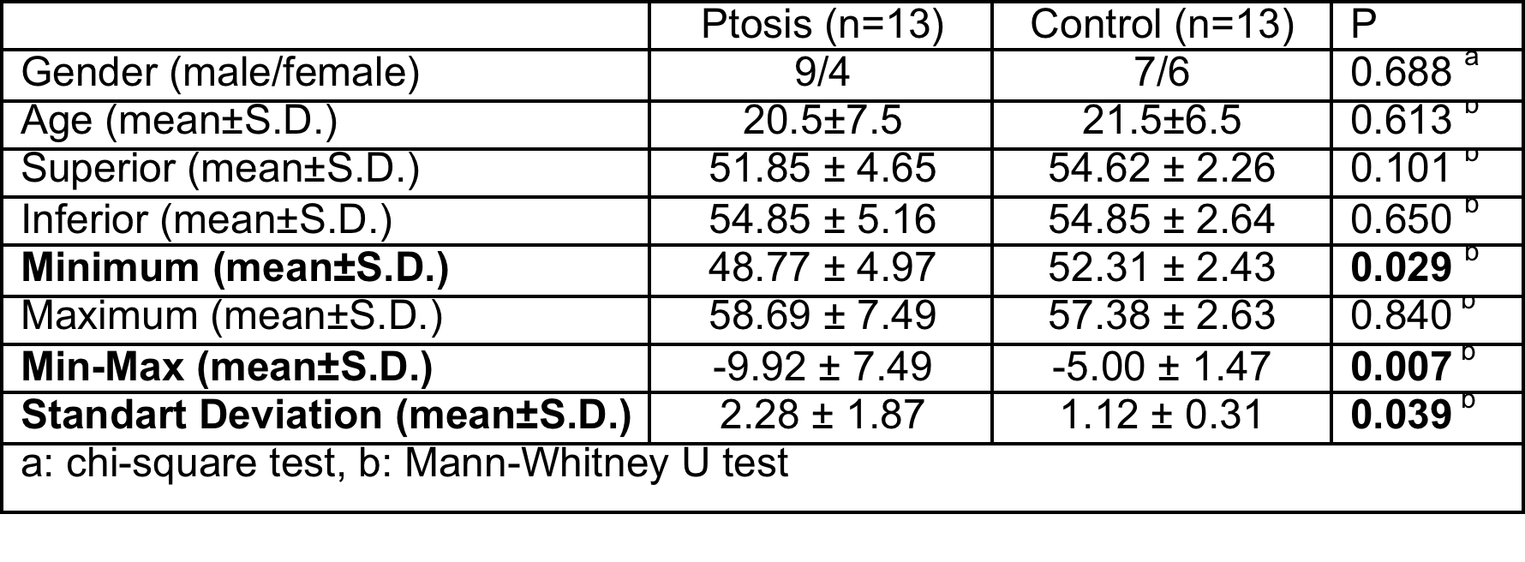
Results:
Best corrected visual acuity of all participants was 20/20 and corneal astigmatisms were ≤ 1.00 D.
There was no difference regarding corneal pachymetric map measurements (SN-IT, Min, Min-Median, S-I, Min-Max) between groups.
Corneal epithelium map measurements: In ptosis group, Minimum CET was thinner, standard deviation of thickness was higher, the negative of Min-Max values were higher, significantly when compared to the control group.
The epithelium was significantly thinner in the superior sectors, compared to the inferior counterparts in the ptosis patients, which was not detected in the control group.

Slide 5
Conclusion:
The mechanic effects of ptotic eyelid to the ocular surface may reshape the corneal epithelium which can be objectively detected by OCT.

