Slide 1
Superior Epithelial Arcuate Lesion in Using Silicone Hydrogel Contact Lens
Ferah Ozcelik, Berna Basarir, Cigdem Altan, Aslı Inal, Banu Satana, Osman Bulut Ocak
Beyoglu Eye Training and Research Hospital, Istanbul, Turkey

Slide 2
Purpose:
Superior epithelial arcuate lesions (SEALs) are often asymptomatic and less frequent complication of soft contact lens wear. We report 5 patients who had SEAL with silicone hydrogel lens wear.

Slide 3
Case Series:
Five patients who developed SEAL after long term soft hydrogel lens wear followed by silicone hydrogel lens use for 6 months, and followed at Beyoglu Eye Research and Training Hospital Cornea and Contact Lens Department are included.
Three patients were male and 2 were female, the mean age was 21,7 years.
SEAL was seen at the sixth months follow-up.
While three patients were asymtomatic, two had complaining of foreign body sensation and pain. Biomicroscopic examination revealed unilateral superior peripheral limbal injection and arcuat shaped flourescein staining at 1-11 clock hours with dry eye findings in all patients. One patient had intracorneal ring segment.
All patients recovered with medical treatment. Cessation of contact lens usage for a month and daily contact lens usage after recovery were recommended.

Slide 4
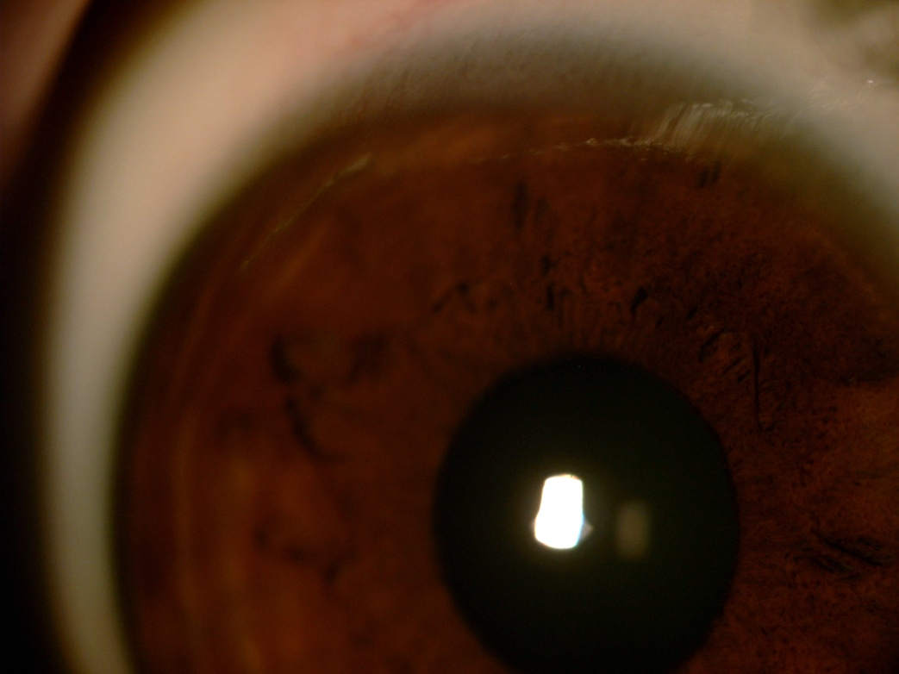
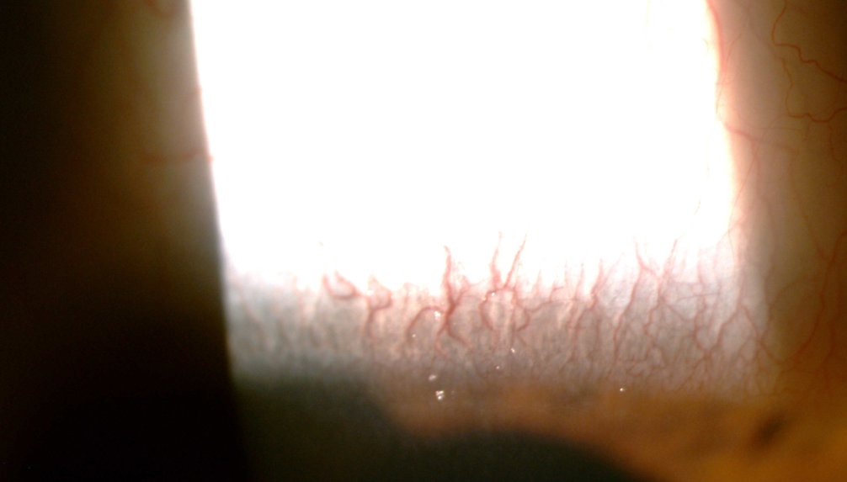

Slide 5
Conclusion:
Inward pressure of the upper lid, mechanical irritation, hypoxia, inadequate wettability appear to influence the occurrence of SEALs.
SEAL complication should be considered in patients who use soft contact lens especially accompanying dry eye signs.

