Slide 1
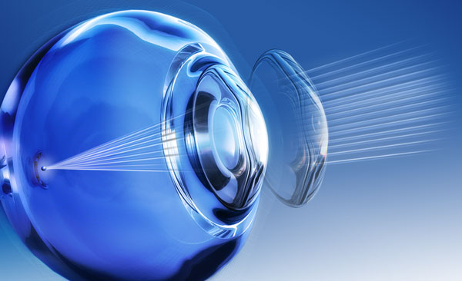
OCULAR SURFACE CHANGES IN CONTACT LENSES WITH DIFFERENT SURFACE MORPHOLOGY
ARSLAN N., CALISKAN S., KOSKER M., DOGAN A.S., ACAR M., GURDAL C.
Ministry of Health, Diskapi Yildirim Beyazit Training and Research Hospital, Ankara, TURKEY

Slide 2
PURPOSE
To determine the effect of plasma surface technology & different contact lens manufacturing techniques on ocular surface & dry eye tests.

Slide 3
Material & Method
Inclusion criteria:
Contact lens users for more
than 4 months
Exclusion criteria:
Patients having any systemic disease
Ocular disease
Patients underwent any ocular surgeries
The individuals were classified
33 individuals using contact lenses treated with plasma surface technology (Group 1)
30 individuals using non coated contact lenses (group 2)
All individuals underwent full ophthalmologic examination including dry eye tests; tear break up time (TBUT) (1=<5, 2=5-10, 3=>10), Schirmer test I (1=<5mm, 2=5-10mm, 3=>10mm)
Ocular Surface disease Index (OSDI) quetionnaire was asked from all individuals (1=>33, 2= 23-33, 3=<22)
Corneal topography, meibography, non invasive tear analysis (NIFBUT).
Performing the tests after applying the contact lens for at least 2 hours
The data were compared in both groups using SPSS statistical analysis program version 20 using Chi-square, Mann-Whitney U, Spearman’s RHO

Slide 4
Results
There was not significant difference in age, gender &contact lens use duration between groups.( p=0,491, p=0,09 and p=0,524).
There was no significant difference in the dry eye tests between groups. (all , p>0.05)
There was no correlation between the duration of contact lens use & dry eye tests results (all, p>0.05).

Slide 5
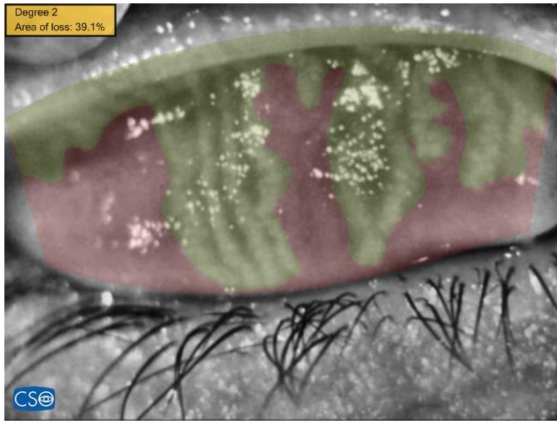
Results
Meibography results were similar in both groups (p=0,736 & 0,070)
Conclusions:
According to our findings, differences in contact lens surface technology caused no difference in the ocular surface or tear function.
Similar meibography findings were observed in both groups, which indicates that their effects are similar.

