Slide 1
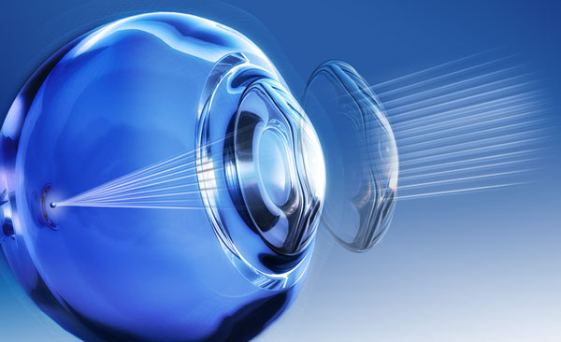
OCULAR SURFACE CHANGES IN CONTACT LENSES WITH DIFFERENT SURFACE MORPHOLOGY
ARSLAN N., KOSKER M., DOGAN A.S., ACAR M., GURDAL C.
Ministry of Health, Diskapi Yildirim Beyazit Training and Research Hospital, Ankara, TURKEY

Slide 2
PRRPOSE
To determine the effect of plasma surface technology & different contact lens manufacturing techniques on ocular surface & dry eye tests.

Slide 3
Material & Method
Inclusion criteria:
Contact users of 15-57 age
Users of at least 4 months
Exclusion criteria:
Patients having any systemic disease
Ocular disease
Patients underwent any ocular surgeries
The individuals were classified
29 individuals using contact lenses treated with plasma surface technology (group 1)
34patient using non coated contact lenses (group 2)
All patients underwent full ophthalmologic examination including dry eye tests; tear break up time (TBUT), schirmer teast I, fluorescein dying of ocular surface according to Oxford grading system.
Corneal topography, meibiography, non invasive tear analysis (NIFBUT).
Performing the tests after applying the contact lens for at least 2 hours
The data were compared in both groups using SPSS statistical analysis program version 21 using Chi-square, Mann-Whitney U & student T tests.

Slide 4
Results
 | Group 1 | Group2 | P
Age (Year) | 24,37±9,82 | 25,08±8,18 | 0.30
Duration (month) | 20,96±35,16 | 20,50±57,23 | 0.60
TOTAL(n) | 29 (46%) | 34 (54%)
 | Phi | kappa | p
Schirmer- TBUT | 0,376 | 0,178 | 0,04
Schirmer -NFBUT | 0,223 | -0,02 | 0,98
NFBUT- TBUT | 0,371 | 0,206 | 0,01
There was a significant correlation between NIFBUT & TBUT but not between schirmer & NIFBUT test. No correlation was found between schirmer test, TBUT, NIFBUT , meibography results & the duration of contact lens use .
 | Group 1 |  |  | Group 2
 | 1 (mild) | 2 (moderate ) | 3 ( severe) | 1 (mild) | 2 (moderate) | 3 ( severe) | P
Schirmer n(%) | 18 (62,1 ) | 6 (20,7 ) | 5 (17,2 ) | 10 (29,4 ) | 12 (35,3 ) | 12 ( 35,3) | 0,02
TBUT n(%) | 24 ( 82,8) | 4 (13,8 ) | 1 (3,4 ) | 15 (44,1 ) | 11 ( 32,4) | 8 (23,5 ) | 0,02
NIFBUT n(%) | 7 ( 24,1) | 14 ( 48,3) | 8 ( 27,6) | 8 ( 23,5) | 15 ( 44,1) | 11 (32,4 ) | 0,77

Slide 5
Conclusion
Different surface morphology of contact lenses can affect dry eye tests evaluation. In words plasma surface technology could have a positive effect on preventing dry eye symptoms.
Correlation was found significant between TBUT & NIFBUT.
Meibography test results is not affected by lens type.

