Slide 1

Microbiological analysis of samples of lens care solutions in reusable soft contact lens trial sets
Dr Katarina Janković Terzć
Ophthalmology practice OkoiOko
Belgrade, Serbia
Katarina@okoioko.com

Slide 2
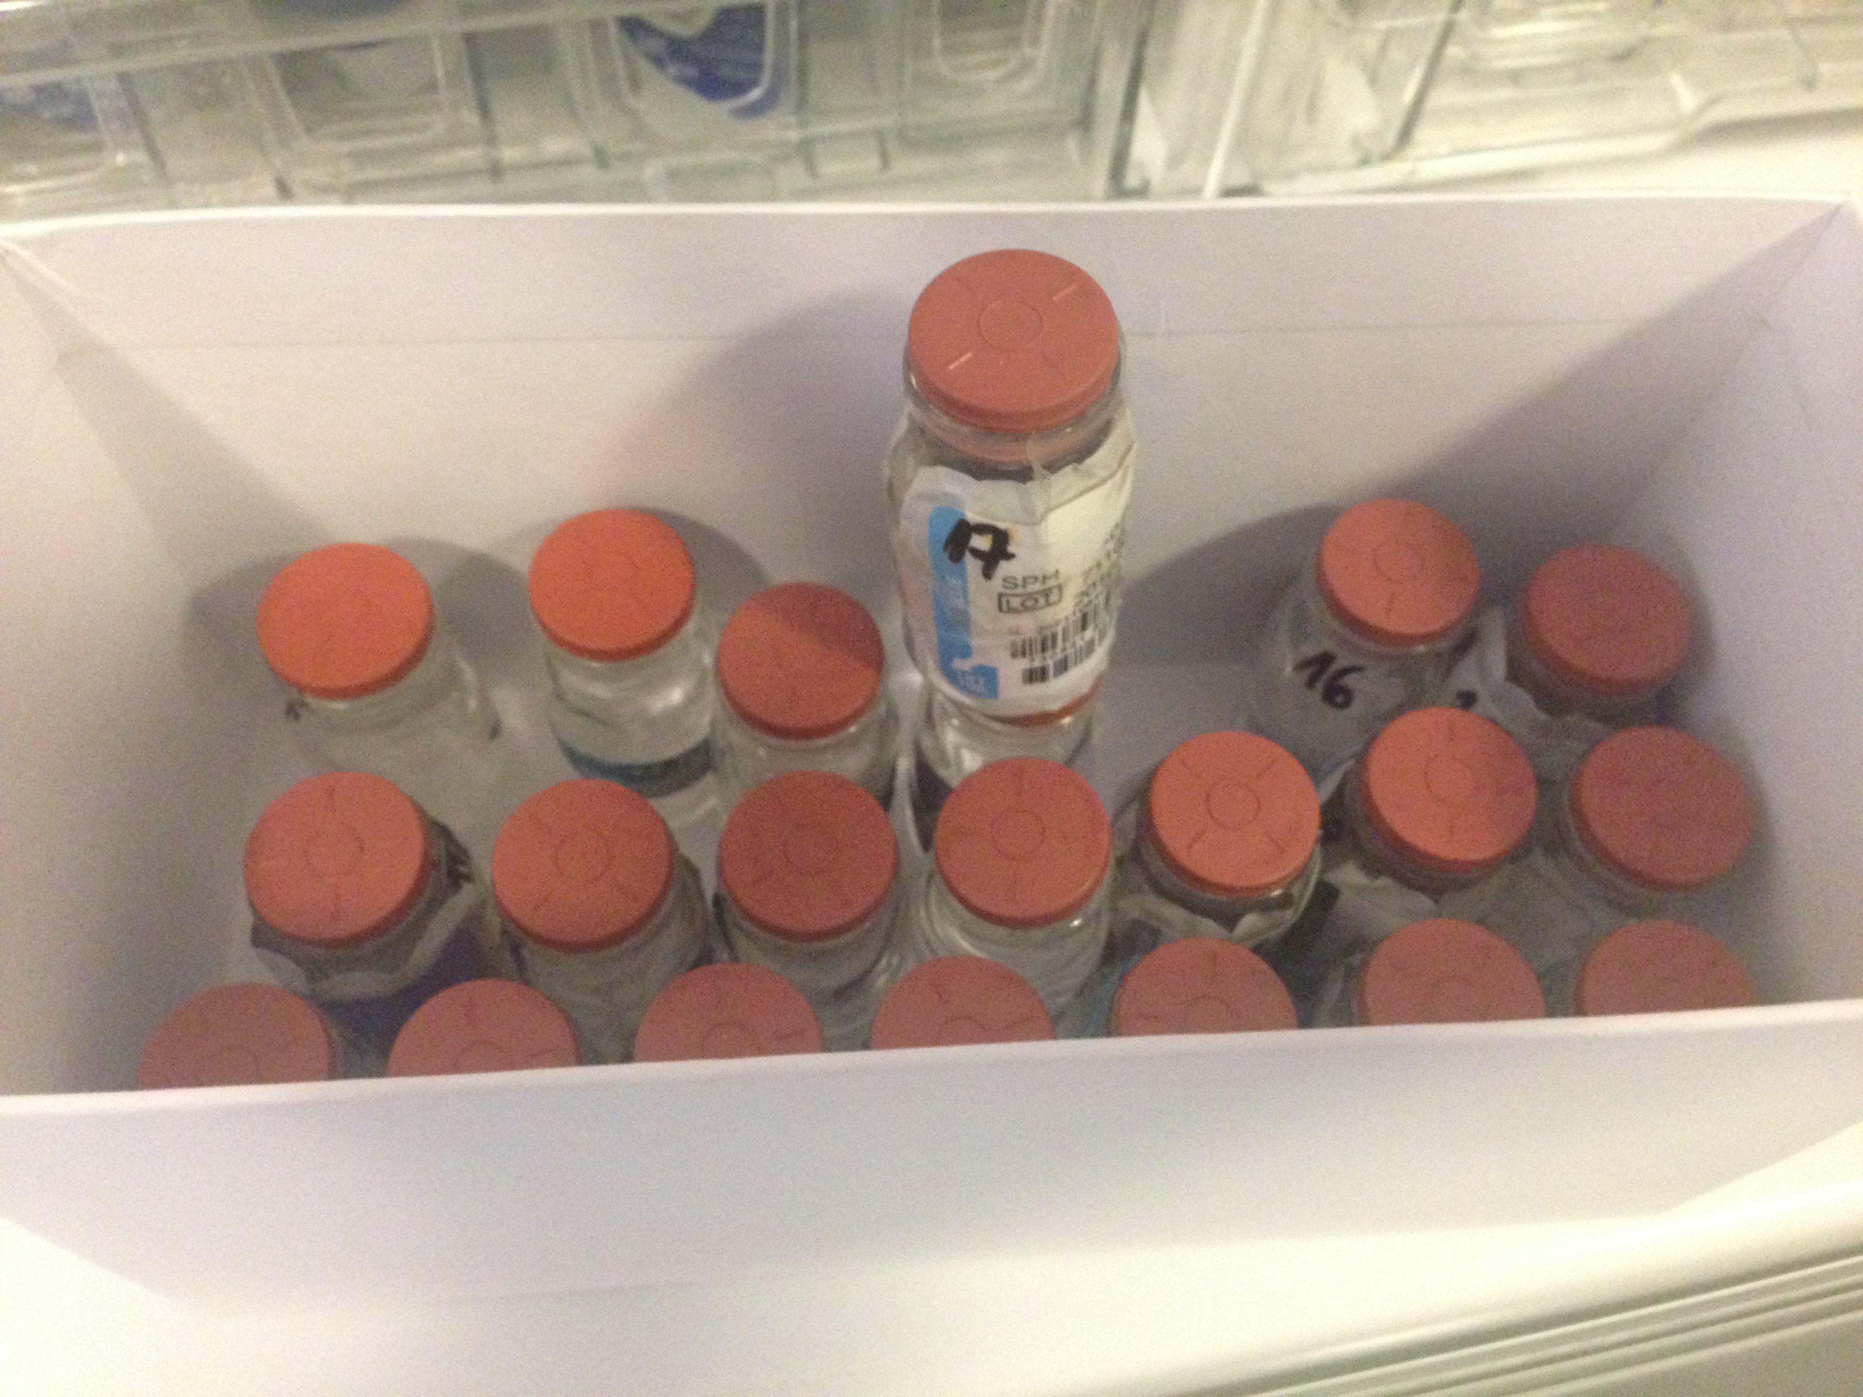
Purpose
The purpose is to analyse microbiological organisms in contact lens care solutions samples taken from randomly selected reusable soft trial contact lenses

Slide 3
Material and method
30 items of reusable trial lenses have been randomly collected from 8 different ophthalmological units from Belgrade.
Samples from contact lens care solutions have been taken to laboratory and directly cultured on broth and solid media as a drop. Sterility of examined solutions has been controlled.
The inoculated broths and plates have been incubated and organisms grown were identified using standard microbiological techniques.

Slide 4
Table 1 - results
In total 8 samples have proven to be sterile. Others have been identified with one or with more microorganisms:
No of samples | Microbiological status
8 | Sterile
7 | Corinebacterium sp.
4 | Staphylococcus sp. coagulase-negative
1 | Pseudomonas sp
1 | Klebsiella
1 | Escherihia colli
1 | Proteus
2 | Fungi
5 | Multiple microorganisms

Slide 5
Conclusion
Reusable trial soft lenses are not safe to use. If re-used they need to be kept in multipurpose solution up to a maximum of one month. Soft trial fitting lenses can be disinfected using hydrogen peroxide system. Some soft lenses have also been approved for heat disinfection.

