Slide 1
Amniotic membrane transplantation in bacterial and herpetic stromal keratitis
Yeşim ALTAY
Ankara Education and Research Hospital

Slide 2
Purpose
To describe the results of amniotic membrane transplantation (AMT) in patients with bacterial and herpetic stromal keratitis
Methods
42 patients with herpetic stromal keratitis
42 patients with bacterial keratitis
AMT (onlay technique) in addition to antimicrobial therapy
Topical steroids were administered after surgery
Outcome parameters: epithelialization time, decrease of stromal inflammation , UCVA

Slide 3
Results
The mean age 55.85±19.07 years
The mean follow-up period 14.70±11.75 months
Epithelialization time:
19.23±7.32 days in herpetic group
19.31±6.30 days in bacterial group
Bacterial group showed statistically significant improvement in UCVA
Desmotocele developed in two patients of herpetic group. Other cases in both groups completed epithelialization after AMT with various amounts of corneal scars

Slide 4
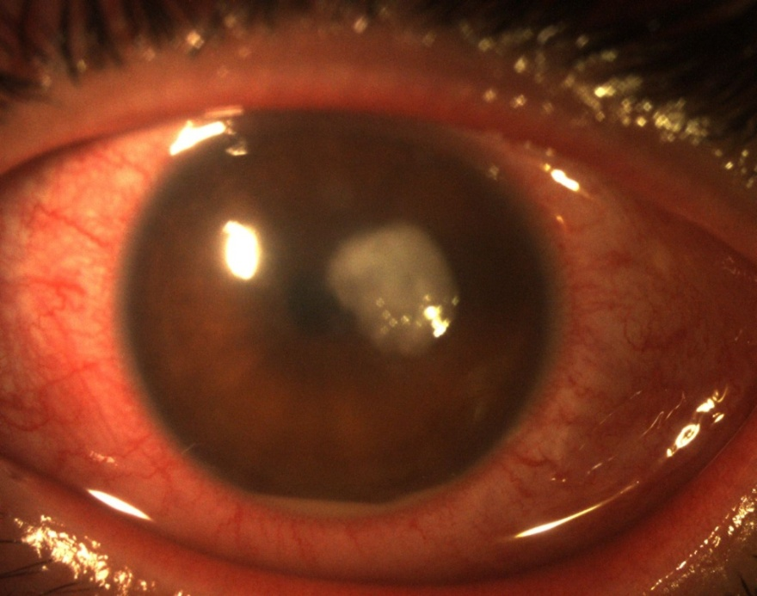
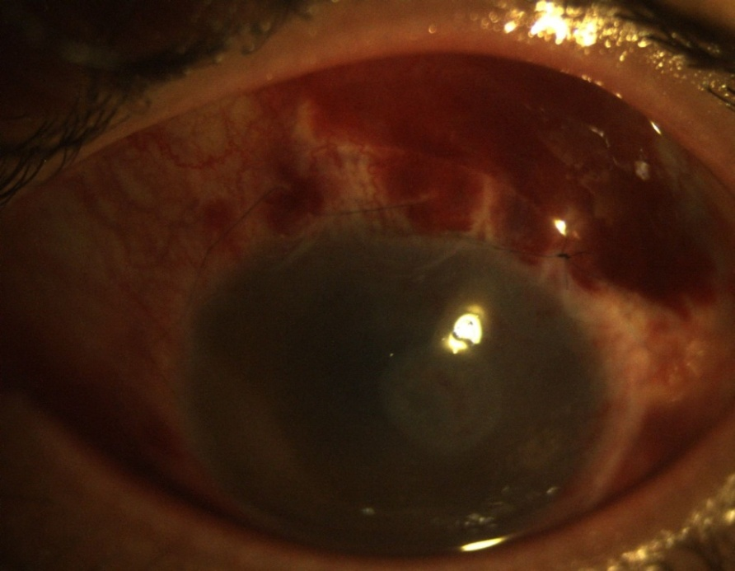
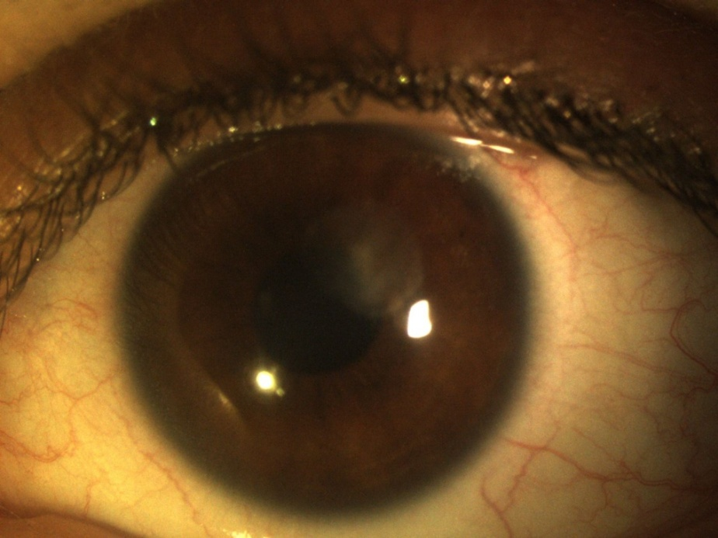

Slide 5
Conclusion
AMT is a convenient approach for the treatment of corneal keratitis resistant to conventional treatment and allows the use of early topical steroid application

