Slide 1



WHAT’S IN A NAME? The importance of lens brand and choice to the CL wearer Anne Madec-Hily MBA¹ Anna Sulley BSc MCOptom FAAO FBCLA¹ Jeremy Atkins MA Hons (Oxon) CMRS² ¹ Johnson & Johnson Vision Care, UK ² Researchcraft Ltd, UK
1 of 4
Background
Methods
Lack of knowledge about contact lenses (CLs) is a significant barrier to CL wear.
Across Europe, two-thirds of those considering CLs (67%) do not feel well informed about them and three in four (76%) want their eye care practitioner (ECP) to provide more CL information.¹
Although motivation to wear CLs has been investigated, patients’ attitudes to brand and experiences of being offered different lenses have not been fully explored.
This study explored usage and attitudes surrounding CLs, particularly around lens brand and choice.
An online survey of vision-corrected consumers aged 16-49 years was conducted in the UK, Italy and France by an independent market research agency in February and March 2014.
The sample comprised 1,350 soft CL wearers (currently wearing), 300 lapsed wearers (used to wear soft CLs but lapsed in previous 24 months), 750 CL considerers (never worn CLs and would definitely or probably consider CLs in the next 12 months) (Table 1).
Some questions asked to a sub-set of wearers (n=675) for questionnaire efficiency
 | UK | Italy | France | TOTAL
Wearers | 500 | 500 | 350 | 1350*
Lapsed | 100 | 100 | 100 | 300
Considerers | 250 | 250 | 250 | 750
TOTAL | 850 | 850 | 700 | 2400
DO ECPs WEAR CLs?
Separate survey of 150 UK ECPs conducted via online interview by an independent market research agency Feb – March 2014
Does ECP wear CL?
Which CL brand do ECPs wear?
*Some questions asked to a sub-set of wearers (n=675) for questionnaire efficiency
YES NO
Table 1: Patient sample
©JJVCI, 2015. All rights reserved
Poster first presented at BCLA Conference 2015.

Slide 2
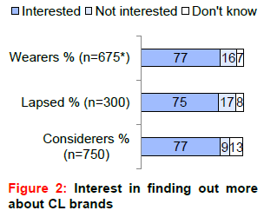
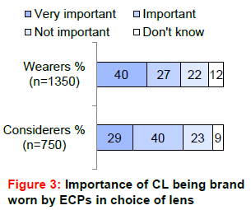
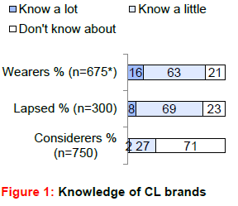
WHAT’S IN A NAME? The importance of lens brand and choice to the CL wearer Anne Madec-Hily MBA¹ Anna Sulley BSc MCOptom FAAO FBCLA¹ Jeremy Atkins MA Hons (Oxon) CMRS² ¹ Johnson & Johnson Vision Care, UK ² Researchcraft Ltd, UK
2 of 4
Results
Only 16% current wearers know a lot about CL brand (Figure 1).
Knowledge of lens brands was similar among lapsed wearers and lower among CL considerers.
77% current wearers wanted to know more about brands (Figure 2). Lapsed wearers and considerers showed similar levels of interest.
Current wearers’ interest in finding out more about brands was nearly 50% higher than about their lens modality (77% vs 54%).
Their level of interest in finding out more about brands was as high as for their type of vision correction (77% vs 74%).
Brand of less importance to considerers than other groups although 69% said ‘brand ECPs wear’ important to CL choice (Figure 3).
©JJVCI, 2015. All rights reserved
Poster first presented at BCLA Conference 2015.

Slide 3
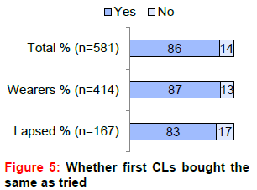
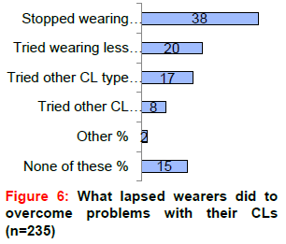
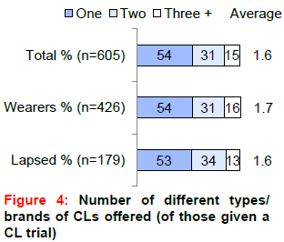
WHAT’S IN A NAME? The importance of lens brand and choice to the CL wearer Anne Madec-Hily MBA¹ Anna Sulley BSc MCOptom FAAO FBCLA¹ Jeremy Atkins MA Hons (Oxon) CMRS² ¹ Johnson & Johnson Vision Care, Wokingham, UK ² Researchcraft Ltd, Leamington Spa, UK
3 0f 4
Results (continued)
54% current and lapsed wearers were offered only one type/brand of CL at the initial trial (Figure 4).
For 52% current wearers, the ECP alone chose their CL and 87% bought the CLs first tried (Figure 5).
78% lapsed wearers experienced problems with their CLs.
Of those who encountered problems and lapsed, 58% either stopped wearing CLs for a while (38%) or tried wearing less often (20%), 17% tried another lens type and only 8% tried another brand (Figure 6).
Around half (51%) lapsed wearers experiencing problems had gone back to ECP that had fitted the CLs. Only 10% went to another ECP.
Majority lapsed wearers (62%) experiencing problems would have continued with CLs had the problem been overcome.
©JJVCI, 2015. All rights reserved
Poster first presented at BCLA Conference 2015.

Slide 4

WHAT’S IN A NAME? The importance of lens brand and choice to the CL wearer Anne Madec-Hily MBA¹ Anna Sulley BSc MCOptom FAAO FBCLA¹ Jeremy Atkins MA Hons (Oxon) CMRS² ¹ Johnson & Johnson Vision Care, Wokingham, UK ² Researchcraft Ltd, Leamington Spa, UK
4 0f 4
Discussion
Conclusions
Majority CL wearers say they do not know a lot about CL brands.
Dumbleton et al² found around half CL wearers (49%) able to recall names of habitual CLs and solutions correctly.
Patients wearing Johnson & Johnson Vision Care CLs (ACUVUE® Brand) had most accurate unprompted recall of their lens brand (72% correct).³
Brand worn by ECPs can influence patients’ lens choice.
CL penetration among ECPs is higher than that in the general population
ECPs (UK) are more likely to wear ACUVUE® Brand CLs than other brands.
More than half current and lapsed wearers offered only one CL type or brand at the initial trial.
Few CL wearers who encountered problems and lapsed have tried another brand. They’re unaware of other options, and that some could work better for them. Wearers drop out often when CL chosen initially does not meet their needs and they don’t know to go to their ECP to discuss this with them.
For majority drop-outs (>7/10) no alternative CL/strategy tried ²
Patients want their ECP to talk to them more about CLs, and wearers want to know more about CL brands.
For many patients, ECP chooses trial lenses and most buy CLs first trialled.
If problems encountered with their CLs, patients don’t always go back to their ECP; if issue had been solved, most would have continued wear
This research highlights importance of ECP/patient communication and need to follow up with wearers and offer alternative lens options.
Brand can be basis for conversation on CL choice.
Consumers cannot select complex products based on intrinsic product knowledge, and are often not interested in understanding technical details
“Brand” to consumers helps them easily identify a product they can trust, especially when they are technical or complex; their confidence in a brand to be safe and high quality is important in many categories, but particularly when considering health and medical devices.
References
UK Shopper Segmentation Study 2012 among 717 CL considerers.
Sulley A et al. Factors in success new CL wearer retention. Optom Vis Sci 2014 E-abstract 145020
Dumbleton K et al. Ability of patients to recall habitual CL products and enhancement of recall using photographic aids. CLAE 2011;34:5 236-40.
CORRESPONDENCE
Email: ahily@its.jnj.com. Johnson & Johnson Vision Care. Pinewood Campus, Nine Mile Ride, Wokingham RG40 3EW
ACKNOWLEDGEMENT
The survey was sponsored by Johnson & Johnson Vision Care.
©JJVCI, 2015. All rights reserved
Poster first presented at BCLA Conference 2015.

