Slide 1

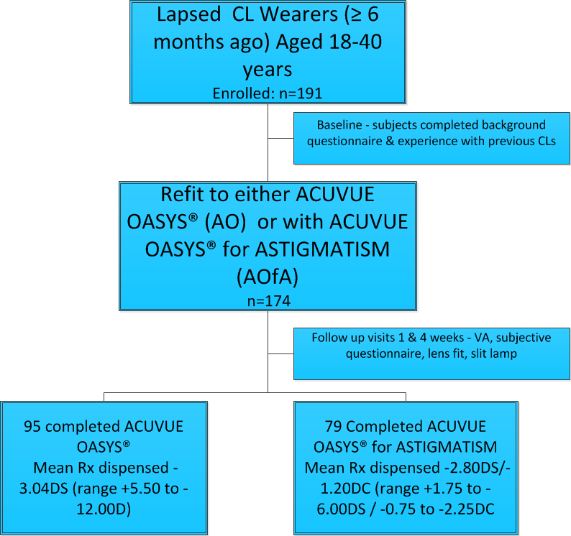
Clinical evaluation lapsed wearers refitted with senofilcon A lenses Kristy Canavan OD FAAO¹ Chantal Coles-Brennan OD FAAO¹ Ryan Butterfield DrPH² Anna Sulley BSc MCOptom FAAO FBCLA³ ¹Johnson & Johnson Vision Care, iNc ² 3M ³Johnson & Johnson Vision Care
1 of 4
Background
Discontinuation from contact lens (CL) wear continues to be a contributing factor in CL practice failing to grow
The main reasons for established CL wearers to drop-out continues to be discomfort and dryness^{1,2}
Previous research suggests CL failure is product or practitioner-related rather than due to patient-specific problems³
A high proportion of lapsed wearers can be successfully re-fit with CLs^{3,4}
Success rates for astigmatic drop-outs have increased over the last decade (from 69% to 94%) and can be attributed to toric soft CL improvements⁴
This study evaluated key reasons for lapsing from CL wear and proportion of pre-presbyopic lapsed wearers that could be successfully re-fitted with senofilcon A CLs
Methods
Open-label, multi-site, 4-wk dispensing study conducted at 10 sites in USA with lapsed CL wearers
Recruitment: via practitioner practice databases, print advertisements & social media (Facebook)
Subjects were re-fitted with 2-weekly replacement, daily wear senofilcon A lenses (ACUVUE OASYS® or ACUVUE OASYS® for ASTIGMATISM (Figure 1)
Care regimens: Opti-Free PureMoist (ALCON), Revitalens Ocutec (AMO) or AOSept Plus (ALCON) selected by the practitioner
Re-taught insertion & removal as required
Primary hypothesis: >50% of subjects can be successfully refit with senofilcon A CLs and complete 4-weeks DW based on practitioner judgment of acceptable physiology, comfort, vision & handling to continue with CL wear
Figure 1: Study flow and subject status

Slide 2
Clinical evaluation lapsed wearers refitted with senofilcon A lenses Kristy Canavan OD FAAO¹ Chantal Coles-Brennan OD FAAO¹ Ryan Butterfield DrPH² Anna Sulley BSc MCOptom FAAO FBCLA³ ¹Johnson & Johnson Vision Care, iNc ² 3M ³Johnson & Johnson Vision Care
2 of 4
Results
Demographics and Previous CL Wear
Study was completed by 174 subjects (95 sphere, 79 toric)
Mean age 29.4 years (range 18-39); 69% female
Average age first tried CLs: 18 years (range 7-37)
Average age stopped CL wear: 26 years (range 13-38)
Time period wore CLs: 5.5 years (range 1-8)
Drop-outs mostly full-time wearers (57% wore ≥5 days/week); 45% have occasionally/regularly slept/napped in CLs
57% subjects unable to recall CL brand prior to discontinuing; for those who could, there was a wide distribution across multiple brands & modalities with 79% spherical and 21% toric designs
Main reasons given at baseline for lapsing were discomfort/dryness (28.3% overall, 24.2% sphere, 33.3% toric) and cost (Figure 2)
2x more subjects re-fitted to the toric CL lapsed due to vision (9.0% vs 3.2% for sphere).
86% interested in trying CLs again, including those who dropped out due to dryness and discomfort
Majority subjects (84.4%) did not consult their eye care practitioner prior to lapsing from CL wear
Figure 2: Primary reason for lapsing from CL wear

Slide 3
Clinical evaluation lapsed wearers refitted with senofilcon A lenses Kristy Canavan OD FAAO¹ Chantal Coles-Brennan OD FAAO¹ Ryan Butterfield DrPH² Anna Sulley BSc MCOptom FAAO FBCLA³ ¹Johnson & Johnson Vision Care, iNc ² 3M ³Johnson & Johnson Vision Care
3 of 4
Results (continued)
VISION AND COMFORT PERFORMANCE
Both spherical and astigmatism lenses were highly rated for vision and comfort (Figure 3); overall performance rated the same/better as their spectacles for 8 out of 10 lapsed wearer
Subjects wore the CLs on average 13 hours per day, with 10.6 hours comfortably
76% subjects rated overall vision quality as excellent/very good overall
Snellen visual acuity was 6/6 or better for >96% of subjects at fitting, 1- & 4-week follow-up visits
SUCCESS RATES AND OVERALL SATISFACTION
Of 191 enrolled, 98.3% subjects (95%CI: 95.04-99.64%) successfully refitted and completed 4-weeks DW (p<0.0001) - Study primary hypothesis met
For those who lapsed due to discomfort (n=67), 82% rated overall opinion as excellent/very good/good (5pt Likert scale)
After wearing AO or AOfA for 4-weeks, >7 out of 10 subjects likely to continue wearing CLs (Figure 3) including 74% of those who lapsed due to discomfort
95% agreed AO/AOfA were easy to take care of (Figure 4)
% subjects
Figure 3: Overall satisfaction lapsed wearers re-fit with senofilcon A CLs
% subject strongly/somewhat agree
Figure 4: Subjective performance lapsed wearers fitted with senofilcon A CLs

Slide 4
Clinical evaluation lapsed wearers refitted with senofilcon A lenses Kristy Canavan OD FAAO¹ Chantal Coles-Brennan OD FAAO¹ Ryan Butterfield DrPH² Anna Sulley BSc MCOptom FAAO FBCLA³ ¹Johnson & Johnson Vision Care, iNc ² 3M ³Johnson & Johnson Vision Care
4 of 4
Discussion and Conclusions
REFERENCES
Richdale K et al, Frequency of and factors associated with CL dissatisfaction and discontinuation. Cornea 2007 26(2):168-74
Dumbleton K et al, Impact of contemporary contact lenses on CL discontinuation. Eye & CL 2013; 39 (1): 93-9
Young G et al. Multi-centre study lapsed CL wearers. OPO 2002; 22:516-527
Sulley A et al. Clinical Evaluation Toric Soft CL Fitting in Current Non-Users. OPO 2013, 33, 94–103
ACKNOWLEDGEMENT
This study was sponsored by Johnson & Johnson Vision Care, Inc
ACUVUE OASYS® and ACUVUE OASYS® for ASTIGMATISM are registered trademarks of Johnson & Johnson Vision Care, Inc.
All other companies brands mentioned herein are the trademarks of their respective owners.
CORRESPONDENCE
Email: kcanava2@its.jnj.com
Johnson & Johnson Vision Care, Inc. 7500 Centurion Parkway, Suite 100/ D-ACAF, Jacksonville, FL 32256, USA
Prime reason for established wearers lapsing from CL wear remains dryness and discomfort, although patients are unlikely to let their practitioners know about any dissatisfaction and hence lapse without trying alternatives
For those able to recall previous lens type, only one in five wore toric CLs but nearly half were dispensed AOfA in this study; more lapsed wearers ultimately re-fitted to torics discontinued previous wear due to vision compared to spherical lapsed wearers suggesting they should have been originally prescribed with a toric CL, or their previous toric CL did not give good vision performance
Practitioners should question their current wearers about satisfaction with CL comfort, vision and overall performance to ensure their lenses are meeting patient needs during routine aftercares to reduce lapsing
Since a similar study was conducted in 2001,where the success rate refitting drop-outs was 77%,³ there have been advancements in CLs; with >98% drop-outs successful with AO/AOfA, these study results support that many lapsed wearers can benefit from being fitted with senofilcon A (ACUVUE OASYS® Brand) contact lenses

