Slide 1

Evaluation of visual performance of a new multifocal contact lens and impact of refractive error Tom Karkkainen, Kurt Moody, Ron Clark, Jasper Xu & Sheila Hickson-Curran Johnson & Johnson Vision Care, Inc.
1 of 4
Background and Purpose
Methods
Correction of presbyopia with soft contact lenses (CLs) can be challenging. Designs used often rely on simultaneous vision optics which can cause some level of vision compromise. In addition other factors can influence the performance of the CLs such as the patients pupil size, CL centration and residual uncorrected refractive cylinder.¹
Pupil size has been shown to be correlated with refractive error.² Diameter of the pupil is smaller in hyperopes than in myopes.³ Difference in pupil size between refractive error groups has the potential to impact visual performance with simultaneous vision CLs.
The purpose of this study was to measure distance, intermediate and near visual acuity (VA) with a new multifocal CL and assess impact of refractive error groups (myope and hyperope). In addition the pupil diameter of subjects was measured to asses if differences exist in this population and determine if there was an impact on visual performance.
Presbyopes were fitted with a new etafilcon A daily disposable multifocal lens (1-DAY ACUVUE® MOIST MULTIFOCAL) and returned for an optimisation visit after 3±1 days. Subjects were then dispensed for additional 7±1 days with the optimised CL.
Binoc Distance logMAR VA (DVA) measured with high contrast (90%), bright illumination (≈160-200 cd/m²) ETDRS (Early Treatment Diabetic Retinopathy Study) charts.
Binocular Intermediate (IVA) and Near logMAR VA (NVA) were measured using high contrast (90%), bright illumination (≈225-275 cd/m²) reduced Guillon-Poling charts at 64cm and 40cm respectively.
Subjects were separated by hyperopic (+0.25D to +4.00D) and myopic (plano to -6.00D) refractive groups and VA reported.
Subject’s pupil size was measured using an infrared NeurOptics VIP-200 pupillometer in bright (≈394-597 lux) and dark (≈0.63- 2.5 lux) illuminations.

Slide 2
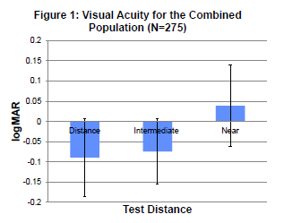
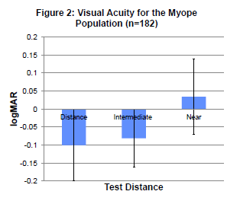
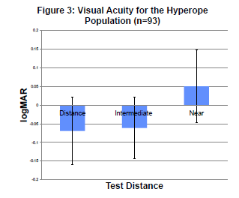
Evaluation of visual performance of a new multifocal contact lens and impact of refractive error Tom Karkkainen, Kurt Moody, Ron Clark, Jasper Xu & Sheila Hickson-Curran Johnson & Johnson Vision Care, Inc.
2 of 4
181 myopes and 94 hyperopes completed the study.
Average age was 50 ± 6 years (range 40-67).
Figures 1-3, summarise VA results
Mean distance, intermediate and near logMAR VA and standard deviations for overall population was -0.089 ± 0.097, -0.074 ± 0.081 and 0.039 ± 0.101 respectively.
Corresponding mean VA’s for sub-populations were -0.100 ± 0.099, -0.081 ± 0.080, 0.034 ± 0.104 for the myopes and -0.069 ± 0.091, -0.061 ± 0.083 and 0.050 ± 0.097 for the hyperopes.
Results

Slide 3
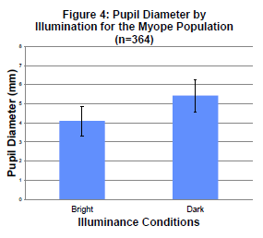
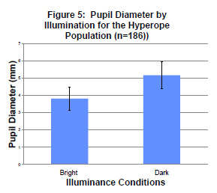
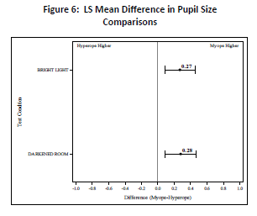
Evaluation of visual performance of a new multifocal contact lens and impact of refractive error Tom Karkkainen, Kurt Moody, Ron Clark, Jasper Xu & Sheila Hickson-Curran Johnson & Johnson Vision Care, Inc.
3 of 4
Figures 4 and 5 summarise measured pupil diameters
Mean pupil diameters for hyperopes (3.82mm ± 0.690, 5.18mm ± 0.785) were smaller than myopes (4.10mm ± 0.768, 5.43 ± 0.841) in both bright and dark.
Figure 6 shows 95% confidence intervals for mean differences in pupil size between two populations at two different light levels. At both light levels measured the difference are statistically significantly different (p<0.05).
Results (continued)

Slide 4
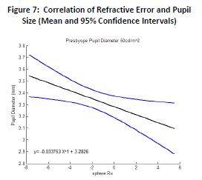

Evaluation of visual performance of a new multifocal contact lens and impact of refractive error Tom Karkkainen, Kurt Moody, Ron Clark, Jasper Xu & Sheila Hickson-Curran Johnson & Johnson Vision Care, Inc.
4 of 4
Discussion
Conclusions
Previous research has shown pupil size impacts performance of multifocal simultaneous vision CLs.
As demonstrated in this study, there are differences in pupil size between refractive groups with hyperopes having smaller pupil sizes than myopes. Additional databases analysed have demonstrated a correlation between refractive error and pupil size (Figure 7).⁴
Taking into account changes in pupil size in the population is an important variable in optical design of multifocal CLs.
1-DAY ACUVUE® MOIST MULTIFOCAL has its optic zone optimised for changes in pupil size that occur across refractive range as well as subjects ADD resulting in 183 unique optical designs.
1-DAY ACUVUE® MOIST MULTIFOCAL delivers a high level of VA as measured by logMAR acuity charts. When comparing VA between two refractive populations, differences was not greater than ≈1.5 letters in any of 3 conditions measured, indicating consistent VA with the MFCL.
A new daily disposable multifocal CL provides a high level of VA at distance, intermediate and near.
VA is similar between the two refractive groups with largest differences measured at any distances tested being approximately 1.5 letters.
Consistency of VA is maintained between refractive groups despite differences in pupil size that could impact multifocal CL performance.
REFERENCES
Benjamin WJ and Borish IM. Presbyopia and the influence of aging on the prescription of contact lenses. In Benjamin WJ, (ed.), Borish’s Clinical Refraction 2nd edition, pp1274-1319. 2006. St. Louis, Butterworth ,Heinemann, Elsevier.
Cakmak HB, Cagil N, Simivali H, Duzen B, Simsek S. Refractive error may influence mesopic pupil size. 2010. Curr Eye Res. 35(2):130-136.
Dumbleton K, Guillon M, Theodoratos P, Wooley B and Moody K. The effects of age and refraction on pupil size and visual acuity. ARVO poster 20115.
JJVC data on file 2010.
CORRESPONDENCE
Johnson & Johnson Vision Care, Inc. 7500 Centurion Parkway, Jacksonville, FL 32256, USA. TKarkkai@its.jnj.com
1-DAY ACUVUE® MOIST MULTIFOCAL and INTUISIGHTTM are trademarks of Johnson & Johnson Vision Care, Inc.

