Slide 1

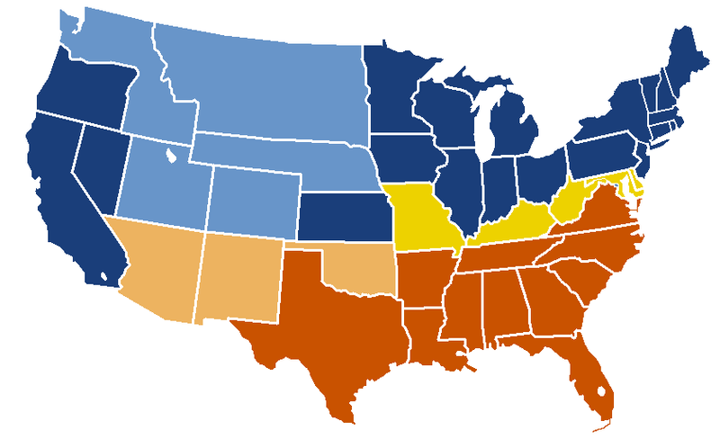

PATIENT PRIORITIES FOR VISION CORRECTION OVER A 25 YEAR PERIOD
The Need for a Health Conversation
Cristina Schnider, OD, MSc, MBA, FAAO, FBCLA Johnson & Johnson Vision Care, Inc.
1 of 3
Background
1998 Survey
Surveys collected from 1165 subjects (age 18-60) from 5 independent practice locations across the US
Subjects asked to pick 3 most & least important items on list of 10
Factors surveyed: Vision, Health of Eyes, Provides Eye Protection, Long Term Comfort, Initial Comfort, Lack of Reliance on a Device, Convenience / Ease of Use, Initial Cost, Maintenance Cost, Controls Nearsightedness
2010 Survey
Market research survey of 3400 vision corrected subjects in US by leading Contact Lens Manufacturer (Johnson & Johnson Vision Care)
Subjects were asked to select their “absolute must haves” from an extensive list of desired attributes.
Attributes that could be selected included various articulations of vision, health, comfort, safety, insurance coverage, vision stabilization and handling features
Eye care practitioners (ECP) are increasingly faced with the dual demands of rendering excellent patient care for their contact lens (CL) wearers, and running a profitable business – goals that can seem at odds with each other at times. We tend to hear from patients about cost, comfort and convenience issues, but rarely receive requests or comments about the health aspects of vision correction options, a factor of key concern to us in our decision making. CL manufacturers have the luxury of conducting large scale interviews of consumers to uncover needs that are both overtly stated, and those that may not even be evident to the person being interviewed, but which can be discerned through statistical analyses. These studies were done to evaluate patient priorities for vision correction and their consistency over time.
Methods
1989 Survey
Surveys returned by 247 subjects (age 18-49) attending university affiliated optometry clinics in Australia and the United States
Subjects asked to rate 7 factors on scale 0 (not a factor) to 5 (essential)
Factors rated: Vision, Health & Safety of Eyes, Long-term Comfort, Initial Comfort, Extended Wear Capability, Convenience of Care, Ease of Handling/Insertion & Removal
1995 Survey
Market research study of 919 vision corrected consumers (18-39) in the US by a global contact lens manufacturer (Ciba Vision)
Subjects rated 31 attributes using a scale 1 (least important) to 10 (most important).
Factors included Safety, Vision, Comfort, Convenience and Cost
©JJVCI, 2015. All rights reserved
Poster first presented at BCLA Conference 2015.

Slide 2
PATIENT PRIORITIES FOR VISION CORRECTION OVER A 25 YEAR PERIOD
The Need for a Health Conversation
Cristina Schnider, OD, MSc, MBA, FAAO, FBCLA Johnson & Johnson Vision Care, Inc.
2 of 3
Results
Results
1989 Survey
1998 Survey
2010 Survey
Feature % “Absolutely Must Have
Best possible vision 56%
No long-term health issues 53%
See effortlessly everywhere 51%
Most comfortable 46%
Best distance vision 44%
Help eyes retain moisture, even after hours of wear 43%
Among lowest risk of infection 43%
Are healthiest for eyes 43%
1995 Survey
©JJVCI, 2015. All rights reserved
Poster first presented at BCLA Conference 2015.

Slide 3
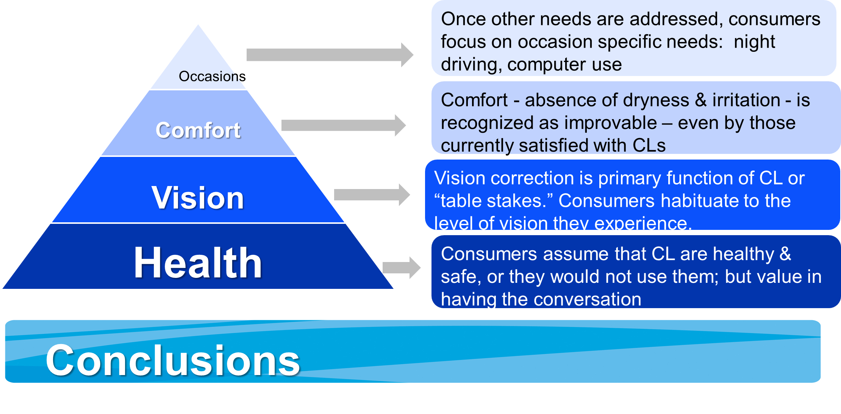
PATIENT PRIORITIES FOR VISION CORRECTION OVER A 25 YEAR PERIOD
The Need for a Health Conversation
Cristina Schnider, OD, MSc, MBA, FAAO, FBCLA Johnson & Johnson Vision Care, Inc.
3 of 3
Discussion
Regardless of country, patient population, survey methodology, time deployed or scale used, health / safety and vision topped the list, with a concern for long-term, sustained comfort following closely behind.
Survey results can be heavily influenced by how questions are presented, and by audience. For example, when the 1989 survey was broken down by soft versus rigid lens wearers, there was a marked difference in the importance of initial comfort, with the rigid lens wearers placing a lower value on it compared to soft lens wearers, based on experience
Attempts were made in later surveys to accommodate all refractive correction options, including spectacles and refractive surgery, as well as overnight wear of contact lenses, yet results remained remarkably consistent.
Expressed in the form of Maslow’s Hierarchy of Needs, Health & Vision are the “food and water”, forming the base of the pyramid
Conclusions
The top priorities for those seeking vision correction were remarkably similar over decades of research using varying populations and level of sophistication in methodology.
This body of work highlights opportunities for engaging patients in a broader conversation about health, an area often overlooked by eye care practitioners
This lack of concordance could be due, in part, to the fact that when visiting the acknowledged ECP - the health care provider for the eyes, the assumption is that vision and health are automatically taken care of, so they speak more about what they can measure (comfort), and see (cost & convenience aspects)
CORRESPONDENCE
Johnson & Johnson Vision Care, Inc.7500 Centurion Parkway, Suite 100/ A-2B, Jacksonville, FL 32256, USA
Email: cschnide@its.jnj.com.
©JJVCI, 2015. All rights reserved
Poster first presented at BCLA Conference 2015.

