Slide 1

The effects of age and refraction on pupil size and visual acuity: Implications for multifocal contact lens design and fitting Kathy Dumbleton¹ Michel Guillon^{1,2} Panagiotis Theodoratos¹ C. Benjamin Wooley³ Kurt Moody³ 1 OCULAR TECHNOLOGY GROUP - International, UK 2 School of Life and Health Sciences, Aston University, UK 3 Johnson & Johnson Vision Care Inc.,FL, USA
1 of 5
Introduction
Efficacy of correction of presbyopia with multifocal (MF) contact lenses (CLs) is contingent on the optimisation of optical designs to meet the specific refractive needs of the patients wearing the lenses.
Pupil size under varying levels of illumination is a key factor to consider in the development of optical designs for presbyopic CL ncorrection and it is widely acknowledged that the size of the pupil can have a significant effect on visual performance.^{1,2}
Several studies have reported a decrease in pupil size with age and determined that age is the strongest patient related determinative factor for pupil size.^{3,4,5}
Evidence in the literature relating to the influence of refractive status is however equivocal, with some studies reporting no significant relationship between refractive error and pupil size,^{5,6} but in other larger studies of refractive surgery candidates the pre-operative refractive status was found to be a determinative factor in pupil size when measured under mesopic conditions.^{7,8}
Until now, no large studies have been conducted in which the effects of age and refractive status on pupil size and visual acuity have been evaluated under different illumination conditions.
The objective of this analysis was to determine the influence of these factors on pupil size and visual acuity in order to make recommendations for MFCL design and fitting.

Slide 2

The effects of age and refraction on pupil size and visual acuity: Implications for multifocal contact lens design and fitting Kathy Dumbleton¹ Michel Guillon^{1,2} Panagiotis Theodoratos¹ C. Benjamin Wooley³ Kurt Moody³ 1 OCULAR TECHNOLOGY GROUP - International, UK 2 School of Life and Health Sciences, Aston University, UK 3 Johnson & Johnson Vision Care Inc.,FL, USA
2 of 5
Materials and Methods
Population
304 subjects: 127 male, 177 female
Age: 39.5 ± 14.2 years (18 to 78 years)
Spherical refractive error: -2.11 ± 2.46 D (-8.10 to +5.00D)
Astigmatism: -0.48 ± 0.46D (0.00 to -3.00D)
Study Design
Non-interventional, retrospective analysis
Routine pre-study screening visits
Normal eyes, other than the need for vision correction
Refraction
Nidek Auto-refractor AF9000
Subjective refinement: cross-cylinder technique with binocular balancing by Humphriss technique⁹
Pupil Measurements
Recording with head mounted eye tracker, infra-red macro video camera (Applied Science Laboratory ) at 3 luminance settings:
250 cd/m² (high luminance ≈ outdoor daylight)
50 cd/m² (medium luminance ≈ indoor evening lighting)
2.5 cd/m² (low luminance ≈ night time driving)
Post hoc measurements of horizontal pupil diameter by masked investigator using SigmaScan™ Pro software
Visual Acuity Measurements
LogMAR visual acuity measurement at two contrasts (90% & 10%) using Guillon-Poling printed charts with 10 letters per line at 4m at three luminance levels (250 cd/m², 50 cd/m2 & 2.5 cd/m²).
Visual Acuity reported in “VA units” = -10 LogMAR
VA 20/20 = 0.0 VA units
VA > 20/20 = VA unit > 0.0 & VA < 20/20 VA unit < 0.0
1 VA line = 1.0 VA unit
1 letter = 0.1 VA unit
Statistics
SPSS 22.0 (IBM UK Ltd.)
Continuous variables checked for normality
Mixed Linear Model (MLM)
Fixed factors: Age, refractive error group, luminance & contrast (VA only)
Repeated factor: Eye
Bonferroni adjustment for post hoc multiple comparisons
Regression Analysis

Slide 3
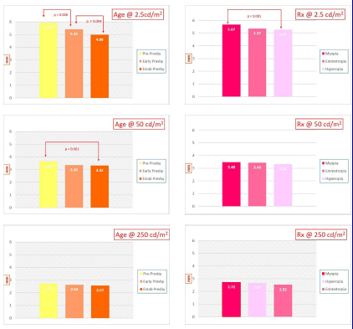
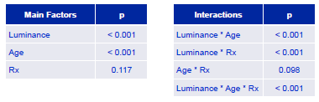
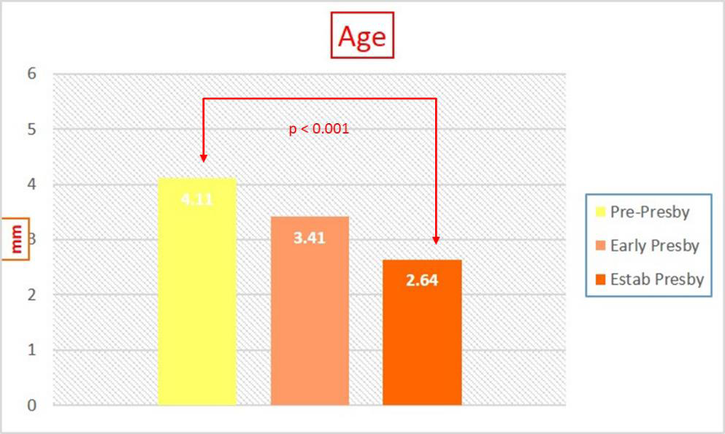
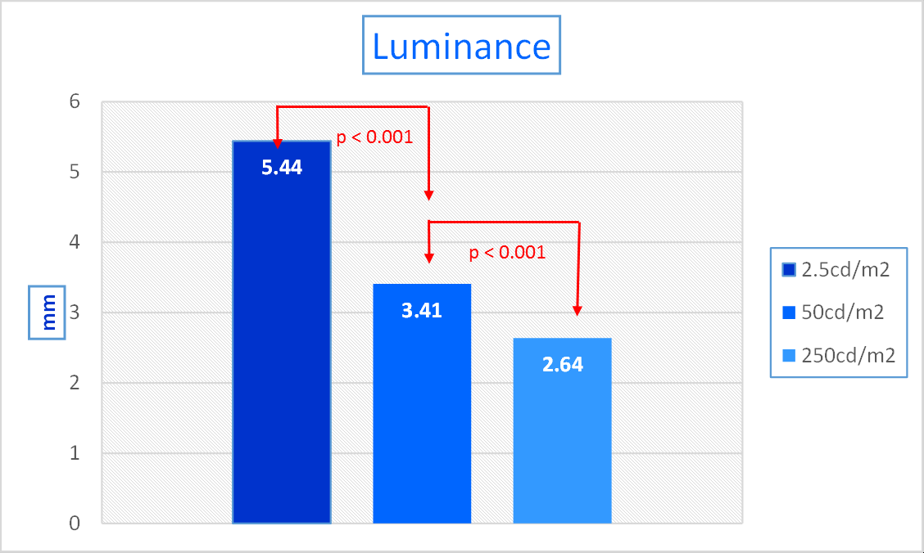
The effects of age and refraction on pupil size and visual acuity: Implications for multifocal contact lens design and fitting Kathy Dumbleton¹ Michel Guillon^{1,2} Panagiotis Theodoratos¹ C. Benjamin Wooley³ Kurt Moody³ 1 OCULAR TECHNOLOGY GROUP - International, UK 2 School of Life and Health Sciences, Aston University, UK 3 Johnson & Johnson Vision Care Inc.,FL, USA
3 of 5
Results - Pupil
MLM – Main Factors and Interactions
Luminance most significant factor (p < 0.001 between all levels)
Age group significant overall, but individual comparisons only between pre-presbyopes and established presbyopes (p < 0.001)
Age difference highly significant at low luminance but no effect at high luminance
Rx difference only significant at low luminance
Regression Analysis
Factors having significant influence (p < 0.001): Lighting Condition, Age, Best Sphere Refraction
Pupil (mm) = 7.748 – 1.514 Lighting Condition* - 0.020 Age (years) - 0.024 Best Sphere (D)
*1 = 2.5cd/mm² / 2 = 50cd.m² / 3 = 250cd/m²

Slide 4
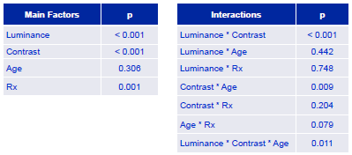
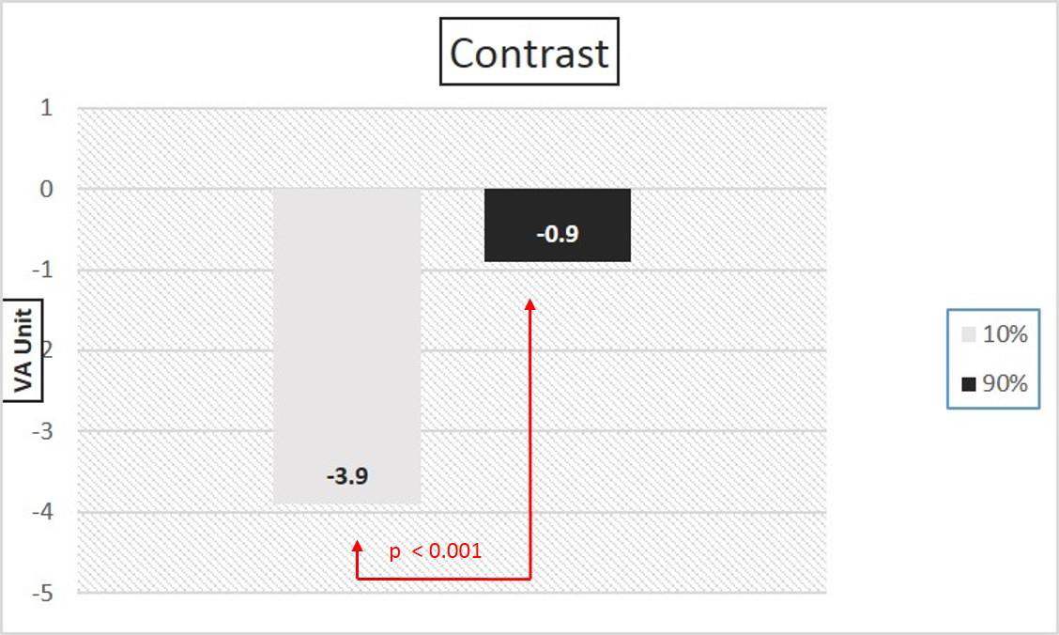
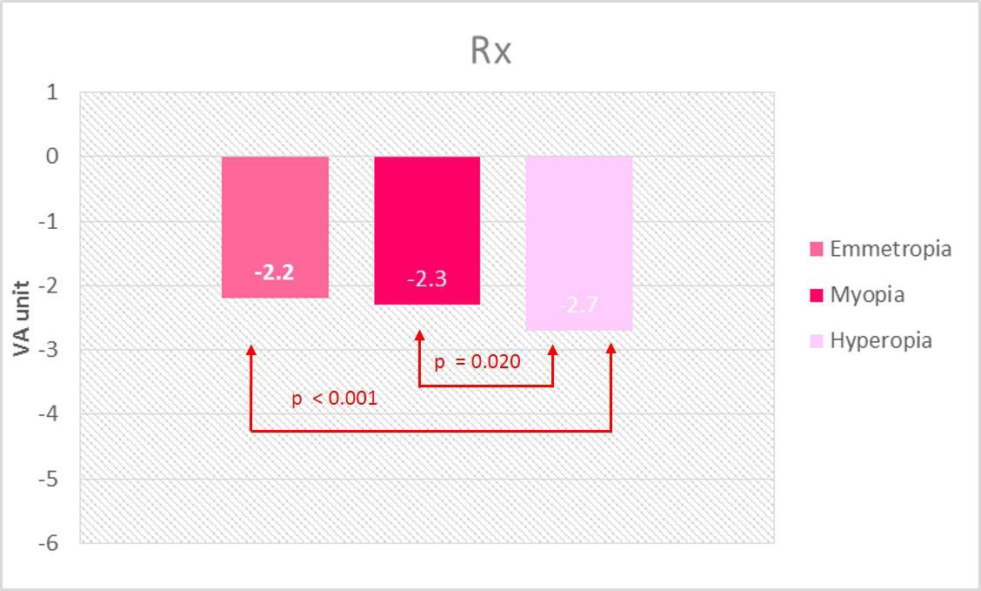
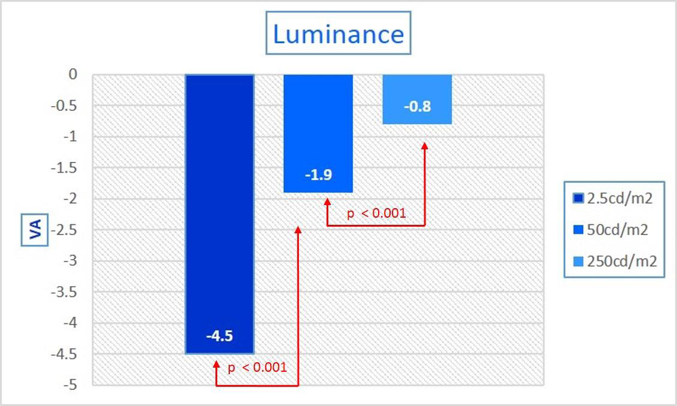
The effects of age and refraction on pupil size and visual acuity: Implications for multifocal contact lens design and fitting Kathy Dumbleton¹ Michel Guillon^{1,2} Panagiotis Theodoratos¹ C. Benjamin Wooley³ Kurt Moody³ 1 OCULAR TECHNOLOGY GROUP - International, UK 2 School of Life and Health Sciences, Aston University, UK 3 Johnson & Johnson Vision Care Inc.,FL, USA
4 of 5
MLM – Main Factors and Interactions
Luminance, Contrast & Rx significant factors
Numerous significant interactions
Luminance effect on VA most evident for night time driving
Contrast most influential factor on VA
VA for hyperopes on average 0.5 line worse than for emmetropes & myopes
Results – Visual Acuity

Slide 5
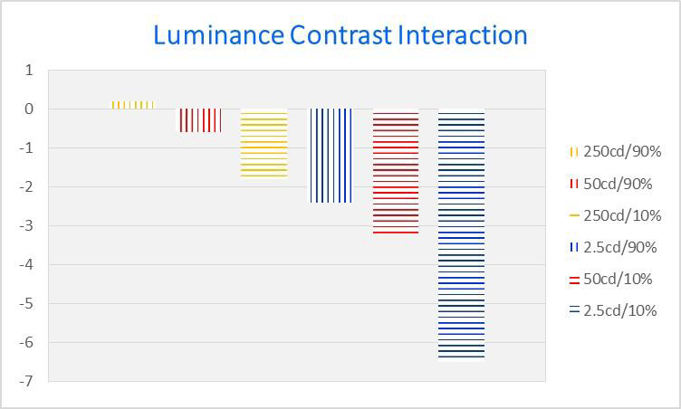
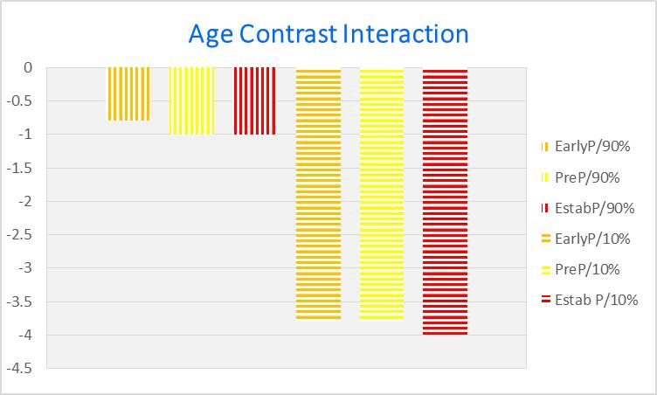

The effects of age and refraction on pupil size and visual acuity: Implications for multifocal contact lens design and fitting Kathy Dumbleton¹ Michel Guillon^{1,2} Panagiotis Theodoratos¹ C. Benjamin Wooley³ Kurt Moody³ 1 OCULAR TECHNOLOGY GROUP - International, UK 2 School of Life and Health Sciences, Aston University, UK 3 Johnson & Johnson Vision Care Inc.,FL, USA
5 of 5
Results – Visual Acuity
Conclusion
Luminance most influential in dictating pupil size with the largest pupil diameters measured at 2.5 cd/m² (night driving condition).
Larger pupils with myopes & younger subjects; most pronounced differences at 2.5 cd/m.
Low luminance influential on VA.
Results of study support need for variations in optical design, other than different near additions, for MFCLs not only according to near ADD power but also based on refractive status. Faster progression from distance to near corrections across optical zone is expected to be required for established presbyopes and hyperopes than for early presbyopes, myopes and emmetropes.
When fitting MFCLs, precise VA measurements should be made, since hyperopes have lower VA and may be more challenging.
Contrast effect greater than luminance effect
Limiting VA testing to high contrast chart overestimates visual performance
Contrast effect greater than age effect
Regression Analysis
Factors having significant influence on VA (p < 0.001): Lighting Condition, Contrast, Age, Best Sphere Refraction
VA = 6.459 – 1.823 Lighting Condition* - 2.975 Contrast** - 0.013 Age (years) - 0.024 Best Sphere (D)
*1 = 2.5cd/mm² / 2 = 50cd.m² / 3 = 250cd/m²
**1 = 90% 2 = 10%
ACKNOWLEDGEMENT
This study was sponsored by Johnson & Johnson Vision Care Inc. USA
REFERENCES
Campbell, F.W. and A.H. Gregory, Effect of size of pupil on visual acuity. Nature, 1960. 187: p. 1121-3.
Woodhouse, J.M., The effect of pupil size on grating detection at various contrast levels. Vision Res, 1975. 15(6): p. 645-8.
Birren, J.E., R.C. Casperson, and J. Botwinick, Age changes in pupil size. J Gerontol, 1950. 5(3): p. 216-21.
Winn, B., et al., Factors affecting light-adapted pupil size in normal human subjects. Invest Ophthalmol Vis Sci, 1994. 35(3): p. 1132-7.
Netto, M.V., R. Ambrosio, Jr., and S.E. Wilson, Pupil size in refractive surgery candidates. J Refract Surg, 2004. 20(4): p. 337-42.
Jones, R., Do women and myopes have larger pupils? Invest Ophthalmol Vis Sci, 1990. 31(7): p. 1413-5.
Cakmak, H.B., et al., Refractive error may influence mesopic pupil size. Curr Eye Res, 2010. 35(2): p. 130-6.
Linke, S.J., et al., Mesopic pupil size in a refractive surgery population (13,959 eyes). Optom Vis Sci, 2012. 89(8): p. 1156-64.
Humphriss, D., Binocular Refraction, in Optometry, K. Edwards and R. Llewellyn, Editors. 1988, Butterworths: London. p. 140-149.

