Slide 1
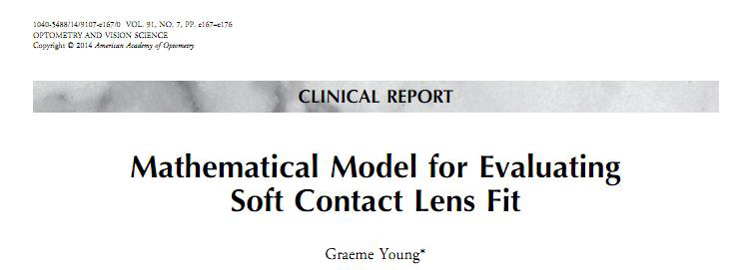


Theoretical Fitting Success Rates for Typical Soft Contact Lens Designs
Graeme Young ¹ Lee Hall¹ Anna Sulley ² Kathrine Osborn Lorenz ³ James Wolffsohn ⁴
1 Visioncare Research Ltd, Farnham, UK 2 Johnson & Johnson Vision Care, Wokingham, UK
3 Johnson & Johnson Vision Care, Inc, Jacksonville, FL, USA 4 Aston University, Birmingham, UK
1 of 5
Introduction
Methods
A recent paper described a spreadsheet mathematical model which can be used to predict the fit of soft lens designs on given corneal topographies.¹ This study evaluated the effect of systematically varying soft lens and ocular topography parameters and provided useful insights into the factors governing soft contact lens (CL) fit.
The model has been improved in two respects:
Separate horizontal and vertical topography
Outputs relating to corneal coverage as well as tightness of fit.
This follow-up study was to evaluate typical soft CL designs using ocular topography data collected from a large population of UK subjects.
The purpose of this study was to calculate theoretical fitting success rates for a range of typical soft CL designs using a mathematical model.
The theoretical fit of typical soft CL designs was evaluated on a large sample of eyes; ocular topography data were used from a previously published study (Hall et al, 2013)² – Table 1.
Table 1: Summary of ocular topography data (N=163); data from Hall et al (2013).²
One eye per subject, spectacle cylinder <2.00D
Ocular variable | Mean (SD) | Median | Range
Apical radius (mm) | 7.78 (0.30) | 7.78 | 7.01 | 8.77
Shape Factor | 0.52 (0.16) | 0.53 | -0.01 | 0.91
Corneal Diameter (mm) | 13.39 (0.44) | 13.4 | 12.10 | 14.41
Corneoscleral Junction (º) | 175.4 (2.3) | 175.4 | 166.2 | 179.7
©JJVCI, 2015. All rights reserved
Poster first presented at BCLA Conference 2015.

Slide 2
Theoretical Fitting Success Rates for Typical Soft Contact Lens Designs
Graeme Young ¹ Lee Hall¹ Anna Sulley ² Kathrine Osborn Lorenz ³ James Wolffsohn ⁴
1 Visioncare Research Ltd, Farnham, UK 2 Johnson & Johnson Vision Care, Wokingham, UK
3 Johnson & Johnson Vision Care, Inc, Jacksonville, FL, USA 4 Aston University, Birmingham, UK
2 of 5
Methods (continued)
Results
A range of 14 representative reusable and daily disposable CL designs was tested (Table 2). Of these, five were available in two base curves (BCs).
The inputs for lens BC and diameter were taken from manufacturer published values while temperature shrinkage factors (room → eye temperature) were measured on actual CLs.³
Success rates were calculated based on the following criteria:
Tightness of fit (i.e. edge strain) falling within the range 0 to 6%. Edge strain is percentage increase in lens edge circumference when fitted to the eye
Horizontal corneal diameter overlap falling within the range 0.2 to 1.2 mm. Overlap is the total amount that the CL overlaps the horizontal cornea when fitted on the eye
For those CLs with multiple BCs, eyes not successfully fitted with the steeper BC were tested with the flatter BC and the aggregate success rates calculated.
A generic monocurve design was also tested for a range of BCs and diameters, using an average model eye.
To evaluate the reliability of the model, theoretical results were compared with actual clinical data from eight previous clinical studies involving nine of the CL types and 1778 subjects. Key variables: i) % eyes reporting frequent/ constant discomfort, ii) % with non-optimal loose fit.
Table 2: Study CLs sorted by shrinkage factor (shaded cells indicate hydrogel CLs)
Lens Code | Daily disposable/ Reusable | Water content (%) | BC (mm) | Diameter (mm) | Shrinkage Factor
A | DD | 46 | 8.50, 9.00 | 14.2 | 0.9969
B | Reusable | 38 | 8.40, 8.80 | 14.0 | 0.9929
C | Reusable | 24 | 8.40, 8.60 | 13.8 | 0.9920
D | DD | 33 | 8.50 | 14.1 | 0.9904
E | Reusable | 36 | 8.60 | 14.0 | 0.9901
F | Reusable | 33 | 8.60 | 14.2 | 0.9870
G | Reusable | 56 | 8.40, 8.80 | 14.1 | 0.9832
H | DD | 56 | 8.60 | 14.1 | 0.9821
I | DD | 54 | 8.40 | 14.2 | 0.9790
J | Reusable | 48 | 8.60 | 14.0 | 0.9786
K | DD | 58 | 8.50, 9.00 | 14.2 | 0.9772
L | DD | 69 | 8.70 | 14.0 | 0.9756
M | DD | 78 | 8.60 | 14.2 | 0.9571
N | DD | 59 | 8.60 | 14.2 | 0.9508
©JJVCI, 2015. All rights reserved
Poster first presented at BCLA Conference 2015.

Slide 3
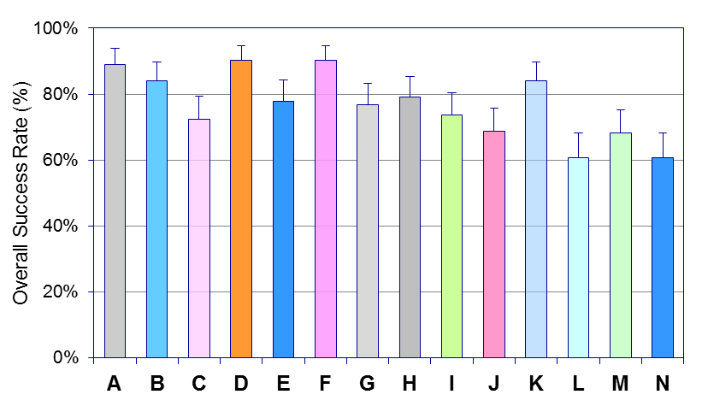
Theoretical Fitting Success Rates for Typical Soft Contact Lens Designs
Graeme Young ¹ Lee Hall¹ Anna Sulley ² Kathrine Osborn Lorenz ³ James Wolffsohn ⁴
1 Visioncare Research Ltd, Farnham, UK 2 Johnson & Johnson Vision Care, Wokingham, UK
3 Johnson & Johnson Vision Care, Inc, Jacksonville, FL, USA 4 Aston University, Birmingham, UK
3 of 5
Results (continued)
Lens | Diameter Success | Small | Large | Tightness Success | Tight | Loose | Overall success | 95% CI
A-2BC | 95.7% | 4.3% | 0.0% | 96.3% | 0.0% | 3.7% | 95.7% | 3.1%
A-St | 92.6% | 3.7% | 3.7% | 93.9% | 4.9% | 1.2% | 89.0% | 4.8%
A-Fl | 84.0% | 16.0% | 0.0% | 77.9% | 0.0% | 22.1% | 70.6% | 7.0%
B-2BC | 90.2% | 9.8% | 0.0% | 95.7% | 0.0% | 4.3% | 90.2% | 4.6%
B-St | 90.2% | 9.2% | 0.6% | 92.0% | 6.7% | 1.2% | 84.0% | 5.6%
B-Fl | 73.0% | 27.0% | 0.0% | 89.6% | 0.0% | 10.4% | 69.9% | 7.0%
C-2BC | 73.0% | 27.0% | 0.0% | 95.1% | 0.0% | 4.9% | 73.0% | 6.8%
C-St | 73.0% | 27.0% | 0.0% | 97.5% | 0.6% | 1.8% | 72.4% | 6.9%
C-Fl | 62.6% | 37.4% | 0.0% | 94.5% | 0.0% | 5.5% | 62.6% | 7.4%
D | 91.4% | 8.0% | 0.6% | 96.9% | 1.2% | 1.8% | 90.2% | 4.6%
E | 78.5% | 21.5% | 0.0% | 95.1% | 0.6% | 4.3% | 77.9% | 6.4%
F | 91.4% | 8.0% | 0.6% | 97.5% | 1.2% | 1.2% | 90.2% | 4.6%
G-2BC | 90.2% | 9.8% | 0.0% | 96.3% | 0.0% | 3.7% | 90.2% | 4.6%
G-St | 90.2% | 9.2% | 0.6% | 85.3% | 14.1% | 0.6% | 76.7% | 6.5%
G-Fl | 73.6% | 26.4% | 0.0% | 90.8% | 0.0% | 9.2% | 71.2% | 7.0%
H | 79.8% | 20.2% | 0.0% | 98.2% | 0.6% | 1.2% | 79.1% | 6.2%
I | 90.8% | 7.4% | 1.8% | 81.6% | 18.4% | 0.0% | 73.6% | 6.8%
J | 69.3% | 30.7% | 0.0% | 95.1% | 0.6% | 4.3% | 68.7% | 7.1%
K-2BC | 90.2% | 9.8% | 0.0% | 95.1% | 0.0% | 4.9% | 90.2% | 4.6%
K-St | 90.2% | 9.2% | 0.6% | 92.0% | 6.7% | 1.2% | 84.0% | 5.6%
K-Fl | 69.3% | 30.7% | 0.0% | 84.7% | 0.0% | 15.3% | 63.8% | 7.4%
L | 62.0% | 38.0% | 0.0% | 92.6% | 0.6% | 6.7% | 60.7% | 7.5%
M | 69.3% | 30.7% | 0.0% | 98.2% | 1.2% | 0.6% | 68.1% | 7.2%
N | 62.0% | 38.0% | 0.0% | 96.9% | 1.8% | 1.2% | 60.7% | 7.5%
Table 3: Summary of theoretical CL fit success rate calculations.
Diameter success based on overlap criteria, tightness success based on edge strain criteria and overall success based on aggregate of both.
Figure 1: Summary of overall success rates for representative CL designs. Only steepest base curve (BC) shown where multiple BCs available
(Error bars indicate 95% confidence intervals)
©JJVCI, 2015. All rights reserved
Poster first presented at BCLA Conference 2015.

Slide 4
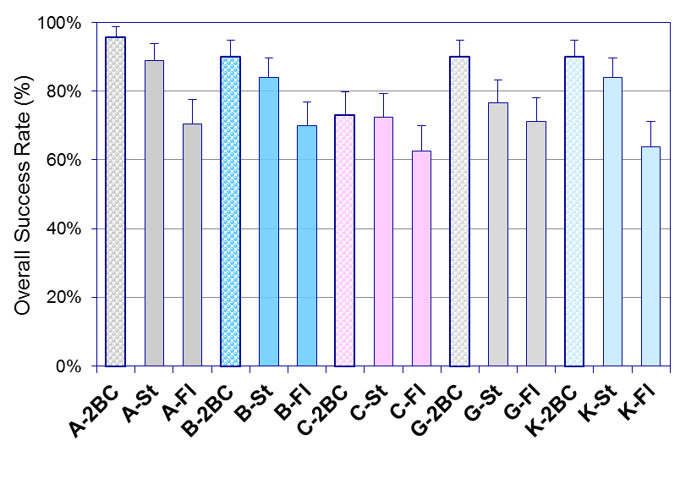
Theoretical Fitting Success Rates for Typical Soft Contact Lens Designs
Graeme Young ¹ Lee Hall¹ Anna Sulley ² Kathrine Osborn Lorenz ³ James Wolffsohn ⁴
1 Visioncare Research Ltd, Farnham, UK 2 Johnson & Johnson Vision Care, Wokingham, UK
3 Johnson & Johnson Vision Care, Inc, Jacksonville, FL, USA 4 Aston University, Birmingham, UK
4 of 5
Results (continued)
For single designs:
Overall success rate ranged from 60.7% (L,N) to 90.2% (D, F) (Fig. 1)
Most common reason for failure, with all but one CL (I), was lens diameter misfit, rather than tightness of fit (Table 3)
Across all CLs, 19.1% were unacceptably small (i.e. corneal overlap <0.2mm); a high proportion of the hydrogel CLs were unacceptably small due to their relatively high shrinkage factors.
With two BCs:
Highest overall success rate was 95.7% (A) (Fig. 2)
Most combinations showed an increase in success rate by using a second BC (e.g. 83.3% → 93.9%)
With one CL type (C), the second BC did not appreciably improve success (73.6% → 74.2%)
For a generic monocurve design
Highest success rate (90.2%) was achieved with an 8.60/14.2mm (BC/diameter) design (Fig. 3); however, this assumed no shrinkage
Figure 2: Summary of overall success rates (SRs) for multiple base curve (BC) designs. Textured bars indicate aggregate SRs for 2 BCs.
(Error bars indicate 95% confidence intervals; ST steep BC, Fl flat BC)
©JJVCI, 2015. All rights reserved
Poster first presented at BCLA Conference 2015.

Slide 5
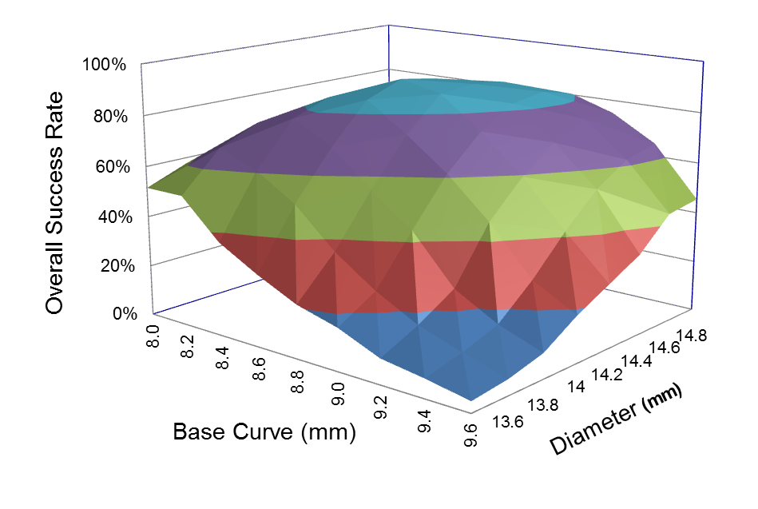
Theoretical Fitting Success Rates for Typical Soft Contact Lens Designs
Graeme Young ¹ Lee Hall¹ Anna Sulley ² Kathrine Osborn Lorenz ³ James Wolffsohn ⁴
1 Visioncare Research Ltd, Farnham, UK 2 Johnson & Johnson Vision Care, Wokingham, UK
3 Johnson & Johnson Vision Care, Inc, Jacksonville, FL, USA 4 Aston University, Birmingham, UK
5 of 5
Results (continued)
Conclusions
Figure 3: Effect base curve & diameter on overall fitting success rate (assumes no shrinkage)
Mathematical modelling allows rapid evaluation of varying soft CL designs and design combinations on a large population sample.
Despite the narrow range of lens parameters, the theoretical success rates showed wide variation (61-90%), for two reasons: i) large variation in shrinkage factor, and ii) importance of selecting the right combination of BC and diameter.
The use of a second BC increased the overall success rate in most (but not all) cases; typically, a second, flatter BC increased the success rate by 7% % suggesting that judicious choice of additional fittings can expand the range of fitting success.
This modelling technique has a number of limitations as it assumes: i) spherical lens profiles, ii) labelled values are correct, iii) no lens decentration, and iv) no variation in fit due to modulus.
Optimum: 8.60/14.2
On comparing results with clinical trial data, there was a positive correlation between theoretical prevalence of small fittings and actual discomfort reports (r=0.896, P<0.01). However, a poor correlation between theoretical and actual tight/loose fittings.
References
Young G. Mathematical model for evaluating soft contact lens fit. OVS 2014; 91:167-76.
Hall L et al. Factors affecting corneoscleral topography. Invest Ophthal Vis Opt 2013; 54:3691-3701.
Young G et al The effect of temperature on soft CL modulus and diameter. ECL 2011; 37: 337-341
©JJVCI, 2015. All rights reserved
Poster first presented at BCLA Conference 2015.

