Slide 1

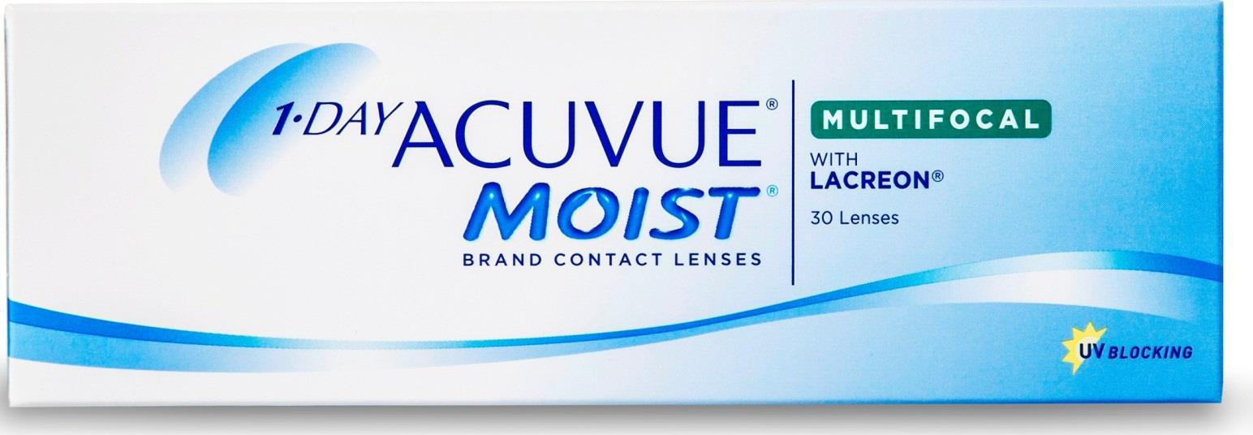

VISUAL ACUITY PERFORMANCE ACROSS DIFFERENT NEAR ADD POWERS WITH A NEW MULTIFOCAL DAILY DISPOSABLE LENS Kurt Moody Tom Karkkainen Ron Clark Jasper Xu Sheila Hickson-Curran Johnson & Johnson Vision Care, Inc.
1 of 4
Background and Purpose
Methods
Contact lens correction for presbyopia has traditionally been challenging. Lenses often require complex fitting and adjustment with varied outcomes. Some lens designs work well for Low Addition (Add) patients, but not as well on Mid or High Add patients. Some lenses are successful for myopic patients, but have lower success on hyperopic subjects.¹
A new soft multifocal contact lens (MFCL) has been designed to address these key issues and provide clear vision across the add and refractive ranges.
1-DAY ACUVUE® MOIST MULTIFOCAL includes:
INTUISIGHT™ centre near aspheric design
Optimised optics based on pupil size across ADD & refractive range²
183 optimised optical powers
Hybrid asphere/sphere back curve for precise centration across most corneal shapes
The purpose of the study was to measure distance (DVA), intermediate (IVA) and near (NVA) with 1-DAY ACUVUE® MOIST MULTIFOCAL across a range of near additions and refractive errors to demonstrate that this MFCL provides clear VA across the ADD and refractive ranges
The fit efficiency (determined by number of lenses used to optimise vision) was also determined.
275 presbyopes were fitted with 1-DAY ACUVUE® MOIST MULTIFOCAL following the fit guide.
21 clinical sites in the USA
Lenses dispensed and worn on a daily disposable basis for up to 12 days
Binocular distance logMAR VA measured using high contrast ETDRS (Early Treatment Diabetic Retinopathy Study) charts
Binocular intermediate (IVA) and near (NVA) VA were measured using reduced Guillon-Poling logMAR charts at 64cm and 40cm respectively.
Data categorized by level of VA achieved
©JJVCI, 2015. All rights reserved
Poster first presented at BCLA Conference 2015.

Slide 2
VISUAL ACUITY PERFORMANCE ACROSS DIFFERENT NEAR ADD POWERS WITH A NEW MULTIFOCAL DAILY DISPOSABLE LENS Kurt Moody Tom Karkkainen Ron Clark Jasper Xu Sheila Hickson-Curran Johnson & Johnson Vision Care, Inc.
2 of 4
Results – Demographics and Visual Acuity
Cohort of 275 presbyopic subjects
77% Female
Age 50 ± 6 years (range 40-67)
All habitual soft CL wearers (any design, material or modality)
Astigmatism <0.75D
181 myopes (plano to -6.00D CL Rx)
94 hyperopes (+0.25D to +4.00D CL Rx)
76 Low Add Subjects (+0.75D to +1.25D)
89 Mid Add Subjects (+1.50D to +1.75D)
110 High Add Subjects (+2.00D to +2.50D)
Overall: Considering full cohort of 275 subjects, 86% attained DVA of 0.0 logMAR or better
Virtually all subjects (97%) attained DVA of 0.1 logMAR or better.
IVA of 0.1 logMAR or better attained by 98% and all subjects (100%) achieved 0.2 logMAR or better
NVA of 0.2 logMAR or better attained by virtually all subjects (95%)
Add group: DVA, IVA and NVA levels were high for virtually all subjects in LOW, MID and HIGH Add groups
Refractive Error: Myopes and Hyperopes each achieved high levels of DVA, IVA and NVA
 | TABLE 1: Proportion of subjects achieving binocular logMAR VA (high contrast, high illumination)
Visual Acuity (logMAR) | Dist. VA ≤0.0 (≥6/6) | Dist. VA ≤0.1 (≥6/7.5) | Intermediate VA ≤0.1 (≥N8@65cm) | Intermediate VA ≤0.2 (≥N10@65cm) | Near VA ≤0.1 (≥N4.5@40cm) | Near VA ≤0.2 (≥N6@40cm)
ALL (n=275) | 86% | 97% | 98% | 100% | 79% | 95%
LOW ADD | 92% | 99% | 99% | 100% | 87% | 97%
MID ADD | 84% | 96% | 99% | 100% | 84% | 97%
HIGH ADD | 82% | 96% | 97% | 100% | 70% | 92%
Myopes | 87% | 98% | 99% | 100% | 84% | 95%
Hyperopes | 82% | 95% | 97% | 100% | 72% | 95%
©JJVCI, 2015. All rights reserved
Poster first presented at BCLA Conference 2015.

Slide 3
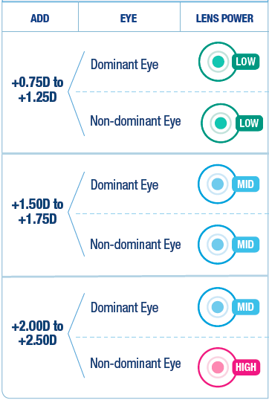
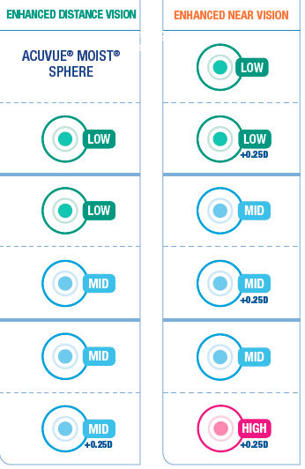
VISUAL ACUITY PERFORMANCE ACROSS DIFFERENT NEAR ADD POWERS WITH A NEW MULTIFOCAL DAILY DISPOSABLE LENS Kurt Moody Tom Karkkainen Ron Clark Jasper Xu Sheila Hickson-Curran Johnson & Johnson Vision Care, Inc.
3 of 4
Results - Fitting
Figure 1: Fit Guide - (Left) starting point of best balance of distance and near - (Right): Modification to Enhance Vision
Following the fitting guide detailed in Figure 1
81% fitted with 3 lenses in total (first pair + one change)
94% fitted with 2 pairs or less (four or fewer lenses in total)
©JJVCI, 2015. All rights reserved
Poster first presented at BCLA Conference 2015.

Slide 4

VISUAL ACUITY PERFORMANCE ACROSS DIFFERENT NEAR ADD POWERS WITH A NEW MULTIFOCAL DAILY DISPOSABLE LENS Kurt Moody Tom Karkkainen Ron Clark Jasper Xu Sheila Hickson-Curran Johnson & Johnson Vision Care, Inc.
4 of 4
Discussion
Conclusions
1-DAY ACUVUE® MOIST MULTIFOCAL is a new daily disposable MFCL option for presbyopic patients. It is designed with patented optics that efficiently distribute the centre near design across the usable pupil zone for each refractive level and add power
Most subjects achieved high levels of VA whether they required a LOW, MID or HIGH near addition.
A large sample of myopes and hyperopes achieved high levels of VA with this new lens. This demonstrates the effectiveness of the optical design which has specific power distribution for each level of refractive error and near addition, based on pupil size.
81% of subjects required 2 or 3 lenses to be fit effectively and virtually all (94%) of the subjects were fit in 2 pairs of lenses or fewer. This represents a very high level of success for a MFCL.
1-DAY ACUVUE® MOIST MULTIFOCAL provides a high level of VA at distance, intermediate and near for subjects across a wide refractive range and who have near Adds from +0.75D to +2.50D.
The high level of visual acuity across the add and refractive range combined with the high fit success rate will make this new MFCL an ideal option for both the presbyopic patient and the clinician.
REFERENCES
Benjamin WJ, Borish IM. Presbyopia and influence of aging on prescription of contact lenses. In Contact Lens Practice: Ruben M & Guillon M ed. Chapman & Hall Medical, London. 1994. pp 763-828.
Wooley B, Karkkainen T. Application of Clinically Developed Eye and Vision Models to Presbyopic Contact Lens Design Optimization. ARVO 2015 POSTER #2173727.
CORRESPONDENCE
Johnson & Johnson Vision Care, Inc. 7500 Centurion Parkway, Suite 100/ W-2B, Jacksonville, FL 32256, USA .
kmoody1@its.jnj.com
Authors are employees of Johnson & Johnson Vision Care, Inc.
1-DAY ACUVUE® MOIST MULTIFOCAL and INTUISIGHT™ are trademarks of Johnson & Johnson Vision Care, Inc.
©JJVCI, 2015. All rights reserved
Poster first presented at BCLA Conference 2015.

