Slide 1
Alternative in the treatment of Neurotrophic Keratopathy
Authours: Stanila Adriana, Stanila D.M., COSTACHE I.
Faculthy of Medicine, University ”Lucian Blaga” Sibiu Ophthalmology Departament, Clinical Hospital, Sibiu
Ocular Surface Research Centre CCSO, Sibiu Romania

Slide 2
Introduction
Neurotrophic keratopathy (NK) is a degenerative disease that occurs as a result of partial or total impairment of trigeminal innervations, leading to the reduction of corneal sensitivity
The use of autologous serum in the form of eye drops can be a treatment for severe ocular surface disorders like neurotrophic keratopathy. The use of the therapeutic contact lenses (TCL) is a good solution also.
Serum is the fluid component of full blood which remains after clotting. It was for the first time described in 1984 by Fox et al. used for kerato-conjunctivitis sicca. It is unpreserved, non-antigenic, it has biomechanical and biochemical properties similar to natural tears.
Therapeutic contact lenses (TCL) were from silicon-hydrogel aproved for therapeutical use
The aim of the study was to show the benefits of treatment with autologous serum and TCL in neurotrophic keratopathy, for persistent epithelial defect.

Slide 3
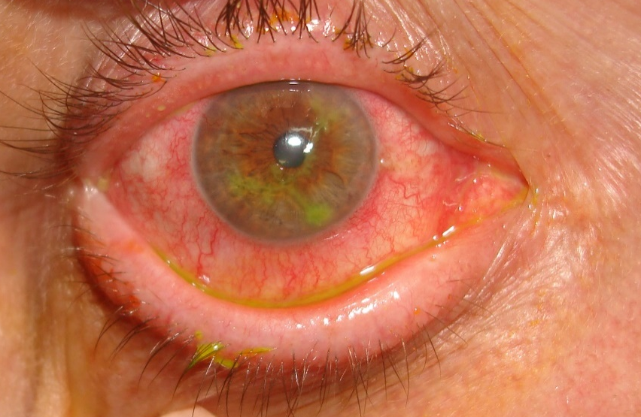
Material and Method
We took in the study a number of 22 cases of NK with persistent epithelial defect treated with autologous serum and TCL together with the usual treatment, in the Department of Ophthalmology in Clinical Hospital Sibiu.
Major causes of NK
Ocular – herpes simplex, herpes zoster, chemical and physical burns, topical anesthetic abuse, ocular surgery, contact lens wear
Systemic – diabetes, neurosurgery, neoplasia, deficit of vitamin A, multiple sclerosis, genetic diseases
In our study there were 18 patients with persistent epithelial defect after herpes simplex, 2 after herpes zoster and 2 after chemical burns; 5 patients from the group were diabetics.
The serum was prepared in the hospital laboratory:
Concentration 20 -100 %
Clotting time prior to centrifugation 0 – 2 days
Duration and force of centrifugation 1500 – 5000 rpm / 5 – 20 minutes
Storage conditions -20 to +4 degrees celsius
Administrated 3-5 times daily, 3-4 weeks.
Herpetic Keratitis

Slide 4
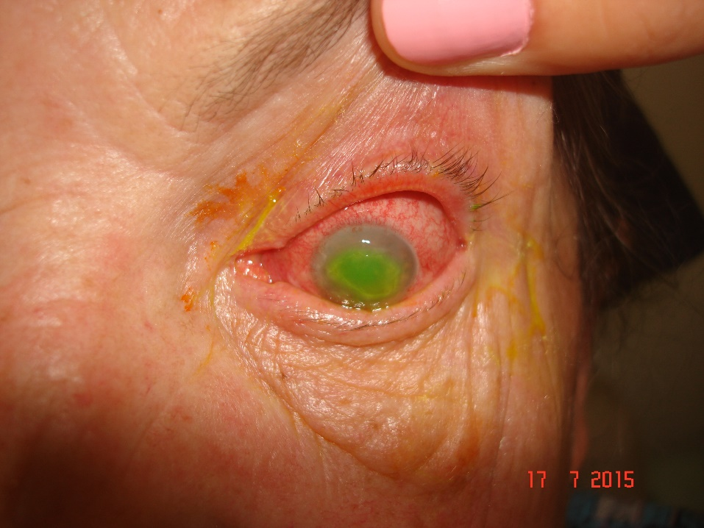
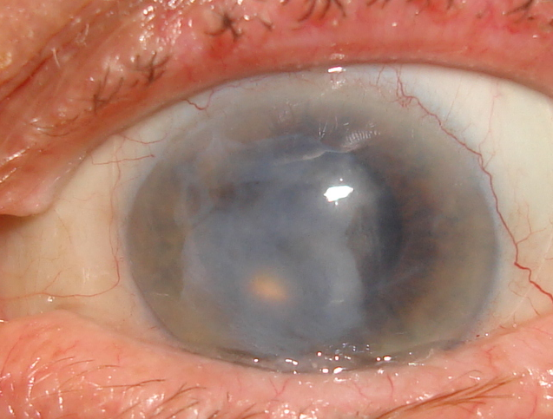
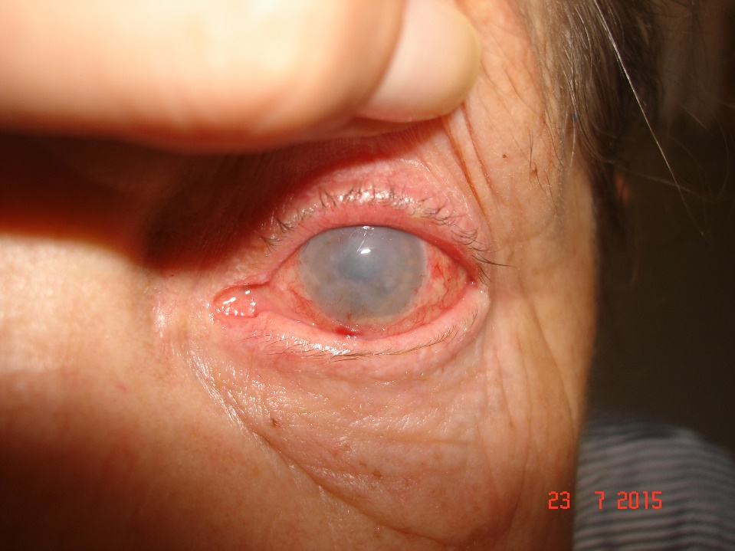
Results and Discussions
In all cases the results were good, the epithelisation of cornea was accelerated.
In some cases the patients lost very soon tcl.
One patient developed a complication, a microbial keratitis
Autologous serum contains epithelio-trophic / modulating factors and promotes growth and migration of ocular surface epithelial cells
NK with persistent epithelial defect
NK with TCL
Microbial keratitis with hypopion

Slide 5
Conclusions
Neurotrophic keratopathy is an orphan disease, very difficult to treat
The treatment of neurotrophic keratopathy is multifactorial
The treatment with autologous serum is benefic
Using TCL is a good solution, but sometimes the patients lost TCL
The danger is to develop a microbial keratitis

