Slide 1
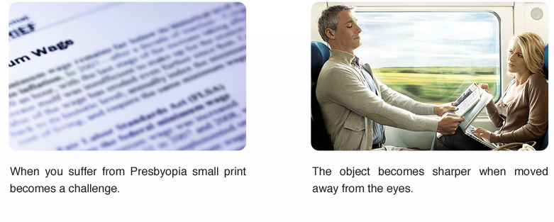
CONTACT LENS OPTIONS FOR PRESBYOPIA IN HYPEROPIC PATIENTS
Authors: Stanila Adriana, Stanila D.M., Costache I.
Faculty of Medicine, University ”Lucian Blaga” Sibiu Ophthalmology Department, Clinical Hospital, Sibiu Ocular Surface Research Centre CCSO, Sibiu Romania

Slide 2
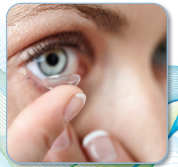
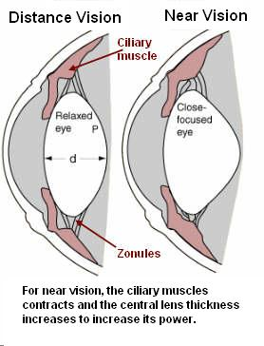
Introduction
Presbyopia is one of the first signs of aging and it has no relation with anterior refractive conditions. The need of glasses for near-vision makes the presbyopes feel old for the first time and sometimes comes like a shock.
Currently presbyopia is explained by the hypothesis of Helmholtz
It says that for distance vision the ciliary muscle relaxes and the zonula becomes tensioned
When the eye accommodates the ciliary muscle contracts, decreasing the tension of the zonula
Lowering the zonular tension in the presence of an elastic lens capsule is followed by lowering of the equatorial diameter and of the radius of the lens both sides curvatures and increasing the central thickness of the lens
The aim of the study is to show different possibilities to correct presbyopia with contact lenses of the hyperopic patients.

Slide 3
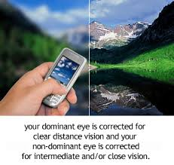
Material and method
We analyzed in our study the possibilities to correct presbyopia in hyperopic eyes with contact lenses.
We used monofocal contact lenses and multifocal contact lenses.
When we used monofocal lenses we fitted the dominant eye for distance and the nondominant eye for near.
This method was well tolerated in the group of young presbyopes aged under 55 years old.
With multifocal contact lenses we tried simultaneous vision but we got to prescribe modified monovision, the dominant eye corrected for distance and nondominant eye with a multifocal contact lens.
Indications to corect hyperopic presbyops with contact lenses:
For people currently wearing contact lenses and becoming presbyops
For simple presbyopes/ hyperops - searching for a mean to keep their active lifestyles at the same level

Slide 4
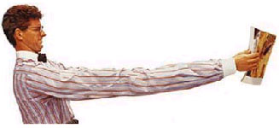
Results and discussions
Monovision is a good solution to correct presbyopia for the hyperopic patients and the best method is with contact lenses.
Nevertheless sometimes monovision patients with CLs needs reading glasses for very fine print or small objects
Monovision = name given to the art of science of fitting contact lenses on a patient with presbyopia
one eye is fit with a distance lens (if needed) and the other eye is fit with a near lens.
when we look into distance – we are using the vision from the dominant eye
our brain pays more attention to the visual information received from the dominant eye.
Monovision works because the brain is tricked into thinking that the CL actually is a part of the natural eye.
Higher benefits in the group of hyperopic patients 45 – 50 years old
Correction of young hyperopic presbyops is better tolerated with multifocal contact lenses in both eyes (simultaneous vision)
Hyperopic presbyops > 50ys – in our opinion, the best solution is monovision correction - correcting the dominant eye for distance and the non dominant eye for near with a multifocal lens
Success rate depends on: previous correction, occupation and motivation

Slide 5
Conclusions
Correcting presbyopia with contact lenses can be both rewarding and challenging.
Monovision is the simplest method to correct presbyopia for the hyperopic patients.
An improved monovision approach is modified monovision with contact lenses.
The degree of difficulty encountered when correcting presbyopia with contact lenses is patient-dependent (motivation, lifestyle) and it’s about selecting a lens type/correction mode that will provide acceptable vision at both distance and near, even if often could be something of a compromise at one distance at least.

