Slide 1
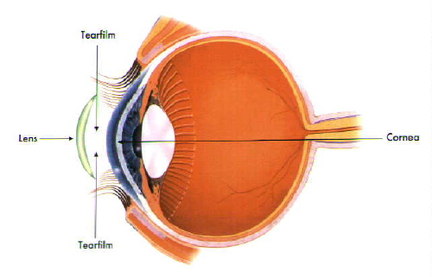
The Use of Therapeutic Contact Lenses in the management of Recurrent Corneal Erosions
Authors: Stanila Adriana, Stanila D.M., Costache I.
Faculty of Medicine, University ”Lucian Blaga” Sibiu
Ophthalmology Department, Clinical Hospital, Sibiu
Ocular Surface Research Centre CCSO, Sibiu
Romania

Slide 2
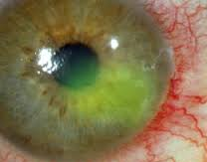
Introduction
Recurent corneal erossion (RCE) syndrome is a condition that is caracterized by a disturbance at the level of the corneal epithelial basement membrane, resulting a poor adhesion and recurent detachement of the epithelium.
Aim of the study
The study intended to reveal the role of the therapeutic contact lenses (TCL) in the management of Recurrent Corneal Erosions (RCE) used as a bandage to protect the corneal skin cells, helping the cornea to heal and reducing the incidence of erosion episodes.

Slide 3
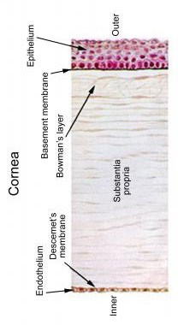
Material, method
We present 20 cases with recurrent corneal erosions where we applied therapeutic contact lenses. All the patients presented acute or subacute symptoms, and shallow corneal injury.
The treatments for recurrent corneal erosion syndrome:
Medical – lubrication: artificial tears, NSAIDs, antibiotic
– bandage contact lense
– combination therapy: oral tetraciclines, topical corticosteroid, lubrication
Surgical – superficial keratectomy
– phototherapeutic keratectomy
Together with the lubrication therapy and sometimes in combination therapy we used to all patients TCL.
In 12 cases we performed also mechanical debridement of the epithelium before aplication of TCL.
Bandage lens treatment was continued 8-16 weeks

Slide 4

Results, discussions
In most of the cases TCL promoted healing, reducing the frequency of applying artificial tears and lubricants, reducing the incidence of new episodes and not the last, improved vision and quality of life of our patients.
Some of the patients used TCL for 2-4 months in order to give the cornea enough time to repair, to facilitate repair of the corneal epithelial basement membrane (EBMD)
New solution in the treatment of RCE can be to polish the Bowman layer with a diamant burr after mechanical debridement and PTK(photo terapeutik keratectomy.)
Persistent use of soft contact lens increases the risk of infections corneal diseases
We had no corneal infections.

Slide 5
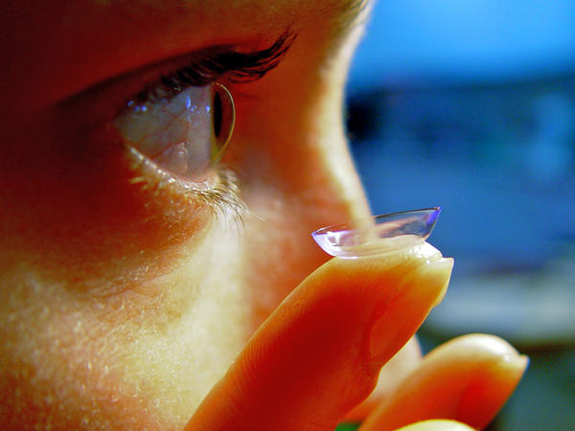
Conclusions
TCL provides good protective effects in corneal erosions, supporting the reepithelization effect, reducing the pain and permitting the binocular vision during the treatment period of time.
TCL is non invazive solution with low cost.
A good quality of life for this pacients.

