Slide 1


CONTACT LENS FITTING FOLLOWING CORNEAL COLLAGEN CROSSLINKING
Betül N. Bayraktutar,MD
Ömür Uçakhan-Gündüz,MD
Department of Ophthalmology,Ankara University Faculty of Medicine
Ankara-TURKEY

Slide 2
Introduction:
Methods:
Corneal collagen crosslinking(CXL) halts the progression of keratoconus by increasing the corneal biomechanical stability.
After CXL, cornea usually flattens and the visual acuity improves to a certain extent. Despite this improvement of patients with keratoconus need a refractive correction, among several alternatives. Contact lenses remain the gold standard in visual rehabilitation of these patients.
Aim; To evaluate different aspects of contact lens fitting following corneal collagen crosslinking (CXL) in keratoconus.
The charts of 105 eyes of 61 patients who were fit with contact lenses following CXL were evaluated retrospectively
The following parameters were noted
UDVA (Uncorrected distance visual acuity)
SCDVA(Spectacle corrected distance visual acuity)
LCDVA(Contact lens corrected distance visual acuity)
Previous refractive correction method
The interval between CXL and contact lens fitting
Contact lens type
Number of trial lenses required for ideal fit
The mean duration of daily wear
Subjective patient comfort
Slit lamp examination findings

Slide 3
Results:
105 eyes, 61 patients
Mean age ; 19.4±4.0 years (15-30 years)
Method of refractive correction before CXL
Interval between CXL and contact lens fit; 6.5±7.1 months (2-36 months)
Topographic K values of patients before CXL and at the contact lens trial
Nothing | RGP | Spectactles | Hybrid contact lens
52 eyes (49%) | 30 eyes (29%) | 21 eyes (20%) | 2 eyes (2%)
<3 month | 3-6 month | >6 month
4 eyes (4%) | 79 eyes (75%) | 22 eyes (21%)
 | <3 month (n=4) |  | 3-6 mont (n=79) |  | >6 month (n=22)
 | Pre-CXL | CL fitting | Pre-CXL | CL fitting | Pre-CXL | CL fitting
K1(D) | 44.9±5.3 | 44.6±5.0 | 47.7±3.9 | 47.3±3.9 | 47.9±6.4 | 47.6±6.6
K2(D) | 48.2±6.9 | 48.6±7.1 | 51.7±4.5 | 51.9±4.4 | 52.4±6.7 | 52.0±6.8

Slide 4
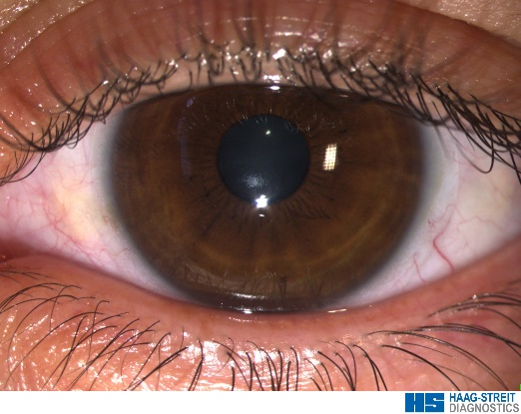
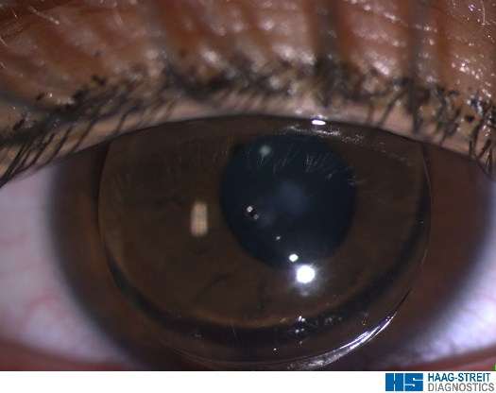
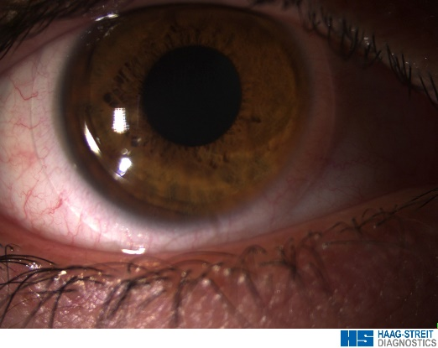
Fitted contact lens types
58 eyes (55%) Rose K2(David Thomas, UK)
12 eyes (12%) Orbiflex K(Swisslens, Switzerland)
19 eyes (18%)Kerasoft 3 (Ultravision, UK)
11 eyes (10%) Purevision 2 for Astigmatism (Bausch&Lomb,USA)
2 eyes (2%)Kerasoft IC (Ultravision, UK)
2 eyes (2%) Soflens toric (Bausch&Lomb,USA)
1 eye (1%) Toris K (Swisslens, Switzerland)
The number of trial lens used for ideal fit was 2.3±1.3 (1-7)
 | Pre-CXL | Post-CXL
BC of ideal RGP(mm) (Diameter:8.7 mm) | 7.0±0.5 | 7.0±0.4
 | Mean UDVA (LogMAR) | Mean SCDVA (LogMAR) | Mean LCDVA (LogMAR)
Post-CXL | 0.98±0.82 (20/200) | 0.21±0.18 (20/32) | 0.03±0.08 (20/22)
Among 105 eyes, 72 eyes continued successfully wearing their lenses with a mean 23.0±12.4 months follow-up (1-48 month)
The mean duration of daily wear;12.8±1.5 hours (9-15 hours)
Patients rated comfort and visual acuity with their contact lenses as "very good" to "excellent," with a desire to continue wearing them
No sight threating complications due to contact lens wear were encountered

Slide 5
Discussion & Conclusion :
CXL improves UDVA and CDVA significantly by flattening the cornea. However additional methods are usually required for the correction of irregular astigmatism due to keratoconus, and contact lenses are the gold standard in this regard.
There is no a consensus for the type of ideal contact lens and the optimal time for contact lens fitting following CXL in the literature.
Few studies report succesful scleral/miniscleral contact lens fit after CXL.
In our study, following CXL, different types of soft and rigid gas permeable contact lenses were fit succesfully starting 3 months after CXL.
In conclusion, contact lenses seem to be safe and effective as a refractive correction method following CXL.
References:
O'Brart DP, Patel P, Lascaratos G et al. Corneal cross-linking to halt the progression of keratoconus and corneal ectasia: Seven year follow-up. Am J Ophthalmol. 2015 [Epub ahead of print]
Wittig-Silva C, Chan E, Islam FM et al. A randomized, controlled trial of corneal collagen cross-linking in progressive keratoconus: three-year results. Ophthalmology. 2014;121:812-21.
Visser ES, Soeters N, Tahzib NG. Scleral lens tolerance after corneal cross-linking for keratoconus. Optom Vis Sci. 2015;92:318-23.
Severinsky B, Wajnsztajn D, Frucht-Pery J. Silicone hydrogel mini-scleral contact lenses in early stage after corneal collagen cross-linking for keratoconus: a retrospective case series. Clin Exp Optom. 2013;96:542-6.

