Slide 1


SOFT CONTACT LENSES
(Air Optix® and Air Optix for Astigmatism®)
IN REFRACTIVE CORRECTION
OF DIFFICULT CASES
Zeynep Bas,MD
Ömür Uçakhan-Gündüz,MD
Department of Ophthalmology,Ankara University Faculty of Medicine
Ankara-TURKEY

Slide 2

The following parameters were noted;
The reason for Air Optix fit
UDVA (Uncorrected distance visual acuity)
CDVA (Spectacle corrected distance visual acuity)
CL-CDVA (Contact lens corrected distance visual acuity)
Keratometry readings
Lens centration, movement and rotational stability
Duration of daily wear
Number of trial lenses required for ideal fit
Subjective patient comfort
Slit lamp examination findings
Aim: To evaluate the visual performance of the Air Optix (Alcon, Switzerland) contact lenses in refractive correction of challenging patients
Methods: The charts of seven patients (thirteen eyes) who were fit with Air Optix (Alcon, Switzerland) contact lenses for the correction of a wide range of refractive disorders were evaluated retrospectively

Slide 3
Results
 | Indications
Keratoconus | 7 eyes of 4 patients (53.8%)
Displaced Apex | 2 eyes of 1 patient (15.3%)
Degenerative Myopia | 2 eyes of 1 patient (15.3%)
Mixed Astigmatism | 1 eye of 1 patient (7.6%)
Amblyopia | 1 eye of 1 patient (7.6%)
Thirteen eyes of seven patients were fit with the Air Optix and Air Optix for Astigmatism contact lenses.
The mean age was 27.0±6.8 years (19-38 years).
The mean follow-up was 31.4±24.2 months (2-67 months).
The number of trial lenses required for ideal fit was 1.3±0.7 lenses.
Mean keratometry reading was 46.6 ± 3.09 D.
Visual Acuity
Mean UDVA | 0.90 ± 0.66 LogMAR
Mean CDVA | 0.07 ± 0.12 LogMAR
Mean CL-CDVA | 0.06 ± 0.16 LogMAR

Slide 4
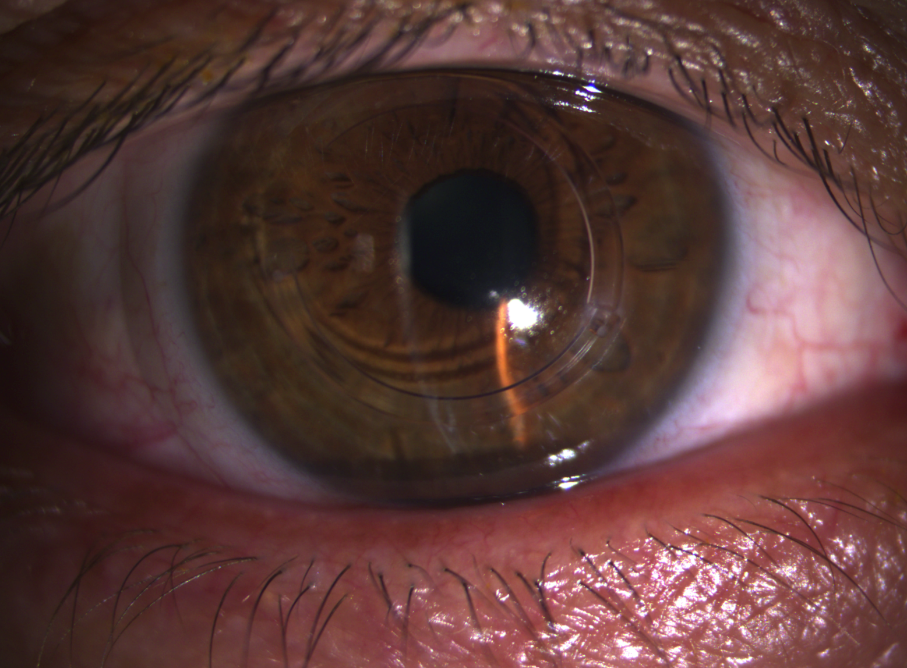


Results
With contact lens wear, improvement in visual acuity was accomplished in 3 eyes of 3 patients (2 to 5 Snellen line) compared to spectacles alone.
In 3 patients 5 eyes, contact lenses are preferred because of anisemetropia.
The duration of daily wear was between 6-12 hours.
The contact lenses exhibited “very good to excellent” centration and movement in all patient eyes at the last follow up examination.
The rotational stability was ”excellent” in all patient eyes.
No vision threatening side effects were encountered.
At the last follow-up examination, patients rated comfort and visual acuity with their contact lenses as "very good" to "excellent" with a desire to continue wearing them.

Slide 5

Discussion & Conclusion
In our study, in a wide range of refractive disorders, Air Optix and Air Optix for Astigmatism CL were fit succesfully in all patient eyes. In selected patients with keratoconus, high astigmatism and degenerative myopia, soft spherical and toric contact lenses may provide adequate visual correction with comfortable day-long wear.
In refractive correction of difficult cases, Air Optix contact lenses seem to be a useful alternative before more sophisticated modalities are tried.

