Slide 1
Aphakic Contact Lens Rehabilitation
on Microphthalmic Eyes
Ahmet T. Ozmen, Ilker Incebıyık, Basak Can, Meral Yıldız
Uludag University, Department of Ophthalmology
Bursa / Turkey
No financial disclosure

Slide 2
PURPOSE
To evaluate outcomes and complications of silicone elastomer contact lens fitting for rehabilitation of aphakia following cataract surgery, on eyes with microphthalmia and congenital cataract.
MATERIALS AND METHODS
Retrospectively, we analyzed 10 eyes of 6 patients (4 girls, 2 boys) with microphthalmia, who underwent congenital cataract surgery and later on fitted successfully with silicone elastomer contact lenses (SilSoft® Super Plus, Bausch + Lomb). Refraction values, best-corrected visual acuities were recorded and complications of contact lens rehabilitation were evaluated for each subject.

Slide 3
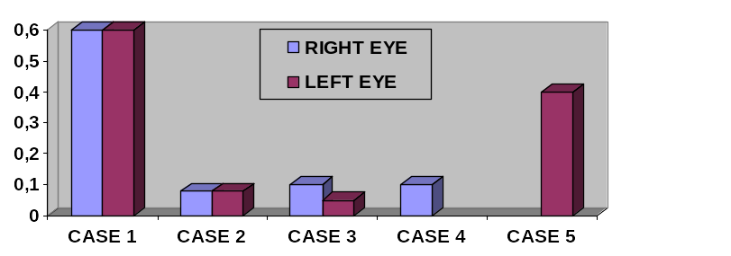
RESULTS
Mean age of the patients: 8 (range: 4-15) years
Mean corneal diameter of the eyes: 9.58 (range:9.5-10) mm
Mean axial length: 17.41 (range: 15.31-18.64) mm
Mean age at the time of contact lens fitting: 11.8 (range: 3-24) months
Mean power of the contact lenses: 26.1 (range: 17-32) diopters (D)
Best-corrected visual acuities (BCVA) improved after contact lens rehabilitation. Mean BCVA: 0.25 (range: counting fingers at 5 meters- 0.6) on Snellen chart. (Figure 1)
Mean follow-up period of contact lens fitting was 4.16 (range: 1-7) years
Other than simple bacterial conjonctivitis succesfully treated with antibiotherapy, no serious complications regarding contact lens usage were observed.
Figure 1 - BCVA after fitting with silicone elastomer contact lenses.(Due to mental retardation of one case, visual acuity testing was not possible.)

Slide 4
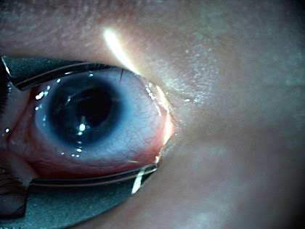
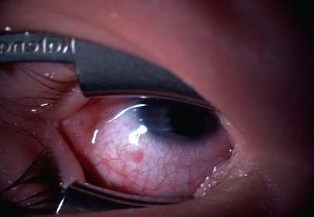
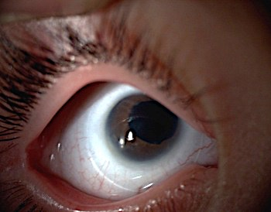
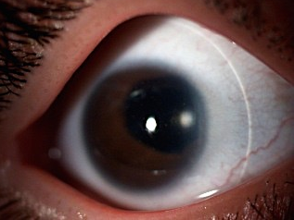
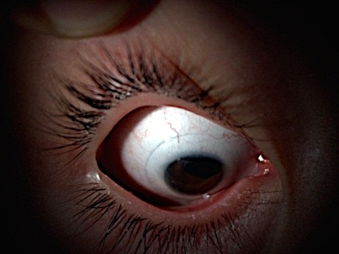
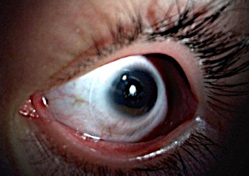
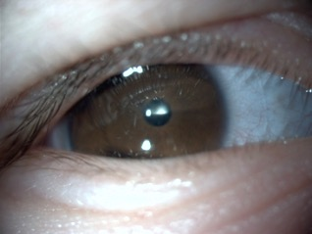
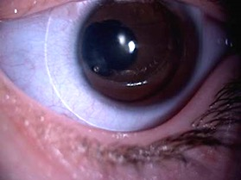
Right
Silsoft Super Plus
Power: +29.00 D.
B:C: 7.5 mm
Diameter:11.3 mm
Left
Silsoft Super Plus
Power: +29.00 D.
B:C: 7.5 mm
Diameter:11.3 mm
Right
Left
Figure 2. Well-fitting silicone elastomer lenses of our microphthalmic aphakic 3 year--old patient.
Figure 1. Both eyes of 3 month-old-baby fitted with aphakic silicone elastomer lenses short after cataract surgery.
Left
Silsoft Super Plus
Power: +29.00 D.
B:C: 7.5 mm
Diameter:11.3 mm
Right
Silsoft Super Plus
Power: +23.00 D.
B:C: 7.5 mm
Diameter:11.3 mm
Left
Silsoft Super Plus
Power: +23.00 D.
B:C: 7.5 mm
Diameter:11.3 mm
Right
Silsoft Super Plus
Power: +29.00 D.
B:C: 7.5 mm
Diameter:11.3 mm
Figure 3. Successful fitting of aphakic silicone elastomer lenses, same patient after 7 years.
Figure 4. Successful fittingof aphakic silicone elastomer lenses, same patient after 4 years.

Slide 5
CONCLUSION
A secure adult-size intraocular lens implantation on microphthalmic eyes is not always technically feasible or may lead to further complications afterwards.
We believe, aphakic contact lenses may be a safer option than intraocular lens implantation for optical rehabilitation of microphthalmic aphakia.

