Slide 1

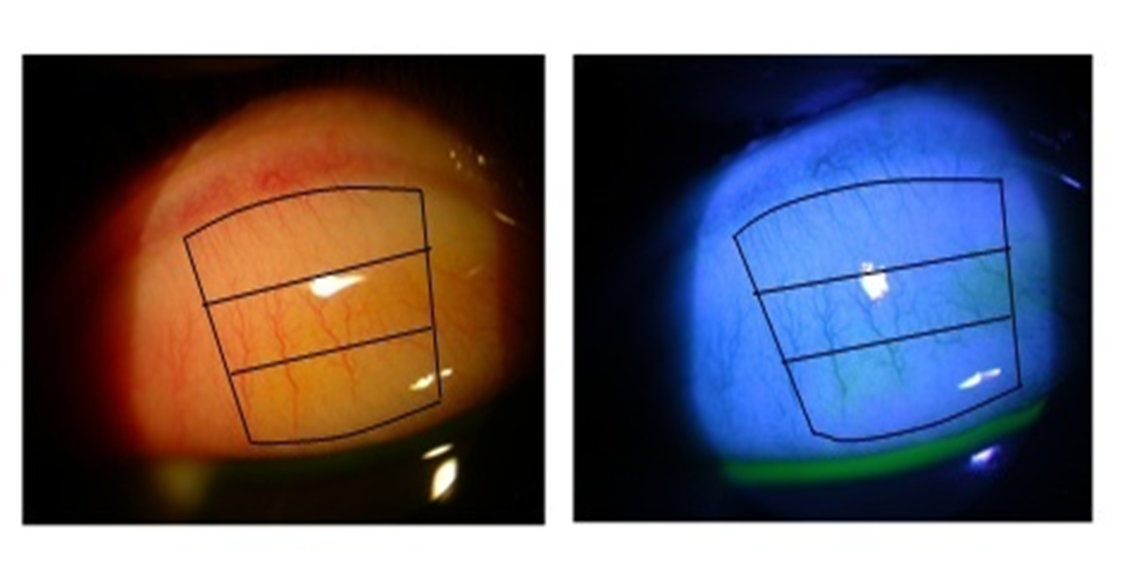
TARSAL GRADING AND CONJUNCTIVA IMPRESSION CYTOLOGY ON RIGID GAS PERMEABLE CONTINUOUS WEAR (RGPCW) CONTACT LENS WEARERS ISHAK B., MOHD ALI B., MOHIDIN N. University Kebangsaan Malaysia, Kuala Lumpur, MALAYSIA
Introduction
◘ Tarsal conjunctiva is in constant rubbing with the surface of contact lens. Changes in tarsal conjunctiva such as in appearance and morphology cells can occur secondary to CL wear (Allansmith et al.1997, Begley et al. 1990).
◘ Aakre et al. (2004) had reported that the contact lens induced papillary conjunctivitis increased in contact lens wearers.
◘ Tarsal grades were found to be higher in contact lens wearers compared to non-contact lens wearers (Anshu et al. 2001).
◘ Control group consists of 47 non-CL wearers.
◘ The examination of tarsal appearance and morphological changes of tarsal cells were carried out on RE only at 0 and 6-month of RGPCW contact lens wear.
◘ Tarsal conjunctiva photos were graded for roughness and redness in 3 separated zones, using IER grading scale (1997) interpolated into 0.1 increments. Photos of the tarsal conjunctiva were taken by using Camera Nikon Coolpix 4500 attached to Topcon SL 3F Slit Lamp (Fig 1). The degree of redness and roughness observed in each of the 3 zones were graded. The average grade for each zone and overall tarsal conjunctiva grade were calculated.
Fig 1: Three zones of tarsal conjunctiva under white light (left)
and cobalt-blue illumination (right)
Objective
To determine any changes in tarsal conjunctiva after 6 months continuous wear (CW) of rigid gas permeable (RGP) contact lens through tarsal and conjunctival impression cytology grading.
Zone 3
Zone 3
Zone 2
Zone 2
Methodology
◘ A group of 45 subjects aged between 19-23 years old were prescribed with RGPCW Menicon Z-alpha® lens and were asked to wear the CL in continuous basis for 6 months. They were selected based on the pre-set criteria: (i) TBUT in normal range (ii) Not wearing CL (iii) No history of systemic/ocular disease (iv) No clinical significant of conjunctiva disease
Zone 1
Zone 1

Slide 2
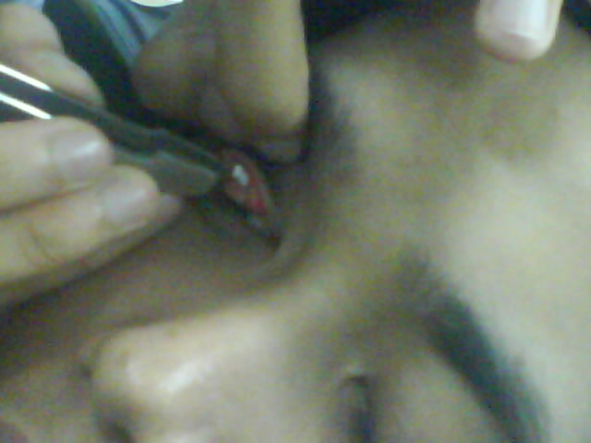
Methodology
◘ Conjunctival impression cytology technique was carried out to observe the changes on surface of tarsal conjunctiva. The technique was performed by applying 3 x 4mm cellulose acetate paper on the tarsal conjunctiva (Fig 2).
Table 1 : Saini grading scale (Saini et al. 1990)
Results
◘ Table 2 showed the distribution of subjects according to race and gender. Majority of the subjects were female and almost 70% of RGPCW lens wearers were Chinese.
Table 2: Distribution of subjects according to race and gender
◘ Table 3 showed the average grades for the redness and roughness of tarsal conjunctiva surface. The redness and roughness grades were averaged from the three different zones.
Table 3: Average grade for the redness and roughness of tarsal conjunctiva surface
Fig 2: Impression was done in few different areas on upper palpebral conjunctiva
 | Male n (%) | Female n (%) | Total n (%)
CL wearers : Malay Chinese | 1 (2.9) 5 (14.7) | 10 (29.4) 18 (52.9) | 11 (32.4) 23 (67.7)
Control : Malay Chinese | 7 (14.9) 7 (14.9) | 19 (40.4) 14 (29.8) | 26 (55.3) 21 (44.7)
◘ The cells were stained with Giemsa, Hematoxylin & Eosin and Periodic Acid Schiff. Later, the cells were examined under light microscope and photo documented. The cytology was graded following Saini grading scale (1990) (Table 1).
Grade | Explanation
I II III IV | Small round epithelial cells with a nucleus to cytoplasm ratio 1:2. Large number of deeply stained goblet cells (PAS positive). A good confluent sheet of cells was usually obtained. A good cell sheet consisting of larger polygonal epithelial cells with decreased nucleus to cytoplasm ratio 1:3. Goblet cells were slightly reduced in number but still deeply stained with PAS. Larger polygonal epithelial cells with further decrease in nucleus to cyto ratio. A reduced number of goblet cells, often with reduced staining. Larger polygonal epithelial basophilic cells with pyknotic nuclei. Intracellular keratin often demonstrable. Absent goblet cells. Often only few loose clumps of cells were obtainable.
 | 0 month | 6 month
CL wearers : Redness Roughness Control : Redness Roughness | 0.92 ± 0.18 1.02 ± 0.27 0.94 ± 0.24 1.02 ± 0.33 | 0.97 ± 0.18 1.10 ± 0.28 0.95 ± 0.23 1.04 ± 0.32

Slide 3
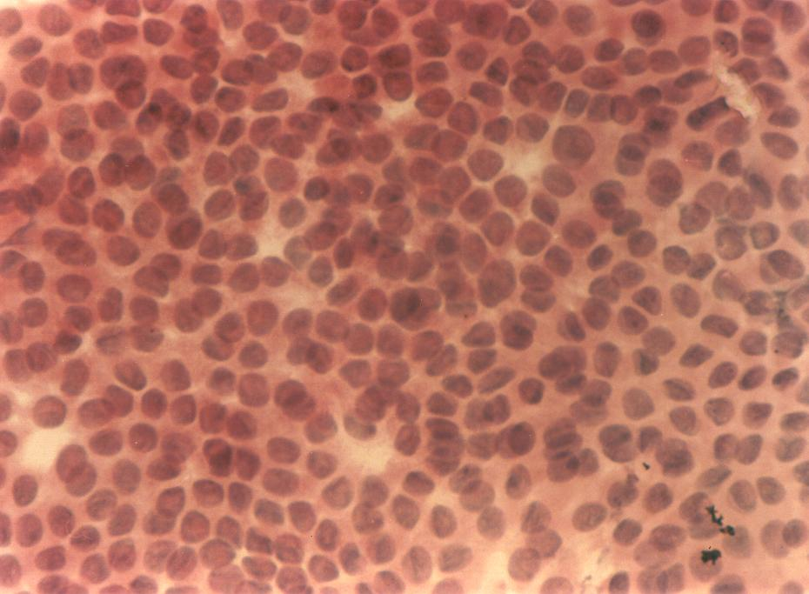
Results
◘ There were no significant difference in tarsal redness (Mann-Whitney, p = 0.803) and roughness grades (Mann-Whitney, p = 0.871) at 0-month between the two groups.
◘ Repeated measurement showed significant differences in tarsal redness (Wilcoxon Signed Ranks test, Z = -3.860, P < 0.001) and roughness (Wilcoxon Signed Ranks test, Z = -3.414, P = 0.001) after 6 months of RGPCW lens wear. However the tarsal grades ≤ 2.0 unit were considered to be in normal scale based on IER grading scale.
◘ All RGPCW lens wearers and control subjects presented grade I of Saini grading scale (good confluent sheet of cells) at baseline and 6-month of wearing the lenses when examined with conjunctiva impression cytology.
Discussion
◘ The tarsal grading was not analyzed according to races because earlier study had showed that no significant difference between the tarsal redness and roughness in normal Malay and Chinese subjects (Ishak et al. 2011).
◘ All the subjects had tarsal conjunctiva grade ≤ 2.0 units at baseline and 6- month of wearing the contact lens. According to IER (1997), tarsal conjunctiva surface with ≤ 2.0 units was considered normal.
◘ The increment of tarsal grades were less than 0.1 unit at 6-month of RGPCW lens wear. According to Cardona & Seres (2009), only a change in grade ≥ 0.5 units would represent a significant difference.
◘ Impression cytology technique may prove useful in understanding ocular surface health and disease in contact lens wear.
◘ Ishak et al. (2012) had reported 91% of 3-month RGPCW lens wearers had demonstrated grade I features while this study showed 100% subjects had grade I after 6 months wearing the RGPCW lens.
Fig 3: Good confluent sheet of cells (Saini’s grade I), stained with H&E at 400x magnification.
Conclusion
◘ The RGPCW contact lens wear for 6 months did not cause any significant clinical changes on tarsal conjunctiva appearance and cell morphology.
◘ Fig 3 showed a normal epithelial cells stained with Hematoxylin & Eosin in one of the RGPCW lens subject. All subjects presented healthy conjunctival epithelial cells during 6 months wearing the RGPCW contact lenses.

Slide 4
References
Aakre, B.M., Ystenaes, A.E., Doughty, M.J., Austrheim, O., Westerfjell, B. & Lie, M.T. 2004. A 6-month follow up of successful refits from daily disposable soft contact lenses to continuous wear of high-Dk silicone-hydrogel lenses. Ophthalmic Physiol. Opt. 24(2): 130-41.
Anshu, Munshu, M.M., Sathe, V. & Ganar, A. 2001. Conjunctival impression cytology in contact lens wearers. Cytopathology 12: 314-320.
Allansmith, M.R., Korb, D.R., Greiner, V.J., Henriquez, A.S., Simon, M.A., Finnemore, V.M. 1997. Giant Papillary Conjunctivitis in Contact Lens Wearers. Am J Ophthalmol 83:697-708.
Begley, C.G., Riggle, A., Tuel, J.A. 1990. Association of giant papillary conjunctivitis with seasonal allergies. Optom Vis Sci 67:192-195.
Cardona, G. & Seres, C. 2009. Grading contact lens complications: The effects of knowledge on grading accuracy. Curr Eye Res. 12: 1074-1081.
IER. 1997. IER grading scales in contact lens. Fourth Edition. Appendix D:863-867.
Ishak, B., Mohd Ali, B. & Mohidin, N. 2011. Grading of tarsal conjunctiva of young adults in Malaysia. Clin. Exp. Optom. 94(5): 458-463.
Ishak, B., Mohd Ali, B. & Mohidin, N. 2012. Impression cytology in rigid gas permeable contact lens wearers. Int. J. of Coll. Research on Internal. Med. & Public Health 4(4): 423-430.
Saini, J.S., Rajwanshi, A. & Dhar, S. 1990. Clinicopathological correlation of hard contact lens related changes in tarsal conjunctival by impression cytology. Acta Ophthalmol (Copenh). 68(1): 65-70.
Thank You

