Slide 1
Discussion practicum 1
Arnoud Boot
Juli 11th 2020

Slide 2
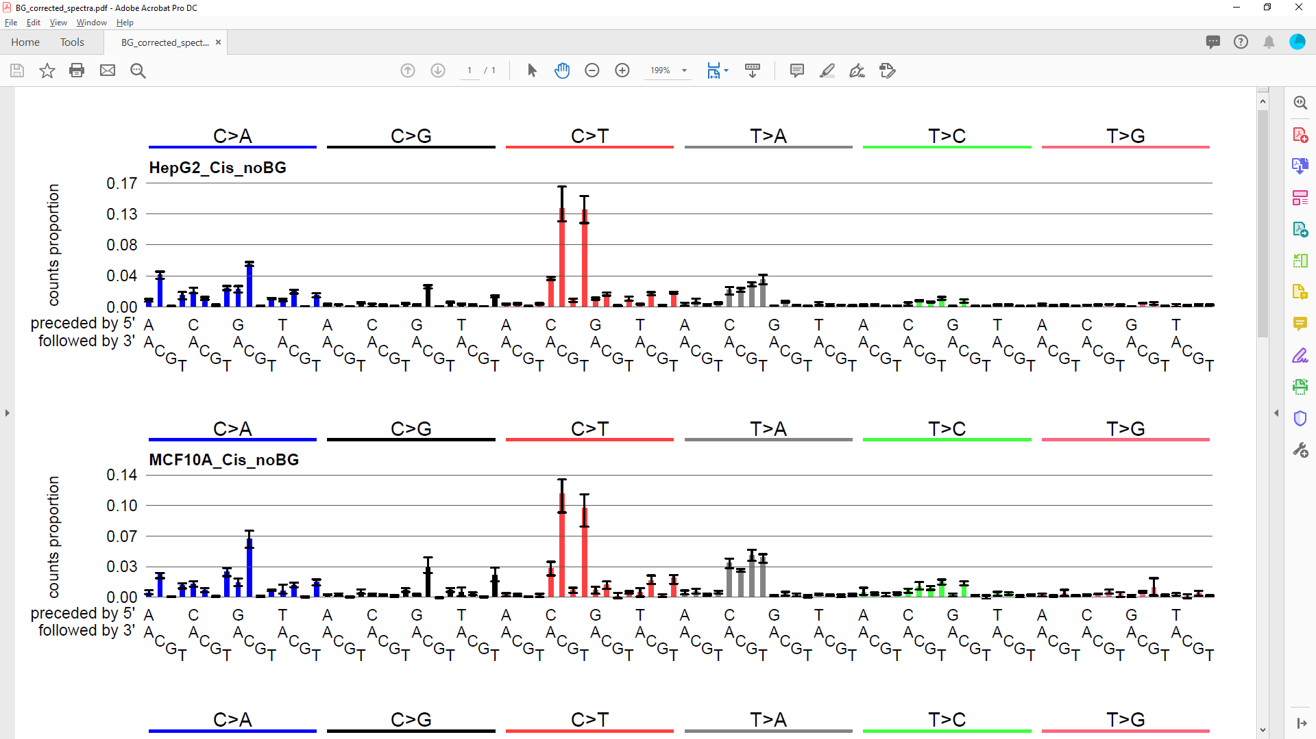
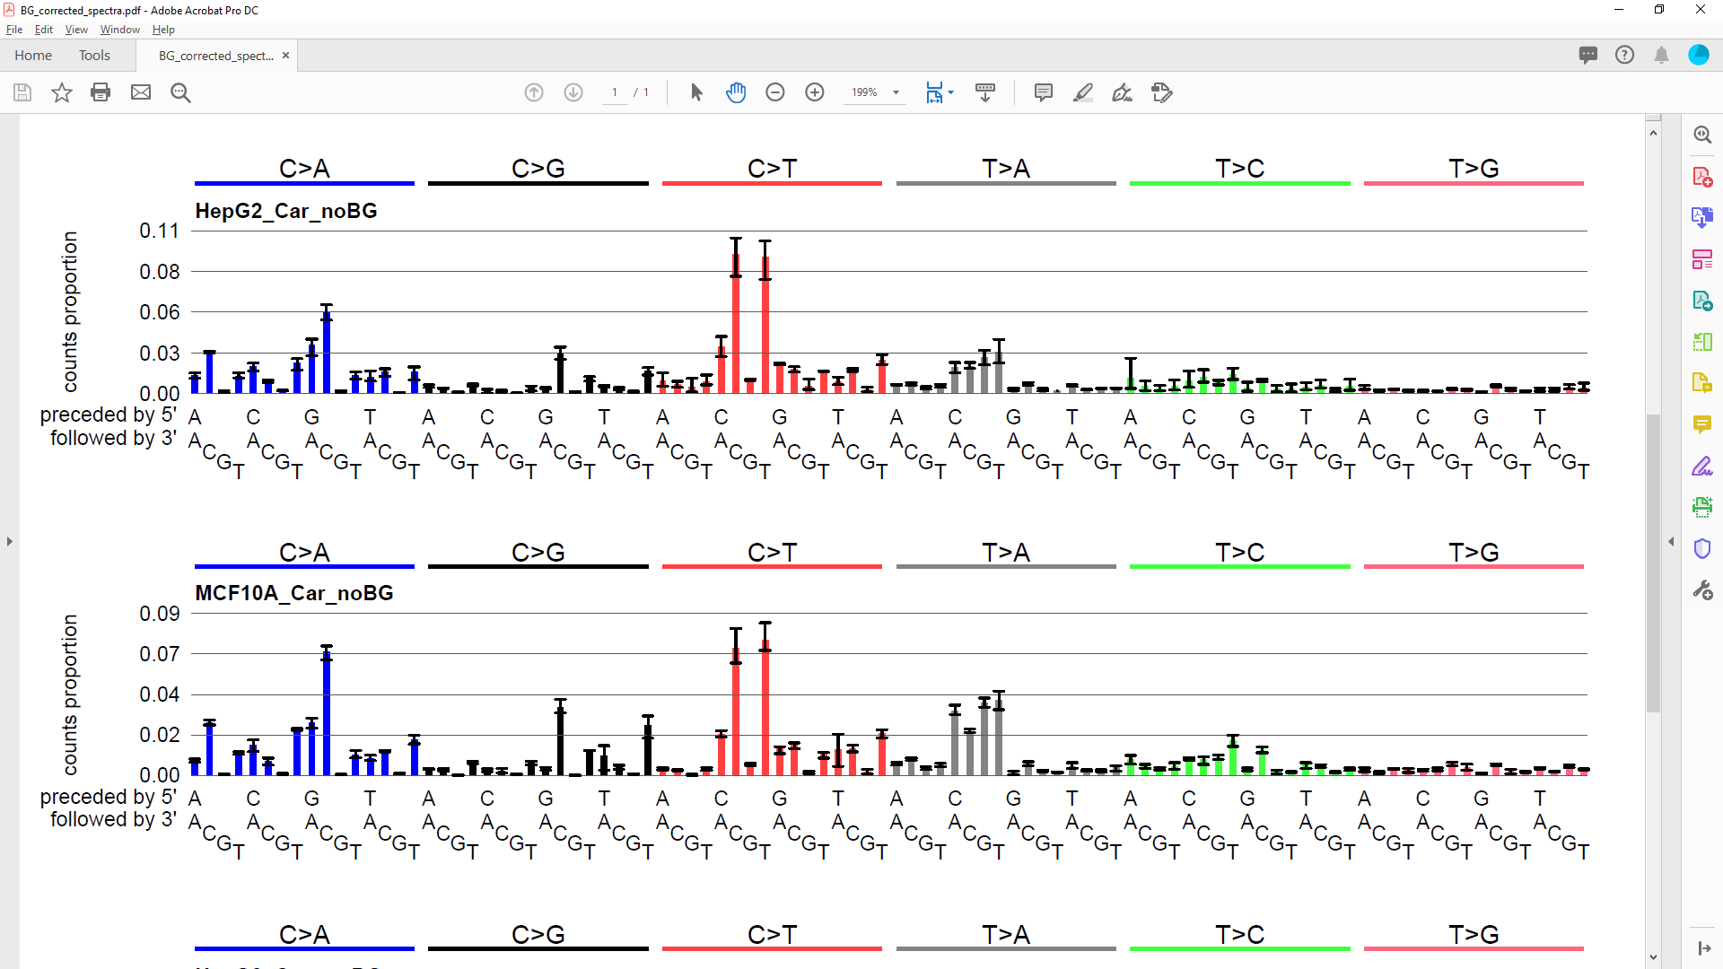
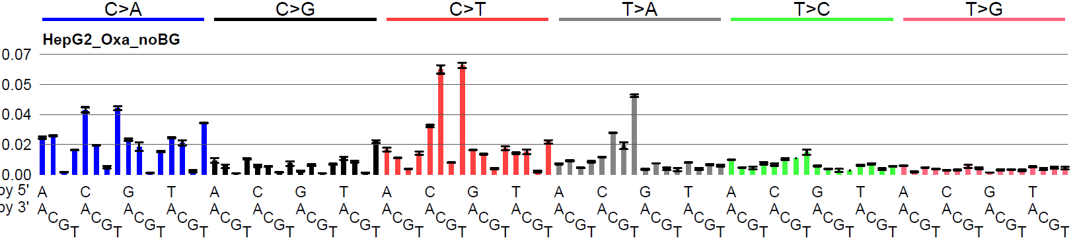
Closing remarks: Cell line specific differences

Slide 3
Closing remarks: Cell line specific differences
HepG2 shows less T>A relative to C>T

Slide 4
Closing remarks: compound specific differences
HepG2 shows less T>A relative to C>T
Carboplatin causes less C>T than cisplatin

Slide 5
Closing remarks: compound specific differences
HepG2 shows less T>A relative to C>T
Carboplatin causes less C>T than cisplatin
Oxaliplatin is clearly different

Slide 6
Closing remarks: Using experimental data to verify signatures
The PCAWG analysis had no information on chemotherapeutic treatment
Alexandrov et al., Nature, 2020

Slide 7
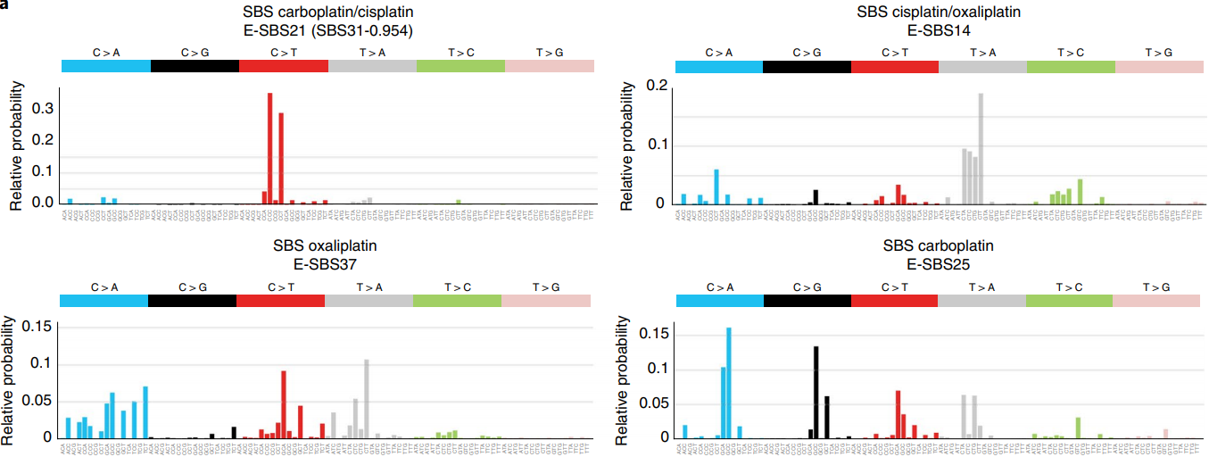
Closing remarks: Using experimental data to verify signatures
NMF on > 3500 metastatic tumors with treatment information gave 4 platinum signatures
Pich et al., Nat.Genet, 2019

Slide 8
Closing remarks: Using experimental data to verify signatures
NMF on > 3500 metastatic tumors with treatment information gave 4 platinum signatures
Without experimental verification, it is difficult to know whether NMF results are correct
Pich et al., Nat.Genet, 2019

Slide 9
Closing remarks: Conclusions
Evaluation of correctness of signature extraction results is complicated
Experimental data can help verify the results
Even though NMF results could give very good reconstruction of the tumors; if the extracted signatures are incorrect, and do not reflect the true underlying mutational processes, the results are meaningless.
We must always look for biologically plausible results; it is not a mathematical exercise.
If you have any questions concerning this practicum, you can always email me at:
arnoud.boot@duke-nus.edu.sg

