Slide 1
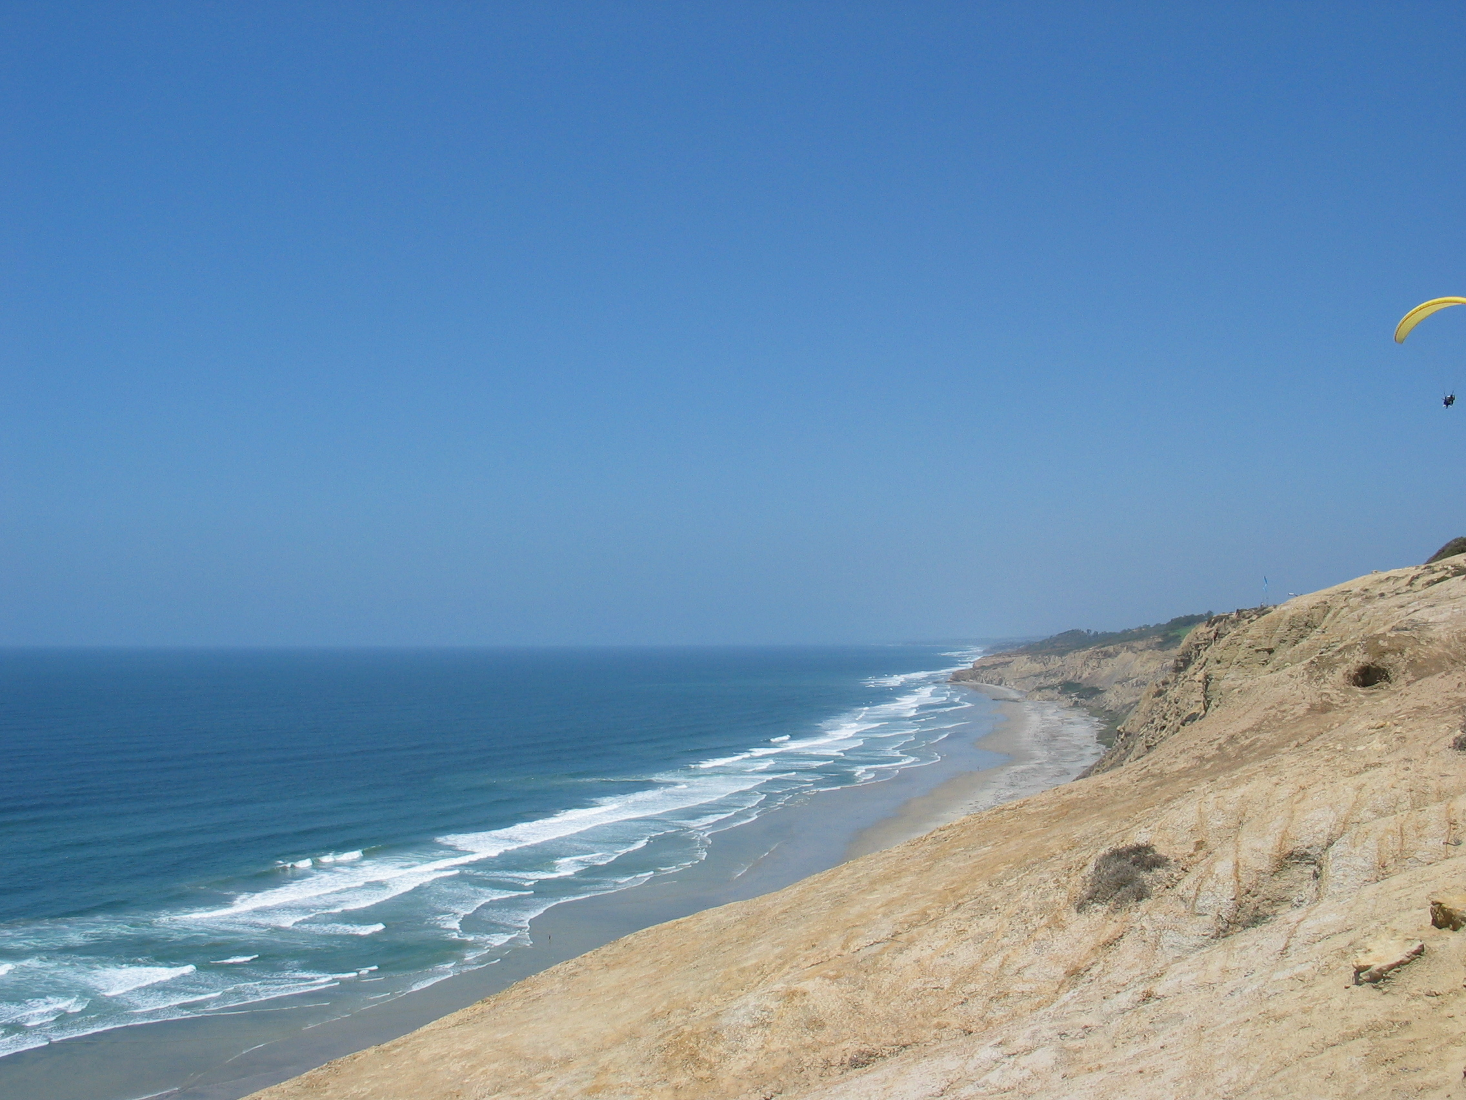


ROMS 4-Dimensional Variational (4D-Var)
Observation Operator
Hernan G. Arango
IMCS, Rutgers University
Andrew M. Moore
University California Santa Cruz
Boulder, CO
NCAR Mesa Lab
April 25, 2016

Slide 2
ROMS 4D-Var Team
Andy Moore – UC Santa Cruz
Hernan Arango – Rutgers University
Art Miller – Scripps
Bruce Cornuelle – Scripps
Emanuelle Di Lorenzo – GA Tech
Brian Powell – University of Hawaii
Javier Zavala-Garay - Rutgers University
Julia Levin - Rutgers University
John Wilkin - Rutgers University
Chris Edwards – UC Santa Cruz
Hajoon Song – MIT
Anthony Weaver – CERFACS
Selime Gürol – CERFACS/ECMWF
Polly Smith – University of Reading
Emilie Neveu – Savoie University

Slide 3
ROMS 4D-Var System
Incremental (linearized about a prior) (Courtier et al., 1994)
Primal (model grid space search) and dual (observation space search) formulations (Courtier 1997)
Primal: Incremental 4D-Var (I4D-Var)
Dual: Physical-space Statistical Analysis System, PSAS (4D-PSAS) (Da Silva et al, 1995); (4D-PSAS)^{T}
Dual: Indirect Representer (R4D-Var) (Egbert et al, 1994); (R4D-Var)^{T}
Strong and weak (dual only) constraint
Preconditioned, Lanczos formulation of conjugate gradient (Lorenc, 2003; Tshimanga et al., 2008; Fisher, 1997)
Second-level preconditioning for multiple outer-loops
Diffusion operator mode for prior covariances (Derber and Bouttier, 1999; Weaver and Courtier, 2001)
Multivariate balance operator for prior covariance (Weaver et al., 2001)
Background quality control (Andersson and Järvinen, 1999)
Physical and ecosystem components
Parallel (distributed-memory, MPI)
Publications: Moore et al., 2011a, b, c (Progress in Oceanography)
WikiROMS Tutorials:
https://www.myroms.org/wiki/index.php/4DVar_Tutorial_Introduction

Slide 4
ROMS 4D-Var Data Assimilation Systems
I4D-Var primal formulation
model grid space search
traditional NWP
lots of experience
strong constraint only (phasing out)
R4D-Var dual formulation
observations space search
formally most correct
mathematically rigorous
problems with high Rossby numbers
strong/weak constraint and
4D-PSAS dual formulation
observation space search
an excellent compromise
more robust for high Rossby numbers
formally suboptimal
strong/weak constraint and (4D-Var)^{T}

Slide 5
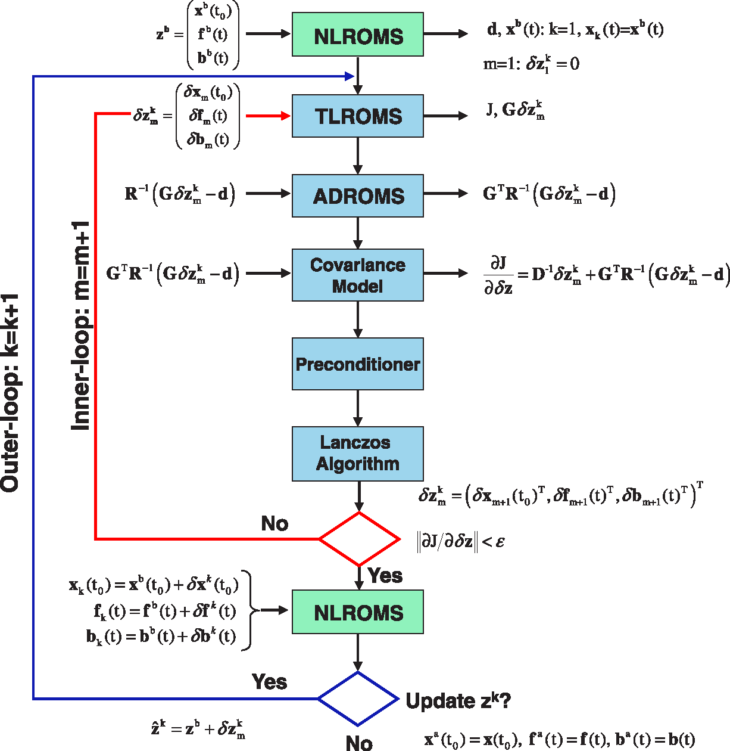
I4D-Var Algorithm
(Moore et al., 2011a)
Notes:
We never compute these matrices but operate on them by using the tangent linear model (G) and the adjoint model (G^T).

Slide 6
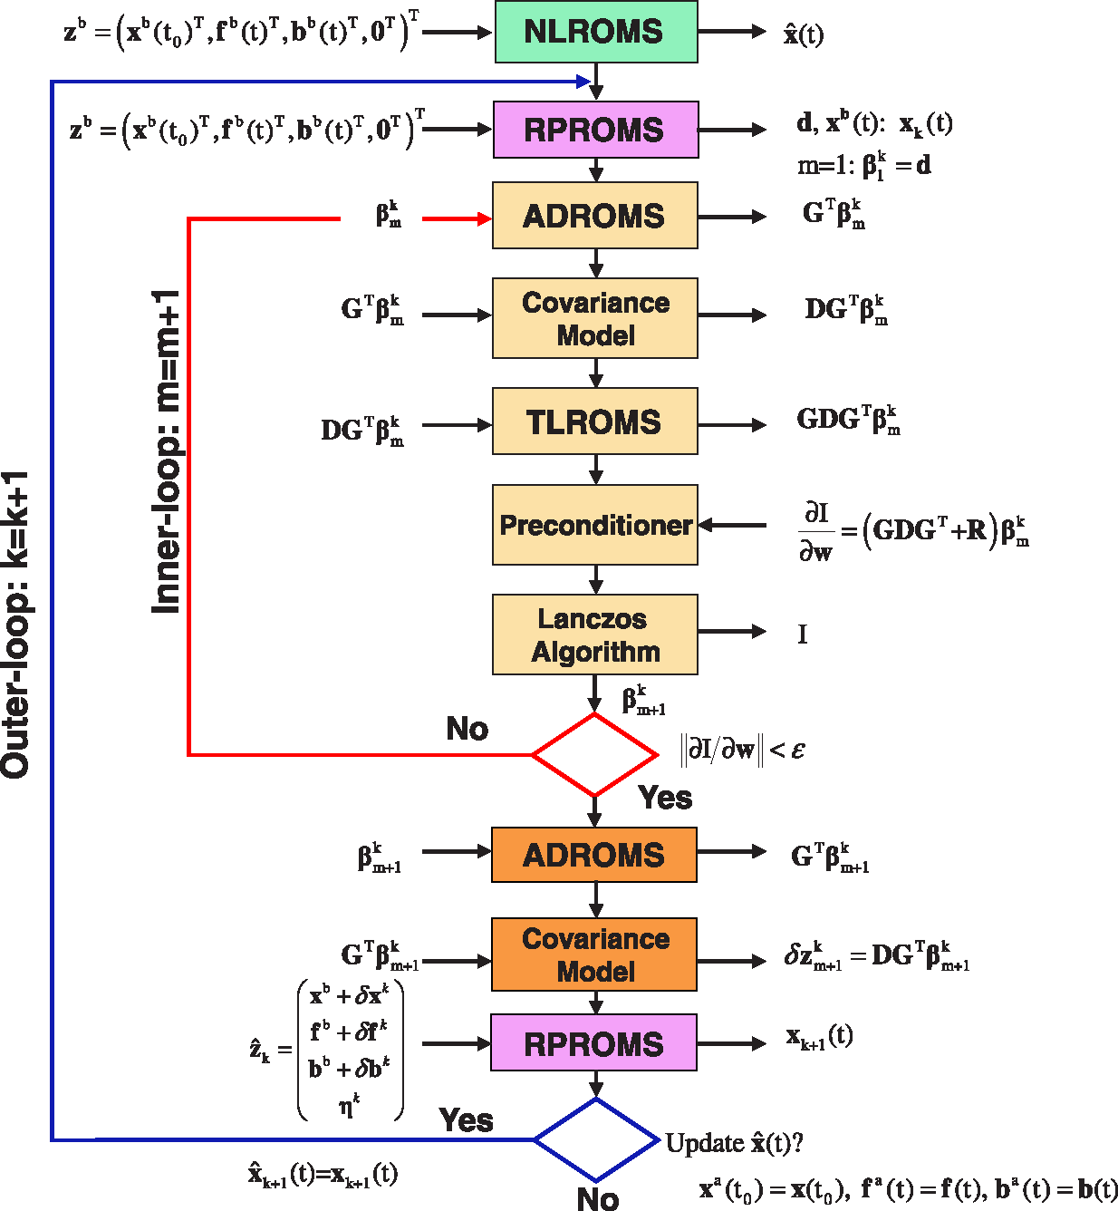
R4D-Var Algorithm
(Moore et al., 2011a)

Slide 7
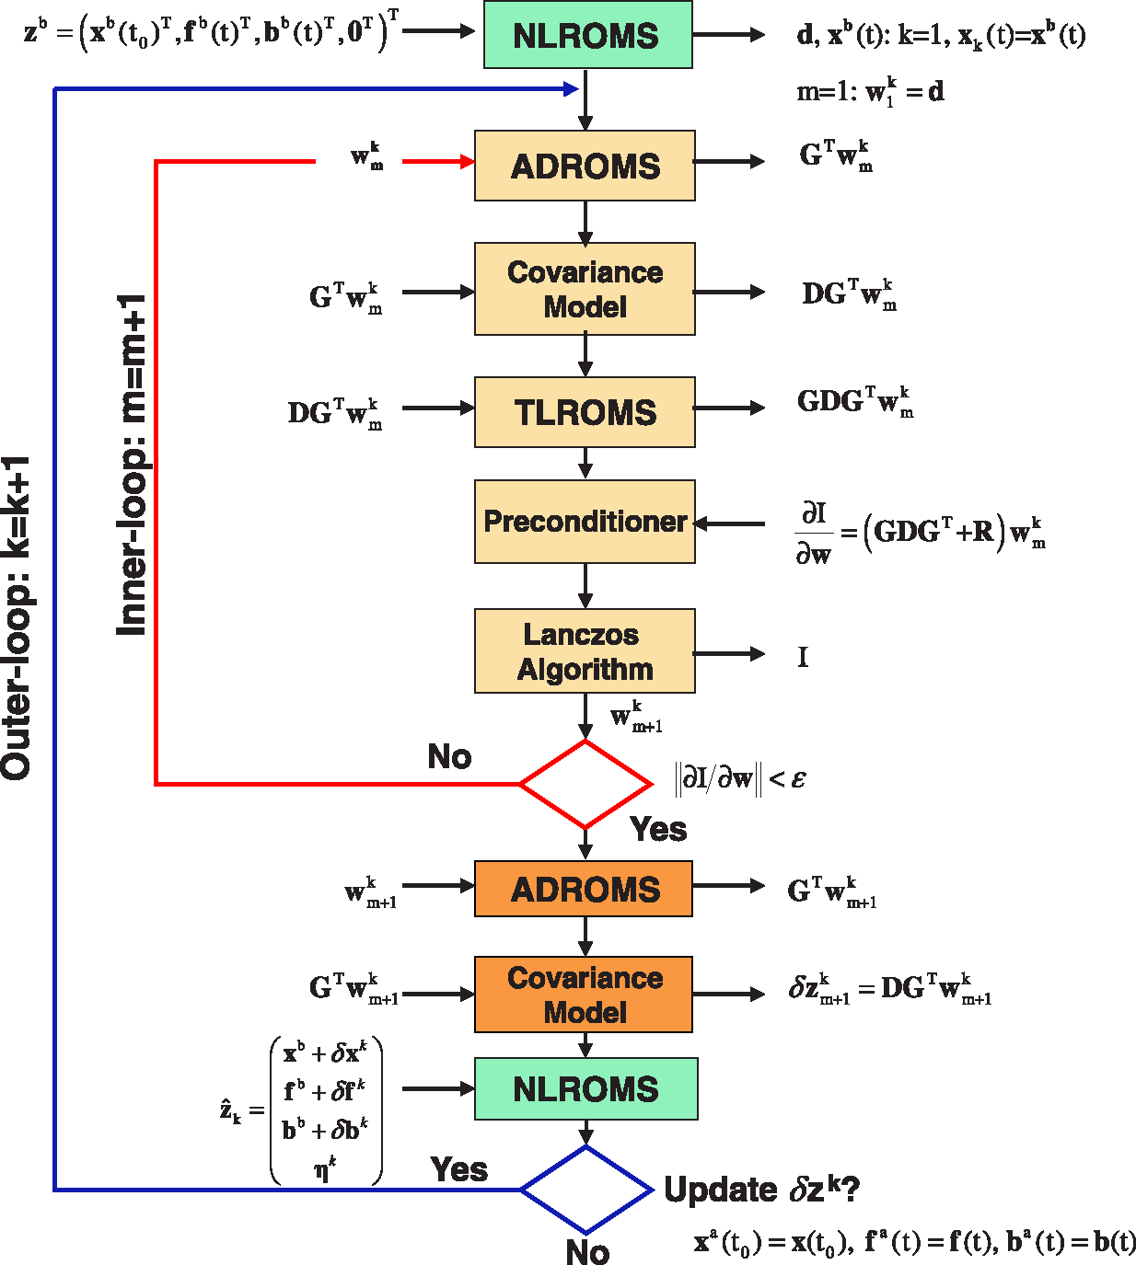
4D-PSAS Algorithm
(Moore et al., 2011a)

Slide 8
ROMS 4D-VAR
f^{b}, B_{f}
Ensemble
4D-Var
ROMS
Obs
y, R
b^{b}, B_{b}
η, Q
x^{b}, B
4D-Var
dof
Adjoint
4D-Var
impact
Priors &
Hypotheses
Hypothesis
Tests
Posterior
Analysis
error
Uncertainty
Term balance,
eigenmodes
Forecast
Clipped
Analyses
Ensemble
(SV, SO)

Slide 9
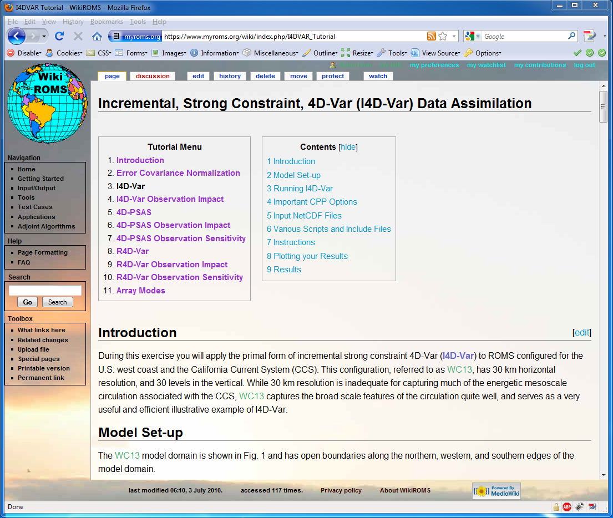
I4D-Var Tutorial Wiki Page

Slide 10
4D-Var Observation Operator

Slide 11
4D-Var Observations NetCDF File
During 4D-Var, the input observations data are used in the following ROMS routines:
Utility/obs_initial.F
Utility/obs_read.F
Utility/obs_write.F
Utility/obs_scale.F
Utility/obs_depth.F
Utility/extract_obs.F
Adjoint/ad_extract_obs.F
Adjoint/ad_htobs.F
Adjoint/ad_misfit.F

Slide 12
Observation Data Sources
Sea Surface Temperature
NOAA PFEG Coastwash OpenDAP (various spatial and temporal resolutions). It is a blended product including microwave AMSR-E, AVHRR, MODIS, and GOES satellites (load_sst_pfeg.m).
http://las.pfeg.noaa.gov/oceanWatch/oceanwatch.php
Sea Surface Height
Gridded altimetry data from AVISO (load_ssh_aviso.m). Username and password required.
http://www.aviso.oceanobs.com/
Hydrographic data
UK Met Office observations datasets (EN3, EN4)
http://hadobs.metoffice.com/en3

Slide 13
Metadata
Dimensions:
survey Number of unique data surveys
state_variable Number of ROMS state variables
datum Observations counter, unlimited dimension
Variables:
Nobs(survey) Number of observations per survey survey_time(survey) Survey time (days)
obs_variance(state_variable) global time and space observation variance obs_type(datum) State variable ID associated with observation obs_provenance(datum) observation origin
obs_time(datum) Time of observation (days) obs_lon(datum) Longitude of observation (degrees_east) obs_lat(datum) Latitude of observation (degrees_north) obs_depth(datum) Depth of observation (meters or level) obs_Xgrid(datum) X-grid observation location (nondimensional) obs_Ygrid(datum) Y-grid observation location (nondimensional) obs_Zgrid(datum) Z-grid observation location (nondimensional) obs_error(datum) Observation error, assigned weight obs_value(datum) Observation value

Slide 14
Observations NetCDF
dimensions:
survey = 13 ;
state_variable = 7 ;
datum = 6815
variables:
int spherical ;
spherical:long_name = "grid type logical switch" ;
spherical:flag_values = "0, 1" ;
spherical:flag_meanings = "Cartesian spherical" ;
int Nobs(survey) ;
Nobs:long_name = "number of observations with the same survey time" ;
double survey_time(survey) ;
survey_time:long_name = "survey time" ;
survey_time:units = "days since 1968-05-23 00:00:00 GMT" ;
survey_time:calendar = "gregorian" ;
double obs_variance(state_variable) ;
obs_variance:long_name = "global time and space observation variance" ;
int obs_type(datum) ;
obs_type:long_name = "model state variable associated with observation" ;
obs_type:flag_values = 1, 2, 3, 4, 5, 6, 7 ;
obs_type:flag_meanings = "zeta ubar vbar u v temperature salinity" ;
int obs_provenance(datum) ;
obs_provenance:long_name = "observation origin" ;
obs_provenance:flag_values = 1, 2, 3, 4, 5, 6, 7, 8, 9, 10, 11 ;
obs_provenance:flag_meanings = "gridded_AVISO_SLA ..." ;
double obs_time(datum) ;
obs_time:long_name = "time of observation" ;
obs_time:units = "days since 1968-05-23 00:00:00 GMT" ;
obs_time:calendar = "gregorian" ;
double obs_lon(datum) ;
obs_lon:long_name = "observation longitude" ;
obs_lon:units = "degrees_east" ;
obs_lon:standard_name = "longitude" ;
double obs_lat(datum) ;
obs_lat:long_name = "observation latitude" ;
obs_lat:units = "degrees_north" ;
obs_lat:standard_name = "latitude" ;
double obs_depth(datum) ;
obs_depth:long_name = "depth of observation" ;
obs_depth:negative = "downwards" ;
double obs_Xgrid(datum) ;
obs_Xgrid:long_name = "x-grid observation location" ;
double obs_Ygrid(datum) ;
obs_Ygrid:long_name = "y-grid observation location" ;
double obs_Zgrid(datum) ;
obs_Zgrid:long_name = "z-grid observation location" ;
double obs_error(datum) ;
obs_error:long_name = "observation error covariance" ;
double obs_value(datum) ;
obs_value:long_name = "observation value" ;
datum = UNLIMITED ; // (6815 currently)
Variable | ID
ζ | 1
u | 2
v | 3
u | 4
v | 5
temp | 6
salt | 7
8
(i2,j2,k2)
7
5
6
4
3
(i1,j1,k1)
1
2

Slide 15
Global Attributes
variables:
. . .
int obs_provenance(datum) ;
obs_provenance:long_name = "observation origin" ;
obs_provenance:flag_values = 1, 2, 3, 4, 5, 6, 7, 8, 9, 10, 11 ;
obs_provenance:flag_meanings = "gridded_AVISO_SLA blended_SST XBT_Met_Office CTD_temperature_Met_Office CTD_salinity_Met_Office ARGO_temperature_Met_Office ARGO_salinity_Met_Office CTD_temperature_CalCOFI CTD_salinity_CalCOFI CTD_temperature_GLOBEC CTD_salinity_GLOBEC" ;
. . .
// global attributes:
:type = "ROMS observations" ;
:title = "California Current System, 1/3 degree resolution (WC13)" ;
:Conventions = "CF-1.4" ;
:state_variables = "\n",
"1: free-surface (m) \n",
"2: vertically integrated u-momentum component (m/s) \n",
"3: vertically integrated v-momentum component (m/s) \n",
"4: u-momentum component (m/s) \n",
"5: v-momentum component (m/s) \n",
"6: potential temperature (Celsius) \n",
"7: salinity (nondimensional)" ;
:obs_provenance = "\n",
" 1: gridded AVISO sea level anomaly \n",
" 2: blended satellite SST \n",
" 3: XBT temperature from Met Office \n",
" 4: CTD temperature from Met Office \n",
" 5: CTD salinity from Met Office \n",
" 6: ARGO floats temperature from Met Office \n",
" 7: ARGO floats salinity from Met Office \n",
" 8: CTD temperature from CalCOFI \n",
" 9: CTD salinity from CalCOFI \n",
"10: CTD temperature from GLOBEC \n",
"11: CTD salinity from GLOBEC" ;
:variance_units = "squared state variable units" ;
:obs_sources = "\n",
"http://opendap.aviso.oceanobs.com/thredds/dodsC \n",
"http://hadobs.metoffice.com/en3" ;
:history = "4D-Var observations, Wednesday - July 7, 2010 - 12:20:37.2629 AM" ;

Slide 16
Longitude and Latitude Locations (Optional)
The obs_lon and obs_lat values are only necessary to compute the fractional grid locations (obs_Xgrid, obs_Ygrid) during pre-processing using obs_ijpos.m
The obs_lon and obs_lat are not used directly in ROMS when running the 4D-Var algorithms for efficiency and because of the complexity of curvilinear grids. The fractional grid locations obs_Xgrid and obs_Ygrid are used instead.
However, they are useful during post-processing and plotting results into maps or when changing application grid.
The size of the observation NetCDF can be an issue, it is smaller if obs_lon and obs_lat are omitted.

Slide 17
ROMS GRID
Horizontal curvilinear orthogonal coordinates on an Arakawa C-grid.
Terrain-following coordinates on a staggered vertical grid.
Coarse-grained parallel tile partitions.
Only distributed-memory (MPI) is possible in all the adjoint-based algorithms. Shared-memory (OpenMP) is not possible because of the way that the adjoint model is coded.
In distributed-memory, we need the adjoint of the MPI exchanges between the tiles.

Slide 18
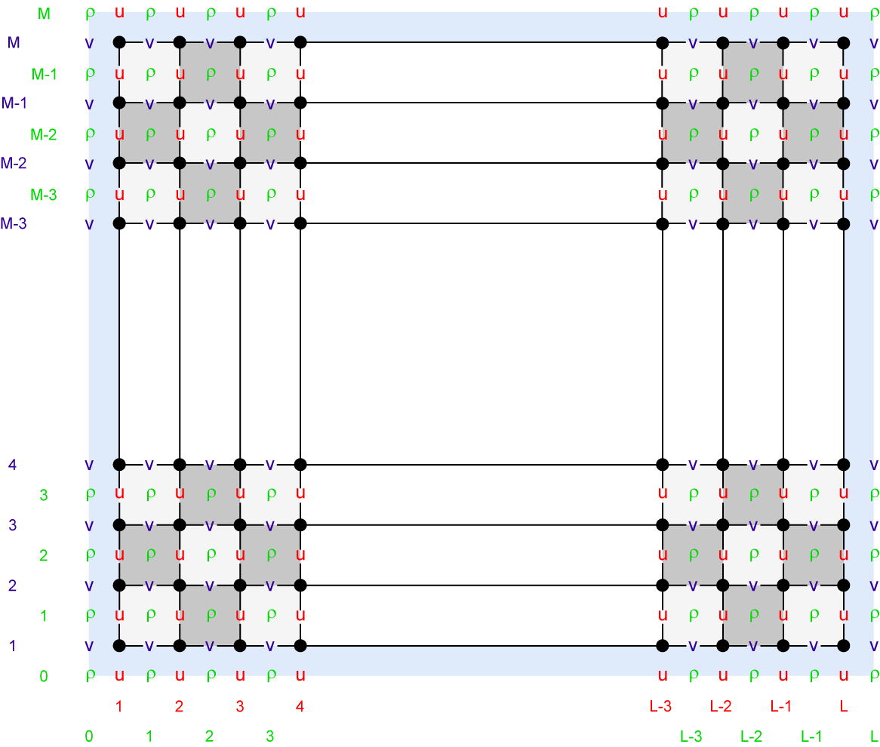
Staggered C-Grid, RHO-points

Slide 19
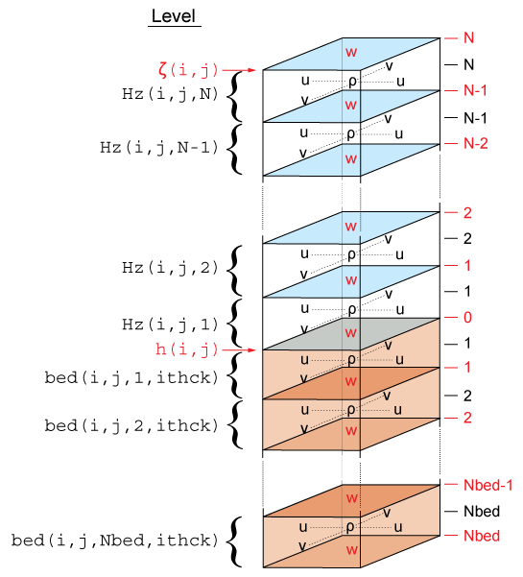
Vertical Terrain-following Coordinates
Vieste
(Italy)
Dubrovnik
(Croatia)
Depth
(m)
Longitude

Slide 20
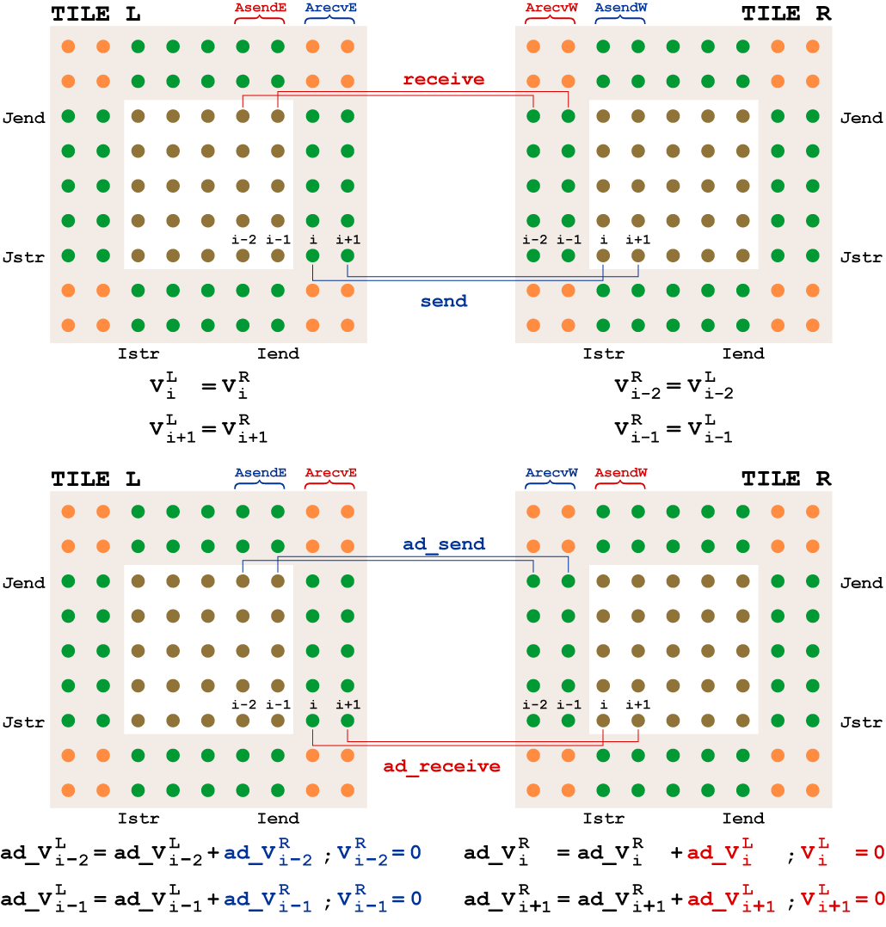
East-West MPI Communications
Nonlinear
With Respect
To Tile R
Adjoint
With Respect
To Tile R

Slide 21
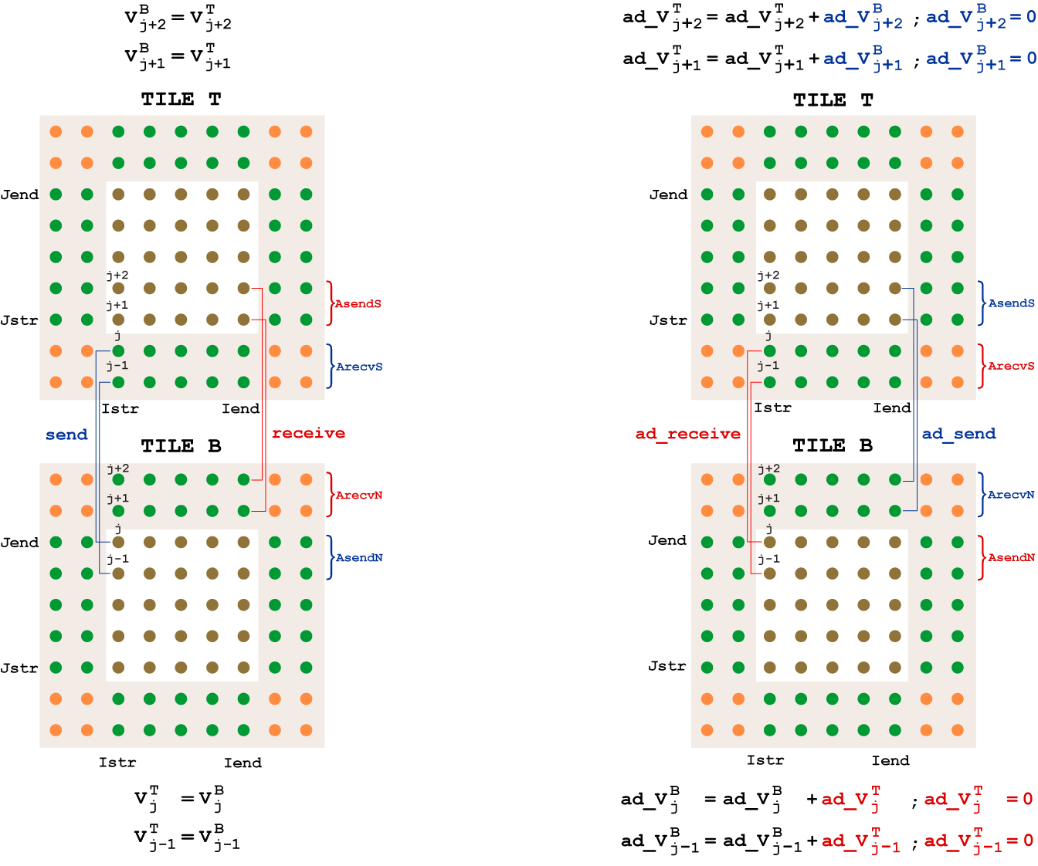
North-South MPI Communications
With Respect
to Tile B
Nonlinear
Adjoint

Slide 22
Processing
Compute observation’s fractional (ξ, η) grid coordinates locations from its (obs_lon, obs_lat).
Find how many unique survey times occur within the data set (survey dimension)
Count observations available per survey (Nobs) and assign their times (survey_time)
Sort the observation in ascending time order and observation type for efficiency
Save a copy of the observation file
Several matlab scripts to process observations

Slide 23
Matlab Scripts
C_observations.m - Creates 4D-Var observation NetCDF file.
d_observations.m - Driver to process 4D-Var observation NetCDF file.
Obs_merge.m - Merges specified 4D-Var observation NetCDF files.
obs_read.m - Reads observation NetCDF file and loads all data into a structure array.
obs_write.m - Writes all observation data in structure array into an existing NetCDF file.
inside.m - Checks if a point is strictly inside of the region defined by a polygon. This is an old Matlab function which is no longer supported. It is very useful in finding outliers in observations (inpolygon).
obs_ijpos.m - Computes observation locations in ROMS fractional coordinates. It uses the deprecated inside.m Matlab function.
super_obs.m - Checks the provided observation data (4D-Var NetCDF file or structure) and creates super observations if there is more than one datum of the same observation type per grid cell.

Slide 24
Matlab Scripts
plot_super.m - Sample script to compute and plot super observations from specified 4D-Var observations NetCDF file.
d_ssh_obs.m - Driver template to extract SSH observations for AVISO. It creates and writes an observation file. Then, it computes super observations and creates and writes a super observations NetCDF file.
d_sst_obs.m - Driver template to extract SST observations from satellite data. It creates and writes an observation file. Then, it computes super observations and creates and writes a super observations NetCDF file.
load_ssh_aviso.m - Extracts AVISO sea level anomaly for the specified region and period of interest from ROMS Grid file.
load_sst_pfeg.m - Extracts satellite sea surface temperature for the specified region and period of interest from ROMS Grid file. The SST data is from the OpenDAP catalog maintained by NOAA PFEG Coastwatch in California. The resolution is 0.1 degree global 5-day average composite.

Slide 25
Matlab Observation Structure
Observations data structure S:
S.ncfile NetCDF file name (string)
S.Nsurvey number of observations surveys
S.Nstate number of state variables
S.Ndatum total number of observations
S.spherical spherical grid switch
S.Nobs number of observations per survey
S.survey_time time for each survey time
S.variance global variance per state variable
S.type state variable associated with observation
S.time time for each observation
S.depth depth of observation
S.Xgrid observation fractional x-grid location
S.Ygrid observation fractional y-grid location
S.Zgrid observation fractional z-grid location
S.error observation error
S.value observation value

Slide 26
Matlab Observation Structure
The following optional variables will be read if available:
S.provenance observation origin
S.lon observation longitude
S.lat observation latitude
The following variable attributes will be read if available:
S.state_flag_values obs_type flag_values attribute
S.state_flag_meanings obs_type flag_meanings attribute
S.origin_flag_values obs_provenance flag_values attribute
S.origin_flag_meanings obs_provenance flag_meaning attribute
The following global attributes will be read if available:
S.global_variables state_variables global attribute
S.global_provenance obs_provenance global attribute
S.global_sources obs_sources global attribute

Slide 27
Assumptions
All scalar observations are assumed to be at RHO-points.
All vector observations are assumed to be rotated to ROMS curvilinear grid, if applicable. Vector observations are always measured at the same location.
All observation horizontal locations are assumed to be in fractional curvilinear grid coordinates.
Vertical locations can be in fractional levels (1:N) or actual depths (negative values).
Removal of tidal signal?
Filtering of non-resolved processes?

Slide 28
Observation Operators
Currently, all observations must be in terms of model state variables (same units):
2D configuration: zeta, ubar, vbar
3D configuration: zeta, u, v, T, S, …
There is no time interpolation of the model solution at observation times:
time - 0.5*dt < ObsTime < time + 0.5*dt
There is no observation quality control (screening) inside ROMS, except ObsScale.
No observation constraints are implemented (Satellite SST measurements)

Slide 29
Observation Interpolation
Only spatial linear interpolation is coded.
If land/sea masking, the interpolation coefficients are weighted by the mask.
If shallower than z_r(:,:,N), observations are assigned to the surface level.
If deeper than z_r(:,:,1), observations are rejected.

Slide 30
Recommendations
Create a NetCDF file for each observation type.
Use a processing program to meld NetCDF observation files (obs_merge.m).
Keep a master copy of each observation file, in case you are running your application at different resolutions.
Decimation of observations. Finite volume representation super observations (super_obs.m).

Slide 31
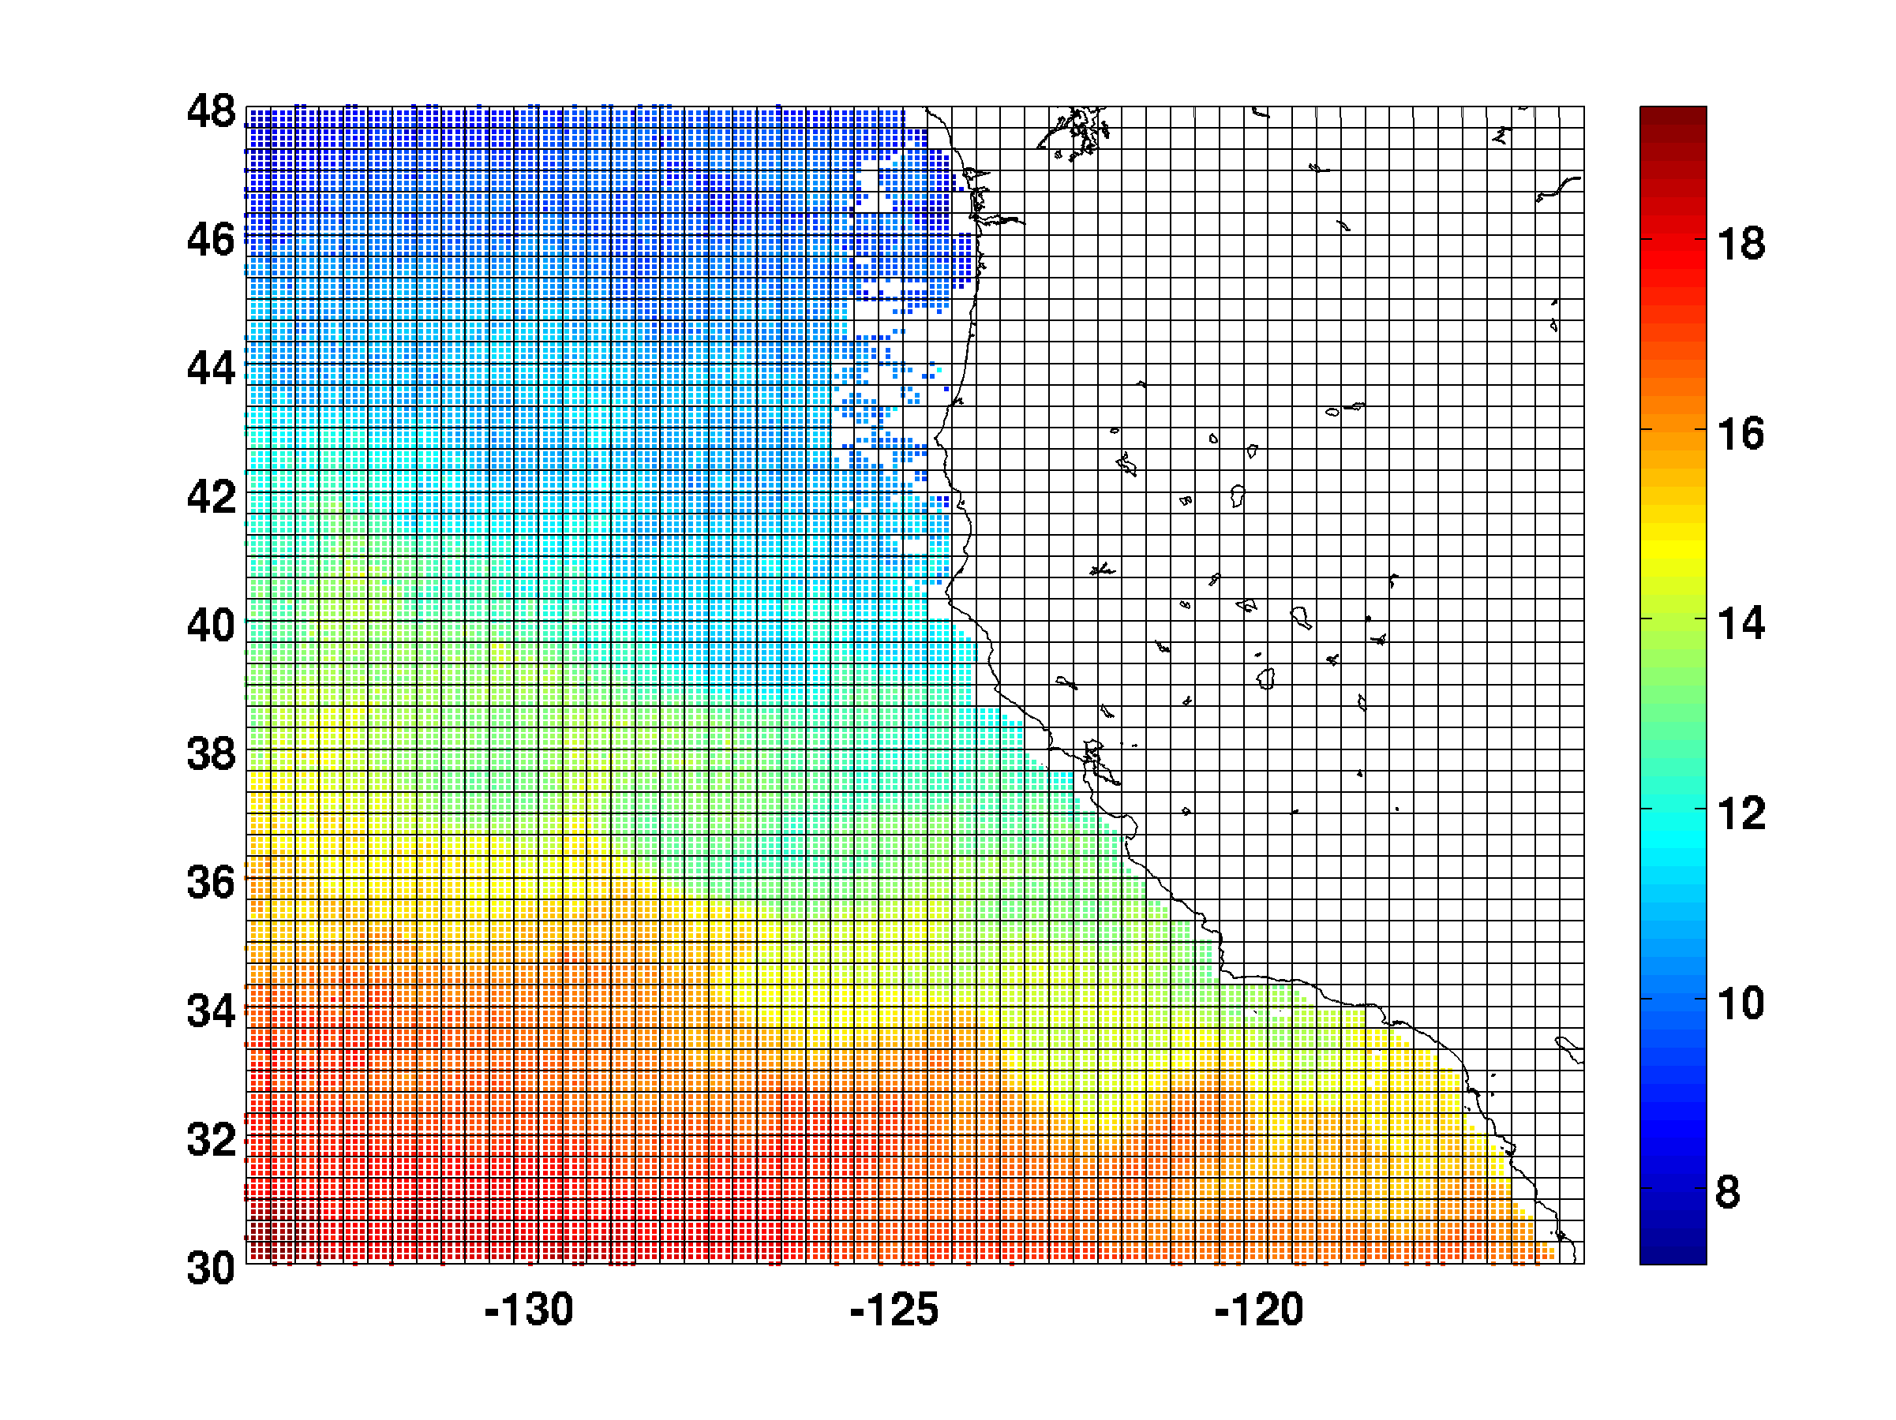
SST Observations (1/10 degree)
Jan 1, 2004

Slide 32
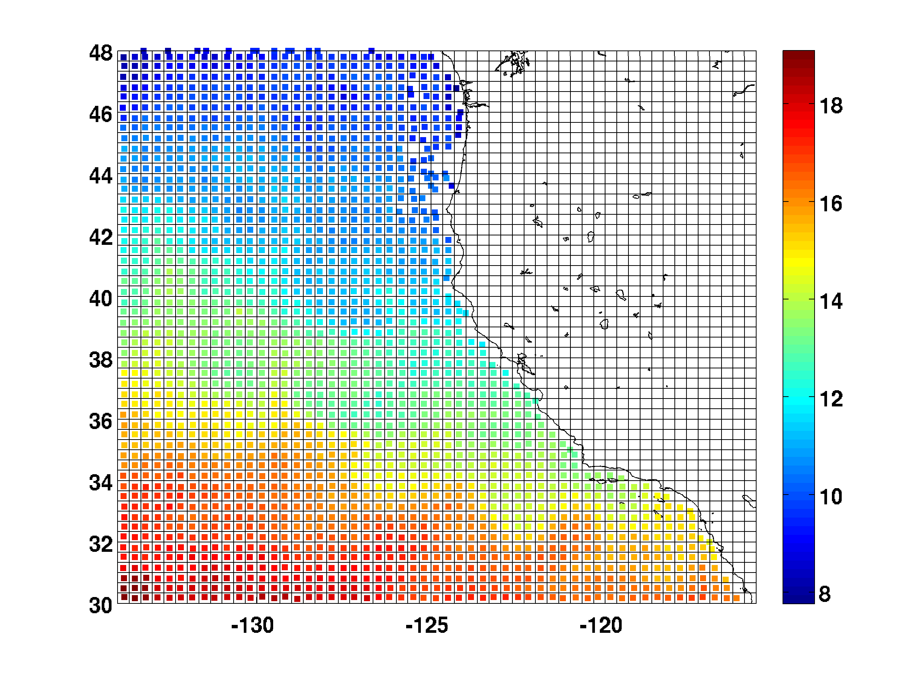
SST Super Observations
Jan 1, 2004

Slide 33
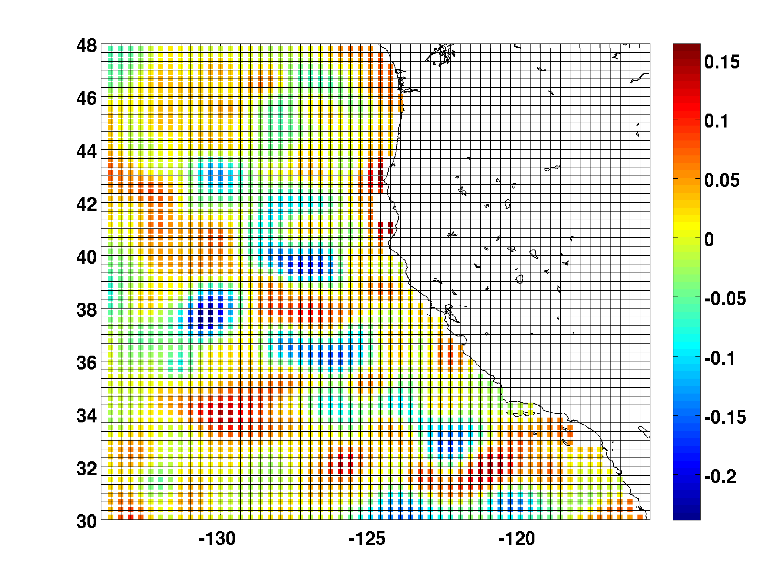
SSH Observations (AVISO)
Jan 1, 2004

Slide 34
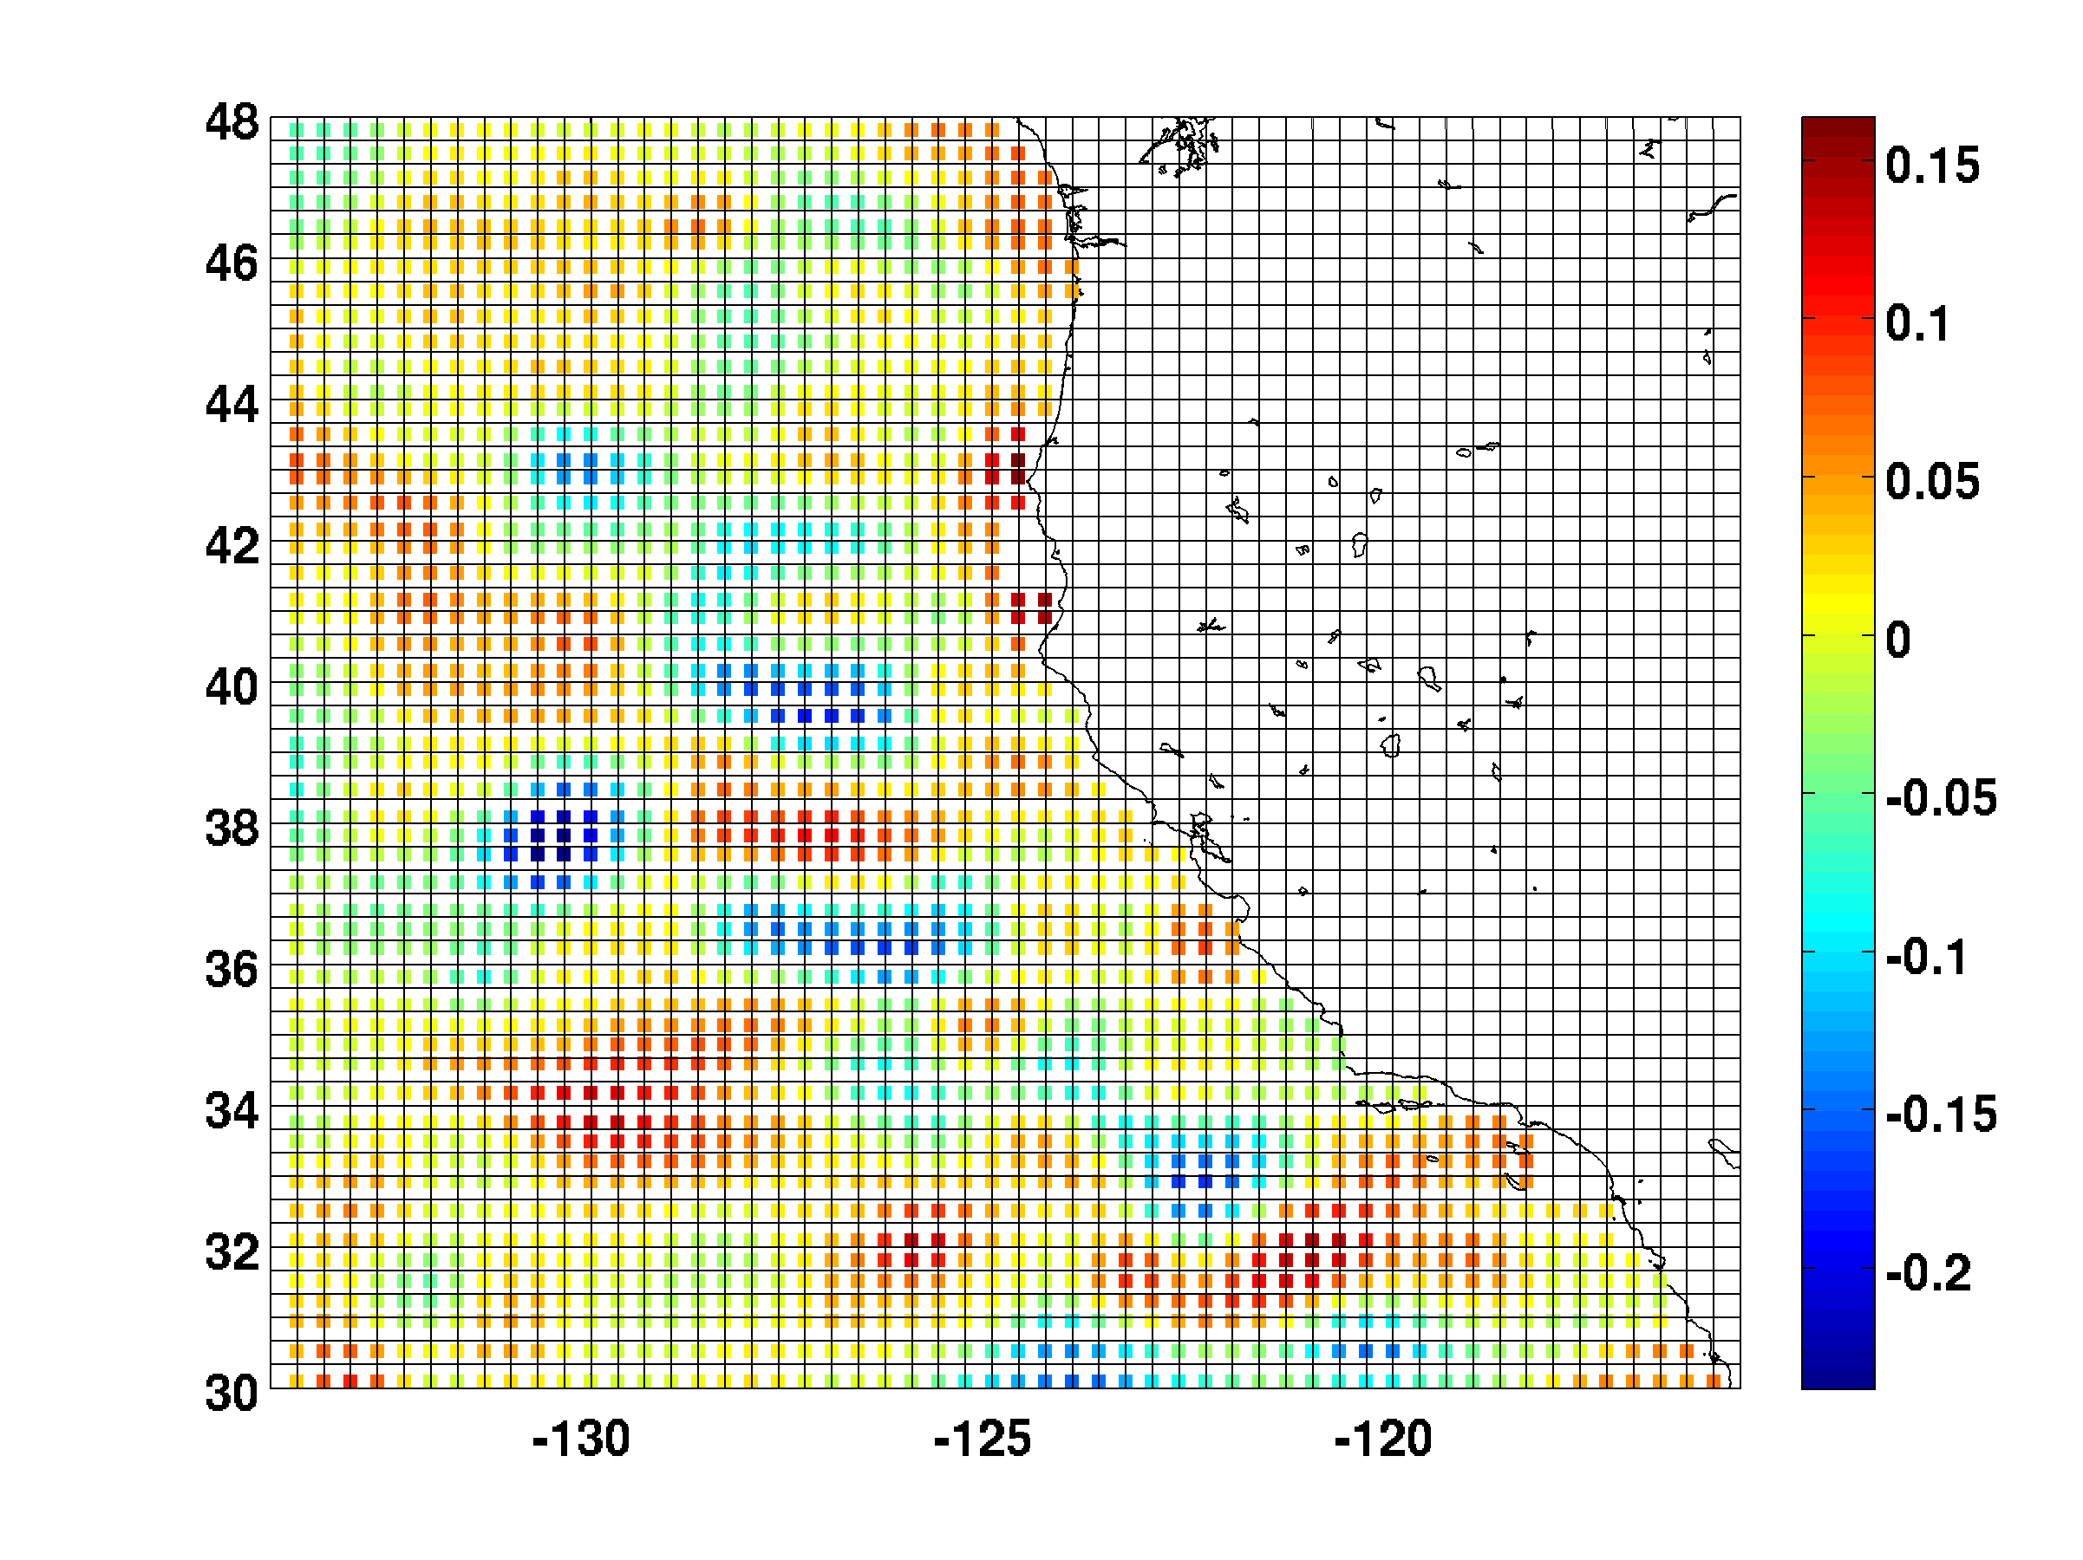
SSH Super Observations
Jan 1, 2004

