Slide 1
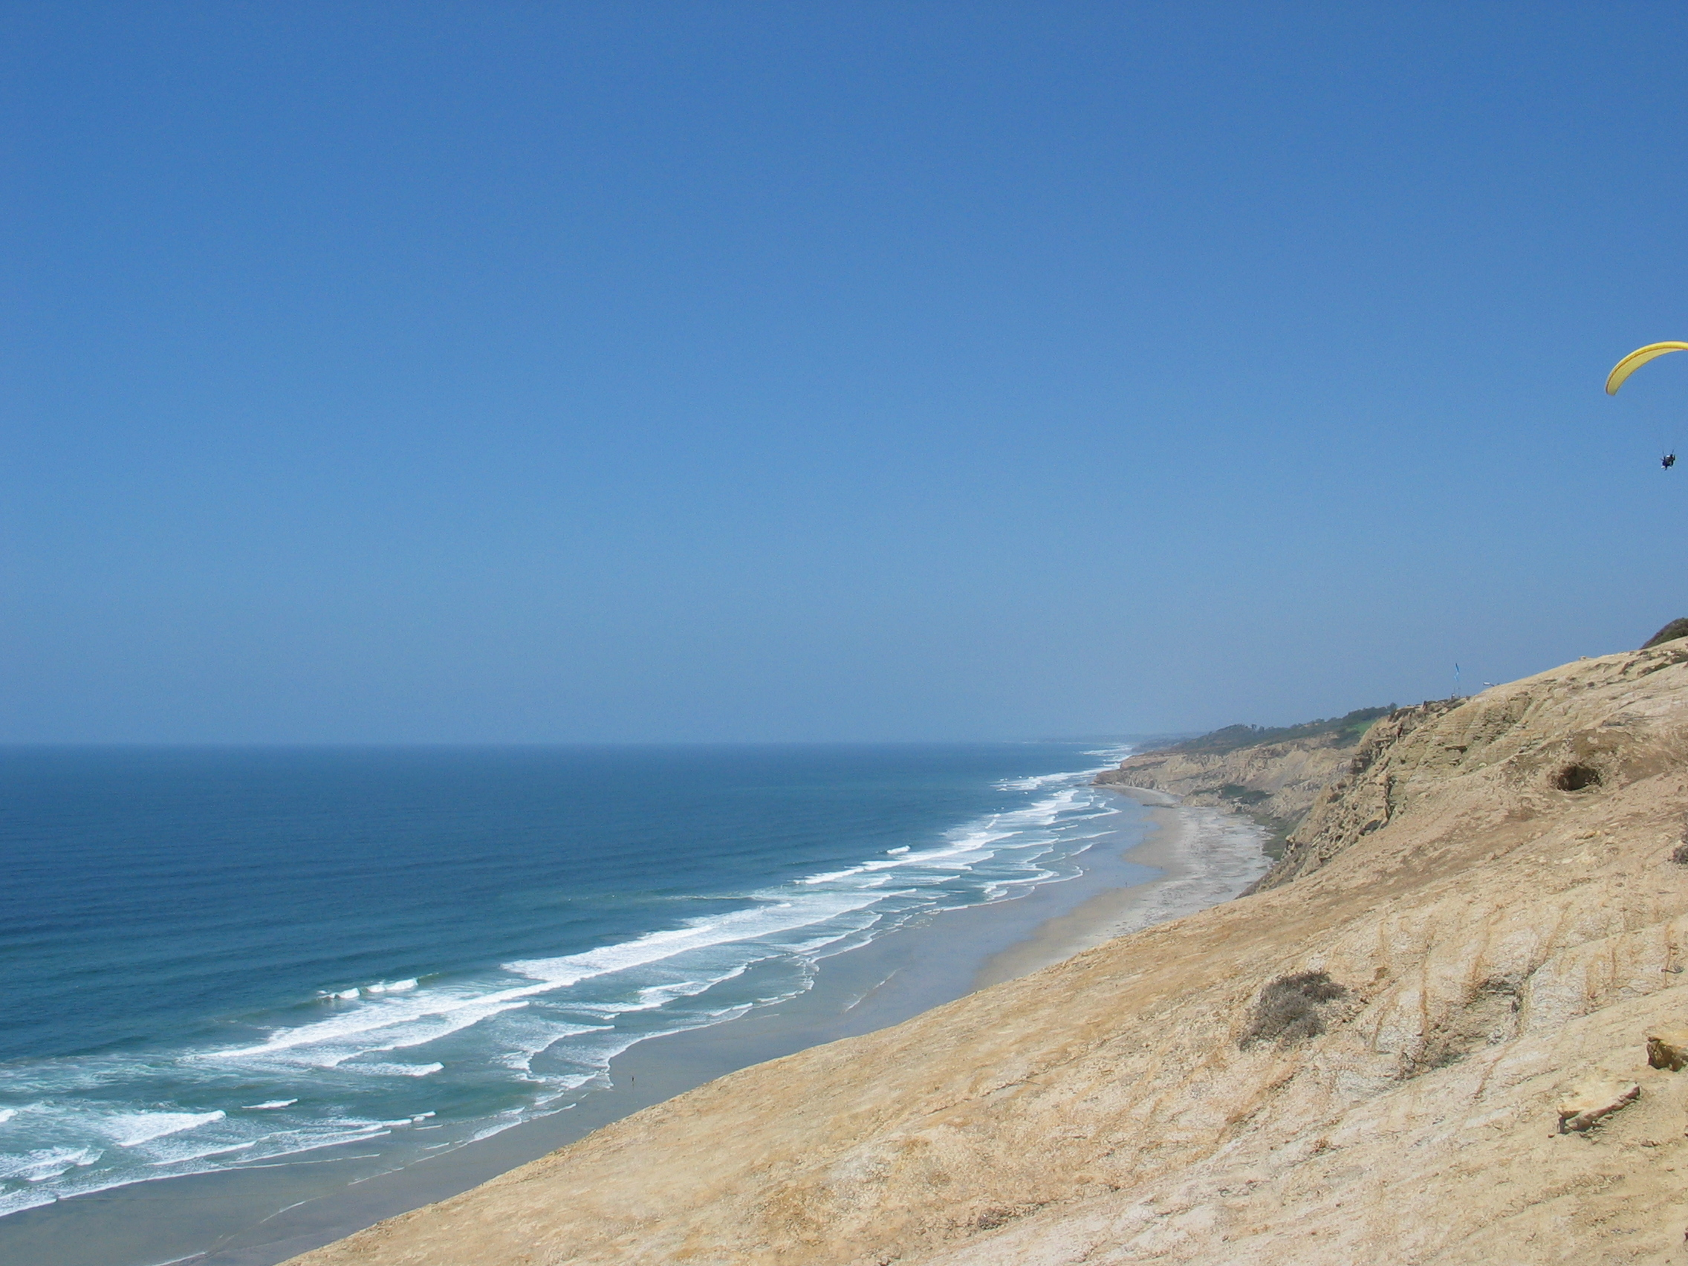
ROMS Framework: Kernel
Hernan G. Arango
Department of Marine and Coastal Sciences
Rutgers University, New Brunswick, NJ, USA
Boulder, CO
NCAR Mesa Lab
April 25, 2016

Slide 2
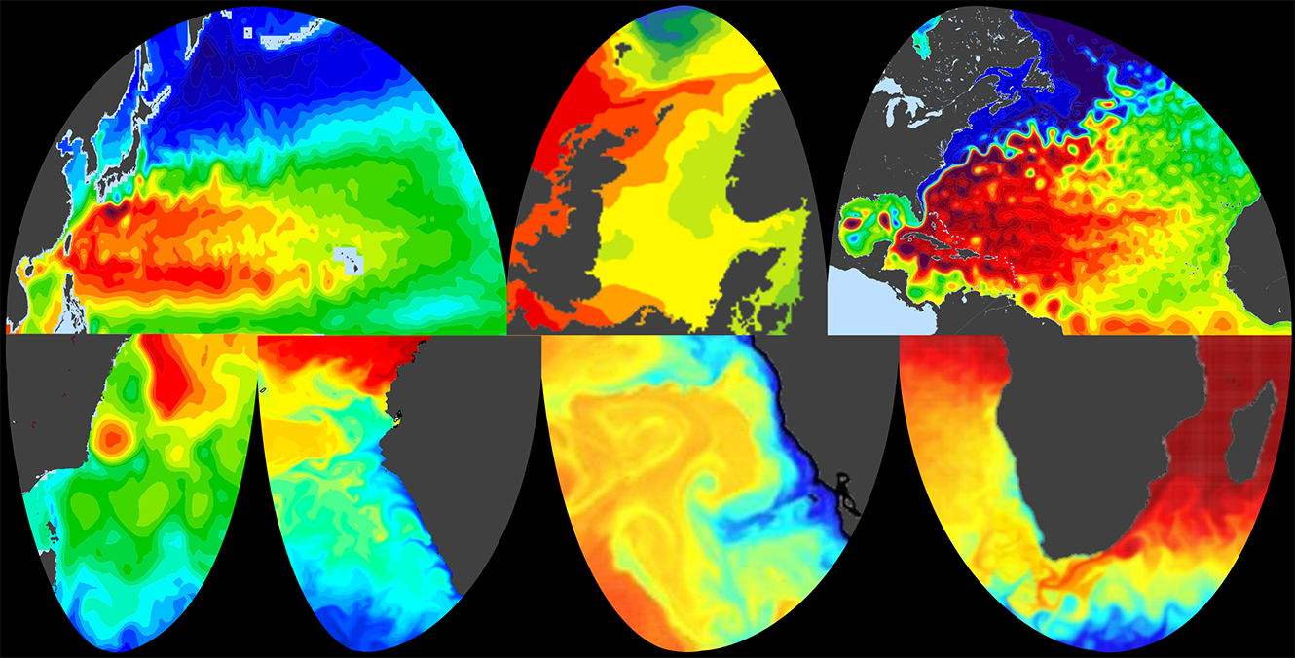
ROMS: Regional Ocean Modeling System
Free-surface, Hydrostatic Primitive Equation Model
Generalized Terrain-Following Vertical Coordinates
Boundary-fitted Orthogonal Curvilinear Coordinates on an Arakawa C-grid: Cartesian, Spherical, and Polar
Multiple Grid and Model Coupling (MCT, ESMF)
High-order Numerical Schemes
Shared- and Distributed-memory (OpenMP, MPI)
F90/F95, C-preprocessing, NetCDF I/O
Tangent Linear, Representer, and Adjoint Models
Adjoint-based Algorithms for 4DVar data assimilation, Ensemble Prediction, Adaptive and Linear Stability Analysis
Tides, Ecosystem, Sediment, Sea Ice Models
Various Vertical Mixing Schemes and Bottom Boundary Layer Parameterizations
Web-Based Documentation and Distribution: www.myroms.org, www.myroms.org/wiki

Slide 3
Vertical Terrain-following Coordinates
Vieste
(Italy)
Dubrovnik
(Croatia)
Depth
(m)
Longitude

Slide 4
Curvilinear Transformation

Slide 5
Model Grid Configuration
Refined
Composite

Slide 6
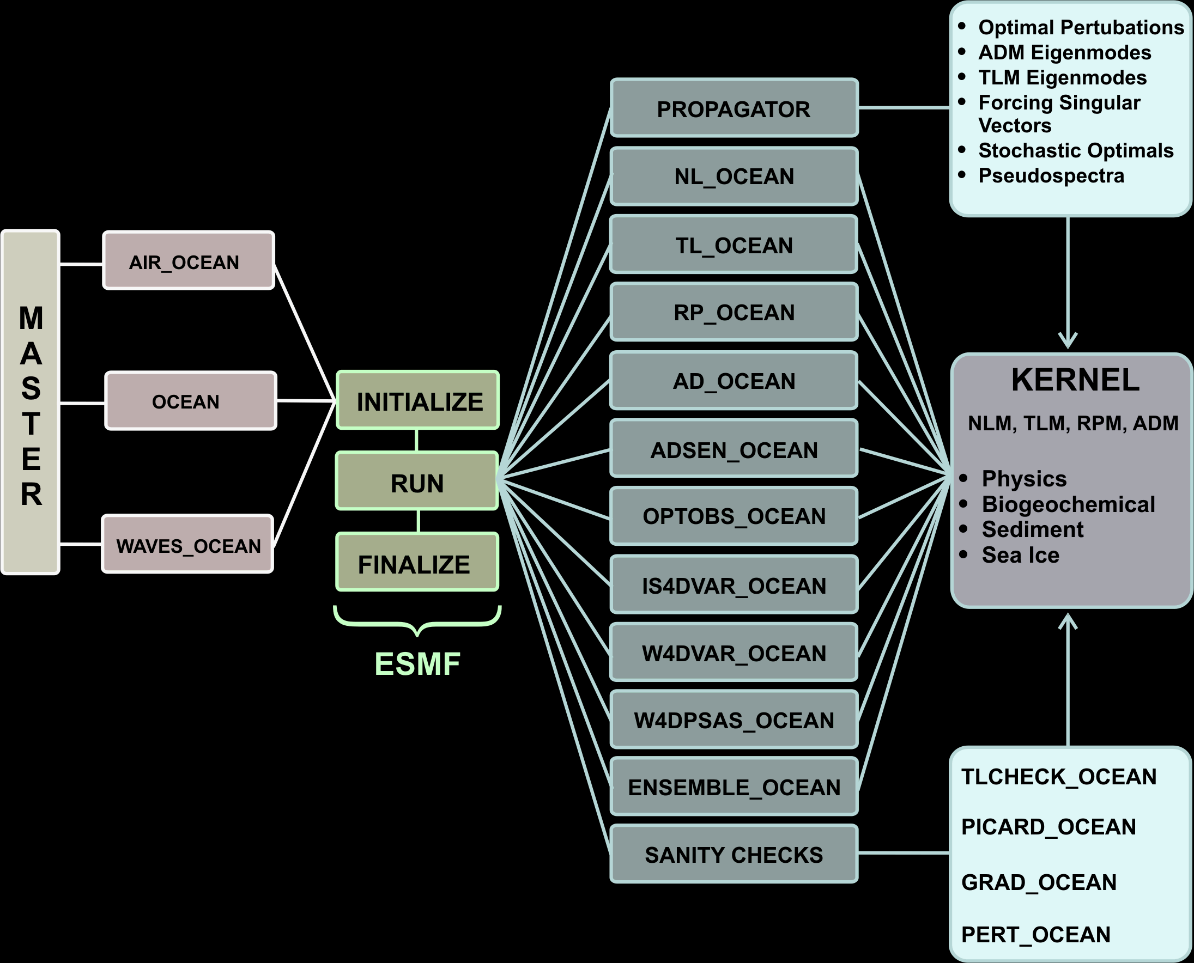
ROMS Framework

Slide 7
ROMS Directory Tree
Adjoint
Bin
Drivers
Compilers
External
Lib
Include
makefile
Modules
src
Master
Nonlinear
ROMS
Obsolete
SWAN
Programs
WRF
SeaIce
Representer
Tangent
Utility
Version

Slide 8
ROMS Drivers
master.F
#include “cppdefs.h”
#if defined AIR_OCEAN
# include "air_ocean.h"
#elif defined WAVES_OCEAN
# include "waves_ocean.h"
#else
# include "ocean.h"
#endif
ocean_control.F
#include “cppdefs.h”
#if defined AD_SENSITIVITY
# include "adsen_ocean.h"
#elif defined AFT_EIGENMODES
# include "afte_ocean.h"
#elif defined FT_EIGENMODES
# include "fte_ocean.h"
#elif defined FORCING_SV
# include "fsv_ocean.h"
#elif defined OPT_PERTURBATION
# include "op_ocean.h"
#elif defined OPT_OBSERVATIONS
# include "optobs_ocean.h"
#elif defined SO_SEMI
# include "so_semi_ocean.h"
#elif defined S4DVAR
# include "s4dvar_ocean.h"
#elif defined IS4DVAR
# include "is4dvar_ocean.h"
#elif defined W4DPSAS
# include "w4dpsas_ocean.h"
#elif defined W4DVAR
# include "w4dvar_ocean.h"
#else
# if defined TLM_DRIVER
# include "tl_ocean.h"
# elif defined RPM_DRIVER
# include "rp_ocean.h"
# elif defined ADM_DRIVER
# include "ad_ocean.h"
# else
# include "nl_ocean.h"
# endif
#endif
ocean.h
#include “cppdefs.h”
PROGRAM ocean
USE ocean_control_mod, ONLY : initialize
USE ocean_control_mod, ONLY : run
USE ocean_control_mod, ONLY : finalize
#ifdef DISTRIBUTE && defined MPI
CALL mpi_init (MyError)
CALL mpi_comm_rank (MPI_COMM_WORLD, MyRank, MyError)
#endif
CALL initialize
CALL run
CALL finalize
#if defined DISTRIBUTE && defined MPI
CALL mpi_finalize (MyError)
#endif
END PROGRAM ocean

Slide 9
Parallelization
Coarse-grained parallelization: horizontal tiles
The NLM, TLM, and RPM can be run in either shared-memory (OpenMP) or distributed-memory (MPI)
The ADM can only be run in distributed-memory (ADM violates shared-memory collision rules)
Aggregation of variables for MPI communications
CALL ad_mp_exchange2d (ng, iADM, 3, Istr, Iend, Jstr, Jend, &
& LBi, UBi, LBj, UBj, &
& NghostPoints, EWperiodic, NSperiodic, &
& ad_Zt_avg1, ad_DU_avg1, ad_DV_avg1)

Slide 10
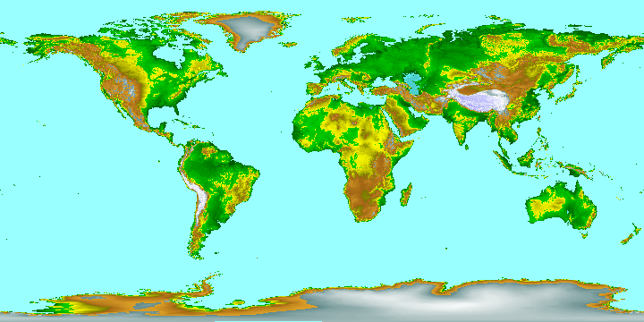
Parallel Tile Partition
8 x 8
Ny
}
}
Nx

Slide 11
East-West MPI Communications
Nonlinear
With Respect
To Tile R
Adjoint
With Respect
To Tile R

Slide 12
North-South MPI Communications
With Respect
to Tile B
Nonlinear
Adjoint

Slide 13

ROMS/TOMS
GOVERNING EQUATIONS

Slide 14
Momentum Governing Equations

Slide 15
Tracers Governing Equations

Slide 16
Continuity Equation
Vertical Velocity

Slide 17
Deviatoric Transverse Stress Tensor

Slide 18
Barotropic-Baroclinic Coupling

Slide 19

ROMS/TOMS:
MODULAR DESIGN

Slide 20
Code Design
Modular, efficient, and portable Fortran code (F90/ F95)
C-preprocessing managing
Multiple levels of nesting: composite and refined grids
Lateral boundary conditions options for closed, periodic, radiation, and hybrid/heterogeneous
Arbitrary number of tracers (active and passive)
Input and output NetCDF data structure
Support for parallel execution on both shared- and distributed -memory architectures

