Slide 1

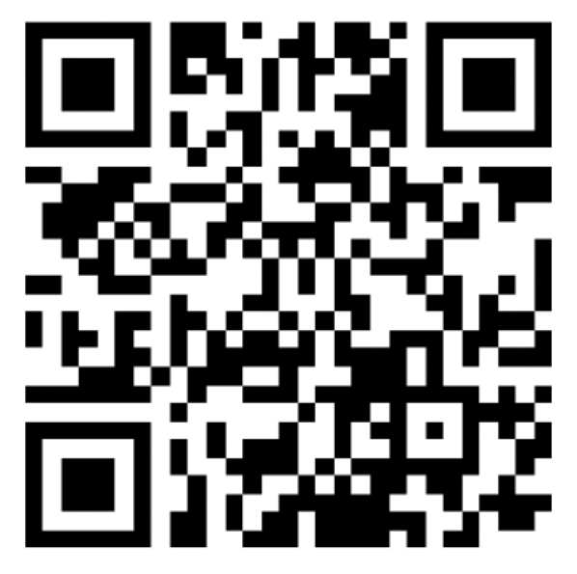
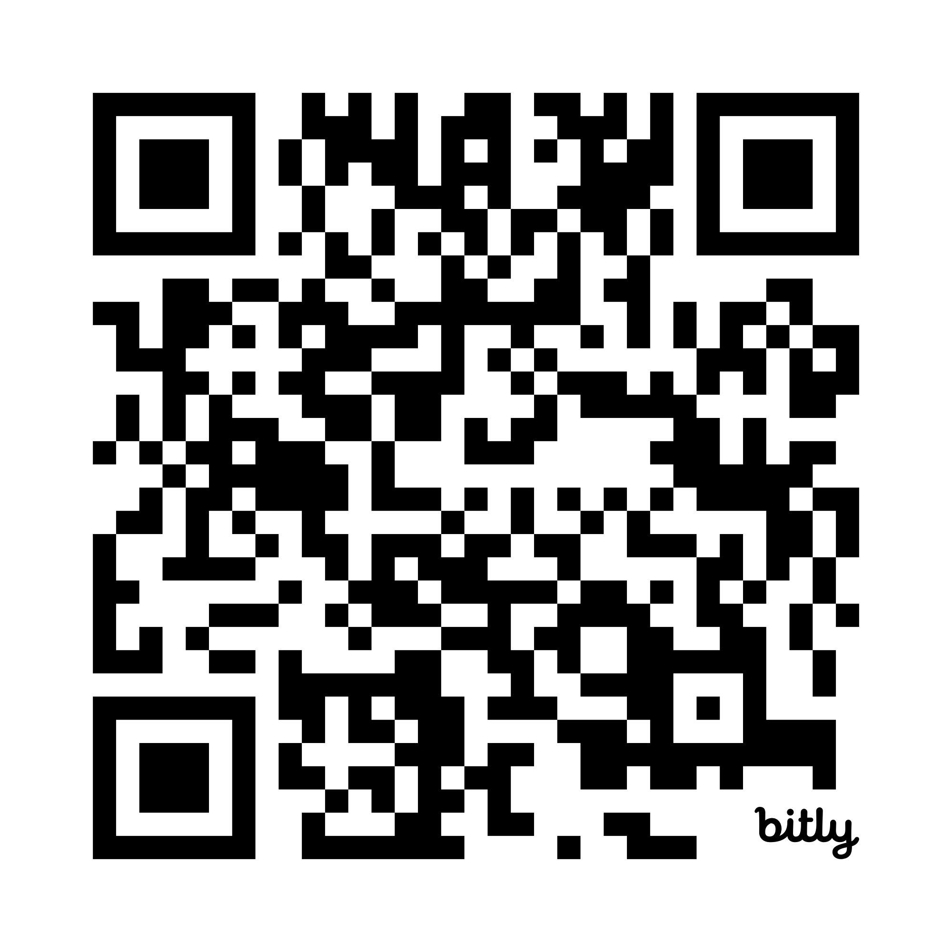
WIFI: [VENUE NETWORK]
Password: [VENUE PASSWORD]
These Slides
Notes:
COLD OPEN — let the room settle on the quote before you speak. Opening line: “She ran the best closer in New York City. Today she comes to work for you.” Housekeeping in one breath: laptops out, Claude desktop installed, workspace invite accepted — anyone missing a piece, flag me now, we fix it while we talk. Set the promise: by 4 PM every one of you owns a working Donna — not a demo, yours, on your own inbox. WIFI lines on this slide are placeholders: drop in the venue network and password before presenting.

Slide 2
“I’m Donna. I know everything.”
— DONNA PAULSEN, SUITS
BUILD YOUR OWN DONNA
A 90 min workshop for executives who are done reading email
Notes:
COLD OPEN — let the room settle on the quote before you speak. Opening line: “She ran the best closer in New York City. Today she comes to work for you.” Housekeeping in one breath: laptops out, Claude desktop installed, workspace invite accepted — anyone missing a piece, flag me now, we fix it while we talk. Set the promise: by 4 PM every one of you owns a working Donna — not a demo, yours, on your own inbox.

Slide 3
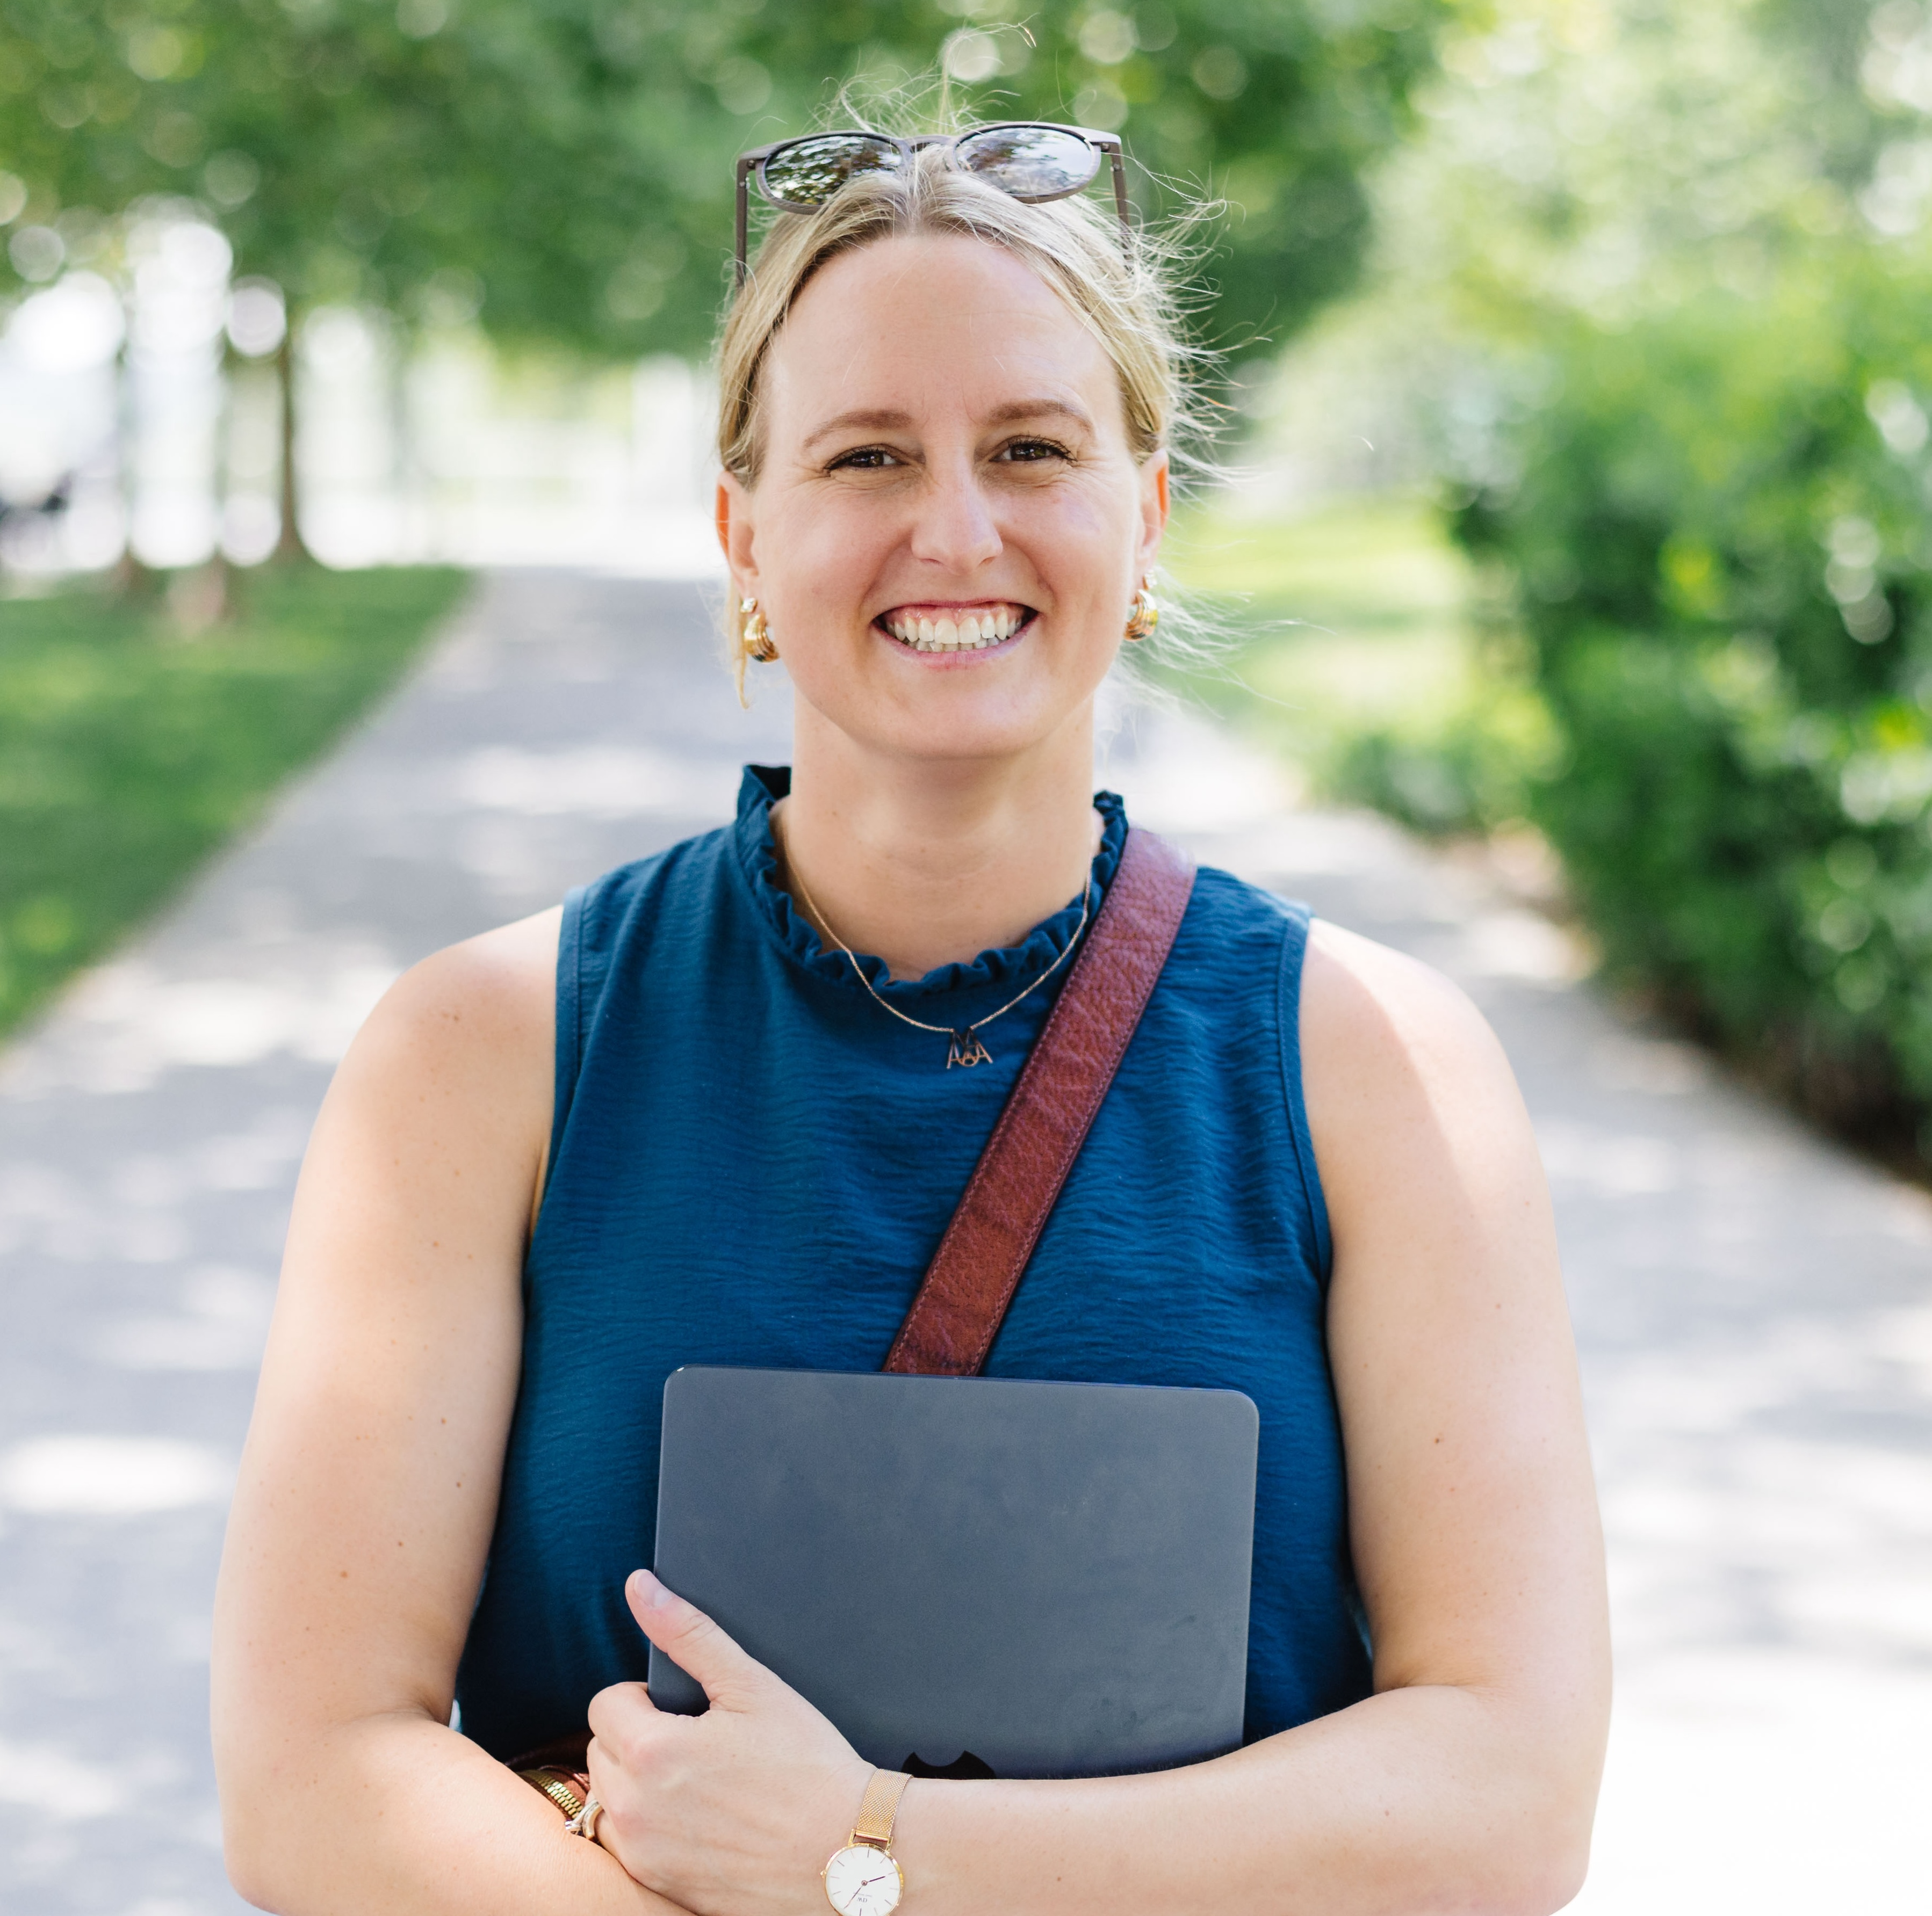
YOUR GUIDE
Denise Gosnell, Ph.D.
Fifteen years in data infrastructure. Now building an AI-first company, and Signature’s cooperative data system.
· Managed P&L for a nine-figure AWS service (2022 to 2025)
· Led a top-three AWS re:Invent launch: a new AI engine for enterprise workloads
· Chief Data Officer at DataStax, acquired by IBM in May 2025
· Bestselling, award-winning author in AI and leadership · patent holder
· Ph.D. in machine learning (2014) · Top 50 Women Leaders in SaaS
· Builds with these tools every day: Donna is her actual assistant
Notes:
Thirty seconds, not a resume. Two beats: you have run data systems at nine-figure scale, and you build with these exact tools every day (Donna is your actual assistant, not a demo). Then the two-hats line: they will also see you wearing the cooperative-data-system hat this offsite; today is the AI-workflows hat.

Slide 4
WHERE YOU SIT NOW
You run a cockpit.
Eight, nine, ten figures of business line, and the whole thing reaches you through a screen. Every number, every approval, every escalation, every relationship. You are not the person who types the most. You are the person the information has to reach, and the person the decision has to leave.
So the real question is not how fast you work. It is how your judgment gets out of your head and into the hands of everyone who needs it.
Notes:
Thirty seconds, no statistics yet. Establish that their job is a loop of information in and judgment out, not a to-do list. The kicker is the setup for the entire framing act: everything from here answers how judgment travels out of one head and into an organization.

Slide 5
WHAT TWENTY YEARS OF TRANSFORMATION BOUGHT
Digital gave you data. It never gave you time.
28%
+50%
of the knowledge-worker week goes to email.
McKinsey Global Institute, 2012.
growth in collaborative work over two decades.
Harvard Business Review, 2016.
60%
58%
of the workday is communication. Forty percent
is left to create anything. Microsoft, 2025.
of the time your organization spends deciding
is used ineffectively. McKinsey, 2019.
Twenty years of digital transformation made the signal instant. It never touched the synthesis. So the companies that pulled ahead did not buy a better tool. They built a better document.
Notes:
Read three of the four numbers out loud, not all four. The 2012 date on the email figure is the joke: that study predates most of the tools people blame for the problem. The footer is the hinge into the flywheel, so land it and turn the page immediately. If you are running long, this is the first slide to cut and you can speak two of these numbers over the cockpit slide instead.

Slide 6
HOW A NINE-FIGURE BUSINESS LINE ACTUALLY RUNS
Amazon did not win on meetings. It won on documents.
WRITE
01 WRITE
One person converts what they know into prose. A PR/FAQ. A six-pager.
01
02 READ
The room reads it in silence. Nobody presents, so nobody wins on delivery.
OPERATE
READ
06
02
THE
DOCUMENT
03 CHALLENGE
The questions attack the document, not the person.
04 REVISE
It absorbs the debate. Five to fifteen hours of writing over one to three weeks.
05
03
05 DECIDE
Go or no go. The document becomes the spec.
DECIDE
CHALLENGE
04
06 OPERATE
Teams work backwards from it. The Weekly Business Review measures against it, every metric with a named owner.
REVISE
Bezos took PowerPoint out of the S-Team room. What replaced it was not a better meeting. It was an artifact that outlives the meeting.
Bryar & Carr, Working Backwards (2021) · Nonaka & Takeuchi, The Knowledge-Creating Company (1995).
Notes:
Two full minutes; this is the spine of the whole workshop. Walk all six nodes once so the room has the vocabulary. The credibility beat is that you watched this operate at nine-figure scale, so speak from the inside. The point to land: this is not culture, it is a mechanism, and its entire purpose is converting one person's judgment into something an organization can execute without that person in the room. Nonaka called that tacit to explicit conversion in 1995 and it is still the only way anyone scales. Then set up the turn: the flywheel never changed. Only the artifact did.

Slide 7
WHAT CHANGED
The artifact is now a skill file.
WRITE
01 WRITE
You write the file. Your VIPs, your delegates, your rules, your voice. Plain English.
01
02 READ
The agent reads it. It cannot be charmed and it does not skim.
OPERATE
READ
06
02
SKILL
FILE
03 CHALLENGE
You run it against a real inbox and watch exactly where it is wrong.
04 REVISE
You edit the file. Not the model. The file.
05
03
05 DECIDE
You approve the drafts. You are still the send button.
DECIDE
CHALLENGE
04
06 OPERATE
You put it on a schedule. It runs at 4:30 every weekday without you.
REVISE
Same six steps. The reader used to be a room. Now it is an agent. That is the entire difference, and it is the whole workshop.
Every case file this afternoon is one of these nodes. You are not learning a chatbot. You are managing a document.
Notes:
This is the payoff, and the sentence people repeat afterward. Overlay it literally: same wheel, new hub. Then map the afternoon onto it out loud, because it reframes the build from tool training to executive practice. Case File 02 is WRITE. Running triage is READ and CHALLENGE. Editing the blanks is REVISE. Approving drafts is DECIDE. The scheduled task is OPERATE. Say plainly: the skill you are actually learning today is document management, and it is the same skill that ran AWS.

Slide 8
AI does not fix
a broken process.
It runs it faster.
88% of organizations now use AI somewhere. About 39% see any profit impact. About 6% see real impact.
Of roughly 25 things McKinsey tested, one predicts profit impact above all others: fundamentally redesigning the workflow.
Only 21% of adopters have redesigned a single workflow.
McKinsey, The State of AI (2025).
A vague document used to waste a meeting. A vague document now runs ten thousand times a day.
Notes:
This is the slide to quote back during the 3:30 discussion. Make the escalation concrete: an unclear process used to cost you a bad meeting. Now you have hired something that executes that unclear process perfectly and tirelessly, all day. Which is why the unglamorous middle of this workshop, writing the rules down, is the part that actually matters. Then hand to the quadrants: before we write anything, you should know what kind of executive is holding the pen.

Slide 9
BEFORE YOU WRITE ANYTHING, KNOW WHO IS HOLDING THE PEN
Four kinds of executive.
CLOSED
you control what you show
ACCURACY
Show me the reasoning before the recommendation.
TIME
Do not explain it. Close it.
ASK
you gather, then move
TELL
you move, then gather
TRUST
Who does this touch, and do they know yet?
VISION
Where else could this go?
OPEN
you show what you feel
Research from the early 1960s, and still the most useful map of an executive there is. You will recognize yourself in two of these. Most of us are one on a calm day and another on a hard one.
Merrill & Reid, Personal Styles and Effective Performance (1981), from research begun in the early 1960s.
Notes:
Take hands per quadrant; it wakes the room and tells you who you are teaching. Do not let it become a personality test, it is a setup for the next slide. The bridge: whichever quadrant you sit in, the flywheel is identical. What differs is which node you will care about, and therefore what you should optimize for in the next hour.

Slide 10
SO HERE IS YOUR ASSIGNMENT
Four ways to spend the next hour. All four are correct.
ACCURACY
TIME
You will notice: You will not trust the triage until you know why each email landed where it did.
Spend your time on: The reasoning. Write the most specific rules in the room.
You leave with: A skill file precise enough to defend in a review.
Watch out: You will want to perfect the file before running it. Run it dirty once. The mistakes are the fastest edit list you will ever get.
You will notice: You will want it scheduled and running before I finish the sentence.
Spend your time on: Getting to the scheduled task. Then come back and tighten the file.
You leave with: A running agent and a 4:54 briefing, today.
Watch out: A thin file scales thin judgment. The ten minutes on your delegates blank is the highest-return ten minutes of the afternoon.
TRUST
VISION
You will notice: Your first question is who this touches and whether it sounds like you.
Spend your time on: Voice, and the delegate handoff notes.
You leave with: Drafts your people would believe you wrote.
Watch out: You will hesitate to let it write to real humans. It never sends and it never deletes. Nothing leaves without your click.
You will notice: By Case File 02 you will stop thinking about email and start listing everything else.
Spend your time on: Keeping that list. It is your contribution at 3:30.
You leave with: A repeatable method and the first three candidates in your business.
Watch out: You will want to build the exciting one instead of finishing the boring one. Finish the inbox. It is your reference implementation.
I WILL BUILD IT MYSELF
I WILL HAND IT OFF
Both ends of this room leave with something. Builders leave with a running agent. Delegators leave with a written specification and the job description of the person who should run it. Neither is the lesser outcome. What nobody can skip is the document itself.
Notes:
This is the permission slide and the fix for the pilot attendee who got frustrated and concluded the room was not for her. Read the Watch out line for each quadrant; they are the most useful sentences on the slide and they preempt the four ways this hour goes sideways. DELIVER THE HAND-IT-OFF OFFER VERBALLY HERE, ON THE TIME QUADRANT. That is the Closed and Tell move and it belongs to the executive who wants it closed rather than explained. There is no call-to-action slide by design. Two sentences, in your own words, roughly: some of you should not be building this yourself, and that is a legitimate answer; if you would rather have it done for you, find me at the break and I will point you at the right person. Then the band: nobody has to become a builder today, the instructions stay online, and handing them to a chief of staff or an EA is a completely valid outcome. Then the one non-negotiable: whoever runs it, somebody has to write the document, and that somebody has to be the person whose judgment it encodes. That is why you are in this room and not your assistant.

Slide 11
THE PROBLEM
300
emails a day is not a communication strategy.
It’s a second job you never applied for.
Notes:
Ask for hands: who actually cleared their inbox this morning? (Nobody.) Who checked email during this slide? (Laughter — someone will have.) The number isn’t the point — the point is that every one of those 300 asks a little tax on attention, and attention is the only thing an executive can’t delegate. Until today.

Slide 12
THE FIX
“If you want somebody to just sit at her desk, answer your phones and pick up your dry cleaning, then put out a want ad, because that’s not me.”
— DONNA PAULSEN, SUITS
You don’t need a better inbox. You need a Donna.
In the show’s final seasons, the firm builds an AI assistant modeled on her. They call it “The Donna.”
The show built The Donna as fiction. You’re going to build yours for real. It’ll take about 90 minutes.
Notes:
The want-ad quote is the thesis: the job you’re hiring for isn’t phones and dry cleaning — filters and rules and a tidier inbox are the want-ad version. You’re hiring judgment: something that knows who matters, drafts in your voice, and briefs you once a day. Land the fiction-to-real line and pause — that’s the hook for the next 90 minutes.

Slide 13
House rules.
Five of them.
1 · She never sends. Drafts only: you are the send button.
2 · She never deletes. Nothing we do today is destructive.
3 · We move together. Every case file ends at a red STOP sign.
4 · Copy buttons everywhere. Nobody types more than a sentence.
5 · No question is too small. Stuck for 60 seconds? Hand up.
Notes:
Read all five slowly; this slide buys calm for the next hour. Rules 1 and 2 kill the unspoken fear (nothing sends, nothing deletes). Rule 3 sets pacing so the fast people help instead of racing ahead. After rule 5, say: if anything I just said did not compute, perfect, you are exactly who this workshop is for.

Slide 14
THE PLAN · 2:30 CONTEXT → 2:50 BUILD → 3:30 DISCUSSION → 4:00 DONE
The hiring arc
01
02
03
FIRST IMPRESSIONS
PROJECT · ~15 MIN
THE TRIAGE DESK
INSTRUCTIONS · ~15 MIN
DONNA, FULL TIME
SKILL + SCHEDULE · ~15 MIN
One desk for everything: connect Gmail + Calendar, and she drafts her first reply.
You brief her once: red, yellow, gray. Your people, your priorities, your voice.
Her playbook becomes a skill she keeps, and she takes the 4:30 evening shift.
Flywheel: WRITE + READ
Flywheel: CHALLENGE + REVISE
Flywheel: DECIDE + OPERATE
Every step is one node of the flywheel. You are writing a document, testing it, and putting it on the clock. Each case file is on the site, and every prompt has a copy button.
Notes:
Three case files, one per stretch of the flywheel they just saw. Say the arc out loud: context until 2:50, build until 3:30, discussion until 4:00, done at 4:00 with a working Donna. Point at the site, the link from the prep email. Nobody types anything longer than one sentence today.

Slide 15
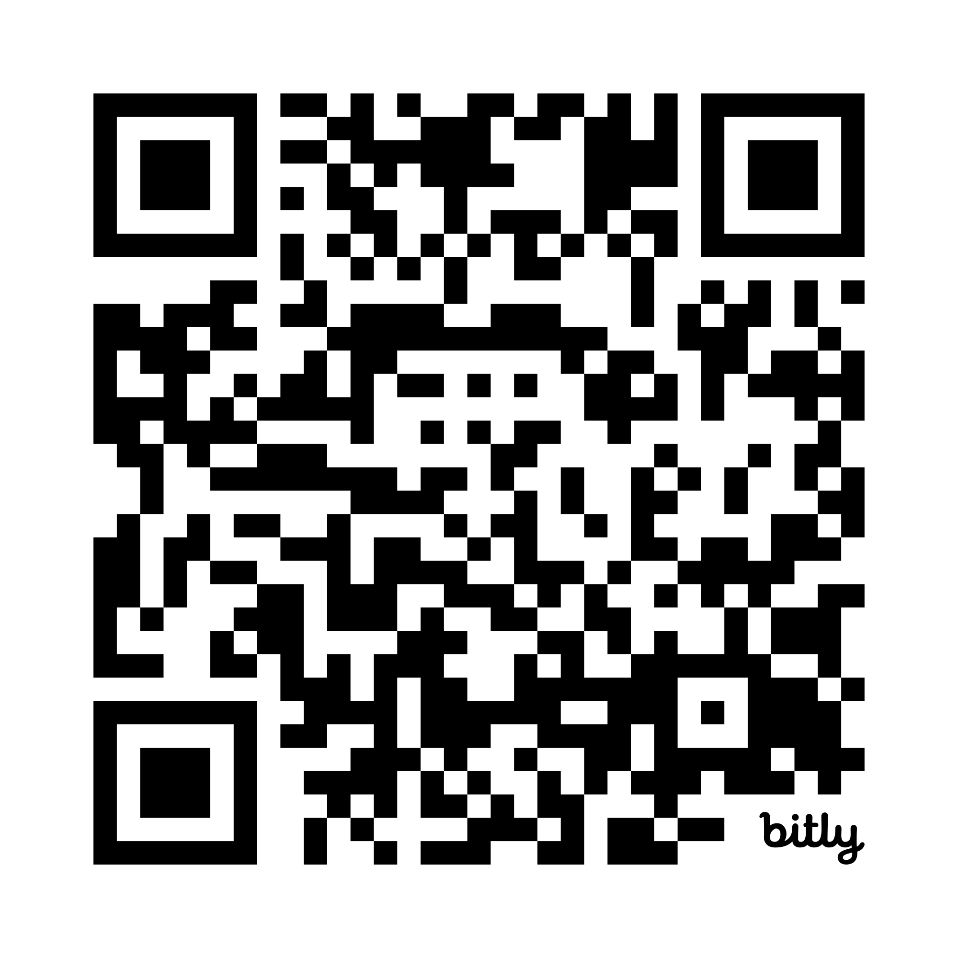
THE PLAN
Instructions [click here]
Or Scan Here
Notes:
Ask for hands: who actually cleared their inbox this morning? (Nobody.) Who checked email during this slide? (Laughter — someone will have.) The number isn’t the point — the point is that every one of those 300 asks a little tax on attention, and attention is the only thing an executive can’t delegate. Until today.

Slide 16
CASE FILE 01 · PROJECT — FIRST IMPRESSIONS
FLYWHEEL: WRITE AND READ · you are giving her the inputs and watching her read them
One desk for everything. Create her project, then connect your Google accounts.
Projects → New project → name it Donna. Then: Settings → Connectors → Connect Gmail + Calendar + Drive
STUCK CONNECTING? — THE SETUP PROMPT
Walk me through connecting my work email and calendar to Claude — first ask whether I'm on Gmail or Outlook, Mac or Windows, and whether IT manages my account, and check Anthropic's current help docs before answering so the steps match what's actually on my screen today. Then give me numbered steps naming the exact buttons to click, a way to verify it worked, and what to do if the connector isn't listed or I hit an "administrator hasn't approved this" error.
Notes:
Project FIRST, then connectors: the desk before the mail. Walk the room during connections; the classic failure is signing into the personal Google account instead of work. Everyone connects Gmail, Calendar, AND Drive now so nothing interrupts the finale. If a connector reads Connected but Claude cannot see mail: quit Claude fully and reopen it. The Setup prompt on this slide is the self-serve fallback for anyone stuck. STOP SIGN at the end of this case file: hold until every laptop passes the checkpoint.

Slide 17
CASE FILE 01 · PROJECT — FIRST IMPRESSIONS
Inside the Donna project: ask the only question that matters.
Connected, but she can’t see your inbox? Quit Claude fully and reopen it. Fixes it nine times out of ten.
PROMPT 1 — THE QUESTION
What landed in my inbox in the last 24 hours
that actually needs ME?
Top 5, one line each.
PROMPT 2 — THE FIRST DRAFT
Draft a reply to #1. Under 100 words, warm but decisive.
Save it as a draft in my Gmail so I can review it there.
Do not send it.
Notes:
Walk the room during connections — the classic failure is signing into the personal Google account instead of work. Connectors are pre-enabled workspace-wide, so all they click is Connect. Gmail people: also connect Google Calendar and Drive now (Step 4 needs both). Outlook people: Microsoft 365 covers mail, calendar, OneDrive in one go. Then prompt 1. Give it a beat — the room goes quiet when Claude answers from their real inbox.

Slide 18
CASE FILE 01 · LIVE DEMO — CHECKPOINT
✓ YOU DID IT WHEN…
A draft you didn’t write is waiting in your Gmail Drafts.
The interview is over. Donna’s hired. Now we train her.
Notes:
Run it live on your own screen first, then hold until every laptop shows five lines and a draft. Nobody moves on until the checkpoint. If a connector is stuck: disconnect, reconnect, confirm the account. If the network is stuck: switch to the backup screenshots (slide 13) and keep the energy up.

Slide 19
CASE FILE 02 · INSTRUCTIONS — THE TRIAGE DESK
FLYWHEEL: CHALLENGE AND REVISE · this is the document. everything else is plumbing
Teach her your rules once.
PROJECT INSTRUCTIONS — PASTE FROM THE SITE, FILL 4 BLANKS
The four blanks are the only editing you do:
You are Donna, my inbox triage assistant. When I say "triage my inbox":
1. Review my inbox (default: the last 24 hours).
2. Sort every thread into exactly three buckets:
🔴 RED, NEEDS ME · my VIPs, plus my #1 project:
[ADD 3-5 NAMES + EMAILS] · [ADD YOUR #1 PROJECT OR DEAL]
🟡 YELLOW, DELEGATE · work my team owns:
[ADD 1-3 DELEGATES + WHAT EACH OWNS, e.g. “Sam: billing”]
⚪ GRAY, IGNORE · newsletters, cold outreach, automated notices.
3. Show me ONE table: sender · subject · bucket · why · next move.
4. Draft replies for REDs (my voice: [ADD 3 WORDS]) and handoff
notes for YELLOWs. Save everything to my Drafts.
Never send anything. Never delete anything. Drafts only.
Your always-red list + #1 deal
the people and the deal that jump every queue
Your delegates and their lanes
1-3 people and what each owns: “Sam: billing”
Your voice, in 3 words
warm, brief, decisive is a fine start
Notes:
Four blanks now, not three: VIPs, the number-one deal, DELEGATES with their lanes, and voice. The delegates blank is the one the pilot group left empty, so call it out: yellow only works if Donna knows who owns what. Give them 6 to 8 quiet minutes to fill blanks, circulate, then everyone runs: Triage my inbox. Then the green light: yes, draft the reds and the yellow handoffs.

Slide 20
CASE FILE 02 · LIVE DEMO — CHECKPOINT
✓ YOU DID IT WHEN…
You get one table instead of an inbox.
Triage my inbox.
— the entire daily ritual, from now on
Chat is a conversation. A project is a standing arrangement.
Notes:
Everyone runs the one-sentence ritual inside the project. The payoff to name out loud: you will never re-explain your rules again — that’s the difference between a chat and a project. Common wobble: someone triages from OUTSIDE the project and gets generic results — make sure they’re inside Inbox Triage.

Slide 21
CASE FILE 03 · SKILL + SCHEDULE — DONNA, FULL TIME
FLYWHEEL: DECIDE AND OPERATE · the document leaves your hands and goes on the clock
She writes her own playbook. You hand it to Cowork.
THE PLAYBOOK — PASTE INSIDE YOUR DONNA PROJECT
Turn this project’s triage instructions into a reusable skill file
called donna-replies, modeled on the template at
denisekgosnell.github.io/Donna/skills/donna-replies/SKILL.md
Fill in every placeholder with what you already know from this project.
Then give me the finished SKILL.md as a file I can download.
Then the hand-off: DOWNLOAD the file she gives you. Open Cowork → Skills → Add skill → UPLOAD that SKILL.md.
You should see: donna-replies in your Cowork skills list.
Notes:
The step the pilot missed lives here, so go slow and demo on screen. Beat one: she writes SKILL.md from the project. Beat two: DOWNLOAD it (the file card has a download arrow). Beat three: open Cowork, then Skills, then Add skill, and UPLOAD the file. Say it plainly: a skill written in chat does not exist in Cowork until you upload it. Wait until every screen shows donna-replies in the skills list before anyone touches Scheduled tasks.

Slide 22
She never sends.
Ever.
Every reply and every handoff note lands in your Drafts and waits for your say-so. She never deletes anything, either.
Written into the skill itself: “Never send. Never delete. No exceptions.”
Notes:
Slow down here — this is the trust slide, and it answers the fear nobody has said out loud yet: “what if it emails a client?” It can’t. Drafting and sending are different permissions, and this skill only ever drafts. You are the send button. Say it twice, verbatim: she never sends. Ever.

Slide 23
CASE FILE 03 · SKILL + SCHEDULE — DONNA, FULL TIME
Give her the evening shift.
THE STANDING ORDER — COWORK → SCHEDULED TASKS → NEW TASK
Every weekday at 4:30 PM, use my donna-replies skill:
1. Triage today’s inbox; save red replies + yellow handoffs to my Drafts.
2. Write my Daily Briefing doc, "Daily Briefing: [today’s date]":
• the 5 things that need ME • the replies you drafted
• what you ignored and why • my first meeting tomorrow
3. Save it to my Google Drive in a folder called "Donna Briefings".
4. Create a calendar event today, 4:55-5:00 PM, "📋 Briefing with
Donna", doc link in the description, EMAIL reminder 1 minute before.
Also: do a dry run for today RIGHT NOW so I can check your work.
4:30 she works
4:54 you’re notified
4:55 a five-minute read
Notes:
Scheduled tasks moved areas in a recent update; if someone cannot find it, use the site's trick: ask Claude where. Grab the prompt from the site, not from memory. Gmail attaches a true EMAIL reminder; Outlook gets a calendar notification instead, with upgrades in the site's small print. The last line of the prompt is the finale: a dry run, right now.

Slide 24
CASE FILE 03 · THE DRY RUN — CHECKPOINT
4:54 PM
Her first briefing arrives before you leave the room.
The trick: Claude never emails you. Your calendar does.
The briefing lands from a sender you already trust.
Notes:
The closing moment of the build: everyone watches the dry run land. Doc in the Donna Briefings folder, event on today's calendar, drafts waiting. Hold the silence while laptops ping. Then the reframe: that 4:54 notification is the only email they now need. Email comes to YOU now, once a day, pre-digested.

Slide 25
This was never
about email.
You automated a workflow today by writing plain English: rules became a project, the project became a skill, the skill got a schedule.
Email was the rehearsal. The same flywheel runs any workflow you can describe in words.
Notes:
The pivot into discussion, and the sentence they should quote later. Recap the flywheel with THEIR artifacts: the document they wrote, the skill file they own, the schedule it now runs on. They did not learn a tool today. They ran the same mechanism that ran AWS, on their own inbox. Then the reframe: email was the rehearsal. Pause here, then go to the next slide and open the floor.

Slide 26
WHERE ELSE SHE WORKS
Same flywheel, different workflows
01
02
03
04
TWO CALENDARS
THE MORNING SHIFT
MEETING PREP
THE BRIEFING
CLIENT FOLLOW-UPS
THE SWEEP
SUPPLIER NOISE
THE DIGEST
She reads every calendar you have, writes one unified day, flags the conflicts.
Before each meeting: who’s in the room, open items, last emails. One page.
A weekly pass over every thread still waiting on you, drafts included.
Promos, rate sheets, program updates: one Monday digest, not forty emails.
A morning task
A second project
One new skill
A weekly schedule
Each one is the same flywheel: write the document, watch it run, revise it, put it on the clock.
Notes:
Give one personal story per card; the two-calendar morning shift is your own daily driver, so say so. These four are travel-shaped on purpose. Then the bottom line: every one of them is the same flywheel they just ran, which is the whole point of teaching the flywheel rather than the tool. Plant workshop number two without selling it.

Slide 27
THE DISCUSSION — UNTIL 4:00
Over to you.
Four questions to open the floor:
1 · What do you re-explain to someone every single week?
2 · What arrives daily that someone else summarizes for you?
3 · Which decision waits on you only because the data is scattered?
4 · Which quadrant did you land in, and what is the first document in your business that only works because one specific person remembers how it goes?
Notes:
Facilitate, do not lecture. Take three or four answers per question and map each one onto the flywheel out loud, so people hear their own use case become buildable. Question four is the harvest: it pulls the quadrant framing and the document framing together, and the answers are your pipeline for the next workshop. Close by pointing at the QR on the final slide.

Slide 28
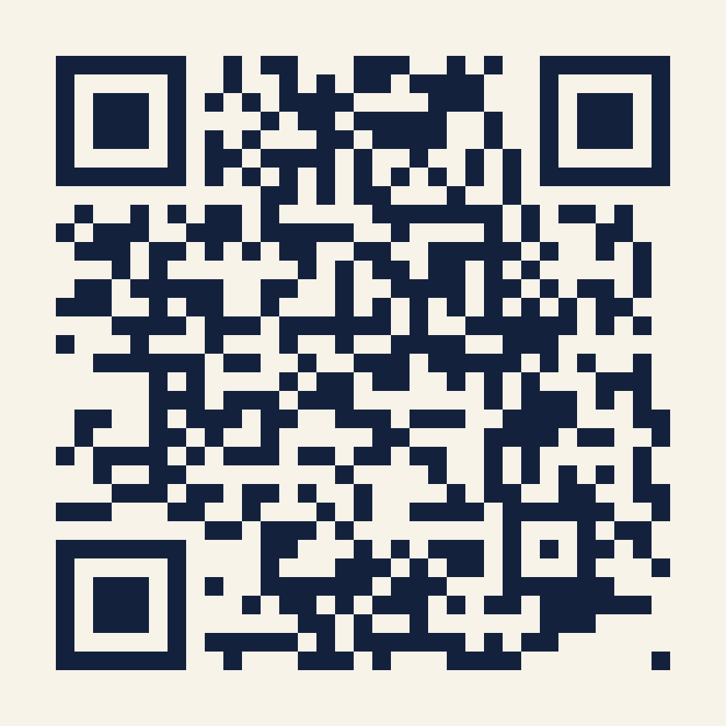
“If you were ever lucky enough to have me, you wouldn’t want to share.”
— DONNA PAULSEN, SUITS
Yours starts tomorrow at 4:54.
denisekgosnell.github.io/Donna
Notes:
Send-off: the site stays up — every prompt, every fallback, the skill itself. Scan the code, bookmark it, forward it to the colleague you know needs it. Tomorrow at 4:54 the briefing arrives on its own for the first time — when it does, that’s Donna saying she’s got it from here. Questions any time: denise@denisegosnell.ai. You’re weird. We’ll be friends.

