Slide 1
D
“I’m Donna. I know everything.”
— DONNA PAULSEN, SUITS
BUILD YOUR OWN DONNA
No code. You copy, you paste, you leave with an agent.
DENISE GOSNELL, PH.D. · WEDNESDAY, OCTOBER 21, 2026
12:00 PM ET · 9:00 AM PT · 5:00 PM LONDON · 6:00 PM PARIS
Notes:
[TIMING] 1 min.
[SAY] She ran the best closer in New York City. Today she comes to work for you. By 1:23 Eastern every one of you owns a working Donna. Not a demo. Yours, on your own inbox, and she gets better every Friday.
[DO] The preamble before this slide ran 12:00 to 12:10. Zoom housekeeping in one breath: Claude open on your laptop, the chat is for two things, a checkmark when you have it and a word when you are stuck. Name the TAs working the chat and the breakout rooms.
[WATCH] Do not start until the chat shows checkmarks from most of the room. The people who fall behind fall behind here, not later.
[NEXT] Here is how the ninety minutes go.

Slide 2
RUN OF THE SHOW
Three acts, ninety minutes.
I
II
III
The idea
The build
The wrap
12:10 TO 12:27
12:27 TO 1:23
1:23 TO 1:40
Open loops, closed loops, and the only trick in the room: an agent is just a document.
Four steps: connect, teach, run, retrain. By 1:23, Donna is working your inbox.
What you built, where the loop turns next, and your first Friday.
First the idea, then the build, then what you walk out with.
BUILD YOUR OWN DONNA
OCTOBER 21, 2026
2
Notes:
[TIMING] 1 min.
[SAY] Three acts. First the idea: open loops and closed loops, and why an agent is just a document. Then we build, four steps, and by 1:23 she is working your inbox. Then the wrap: what you built, where it turns next, and your first Friday.
[DO] Point at the middle card. That is most of the ninety minutes, and most of it is you pasting.
[WATCH] Do not read the card text. Say the three act names and the clock on the middle one.
[NEXT] Fifty-five seconds of silence. Let the video do the talking.

Slide 3
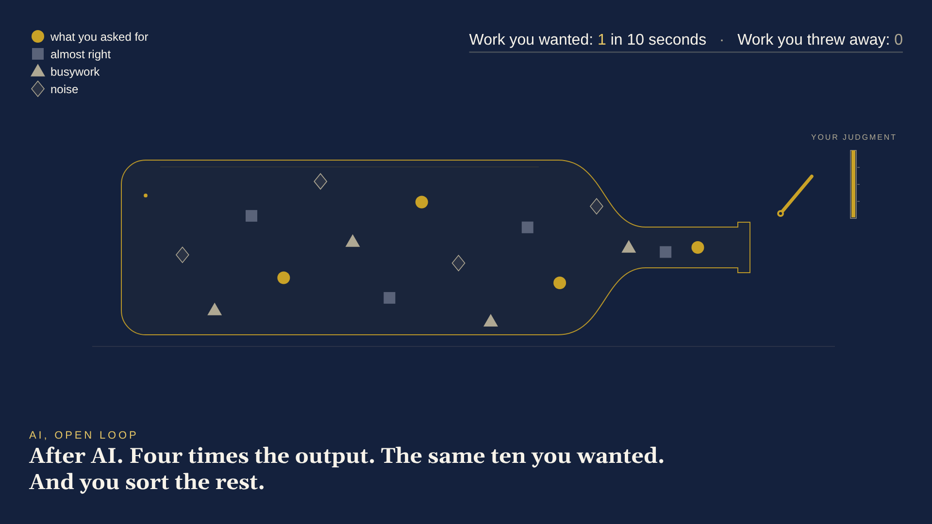
WHERE WE ARE WITH AI AT WORK
Notes:
[TIMING] 2 min.
[SAY] Nothing. Fifty-five seconds. Let it play to the end card.
[DO] Press play the moment the slide lands. If it stalls, go to the hidden slide right after this one and narrate the three stills in the captions' words.
[WATCH] The numbers are a cartoon, not a statistic. If anyone asks, say so: an illustration of what everyone in the room already feels.
[NEXT] Here is the one idea the whole hour sits on.

Slide 4
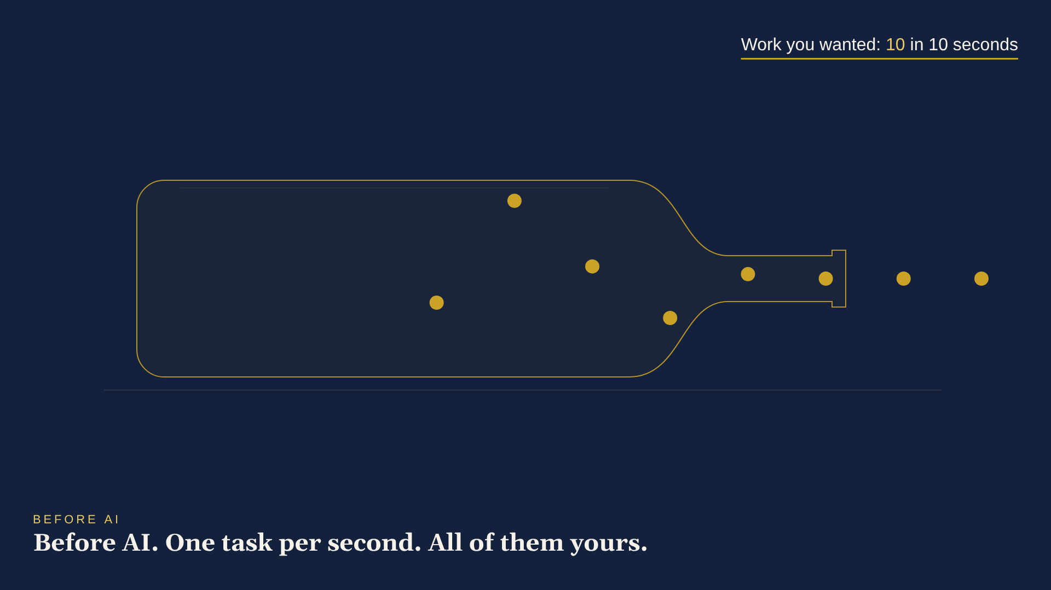
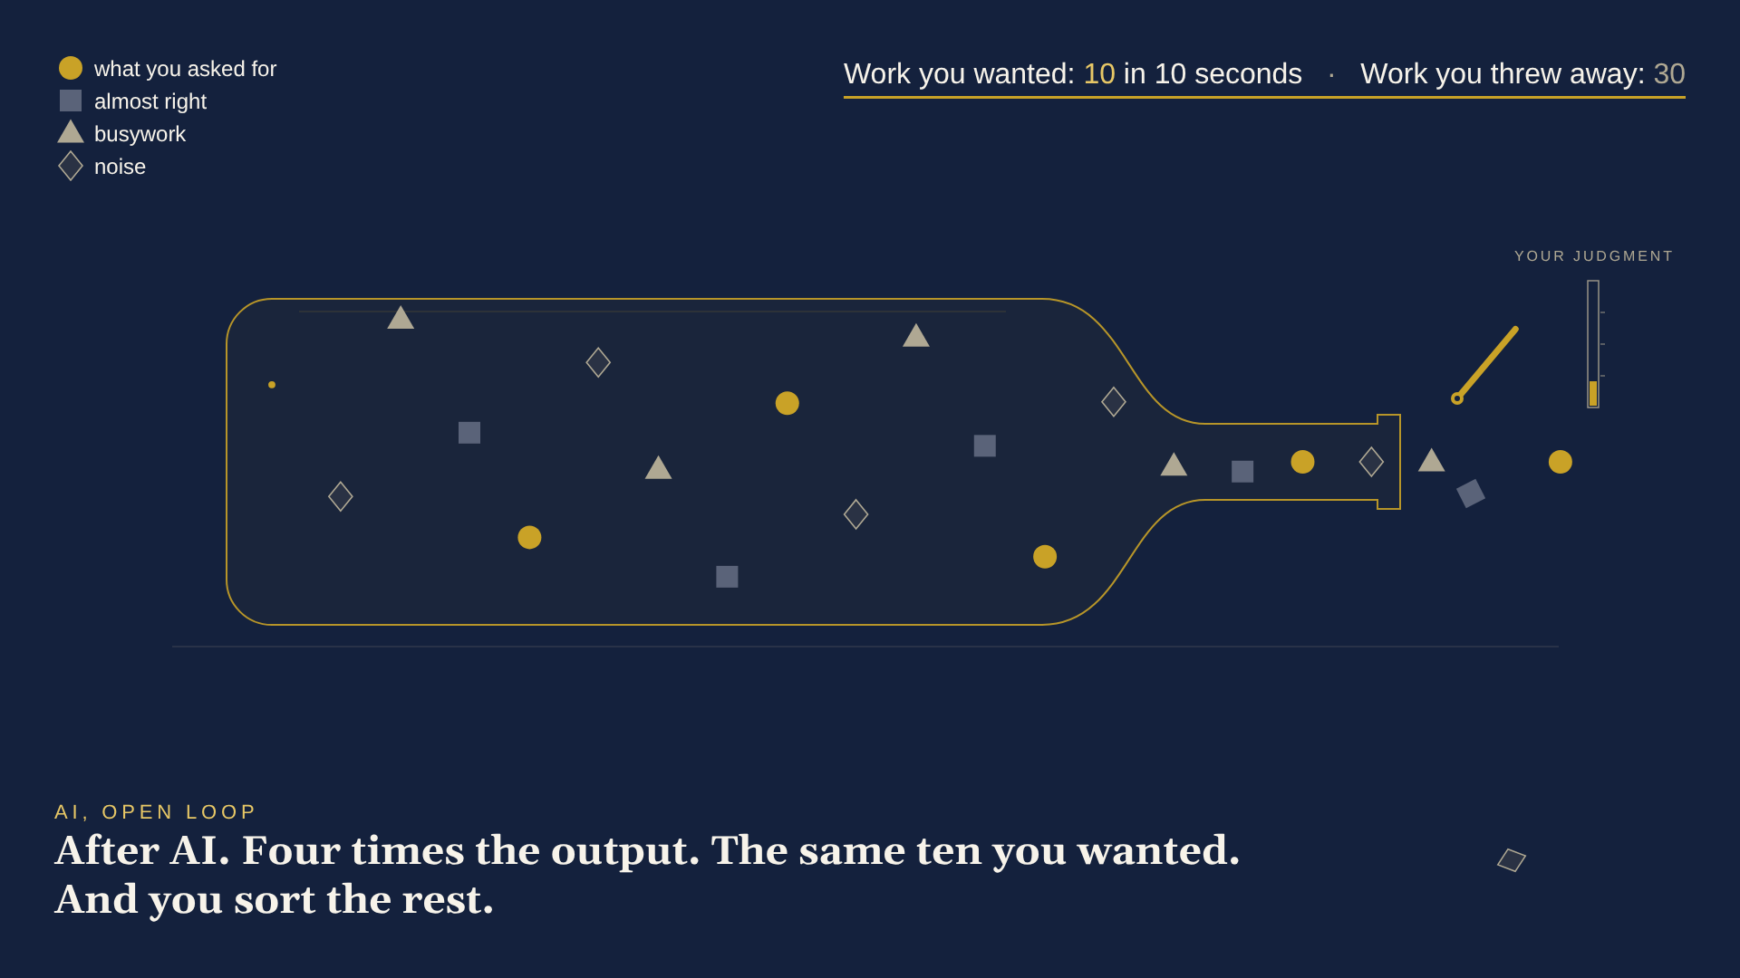
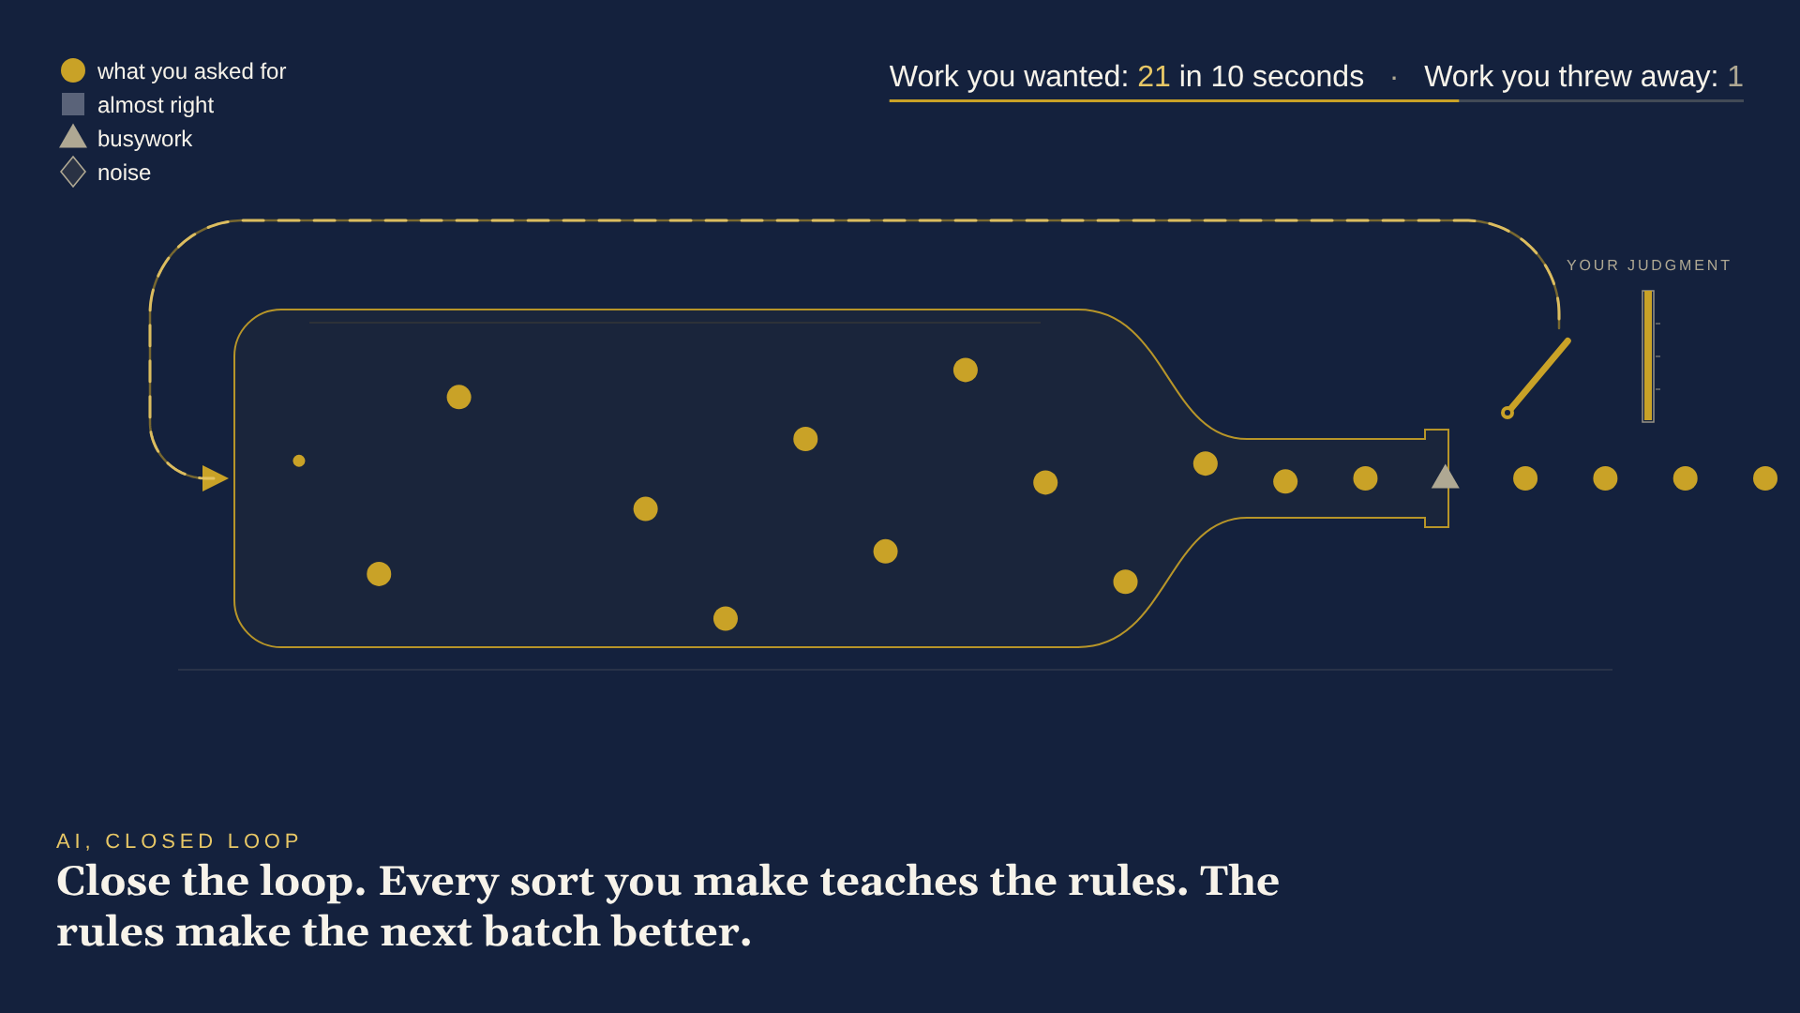
WHERE WE ARE WITH AI AT WORK · THE BOTTLE, IN THREE FRAMES
Before AI. One task per second. All of them yours.
After AI. Four times the output. The same ten you wanted. And you sort the rest.
Close the loop. Every sort you make teaches the rules. The rules make the next batch better.
BUILD YOUR OWN DONNA
OCTOBER 21, 2026
Notes:
[TIMING] 0 min. Hidden. Use only if the video on the previous slide will not play.
[SAY] Walk the three captions left to right, in those words.
[NEXT] Here is the one idea the whole hour sits on.

Slide 5
Open loops make more work.
Closed loops make better work.
OPEN
CLOSED
01
THE
RULES
work goes out
04
THE
RULES
02
nothing comes back
03
AI makes open loops cheap. That is the whole problem.
BUILD YOUR OWN DONNA
OCTOBER 21, 2026
4
Notes:
[TIMING] 1 min.
[SAY] Read the two lines at the top out loud, slowly. Then the caption: AI makes open loops cheap. That is the whole problem, and it is the whole opportunity.
[DO] Point left, then right. Open: work goes out, nothing comes back. Closed: the result comes back to whoever set the rules.
[WATCH] Do not define feedback loops, control theory, or anything with a Wikipedia page. Two sentences and move.
[NEXT] Every workflow you have is one of these two shapes. Here is the closed one, with its four stops.

Slide 6
ANY WORKFLOW YOU CAN DESCRIBE
Every workflow is a loop.
CONNECT
01 CONNECT
01
Work comes in.
02 TEACH
Write the rules down once.
RETRAIN
04
THE
WORK
02
TEACH
03 RUN
The work gets done, on a schedule.
03
04 RETRAIN
Look at what came back. Fix the rules.
RUN
Email. Invoices. Hiring. Support tickets. Same four stops.
BUILD YOUR OWN DONNA
OCTOBER 21, 2026
5
Notes:
[TIMING] 2 min.
[SAY] Four stops. Work comes in. Somebody writes the rules down once. The work gets done, on a schedule. And then the part almost nobody builds: you look at what came back and you fix the rules.
[DO] Walk the ring clockwise with your cursor so the room has the four words. Say them: connect, teach, run, retrain. They will hear those four words about forty more times today.
[WATCH] Do not get pulled into which workflows. Email, invoices, hiring, tickets. One breath. The point is the fourth stop.
[NEXT] Now, the part that is actually a computer science lecture, in one slide.

Slide 7
WHAT MACHINE LEARNING ACTUALLY IS
Machine learning runs this loop.
CONNECT
01 CONNECT
01
Collect the data.
02 TEACH
Train the model on it.
RETRAIN
04
THE
MODEL
02
TEACH
03 RUN
Put it to work and watch what it does.
03
04 RETRAIN
Compare to what you wanted. Retrain.
RUN
Over fifty years of this loop. The prompt was never the hard part. Step four was the job.
BUILD YOUR OWN DONNA
OCTOBER 21, 2026
6
Notes:
[TIMING] 1 min.
[SAY] Same four stops. This is how computer scientists have built anything that learns for over fifty years: collect the data, train the model, put it to work, then look at what it got wrong and retrain. Silicon Valley spent two years telling you the magic was in the prompt. It was not. You can ask the AI to write the prompt. The part that matters is step four, and you already know how to do it. It is called looking at how the week went.
[DO] Point at the hub: the model. Then at station four. Hold there.
[WATCH] Say 'over fifty years', not 'invented'. Engineers had feedback loops before computer scientists did. If anyone technical pushes: the textbook version adds evaluate and monitor; we fold them into RUN and RETRAIN.
[NEXT] And here is the only trick in the whole workshop.

Slide 8
WHAT YOU BUILD IN THE NEXT HOUR
An agent is just a document.
CONNECT
01 CONNECT
01
Connect her to your inbox and calendar.
02 TEACH
Four questions. She writes her playbook.
RETRAIN
04
02
TEACH
DONNA
03 RUN
She takes the 4:30 shift, every weekday.
03
04 RETRAIN
Fridays she reviews her week. You sign it.
RUN
You are not retraining Claude. You are retraining Donna. And Donna is a document you own.
BUILD YOUR OWN DONNA
OCTOBER 21, 2026
7
Notes:
[TIMING] 1 min.
[SAY] Same wheel. New hub. Donna is a document: her playbook. Connect it to your inbox, teach it your rules, run it on a schedule, and on Fridays she reads her own week and proposes edits to her own playbook. You are not retraining Claude. Nobody's model changes on Friday. You are retraining Donna, and Donna is a document you own.
[DO] Point at the red hub. That is the file they will download in step three.
[WATCH] This is the sentence people repeat afterward. Say it twice.
[NEXT] Proof that this is real: what mine does for me.

Slide 9
PROOF OF LIFE: HOW MY DONNA WORKS FOR ME TODAY
What my Donna does for me.
Holds the calendar. A thread picks a time. The hold is already on my calendar.
Reads every Slack channel. All of them. I read one briefing.
Checks the guest list. Every invite, scanned. The people who matter are on it.
Runs the 24-hour reply desk. No real email goes a day without an answer or a holding reply.
Preps me for strangers. A one-page brief before I meet anyone new, in my inbox and Drive.
Plans tomorrow at 4 PM. Before I log off, tomorrow is laid out: meetings, prep, buffers, risks.
Eggs versus balls. She watches my real goals and warns me before I drop an egg.
All of it from one playbook, written in plain English. Today you write yours.
BUILD YOUR OWN DONNA
OCTOBER 21, 2026
8
Notes:
[TIMING] 1 min.
[SAY] This is not a demo account. Mine holds calendar time the moment a thread converges, checks every invite for the people who matter, preps me before I meet a stranger, watches the eggs versus the balls, reads every Slack channel, runs a 24-hour reply desk, and plans tomorrow before I log off.
[DO] Pick two and tell the story in one breath each: the calendar hold that appeared before you finished reading, and the egg she caught. Keep it fun; the numbers are on the next slide.
[WATCH] Eggs versus balls: the goals that break if dropped are eggs; everything else bounces. She knows which is which because I wrote it down once.
[NEXT] What does that give back? The receipts.

Slide 10
THE RECEIPTS
What she gives back.
3.5 hrs
35
100+
saved on post-conference follow-ups. Four hours by hand. Thirty-three minutes with Donna, the Friday after a conference.
personalized one-to-one event invitations, written in 75 minutes. Before Donna: not possible, so not done.
meeting briefs since August 7, one per meeting, written before I walk in. 27 prep blocks on my calendar in the last 30 days.
Published benchmark: Microsoft's first 297 Copilot users reported 64% less time on email and 1.2 hours a week back. (Work Trend Index, November 2023)
BUILD YOUR OWN DONNA
OCTOBER 21, 2026
9
Notes:
[TIMING] 1 min.
[SAY] Three receipts from my own calendar. The Friday after a conference, the follow-ups that used to take four hours took thirty-three minutes. Thirty-five personalized invitations in seventy-five minutes, which I simply would not have done before. And over a hundred meeting briefs since August, every one written before I walked in.
[DO] Point at the middle number. The honest ROI is the work that was not possible before, not just the hours saved.
[WATCH] The Microsoft figure is a survey of early Copilot users, self-reported, so call it a benchmark and not a promise. Your own receipts are the ones that count; they start Thursday at 4:30.
[NEXT] One honest slide about which AI to use.

Slide 11
WHICH AI?
Pick your tool. Keep your playbook.
Copilot
Perplexity
ChatGPT
Claude
AI inside Microsoft 365. Pick it if your company lives in Outlook and Teams.
Research with sources. Ask the web, get the citations.
The everyday all-rounder, with the widest set of tricks.
Careful writing, plus agents that do the work: projects, connectors, skills, scheduled tasks.
What you build today is a plain-text playbook. Download it, and paste it into any of these tomorrow.
BUILD YOUR OWN DONNA
OCTOBER 21, 2026
10
Notes:
[TIMING] 1 min.
[SAY] One phrase each, no religion. Copilot is the AI inside Microsoft 365. Perplexity is research with sources. ChatGPT is the everyday all-rounder. Claude is careful writing plus agents that do the work, which is why today runs on it: projects, connectors, skills, and scheduled tasks.
[DO] Point at the dark card, then at the caption. The skill you build today is a file. It is portable.
[WATCH] Do not get pulled into a feature war. The honest answer to 'which is best' is: the playbook is yours either way; the tool is the one your company allows.
[NEXT] And one honest slide about free versus paid.

Slide 12
FREE OR PAID CLAUDE?
Free works. You press start.
ON EVERY PLAN, FREE INCLUDED
PAID PLANS ADD
Steps 1 and 2, exactly as written.
Scheduled tasks: she starts the 4:30 shift and the Friday retrain without you.
Her playbook as a skill you own (Step 3).
Say "Triage my inbox" at 4:30: her shift, started by you.
That is the whole difference: who presses start.
Say "Retrain" on Friday: her review, started by you.
An agent you start by hand is still an agent. Two phone reminders replace the scheduler: 4:30 weekdays, 3:00 Fridays.
BUILD YOUR OWN DONNA
OCTOBER 21, 2026
11
Notes:
[TIMING] 1 min.
[SAY] If you are on the free plan, nothing today is closed to you except one button. Steps 1 and 2 are identical. In step 3 you still build the skill. The paid plans add scheduled tasks, so she starts her own shift. On Free, you start it: open the Donna project at 4:30 and say Triage my inbox. Friday, say Retrain. Same agent, same playbook. Only the start button moves.
[DO] Point at the left column, then the one line on the right. Do not apologize for the free plan; it is a complete build.
[WATCH] The site has a free-plan box in Step 3 and Step 4 with the exact sentences to paste. Phone reminders at 4:30 and Friday 3:00 replace the scheduler.
[NEXT] One promise before anyone connects an inbox.

Slide 13
She never sends. Ever.
She never deletes. She reads your inbox and your calendar, writes drafts, and puts events on your calendar. That is her whole job, and it is written into her playbook.
Written into the skill itself: “Never send anything. Never delete anything.”
Notes:
[TIMING] 1 min.
[SAY] Say it twice, verbatim: she never sends. Ever. And she never deletes.
[DO] Slow down here. This is the trust slide, and it answers the fear nobody has typed in the chat yet: what if it emails a client?
[WATCH] Her playbook forbids it in its first line, and nothing leaves until you press send on a draft you have read. You are the send button. If someone asks about privacy, the appendix has the plan-by-plan answer; do not go there now.
[NEXT] Five house rules, then we build.

Slide 14
HOUSE RULES
Five of them.
1
She never sends. Drafts only. You are the send button.
2
She never deletes. Nothing we do today is destructive.
3
We move together. Every step ends at a checkpoint: type ✓ in the chat.
4
Copy buttons everywhere. Nobody types more than a sentence.
5
No question is too small. Stuck for 60 seconds? Say so in the chat or raise your hand. A TA takes you into a Zoom room, 1:1.
If anything I just said did not compute, perfect. You are exactly who this is for.
BUILD YOUR OWN DONNA
OCTOBER 21, 2026
13
Notes:
[TIMING] 1 min.
[SAY] Read all five slowly. This slide buys calm for the next hour.
[DO] Rules 1 and 2 kill the unspoken fear. Rule 3 is how we move on Zoom: a checkmark in the chat at every checkpoint, and nobody moves until the count matches. Rule 5: say so in the chat or raise your hand, and a TA takes you into a Zoom room one to one.
[WATCH] After rule 5, say the last line out loud. It is the one that keeps people from hiding.
[NEXT] Four steps. By 1:23 she is working for you.

Slide 15
THE PLAN, EASTERN
Four steps. By 1:23 she’s working for you.
01
02
03
04
CONNECT
TEACH
RUN
RETRAIN
A desk, your inbox, her first draft.
Four questions. She writes her playbook.
Her playbook becomes a skill on a schedule.
One more task: Fridays she reviews her week.
12:27
12:41
12:55
1:11
Nobody types anything longer than one sentence today. Every prompt has a copy button on the site.
BUILD YOUR OWN DONNA
OCTOBER 21, 2026
14
Notes:
[TIMING] 1 min.
[SAY] Four steps, one per station of the loop you just saw. Connect at 12:27, teach at 12:41, run at 12:55, retrain at 1:11. At 1:23 she is working for you, and she has already given herself her first performance review.
[DO] Say the arc out loud, then point at the clock on each card. From here, each step opens with one slide that says what we are doing, then we switch to the site.
[WATCH] Nobody types anything longer than one sentence today. Say that; it lowers the temperature.
[NEXT] Last thing before we build: everyone opens the instructions.

Slide 16
BEFORE WE BUILD
Open the instructions.
donnainstructions.denisegosnell.ai
PASSWORD
donna2026
Phone or laptop. Keep it open: every prompt has a copy button.
The site is the live version. If they disagree, the site wins.
BUILD YOUR OWN DONNA
OCTOBER 21, 2026
15
Notes:
[TIMING] 1 min.
[SAY] Open the site now, on your phone or in a tab beside Claude. Type the password: donna2026, all lowercase, no spaces. The TAs are putting the link and the password in the chat.
[DO] Say the password out loud twice and paste the link and the password into the Zoom chat yourself. Wait for checkmarks.
[WATCH] Someone will type the password with a capital letter or a space; the site ignores both. Someone else will be on the promo page instead of the instructions; the link in the chat fixes it.
[NEXT] Step one.

Slide 17
CONNECT
STEP ONE · CONNECT
First impressions.
Give her a desk, connect your inbox, and watch her read it.
IN THIS STEP
1/ Create her project.
2/ Connect Gmail, Calendar, and Drive.
3/ Two prompts: the question, then the first draft.
Now go to the instructions: Step 1 on the site.
donnainstructions.denisegosnell.ai
BUILD YOUR OWN DONNA
OCTOBER 21, 2026
16
Notes:
[TIMING] 1 min.
[SAY] Step one, three things: create her project, connect the three Google accounts, then two prompts. The desk before the mail.
[DO] Read the three lines. Then switch the screen share to the site, Step 1, and stay there until the checkpoint.
[WATCH] Watch the pip in the top right. One of four stations lit. By 1:23 all four are.
[NEXT] The site, Step 1.

Slide 18
STEP ONE · FIRST IMPRESSIONS
Create her project, then connect.
CONNECT
THE SETUP
PROMPT 1 · THE QUESTION
Projects, New project. Name it Donna.
What landed in my inbox in the last 24
hours that actually needs ME? Top 5, one
line each.
Customize, then Connectors.
Connect Gmail, Calendar, and Drive.
PROMPT 2 · THE FIRST DRAFT
Draft a reply to #1. Under 100 words,
warm but decisive. Read my sent emails
and learn how I write. Never use em
dashes. Never use AI speech patterns.
Save it as a draft. Do not send it.
Still stuck? Say so in the chat or raise your hand. A TA takes you into a Zoom room, 1:1.
BUILD YOUR OWN DONNA
OCTOBER 21, 2026
17
Notes:
[TIMING] 8 min.
[SAY] Project first, then connectors. The desk before the mail. Then two prompts, from the site, inside the Donna project. Prompt 2 now makes her read your Sent folder first, and bans em dashes and AI speech patterns.
[DO] Share the site, Step 1. Give prompt 1 a beat: the chat goes quiet when Claude answers from their real inbox. Then prompt 2, and send them to their Drafts folder.
[WATCH] The classic failure is signing into the personal Google account instead of work, or a work account whose IT blocks the connector: the note on the page says bring a personal Gmail. If a connector reads Connected but Claude cannot see mail, quit Claude fully and reopen. Still stuck: a TA takes them into a Zoom room.
[NEXT] Hold at the checkpoint.

Slide 19
STEP ONE · CHECKPOINT
CONNECT
A draft you didn’t write is waiting in your drafts folder.
The interview is over. She’s hired. Now we teach her.
BUILD YOUR OWN DONNA
OCTOBER 21, 2026
18
Notes:
[TIMING] 5 min.
[SAY] Nothing until the chat shows a checkmark from nearly everyone.
[DO] Run it live on your own screen first, then hold. Count the checkmarks out loud. The TAs chase the stuck.
[WATCH] If a connector is stuck: disconnect, reconnect, confirm the account. If someone is hopelessly stuck, a TA takes them into a Zoom room and the room keeps moving.
[NEXT] Step two, and this is the one that matters.

Slide 20
TEACH
STEP TWO · TEACH
The triage desk.
Four questions. She writes her own playbook.
IN THIS STEP
1/ Paste her playbook into a new chat.
2/ Answer her four questions. Take your time.
3/ Type: Triage my inbox.
Now go to the instructions: Step 2 on the site.
donnainstructions.denisegosnell.ai
BUILD YOUR OWN DONNA
OCTOBER 21, 2026
19
Notes:
[TIMING] 1 min.
[SAY] Step two is the document. Everything else today is plumbing. Three things: paste her playbook into a new chat in the Donna project, answer her four questions, then type Triage my inbox.
[DO] Pip moves to TEACH. Read the three lines, then share the site, Step 2.
[WATCH] Give people time here. The better the answers, the better the Donna.
[NEXT] The site, Step 2.

Slide 21
STEP TWO · THE TRIAGE DESK
This is the document. She writes it.
TEACH
PASTE INTO A NEW CHAT IN YOUR DONNA PROJECT
THE FOUR QUESTIONS
Here is my triage playbook template. Read it, then run
its Setup Interview on me exactly as written: four
questions, one question at a time, and give me time to
answer. Start now with your greeting and Question 1 of
4.
[the full template rides along in the same paste. One
copy button on the site, Step 2.]
1 · Reply Now the 3 to 5 who never wait
2 · By End of Day your team
3 · Your priorities one to three, right now
4 · Your voice three words and a sign-off
Take your time. The better you answer, the better she works.
BUILD YOUR OWN DONNA
OCTOBER 21, 2026
20
Notes:
[TIMING] 9 min.
[SAY] You do not write the document. You answer four questions and she writes it. Reply Now, By End of Day, your priorities, your voice. Take your time; specific answers make a better Donna.
[DO] Everyone pastes the template from the site into a NEW chat inside the Donna project. Gate: every screen shows 'Four questions. Take your time.' and QUESTION 1 OF 4. Checkmarks in the chat. Then let them answer. Circulate through the chat with the TAs.
[WATCH] Someone will paste OUTSIDE the Donna project and get generic results; get them inside the project, it is the first note on the page. Nobody gets hurried: there is no shortcut phrase this time.
[NEXT] The checkpoint, and the ritual.

Slide 22
STEP TWO · CHECKPOINT
TEACH
You get one table instead of an inbox.
THE ENTIRE DAILY RITUAL, FROM NOW ON
Triage my inbox.
Chat is a conversation. A playbook is a standing arrangement.
BUILD YOUR OWN DONNA
OCTOBER 21, 2026
21
Notes:
[TIMING] 4 min.
[SAY] You will never re-explain your rules again. That is the difference between a chat and a playbook.
[DO] After the OPEN FOR BUSINESS banner, everyone runs the one-sentence ritual inside the project. Hold until the checkmarks say every screen shows a table.
[WATCH] Reply-Now drafts are already sitting in their Drafts folder. Have them check; that is the gasp.
[NEXT] Step three. The document leaves your hands.

Slide 23
RUN
STEP THREE · RUN
Donna, full time.
The document leaves your hands and goes on the clock.
IN THIS STEP
1/ She writes her playbook file.
2/ You upload it as a skill.
3/ Schedule the 4:30 shift.
Now go to the instructions: Step 3 on the site.
donnainstructions.denisegosnell.ai
BUILD YOUR OWN DONNA
OCTOBER 21, 2026
22
Notes:
[TIMING] 1 min.
[SAY] Step three is where it stops being a conversation and becomes an employee. Three things: she writes her playbook file, you upload it as a skill, then you schedule the 4:30 shift.
[DO] Pip moves to RUN. Read the three lines, then share the site, Step 3.
[WATCH] Free-plan people: the first two work for them; the schedule needs a paid plan, and the site says what they do instead.
[NEXT] The site, Step 3.

Slide 24
STEP THREE · HER PLAYBOOK
She writes her own playbook file.
RUN
PASTE IN THE SAME CHAT, AFTER YOUR FIRST TABLE
THEN THE HANDOFF
Turn this conversation's triage setup into a reusable
skill named donna-triage. Fill in the template with
everything you learned about me. Keep the daily shift,
the Friday retrain, and the Setup Interview. Keep the
hard rules: never send, never delete. Give me the
skill as a downloadable zip named donna-triage.zip
containing donna-triage/SKILL.md.
1
She writes the file.
2
Download it: the file card's arrow.
3
Customize, Skills, +, Create skill, Upload a skill. Pick the zip.
Full prompt on the site, Step 3. See donna-triage in your skills list before anyone touches Scheduled.
BUILD YOUR OWN DONNA
OCTOBER 21, 2026
23
Notes:
[TIMING] 6 min.
[SAY] A skill written in chat does not exist until you upload it. The file is a zip; the Skills screen wants a zip. Go slow and demo it on screen.
[DO] Three beats. She writes it. You DOWNLOAD it. You UPLOAD it under Customize, Skills, plus, Create skill, Upload a skill. Wait until the chat says every screen shows donna-triage in the list.
[WATCH] Stay in the SAME chat as step two; a fresh chat has not met them yet and writes a blank template. The gotchas are on the site: no Skills menu means the capability switch is off; a refused upload means the zip is not a folder with SKILL.md inside. The workaround for anyone: paste the playbook text into the scheduled task itself.
[NEXT] Now give her the 4:30 shift.

Slide 25
STEP THREE · THE 4:30 SHIFT
Give her the 4:30 shift.
RUN
SCHEDULED · NEW TASK · CREATE WITH CLAUDE
4:30
she works
Every weekday at 4:30 PM my local time, use my
donna-triage skill: triage today's inbox, save the
Reply-Now drafts to my email Drafts, create a 5-minute
calendar event 10 minutes from now titled "Inbox
Triage: Donna", write the whole report into the event
description (short lines, no tables), and set an EMAIL
reminder 1 minute before. Also do a dry run right now
so I can watch the first one land.
4:39
the email lands
4:40
one read, whole inbox
Runs on Claude's side, laptop closed.
Paid plans only. Free: run her by hand.
Full prompt on the site, Step 3. Paste by 1:06.
BUILD YOUR OWN DONNA
OCTOBER 21, 2026
24
Notes:
[TIMING] 5 min.
[SAY] The last line of that prompt is the finale of this step: a dry run, right now, with today's event ten minutes out so the email lands while we are still together.
[DO] Grab the prompt from the site rather than retyping. Scheduled in the left sidebar, New task, Create with Claude. If Claude asks how much she may do without checking in, pick the hands-free option. Free-plan people: no Scheduled menu; they run her by hand with Triage my inbox, and the site says so.
[WATCH] Scheduled tasks run on Anthropic's side now, so a closed laptop is fine; say that plainly. 'My local time' matters: half this room is in Europe. Paste by 1:06 at the latest so the event lands before step four.
[NEXT] Everybody watch your calendar.

Slide 26
STEP THREE · CHECKPOINT · EASTERN
RUN
1:11
Her first shift lands as the last step starts.
The trick: Claude never emails you. Your calendar does.
Three stations lit. One left, and it is one more scheduled task.
BUILD YOUR OWN DONNA
OCTOBER 21, 2026
25
Notes:
[TIMING] 4 min.
[SAY] Open today's calendar. The checkmark is the event with the triage inside it. The email arrives a minute before it starts, right as step four begins.
[DO] Everyone opens the event: the whole triage in its description, drafts waiting. Hold the silence. Checkmarks in the chat.
[WATCH] The event appears when the dry run finishes, two to five minutes after the paste; the email follows ten minutes after the task started, so most land around 1:15. Do not wait for the email here. Move on at 1:11 and let it arrive during step four.
[NEXT] Three stations lit. Now the one almost nobody builds.

Slide 27
RETRAIN
STEP FOUR · RETRAIN
Her performance review.
One more scheduled task. Every Friday she reviews her week. You sign it.
IN THIS STEP
1/ Schedule the Friday retrain.
2/ Watch her first review land at 1:23.
3/ Monday: sign it.
Now go to the instructions: Step 4 on the site.
donnainstructions.denisegosnell.ai
BUILD YOUR OWN DONNA
OCTOBER 21, 2026
26
Notes:
[TIMING] 1 min.
[SAY] Step four. Donna Paulsen would never sit through a performance review. So she gives herself one, every Friday, and you sign it. It is one more scheduled task, same place as the 4:30 shift.
[DO] Pip: all four stations lit. Read the three lines, then share the site, Step 4.
[WATCH] Nothing yet.
[NEXT] The site, Step 4.

Slide 28
STEP FOUR · THE FRIDAY RETRAIN
Fridays, she reads her week.
RETRAIN
SCHEDULED · NEW TASK · CREATE WITH CLAUDE
SHE LOOKS AT
Every Friday at 3:00 PM my local time, use my
donna-triage skill to retrain: read this week's triage
reports, drafts, and the emails I actually sent.
Compare. Propose changes to my playbook: people,
priorities, voice. Keep the hard rules. Put "Donna's
Week in Review" on my calendar Monday 8:00 AM with an
EMAIL reminder and save it to a Drive folder called
"Donna". Also do a dry run right now on this week so
far.
her reports
her drafts
your sent emails
WHAT COMES BACK
changes, with a why
you approve first
Full prompt on the site, Step 4. Paste by 1:13.
BUILD YOUR OWN DONNA
OCTOBER 21, 2026
27
Notes:
[TIMING] 6 min.
[SAY] Your Sent folder is her report card. She reads the reports she wrote, the drafts she saved, and the emails you actually sent, and she proposes changes to her own playbook. Numbered, each with a because. Nothing changes until you say approve.
[DO] Paste first, by 1:13, then talk. Same place as the daily shift: Scheduled, New task, paste. The last line runs it right now on this week so far, with today's event ten minutes out, which lands at 1:23 if the paste is at 1:13. Talk through the Sent-folder idea while she reads the week. Yes, on a Wednesday: the Sent folder since Monday gives her plenty to say.
[WATCH] Someone will ask whether she can just apply the changes herself. No, and that is the point: the human signature is what closes the loop. Monday, one paste and one upload, only when she proposes something.
[NEXT] While she reads: the reframe.

Slide 29
This was never about email.
You built a loop today by writing plain English. Rules became a project, the project became a skill, the skill got a schedule, and the schedule got a Friday.
Email was the rehearsal. The same loop runs any workflow you can describe in words.
BUILD YOUR OWN DONNA
OCTOBER 21, 2026
28
Notes:
[TIMING] 2 min.
[SAY] While her review is landing: recap the loop with THEIR artifacts. The playbook she wrote, the skill file they own, the schedule it runs on, the Friday it learns on. They did not learn a tool today. They built a loop, and closed it.
[DO] Two minutes, no more. Then the calendar.
[WATCH] Nothing.
[NEXT] 1:23. Open your calendar.

Slide 30
STEP FOUR · CHECKPOINT · EASTERN
THE LOOP IS CLOSED
1:23
Her first Week in Review is on your calendar.
Four stations. Connect, teach, run, retrain. That is a learning system, and it is yours.
The loop is closed.
BUILD YOUR OWN DONNA
OCTOBER 21, 2026
29
Notes:
[TIMING] 3 min.
[SAY] Nothing. Let it land. Then: four stations. Connect, teach, run, retrain. That is a learning system, and it is yours.
[DO] Everyone opens the event: proposed changes at the top, numbered, each with a because. Checkmarks in the chat. Point at the pip: all four lit, and the caption says the loop is closed.
[WATCH] A few reviews will land a minute or two late. Keep talking; they will arrive during the next slide.
[NEXT] What did we just build?

Slide 31
THREE ACTS, REVISITED
What you just built.
I
II
III
The idea
The build
The wrap
DONE
DONE, 1:23
NOW
Every workflow is a loop. Closed loops get better. You can name all four stations.
A project, a playbook she wrote, a skill you own, two standing orders. She is live.
Where your loop turns next, and the Friday she tells you what she got wrong.
You did not learn a tool today. You built a loop, and closed it.
BUILD YOUR OWN DONNA
OCTOBER 21, 2026
30
Notes:
[TIMING] 1 min.
[SAY] Same three cards from the top of the hour. The idea: every workflow is a loop, and closed loops get better. The build: a project, a playbook she wrote, a skill you own, two standing orders, and she is live. The wrap starts now.
[DO] Point at each card in turn. This is the slide you promised them at 12:12.
[WATCH] Free-plan people built the same thing; their standing orders are two phone reminders. Say so if you see the question in the chat.
[NEXT] Where does the loop turn next?

Slide 32
THE DISCUSSION
Where does the loop turn next?
CONNECT
CONNECT: What arrives every day that you read by hand?
01
TEACH: What do you re-explain to somebody every single week?
RETRAIN
04
THE
WORK
02
TEACH
RUN: What would you want running at 4:30 tomorrow without you?
03
RETRAIN: What did you learn last month that nobody wrote down?
RUN
Answer any one of these out loud and you have just specified your next agent.
BUILD YOUR OWN DONNA
OCTOBER 21, 2026
31
Notes:
[TIMING] 12 min.
[SAY] Same four stations, pointed at the rest of your work. Every one of these questions is a workflow somebody on this call is doing by hand.
[DO] Facilitate from the chat; read answers aloud and map each one onto the ring so people hear their own use case become buildable. Three or four answers per station.
[WATCH] Give one personal story: the two-calendar morning shift is your own daily driver, so say so. The RETRAIN answers are your pipeline for the next workshop. Write them down.
[NEXT] What happens next, starting tomorrow.

Slide 33
WHAT HAPPENS NEXT
Your first Friday.
Mon 8:00
Thu 4:30
her Week in Review, on your calendar
her first real shift
Fri 3:00
Mon, you sign it
her first real retrain
one paste, one upload
If she gets it wrong, you do not need a better prompt. You need to retrain with better info, and more specific info.
donnainstructions.denisegosnell.ai · denise@denisegosnell.ai
BUILD YOUR OWN DONNA
OCTOBER 21, 2026
32
Notes:
[TIMING] 3 min.
[SAY] Tomorrow at 4:30 she works her first real shift, and the email lands at 4:39. Friday at 3:00 she reads her week. Monday at 8:00 her Week in Review is on your calendar, and you sign it with one paste and one upload. If she gets it wrong, you do not need a better prompt. You need to retrain with better info, and more specific info.
[DO] Point at Monday. That is the loop closing for the first time without you in the room.
[WATCH] The site stays up: every prompt, every rescue prompt, the Monday signature. Questions to the email address, any time.
[NEXT] Send-off.

Slide 34
D
“If you were ever lucky enough to have me, you wouldn’t want to share.”
— DONNA PAULSEN, SUITS
Yours starts tomorrow at 4:30.
donnainstructions.denisegosnell.ai · denise@denisegosnell.ai
Notes:
[TIMING] 1 min.
[SAY] Tomorrow at 4:39 the triage arrives on its own for the first time. Friday she reads her week. Monday she tells you what she wants to change. When that lands, that is Donna saying she has got it from here.
[DO] Questions any time: denise@denisegosnell.ai. The site stays up with every prompt.
[WATCH] Stop the recording after the last question, not before.
[NEXT] Done. You're weird. We'll be friends.

