Slide 1
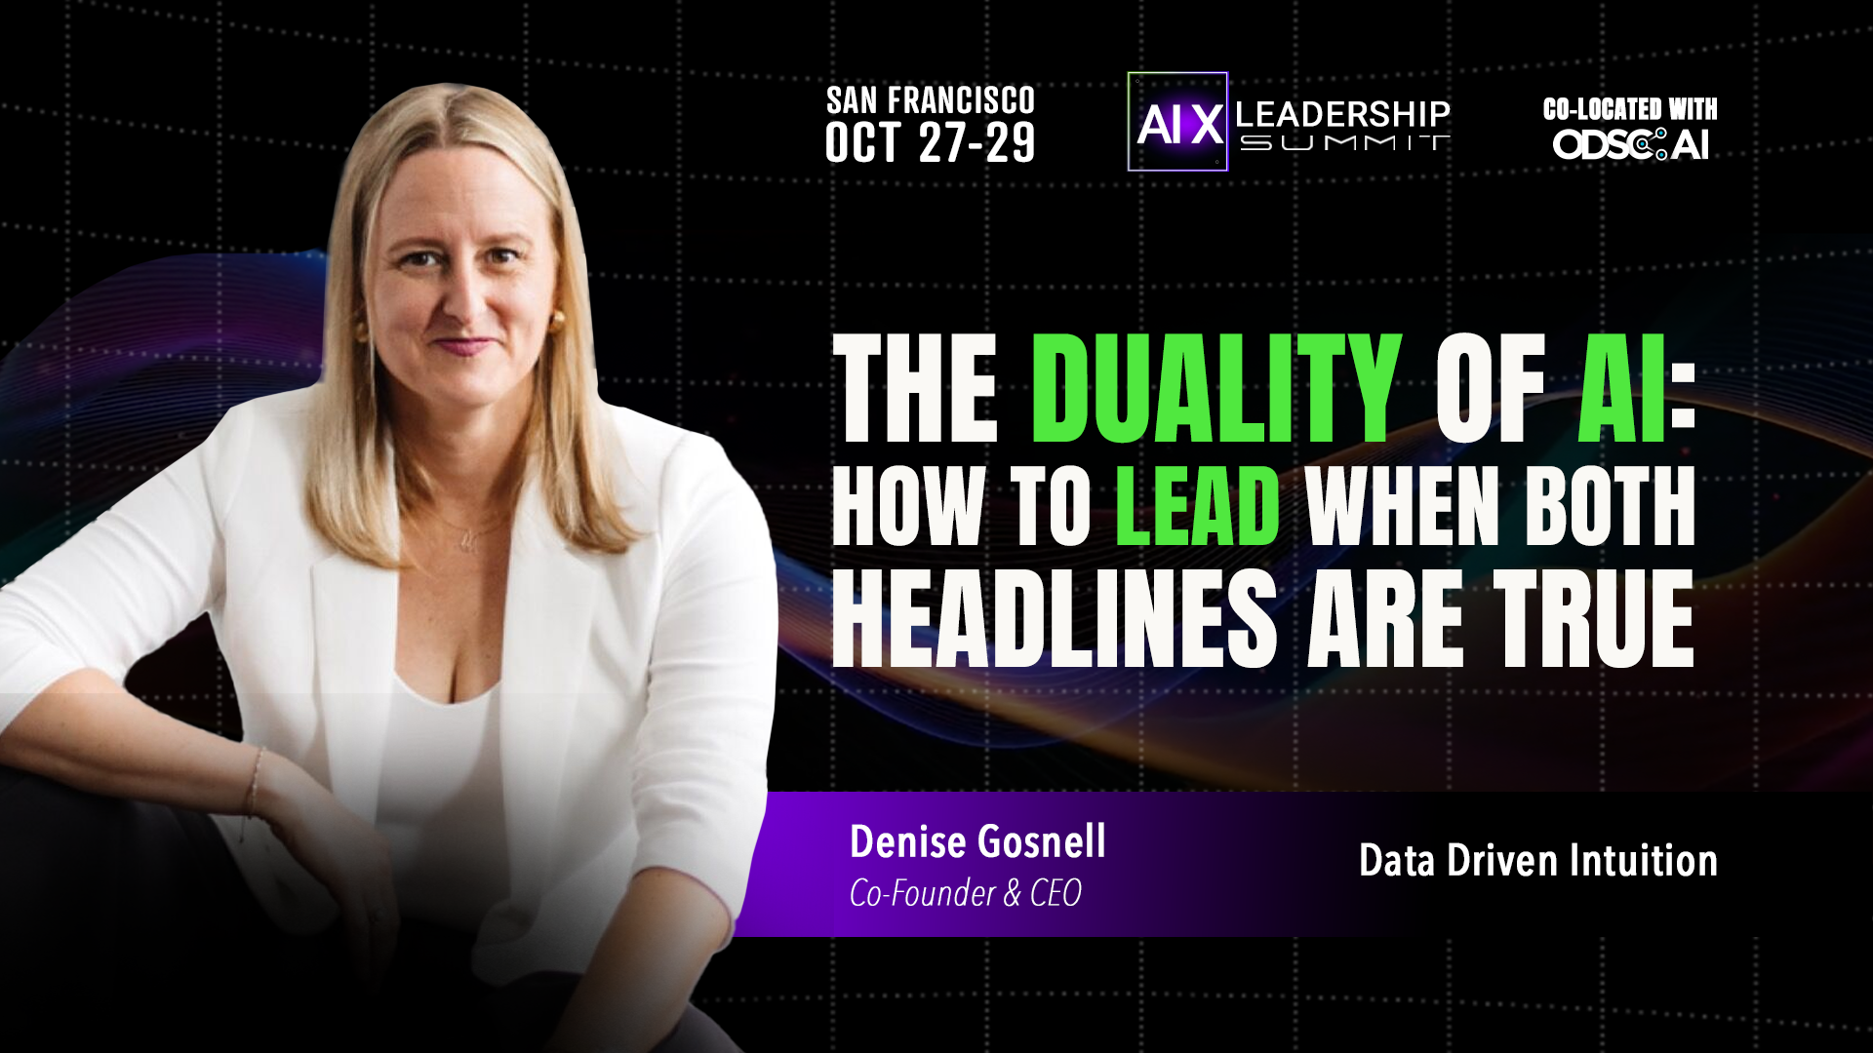
Notes:
Host intro • wait for applause • click → TN photos
• no script on this slide
• first click → two TN photos → your opener, then "In late April of 2014…"

Slide 2
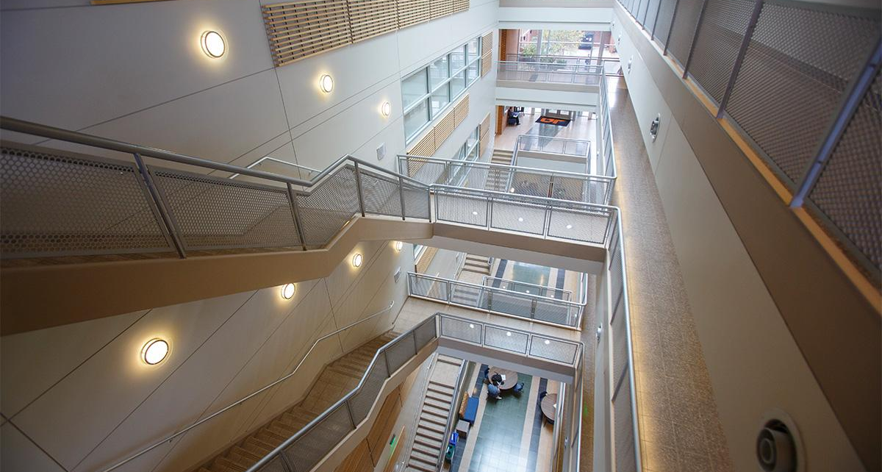
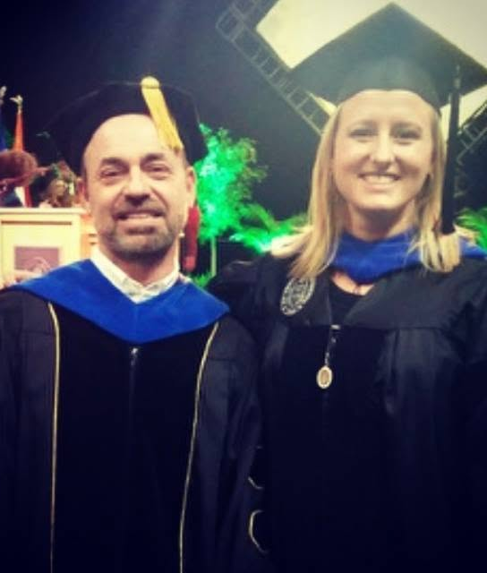

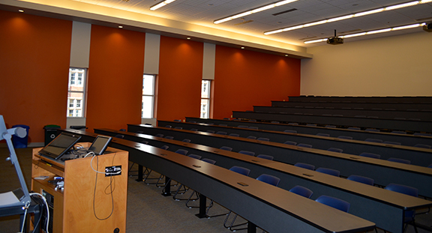
© 2026 Denise Gosnell, All rights reserved.
Notes:
YOUR OPENER • then 2014 • cs102 • 120 students • last gate • check the box
• Every executive I talk to is hearing the same pitches on AI
• And almost nobody will tell them what's real
• Buckle up y'all. I'm about to dive into the on-the-ground reality of AI
• In late April of 2014… lecture hall at the University of Tennessee (not "just down the street")
• 525 Min Kao • proctoring Dr. Mike Berry's CS 102 final • my last final as a TA
• 120 students, heads down • last gate before summer break
• some passionate • others simply checking a box

Slide 3

© 2026 Denise Gosnell, All rights reserved.
Notes:
Micah • curious • for loops • blue books • bear hug • invisible puzzles • why I'm here
• One of those students was Micah • mostly showed up • middle of the pack
• curious • "mostly showed up" → "always showed up" • for loops in the lab
• compounding benefits of automation
• So there I was, standing in room 525 • blue books • they're probably coming back
• hands it to me • biggest bear hug of my life • lifts me clean off the ground
• just wanting a box checked → new passion for solving invisible math puzzles
• Dr. Berry: "you've lit that kid on fire" • switched his major • thank me for showing him his path
• And that is why I'm standing here today

Slide 4

© 2026 Denise Gosnell, All rights reserved.
Notes:
open a door • make it visible • GOOD MORNING SAN FRANCISCO • Denise
• I thought I had spent the semester teaching computer science
• What I had really done was open a door • Micah walked through it
• But first, somebody had to make the door visible
• Good morning, San Francisco. My name is Denise Gosnell.

Slide 5
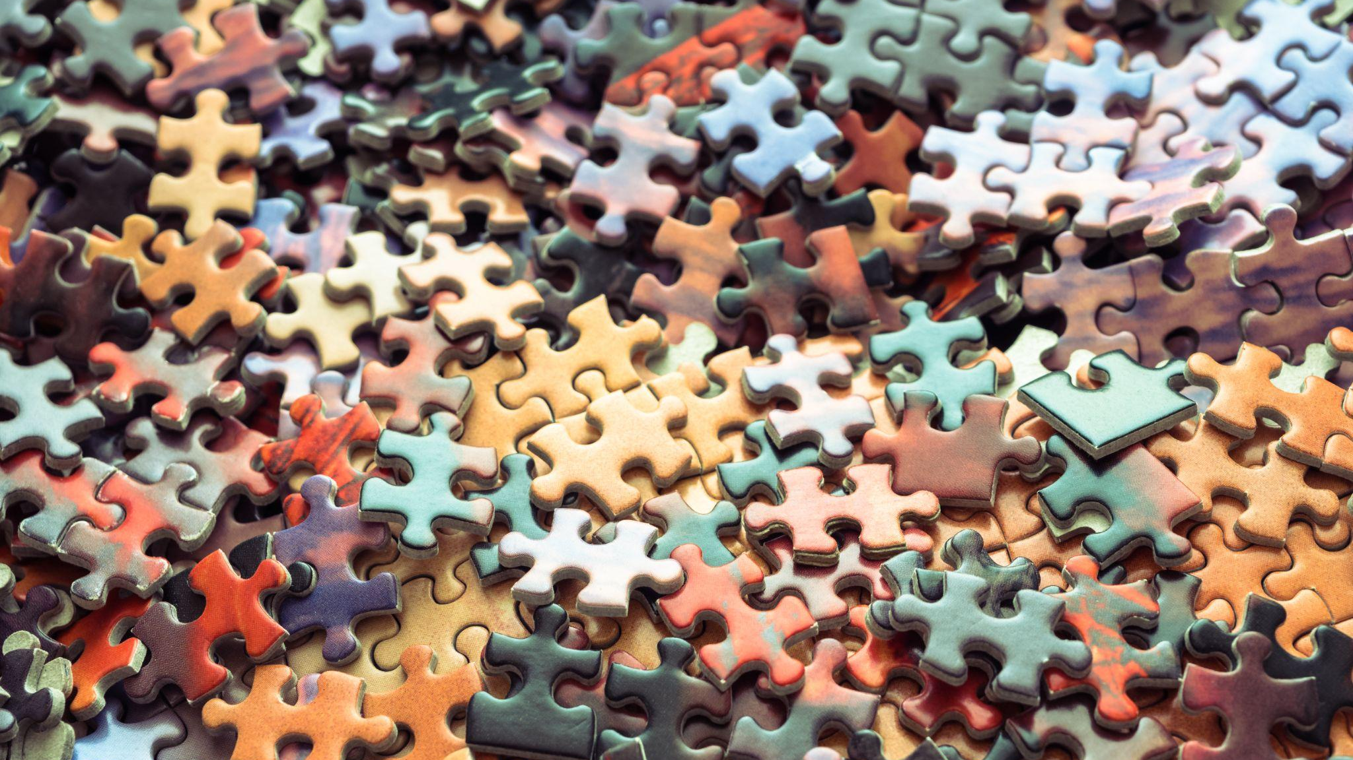
© 2026 Denise Gosnell, All rights reserved.
Notes:
HIDDEN IN SF DECK • puzzle story (not in the SF talk)
• skip

Slide 6
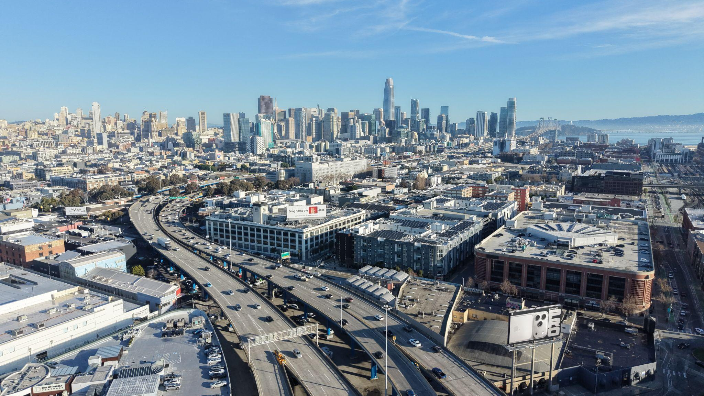

© 2026 Denise Gosnell, All rights reserved.
Notes:
one destination: Silicon Valley • learn from the best • gravity well of open source • graph tech • broken silo = duality
• After finishing my PhD, only one destination for me: Silicon Valley
• I wanted to learn and build from the best
• quickly fell into the gravity well of open source
• leader in open-source graph technology • Netflix, Starbucks, Home Depot, FedEx, SnapChat, the Federal Government
• connect data in ways that break silos
• a broken silo is itself a duality • breaks somebody's comfortable model → opportunity for someone else

Slide 7
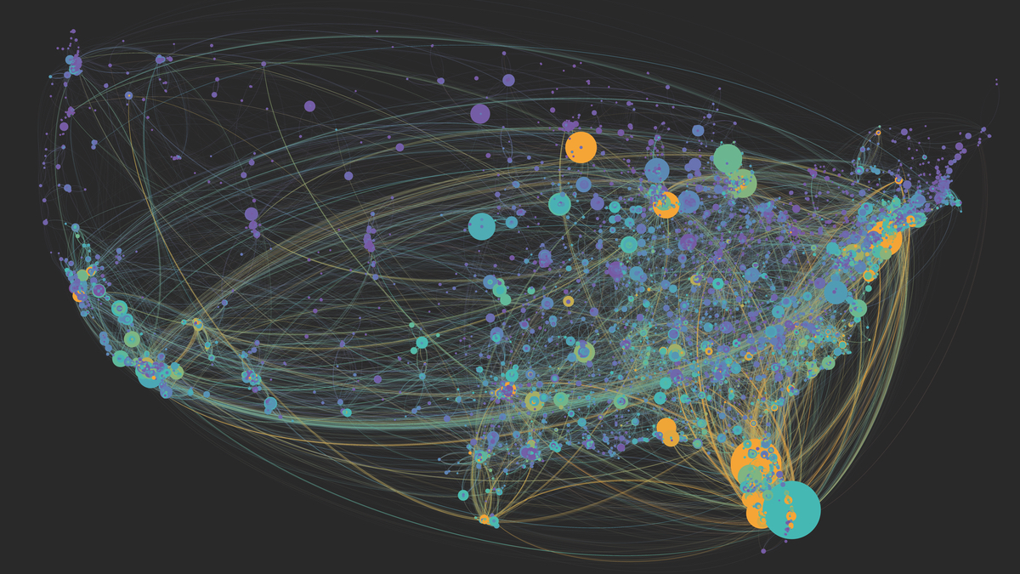
© 2026 Denise Gosnell, All rights reserved.
Notes:
$20M medicare fraud • claims processing • PBMs • sued out of existence • door for one = wall for another
• Like that time, right after my PhD, at a healthcare startup in Charleston, South Carolina (say "in", not "here in")
• exposed a $20M medicare fraud scheme simply by connecting data sets
• same start-up: automated claims processing • saved people real money
• made drug prices transparent • exposed games the PBMs were running
• you can guess what happened next: (pause) a PBM sued us out of existence
• After enough times, you stop seeing innovation as one thing
• a door for one person is a wall coming down for someone else

Slide 8
Technology doesn't pick.
People do.
© 2026 Denise Gosnell, All rights reserved.
Notes:
TECH DOESN'T PICK • my duality • colorblind • synthesis when moving • swimming laps
• Here's the important thing about that:
• The technology doesn't pick. People do.
• something else about me: I've always lived in a duality between what makes sense to me and what everybody else says is true
• not like colorblindness (Peyton Manning as mayor of Knoxville = TN joke, optional here)
• my biggest moments of synthesis don't arrive at my desk • they arrive later, when I'm moving
• swimming laps • I understand by moving. Talking. Testing. Making.

Slide 9
Learning Styles
Visual
Auditory
Reading & Writing
Kinesthetic
Notes:
four buckets • kinesthetic = me • software = reading & writing • Python, Java, C++ • outside the door
• research rabbit hole… four buckets
----> Visual. Auditory. Reading and writing. Kinesthetic.
• I'm the kinesthetic type. Things click for me when I'm moving.
• traditional software development is tailored for the reading and writing learners • Python, Java, C++
• If that's hard for you, you were standing outside the door

Slide 10
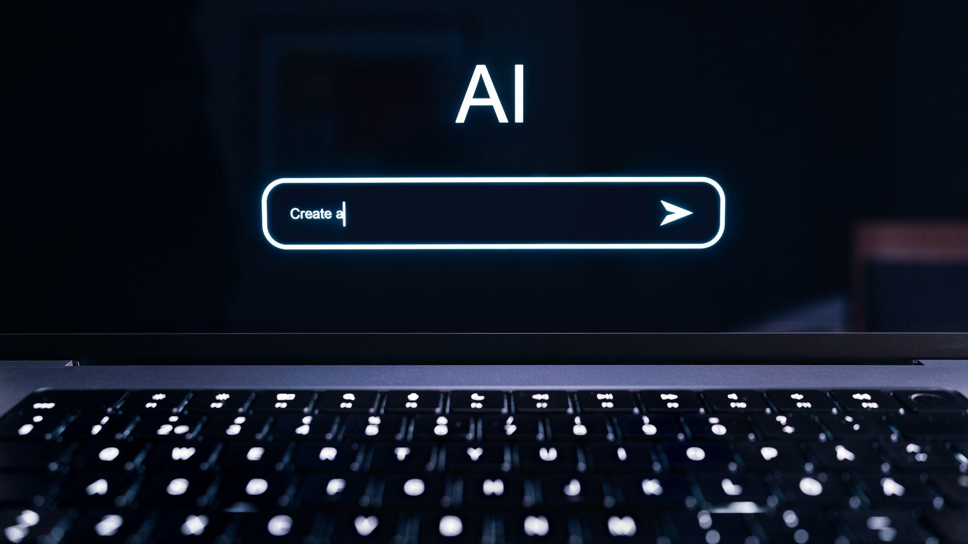
Build me a polished memo
© 2026 Denise Gosnell, All rights reserved.
Notes:
AI opens that door • plain English • polished memo • dozen responsibilities • THAT IS REAL • new builders
• AI, however, is opening that door
• describe the problem in plain English—or French or Mandarin or Hungarian—and begin to build
• struggles to turn an idea into a polished memo → talk it through with Claude, find the shape of the argument
• overwhelmed by a dozen responsibilities → a system that gives them more of their day—and themselves—back
• That is real. I see it happening in front of me. We all do.
• open the door and show people through → a whole new group of builders who can finally be seen

Slide 11

© 2026 Denise Gosnell, All rights reserved.
© 2026 Denise Gosnell, All rights reserved.
Notes:
HIDDEN IN SF DECK • J (not in the SF talk — Karen instead)
• skip

Slide 12
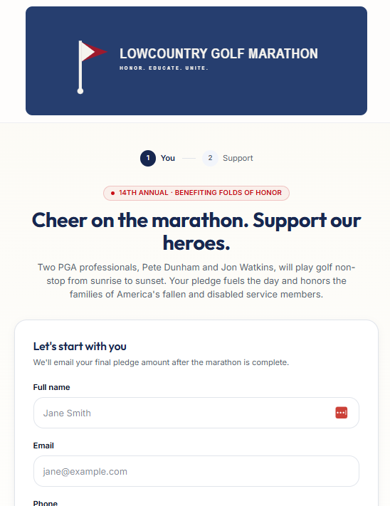
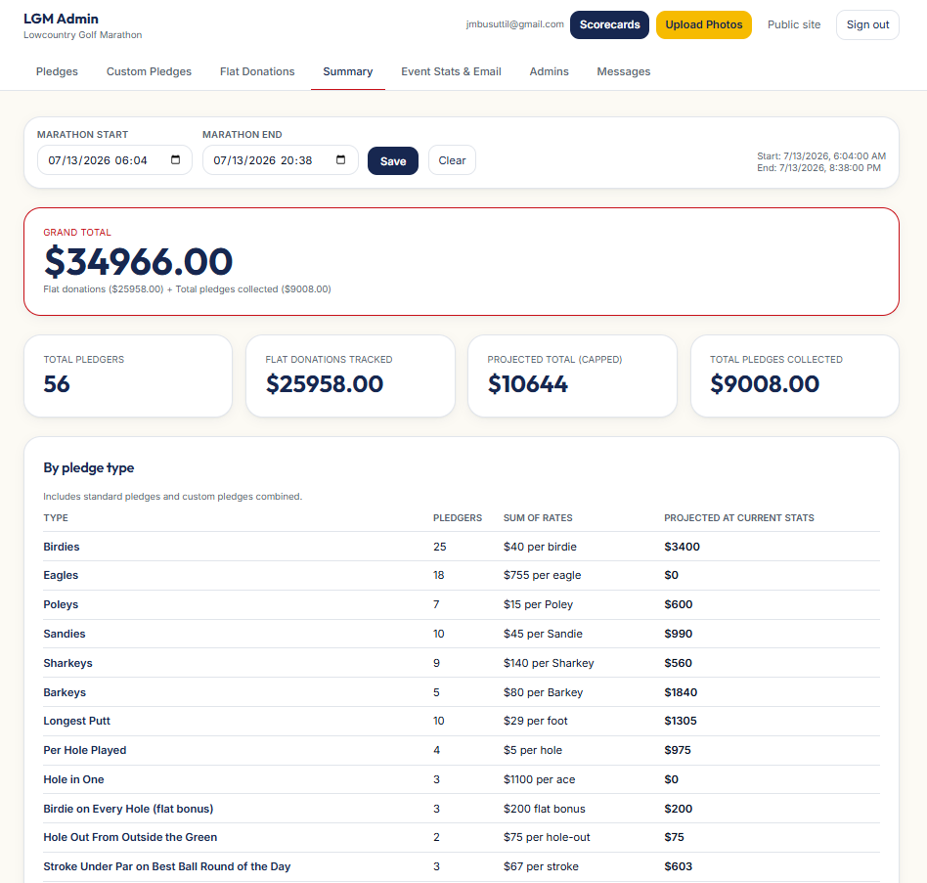
Notes:
HIDDEN IN SF DECK • J's app (not in the SF talk — Karen instead)
• skip

Slide 13
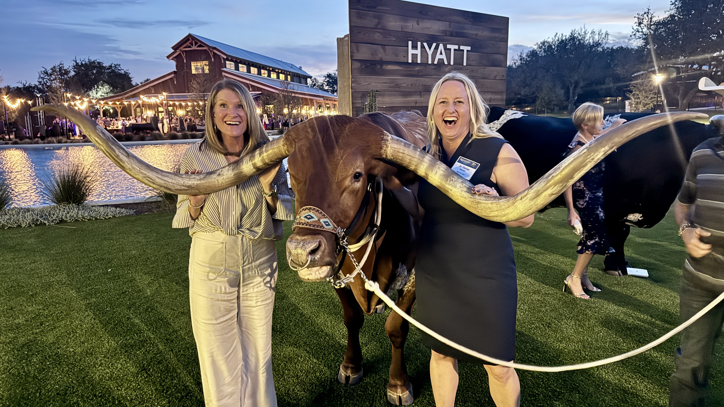
© 2026 Denise Gosnell, All rights reserved.
Notes:
Karen • multi-billion • millions on Salesforce • 18 months, didn't work • losing streak
• Take an executive I work with, Karen. She owns tech for a multi-billion-dollar company.
• Before we ever met: millions out of her own P&L on a project with Salesforce
• modernize and secure her data infrastructure • a year and a half later, it still didn't work
• walked into our first meeting like someone on a losing streak, bracing for one more
• buried under a run of projects that didn't land

Slide 14
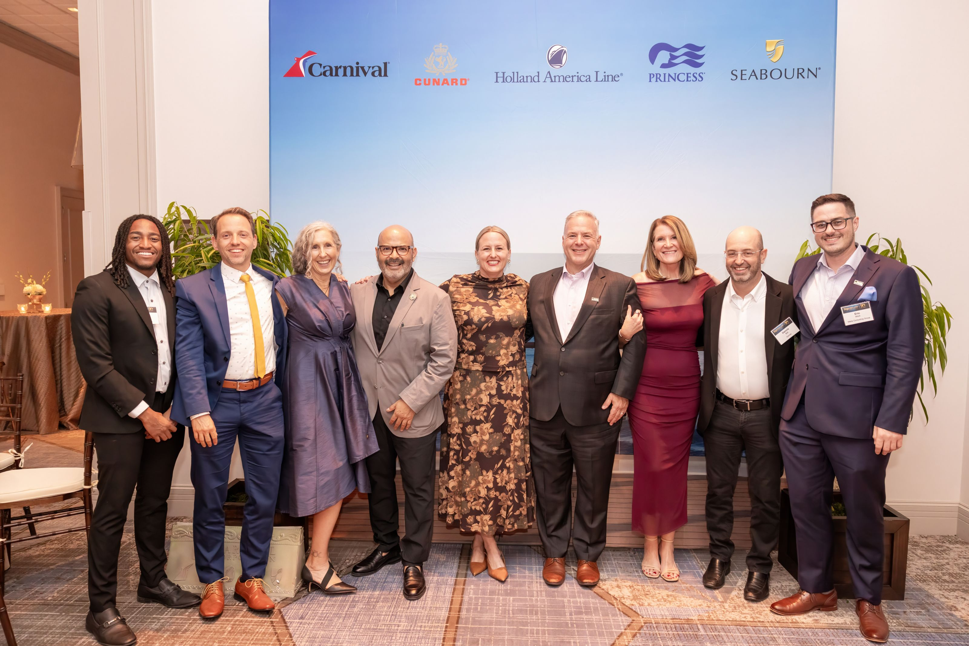
© 2026 Denise Gosnell, All rights reserved.
Notes:
open source + AI • 90 days • 40% less • no miracle • opened the door
• Together, using open source and AI, we built
• Ninety days later she had the thing Salesforce couldn't deliver in eighteen months
• and it cost her about 40% less
• For Karen—I didn't perform a miracle. All I did was open the door for her.

Slide 15
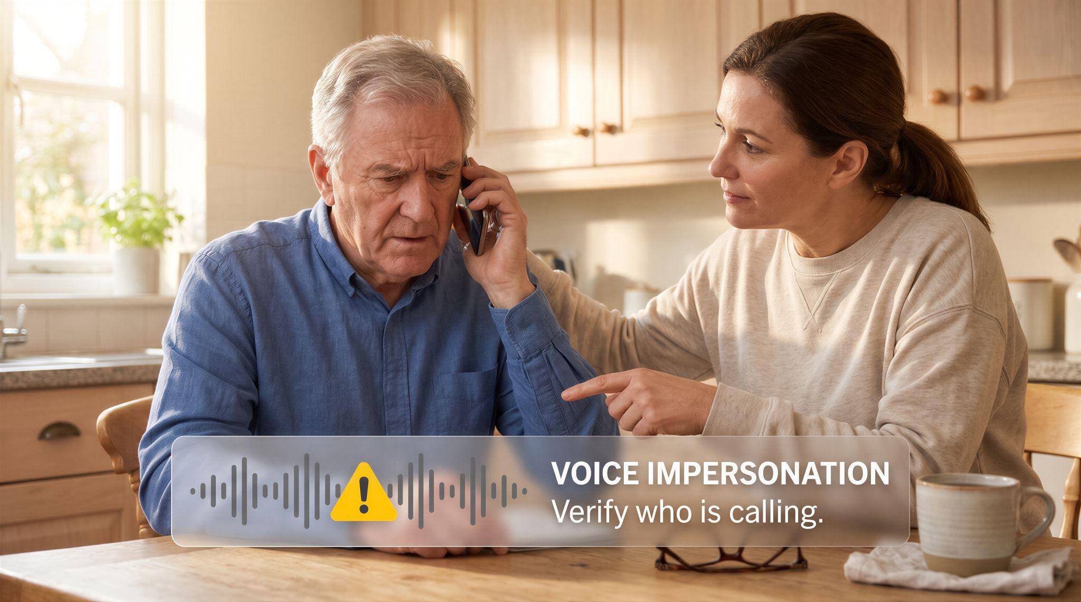
© 2026 Denise Gosnell, All rights reserved.
Notes:
not immune • disruption, displacement, fear • NOT IRRATIONAL • job • parents / deepfakes • kids / startup pivots
• even as I talk about the positives: AI is not immune from the duality of technology
• The disruption, the displacement, the fear
• It is not irrational for people to worry about their job
• …their elderly parents falling victim to deepfake scams
• …their children growing up in a less stable world, disrupted more quickly than a startup pivots (SF swap for "UT freshman changes majors")

Slide 16

This is the Duality of AI
© 2026 Denise Gosnell, All rights reserved.
Notes:
THE DUALITY • open / close • voice / counterfeit • first-time builder / control the tools • time back / automate away • both real, neither guaranteed
• This is the Duality of AI
• AI can open doors, but just as easily, AI can close them
• give voice to people who have been talked over—and counterfeit someone's voice and steal their identity
• help a first-time builder create something valuable—and let a small group of companies control the tools every builder depends on
• give us time back for families, friends, ourselves—and tempt us to automate away the relationships that make the time worth having
• Both sides are real. Neither is guaranteed.

Slide 17
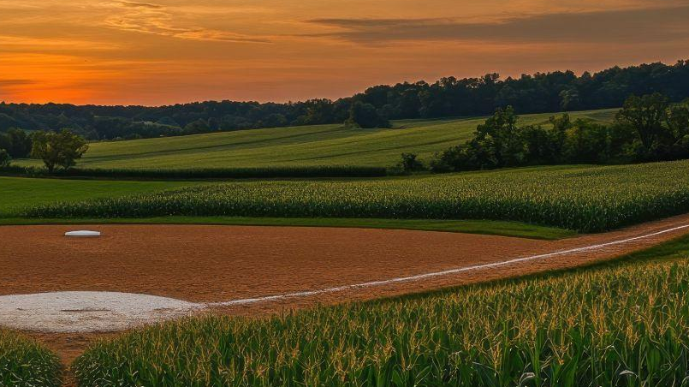
AI is not a Field of Dreams
© 2026 Denise Gosnell, All rights reserved.
Notes:
not Field of Dreams • built on purpose • door openers • three places: jobs, prosperity, agency
• AI is not Field of Dreams. If we build it, the positive side will not magically come.
• The positive side has to be built on purpose
• people in positions of leadership—technology, business, society—must become door openers
• three places where the Duality of AI is present in all of our lives • the choice to open or close doors for…
• …individuals and their jobs • …communities and their prosperity • …our own agency

Slide 18
Three Great Tensions of AI
1
AI will eliminate jobs and create new ones
2
AI will create shared prosperity or extract it
3
AI will democratize control or concentrate it
Notes:
Three Great Tensions • RAISE HAND • right room
• I call these the Three Great Tensions of AI
• Let me ask you: Who here wants to open doors for individuals, for their communities, and for society? [raise hand]
• Who here wants to close doors instead? [lower hand]
• Great. You're in the right room.

Slide 19
Technology doesn't pick.
People do.
We do.
© 2026 Denise Gosnell, All rights reserved.
Notes:
say it again • PEOPLE DO. WE DO. • → first tension
• So let me say it again, the technology doesn't pick. People do. We Do.

Slide 20
AI will eliminate jobs and create new ones
The First Great Tension
Notes:
First Great Tension divider
• "Let me show you a quote I read recently that rings true to me"

Slide 21
“Today we stand on the threshold of a new industrial revolution, the revolution of automation.
This is a revolution bright with the hope of a new prosperity for labor and a new abundance for America.
But it is also a revolution which carries the dark menace of industrial dislocation, increasing unemployment, and deepening poverty.”
Notes:
read the quote • any guesses? • JFK • written for this moment • early 60s = today
• (read the quote on the slide)
• Anyone know who that was? Any guesses?
• That's John F. Kennedy. Read it again and try to tell me it wasn't written for this moment.
• A quote from the early 60s is equally applicable today

Slide 22
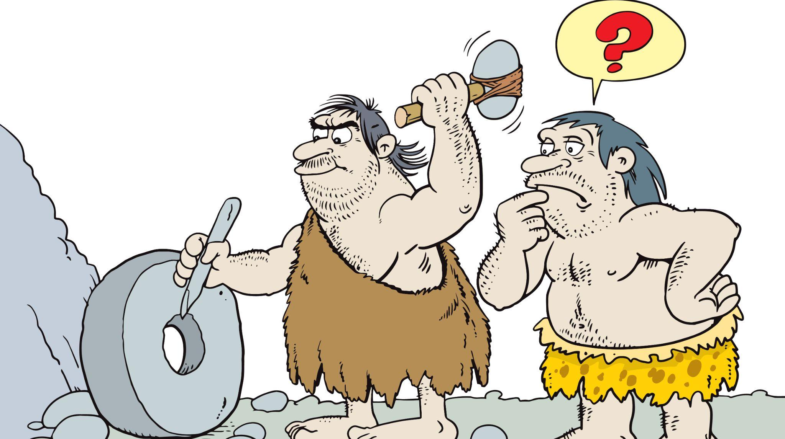
© 2026 Denise Gosnell, All rights reserved.
Notes:
Thog & Grog • sledge vs wheel • invent → change → disruption • positive & negative • inherent tension
• Thog probably lamented the downfall of his sledge business when Grog invented the wheel
• We invent new things. Those new things bring change. Change is disruptive.
• positive effects and negative effects • This is the inherent tension in change

Slide 23
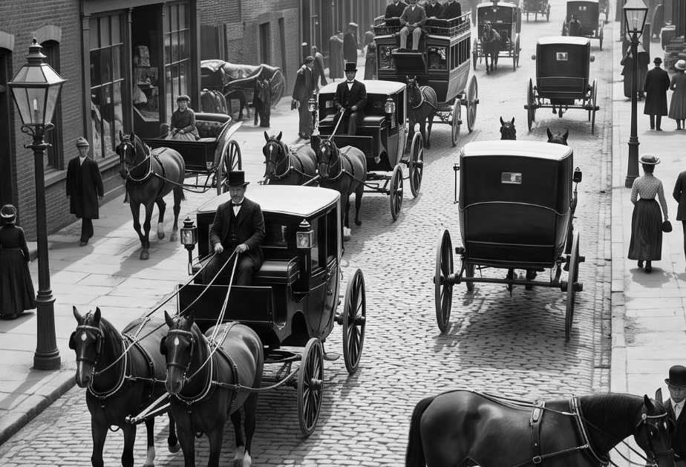

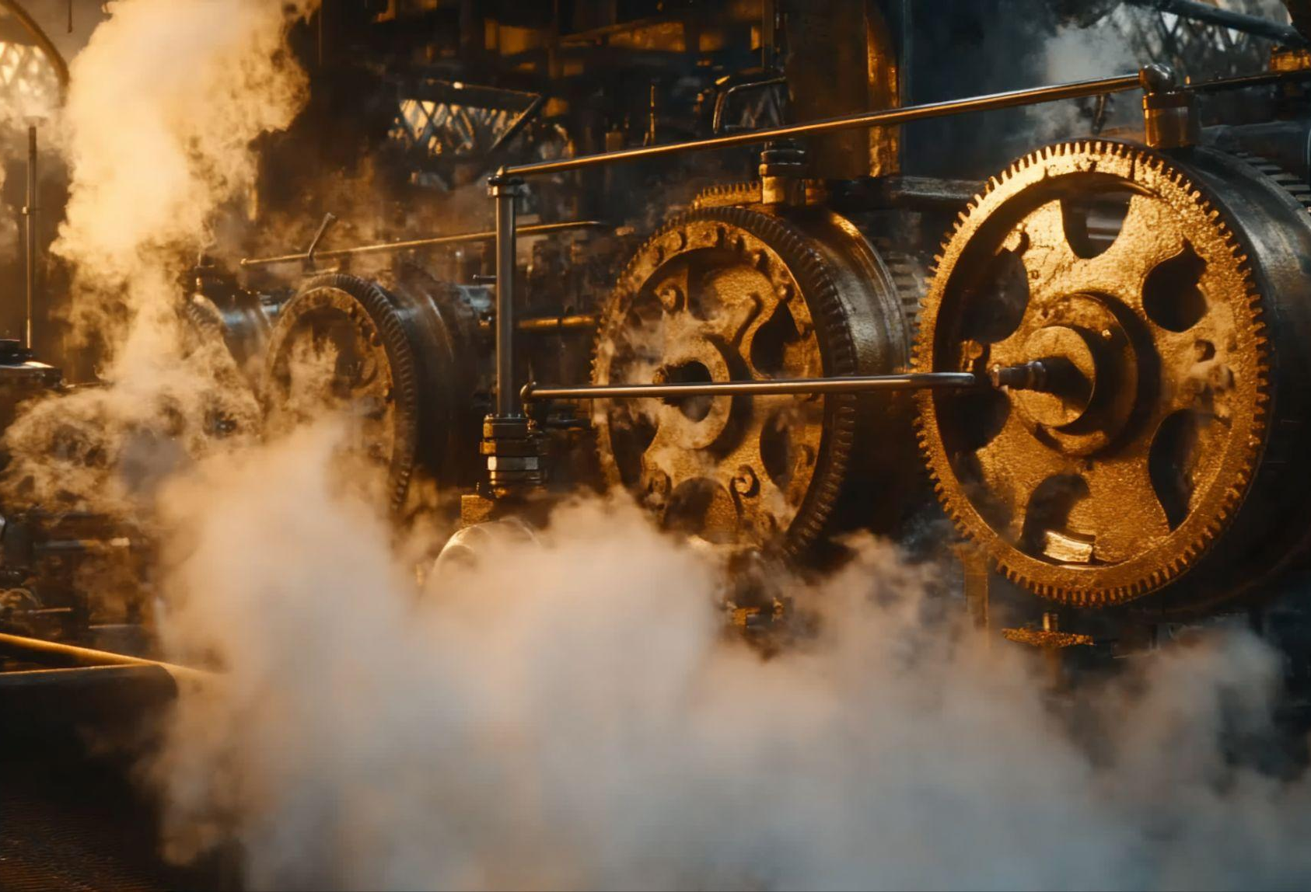
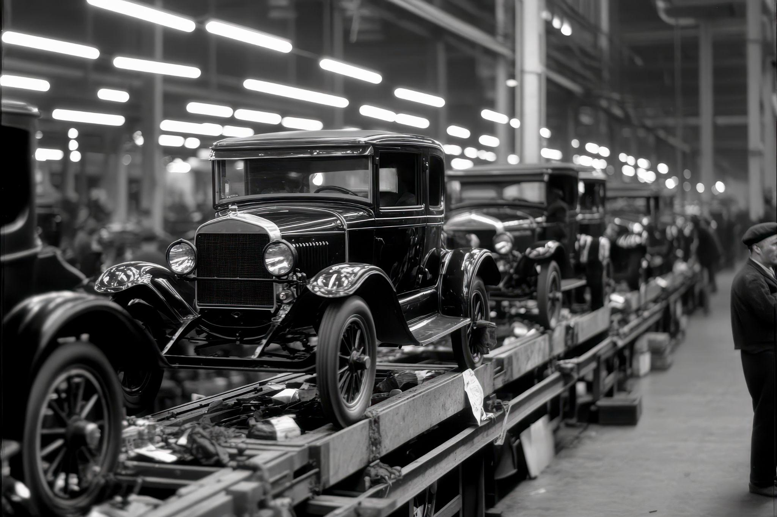
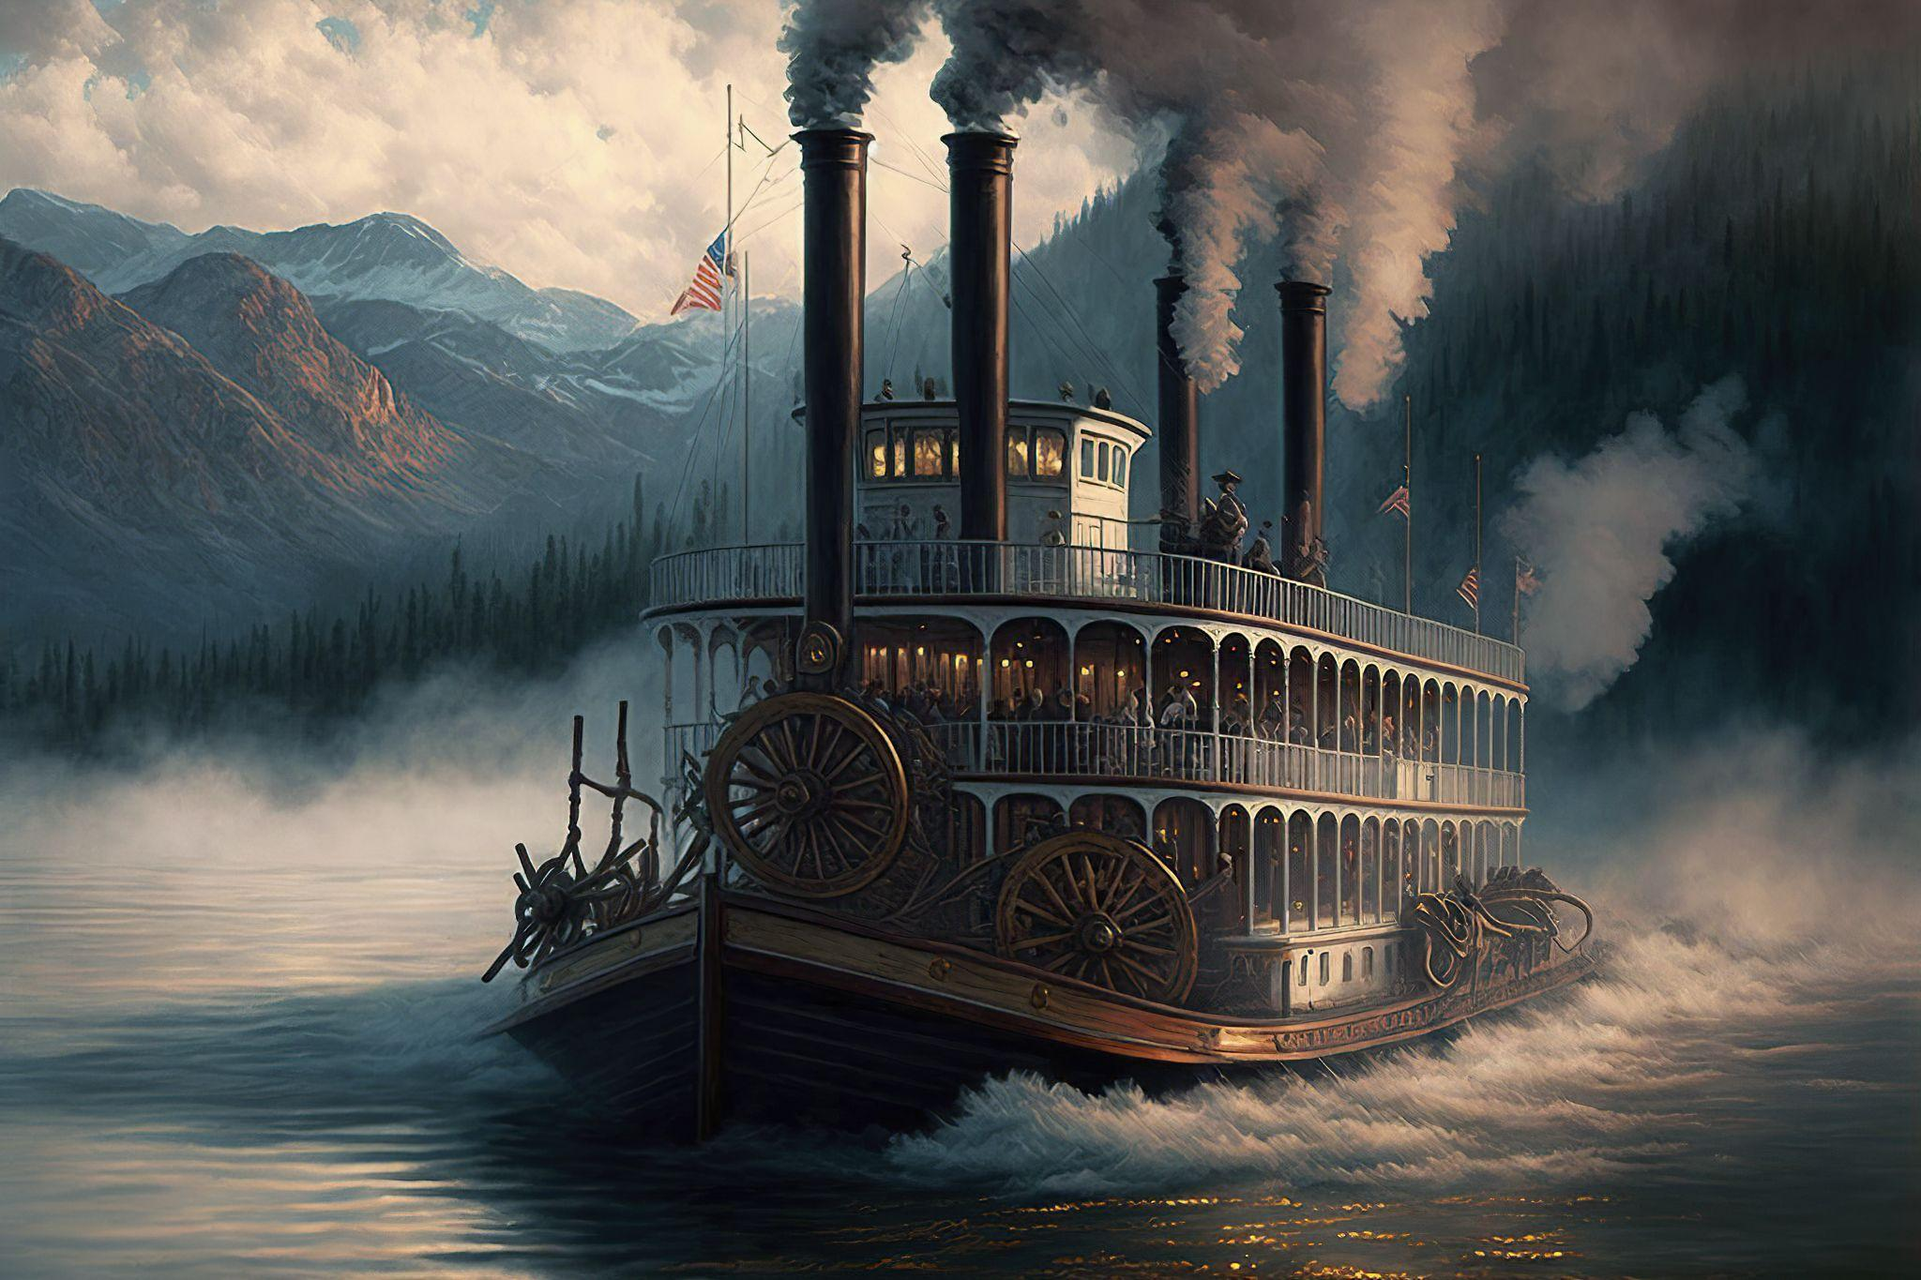
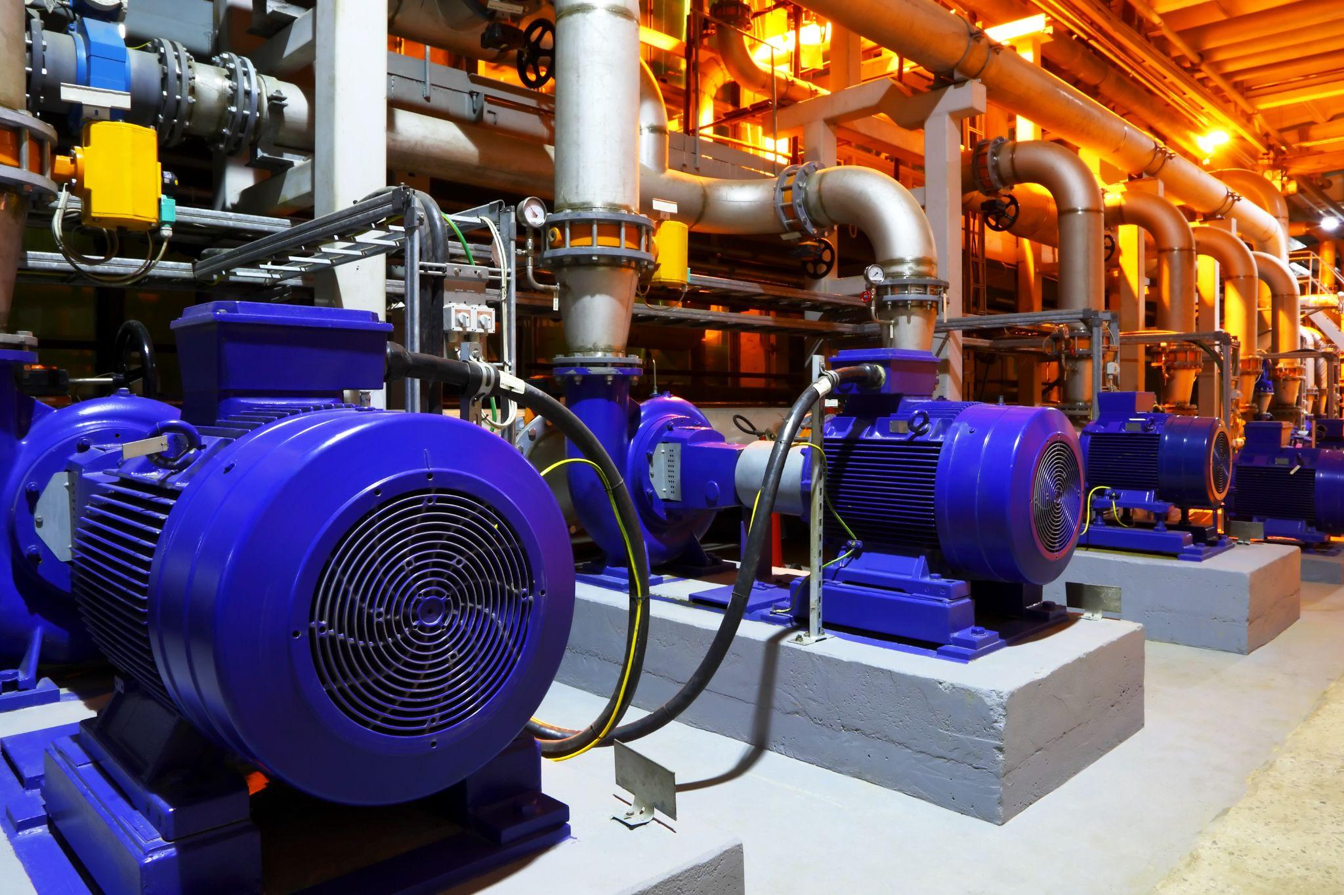
Inherent Tension in Change
© 2026 Denise Gosnell, All rights reserved.
Notes:
humans don't like change • when it happens to US • feels like loss • careers, lifetime • LOSS OF IDENTITY
• But humans don't like change
• we understand intellectually that change is inevitable
• but when it happens to us—alters our routines, threatens what we built, removes a path we counted on—it does not feel like progress
• It feels like loss.
• when it touches our careers • paths built over years, decades, a lifetime
• That's not just a loss of convenience or routine. That's a loss of identity.

Slide 24
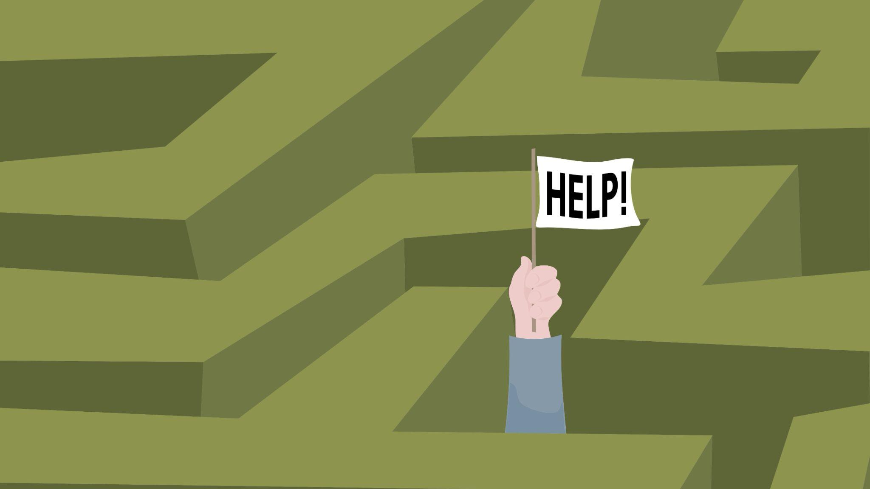
© 2026 Denise Gosnell, All rights reserved.
Notes:
we lose who we are • dismiss resistance as ignorance • WE TELL THEM… • tell that to the person who lost their job • AI eliminates & creates • "technically possible"
• We lose who we are.
• tempting for those of us excited about AI to dismiss resistance as ignorance
• We tell them disruption has happened before • in the long run, innovation creates more prosperity
• And that's true, but tell that to the person who lost their job.
• AI will eliminate jobs. But equally inevitable is the creation of new work.
• robot automates an assembly-line job → "technically possible" to retrain in robotics or software engineering
• "technically possible" is doing a lot of work there

Slide 25
Telephone Switchboard Operators
1.5M
40k
<2k
1950
1984
2026
© 2026 Denise Gosnell, All rights reserved.
Sources: Federal Reserve Bank of Richmond; Bureau of Labor Statistics
Notes:
switchboard: 1.5M → 40k → <2k • new jobs: design, maintain, computerized • SOMEONE HAD TO • on a chart = recovery • AGGREGATE
• 1950: almost 1.5 million telephone switchboard operators • 1984: 40,000 • today: under 2,000
• jobs disappeared even as new ones were created: design and build the automation • maintain it • computerized
• Those new jobs required different skills. Someone had to learn them, and someone had to pay for that.
• They were in different places. Someone had to move, or be left behind.
• They came years later. Someone had to live through the gap.
• And many of them went to entirely different people.
• On a chart, that looks like a recovery. To the operator who lost her job, it was not.
• That is the part we risk losing when we talk only in aggregate

Slide 26
We risk losing the part that makes us human.
Notes:
WE RISK • the part that makes us human • (pause) • → second tension
• We risk losing the part that makes us human.

Slide 27
AI Can Create Shared Prosperity —or Become Extractive
The Second Great Tension
Notes:
who benefits — who pays • innovation vs community • adds or extracts • extraordinary value • growth ≠ prosperity
• The second great tension is about who benefits—and who pays
• the tension between innovation and community—whether innovation adds to community or extracts from it
• AI has the potential to create extraordinary value
• But economic growth does not automagically equate to community prosperity

Slide 28
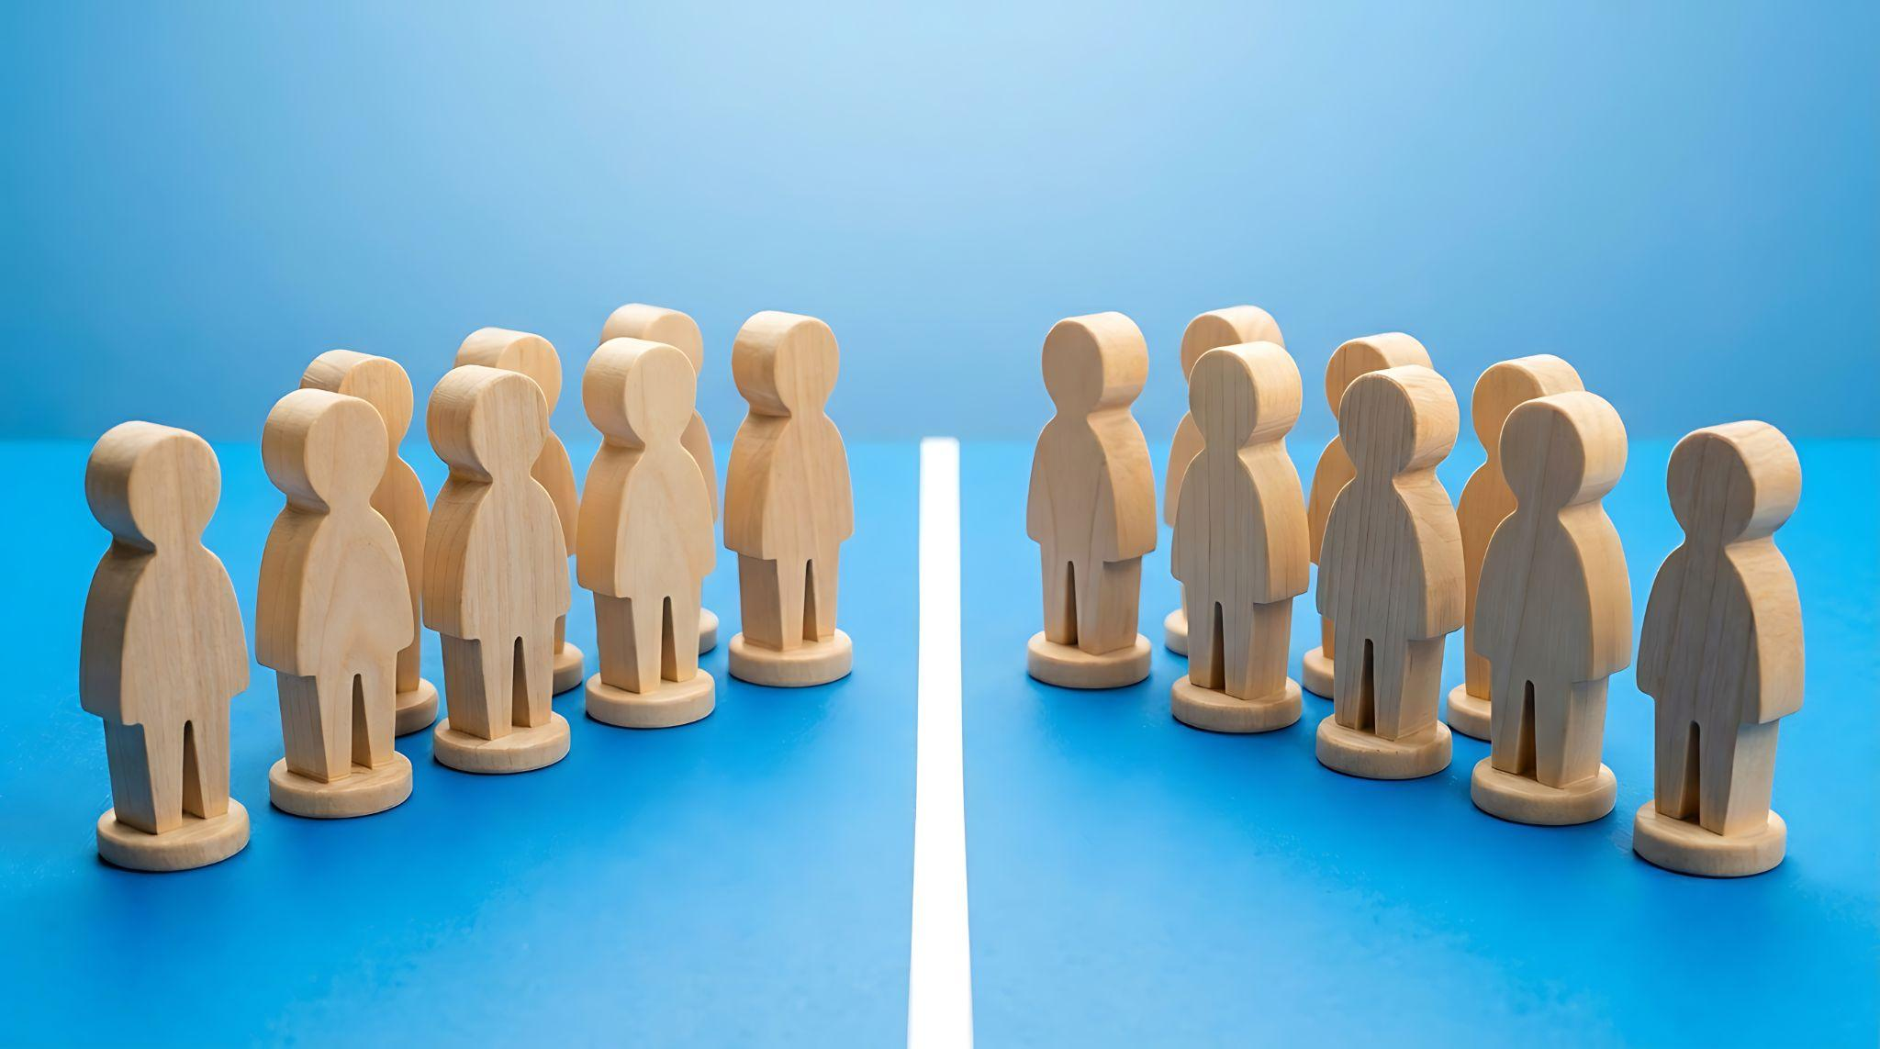
© 2026 Denise Gosnell, All rights reserved.
© 2026 Denise Gosnell, All rights reserved.
Notes:
innovation is global • BURDEN IS LOCAL • land, power, water, public infrastructure • no guarantee it returns
• The innovation may be global. The benefits may flow to customers, investors, and businesses around the world.
• But the burden is local.
• It is the community that supplies the land, the power, the water, and the public infrastructure
• no guarantee that the value created will return to the people who live there

Slide 29

© 2026 Denise Gosnell, All rights reserved.
© 2026 Denise Gosnell, All rights reserved.
Notes:
data center = what people can see • PINATA • abstract vs concrete • NOT to stop building • earn trust • what else can we build
• a data center is the first part of the AI economy people can actually see
• Data centers are the pinata in the room they can hit
• An AI model is abstract. The algorithm is invisible. But the building at the edge of town? That's concrete.
• The answer is not to stop building.
• build in a way that earns and sustains community support and trust
• And it means asking what else we can build.

Slide 30
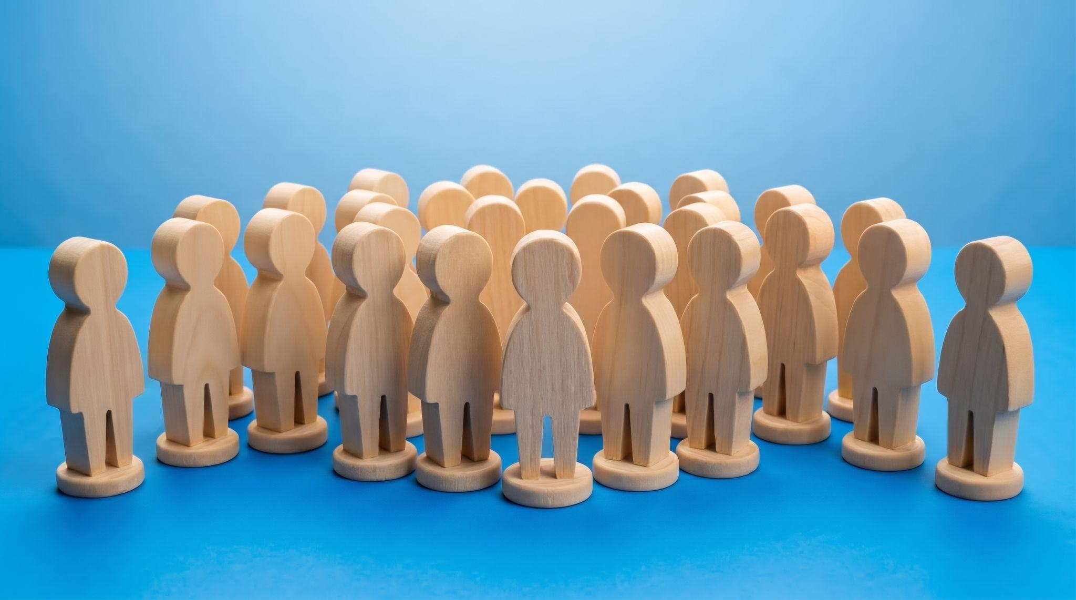
© 2026 Denise Gosnell, All rights reserved.
© 2026 Denise Gosnell, All rights reserved.
Notes:
HIDDEN IN SF DECK • earn & sustain trust (folded into slide 29 in the SF talk)
• skip

Slide 31
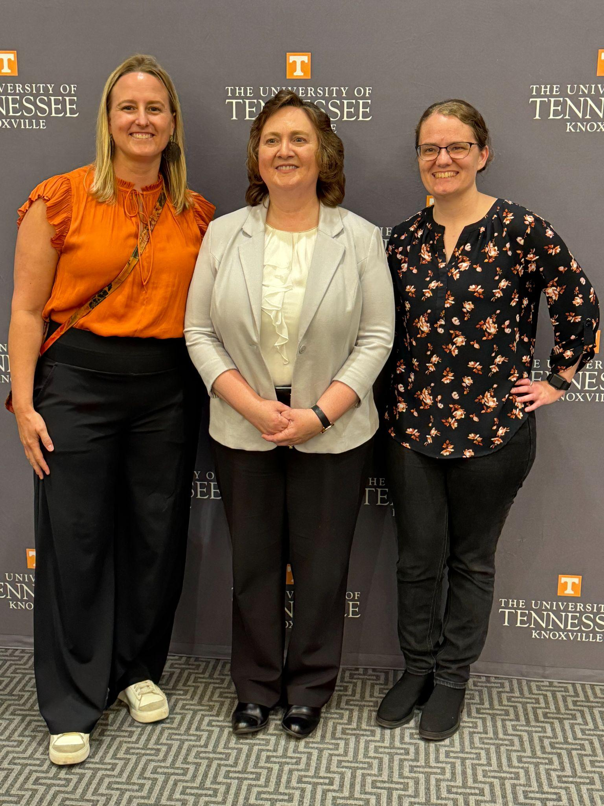
© 2026 Denise Gosnell, All rights reserved.
© 2026 Denise Gosnell, All rights reserved.
© 2026 Denise Gosnell, All rights reserved.
Notes:
Katie Schuman • same time at UT • I left, she stayed • neuromorphic = chips like a brain • fraction of the energy
• Dr. Katie Schuman and I were doing our PhD research at the University of Tennessee at the same time
• I left for Silicon Valley. Dr. Schuman stayed and became one of the leading neuromorphic-computing researchers in the world.
• Neuromorphic chips work more like a brain than a conventional processor
• certain learning tasks on a fraction of the energy

Slide 32
© 2026 Denise Gosnell, All rights reserved.
© 2026 Denise Gosnell, All rights reserved.
© 2026 Denise Gosnell, All rights reserved.
Notes:
lab tour • pole-balancing • <10% of GPU energy • DROPPED THE CHIPS • better and worse • something important
• I toured Dr. Schuman's lab • summer research students • chips learning the classic pole-balancing problem
• less than 10% of the energy required using today's GPUs
• Then they handed me a tray of the early chips. And I dropped them.
• My stomach fell through the floor • millions of dollars of research
• "Oh, don't worry. Those are from years ago. We're already generations past those. We wouldn't hand you one of the new ones."
• better and worse at exactly the same time
• But those chips represented something important.

Slide 33

© 2026 Denise Gosnell, All rights reserved.
© 2026 Denise Gosnell, All rights reserved.
Notes:
price of progress? • THEY ARE NOT • shaped by decisions • not choose—CONNECT • COST of what stays behind
• we talk about the demands created by AI as if they are simply the unavoidable price of progress
• They are not.
• They are shaped by decisions: what we fund, what we build, which approaches we pursue, whose needs we consider
• The leadership responsibility is not to choose between innovation and community. It is to connect them.
• That is what we miss when we measure the opportunity of innovation and not the cost of what stays behind

Slide 34
We risk hollowing out the communities we are supposed to be building up.
Notes:
WE RISK • hollowing out • communities we should be building up • → third tension
• We risk hollowing out the communities we are supposed to be building up.

Slide 35
AI Can Democratize Control—or Concentrate It
The Third Great Tension
Notes:
third tension: CONTROL • who builds • inspect, question, adapt, decide • who retains agency • can be narrow
• And that brings us to the third great tension: control
• Who gets to build with AI? Who gets to inspect it, question it, adapt it, and decide how it is used?
• And who retains agency over the parts of their lives that AI increasingly touches?
• This tension can be narrow.

Slide 36

“You’re going to get a handful of companies that run these closed models that are going to be in control of the APIs and therefore able to tell you what you can build.”
-Mark Zuckerberg
Notes:
(quote on slide — pause, let them read) • democratize software? • OR handful of companies • renting access • forfeit data, privacy, thoughts • wider
• Will AI democratize software development… far more people building tools and solving problems?
• Or will the essential technology be controlled by a handful of companies
• everyone else renting access on terms they did not set • forfeit their data, their privacy, their deeply personal thoughts
• But the tension can also be much wider.

Slide 37
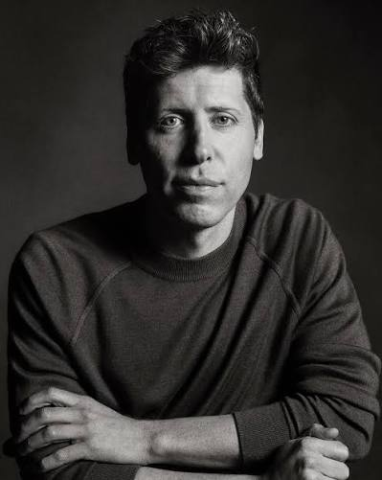
"We see a future where intelligence is a utility, like electricity or water, and people buy it from us on a meter.”
-Sam Altman
Notes:
(quote on slide — pause, let them read) • control over their own lives? • OR institutions monitor, predict, influence • not an alarmist • sane people pause • opening or closing?
• Will AI give people more control over their own lives?
• Or will it give institutions more power to monitor people, predict them, influence them, and make decisions about them?
• Believe me, I'm not an alarmist, but these kinds of quotes from the people building the tools that will power our future should give most sane people pause
• Is this future opening doors or closing them?

Slide 38
The architecture of a technology helps determine the distribution of power around it
Notes:
HIDDEN IN SF DECK • open source explainer / Apple / Google EU (not in the SF talk)
• skip

Slide 39

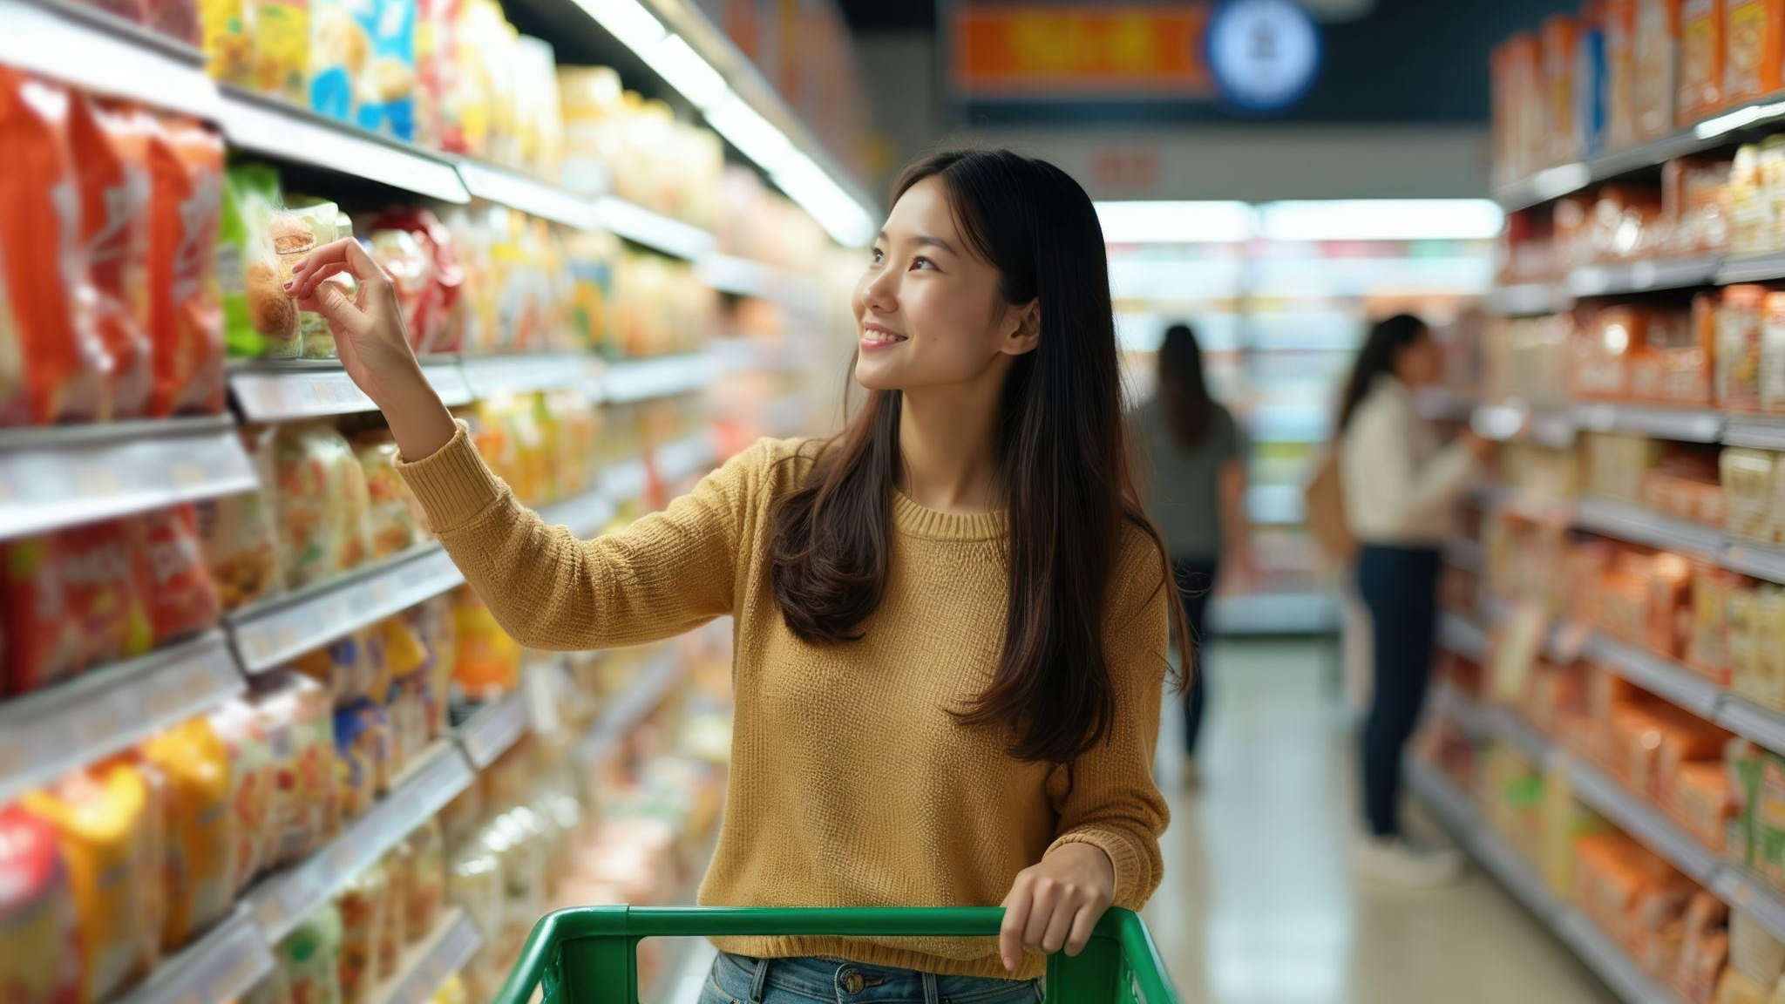

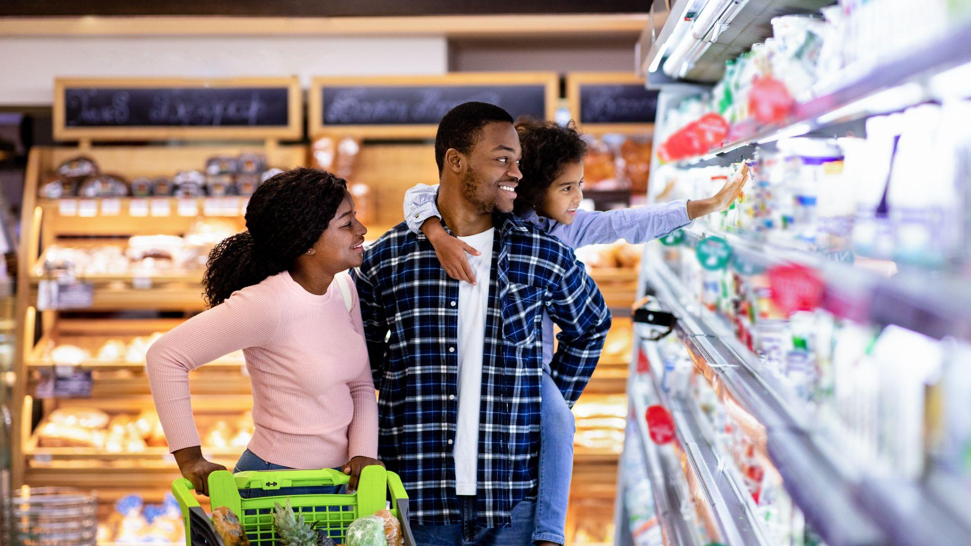
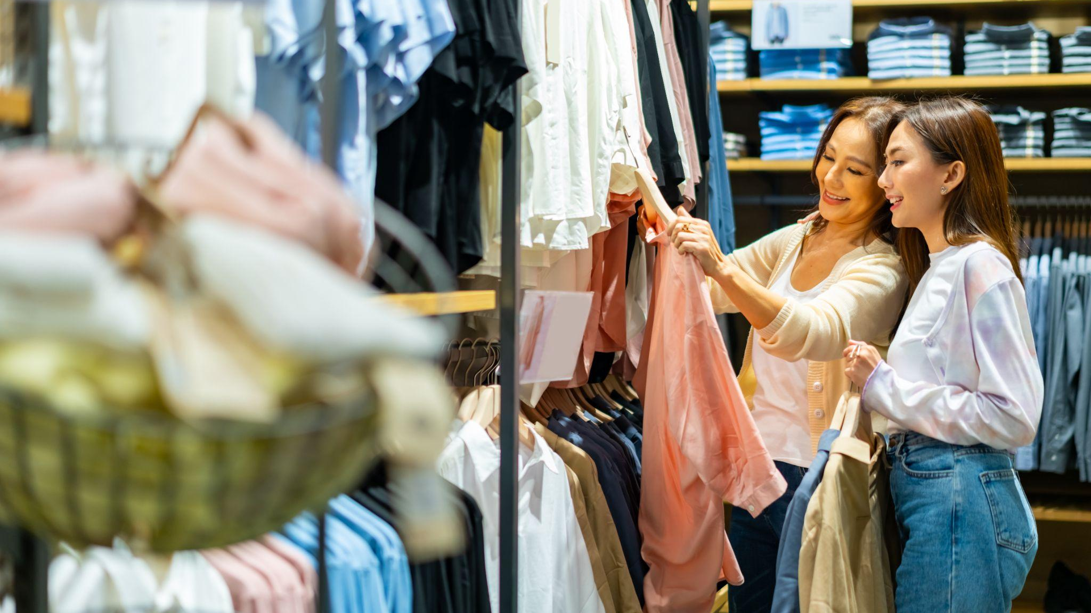
© 2026 Denise Gosnell, All rights reserved.
© 2026 Denise Gosnell, All rights reserved.
Notes:
we ask AI: true, matters • ACT on our behalf • can also weaken • outsourcing the struggle
• We ask AI in chat what is true. We ask AI what matters.
• And increasingly, we ask AI to act on our behalf.
• (callback if you want one: Karen, not J)
• But the same technology can also weaken the very capabilities it appears to expand
• If we routinely ask AI what to think before we have tried to think, we risk outsourcing more than a task
• We risk outsourcing the struggle through which judgment develops.

Slide 40
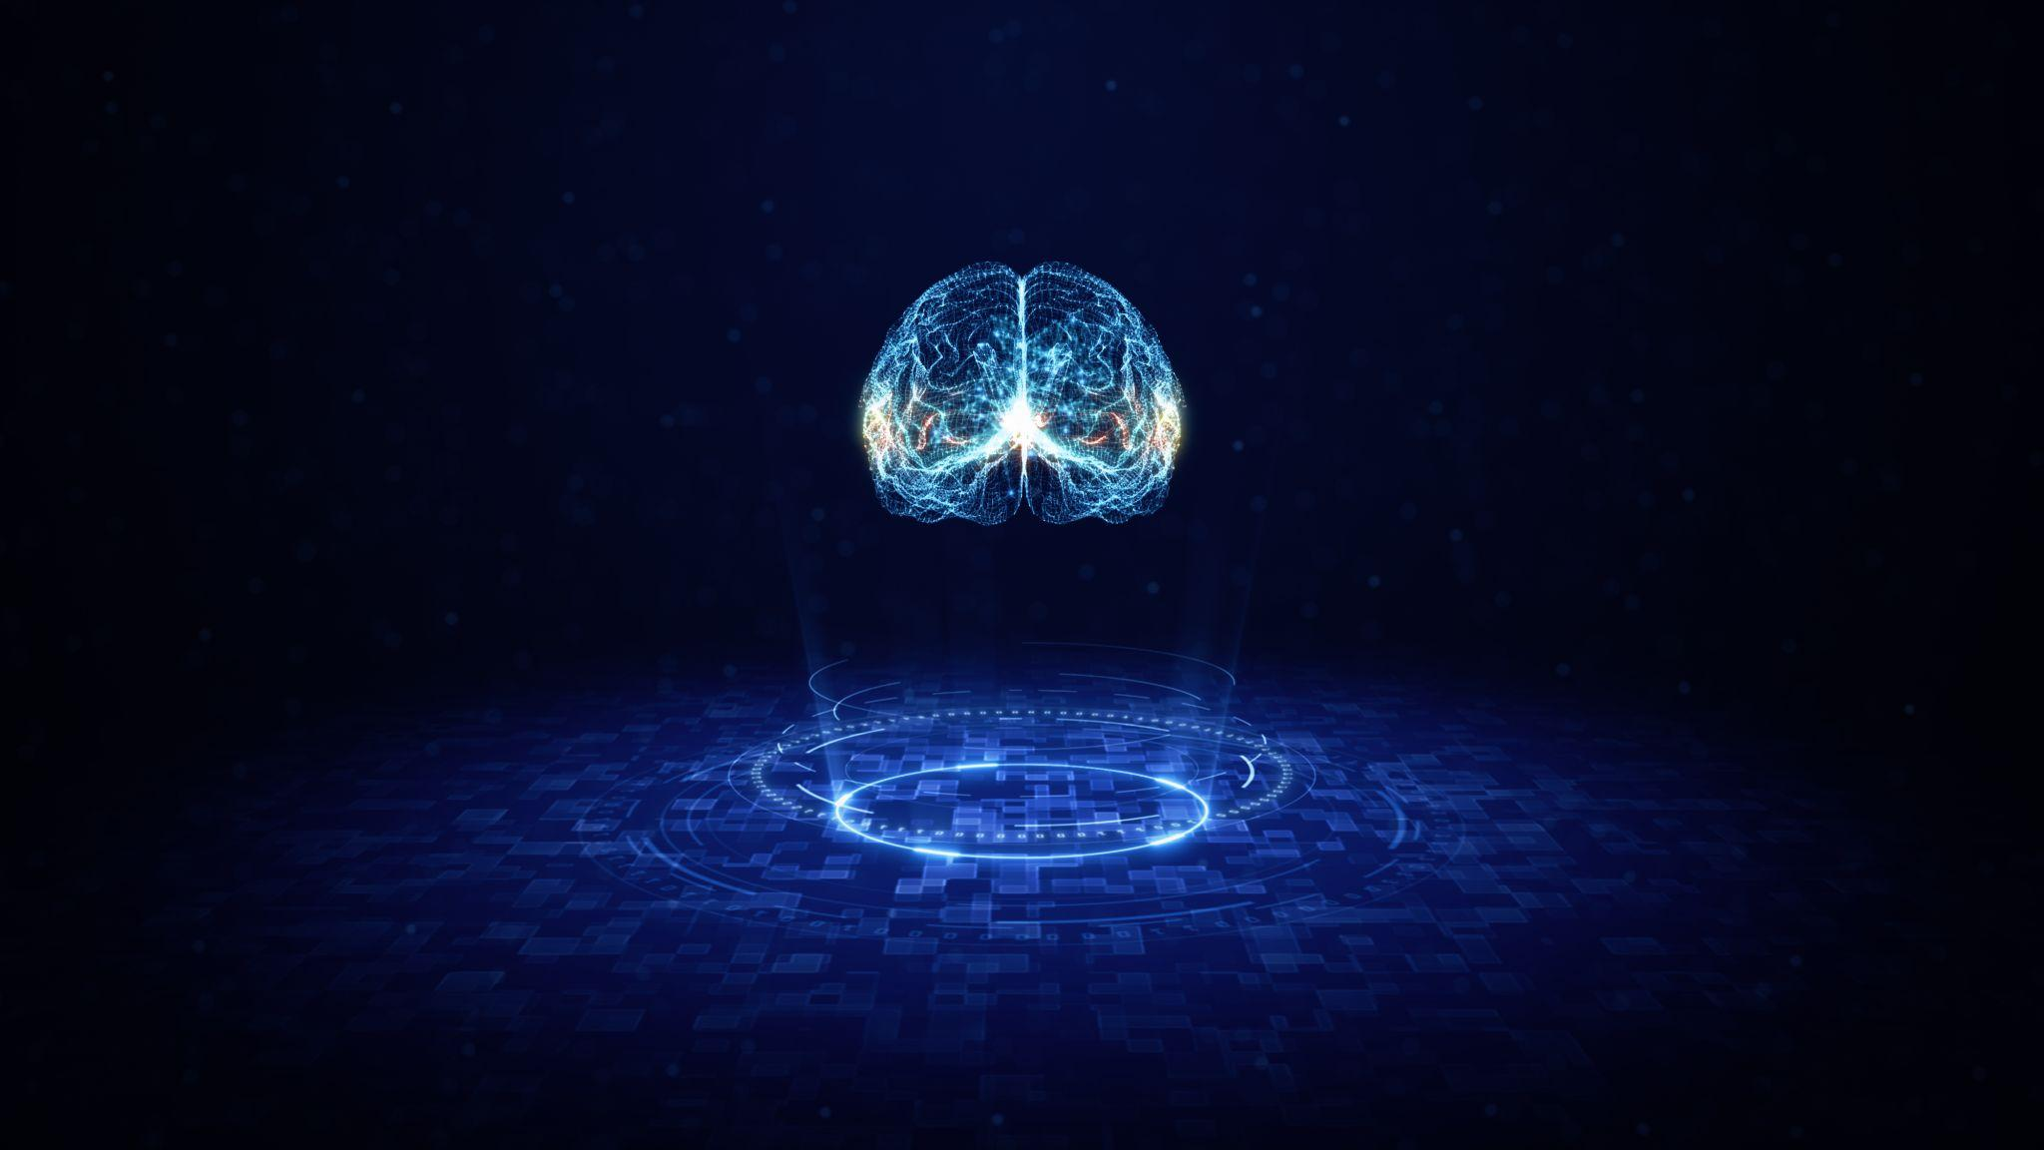
© 2026 Denise Gosnell, All rights reserved.
Notes:
analytical cognition • not just an answer • the PROCESS: evidence, uncertainty, assumptions, bias, changing our minds • enhance or short-circuit • answer as gospel • convenient like Google • Manning or Brady
• I'm talking about analytical cognition, about critical thinking
• not simply the production of an answer
• the process: examining evidence, tolerating uncertainty, recognizing assumptions, acknowledging our own bias, changing our minds
• AI can enhance that process. Or short-circuit it if we take the answer as gospel.
• It's convenient. So is Google. • library • argument at a bar: more passing TDs, Manning or Brady?

Slide 41
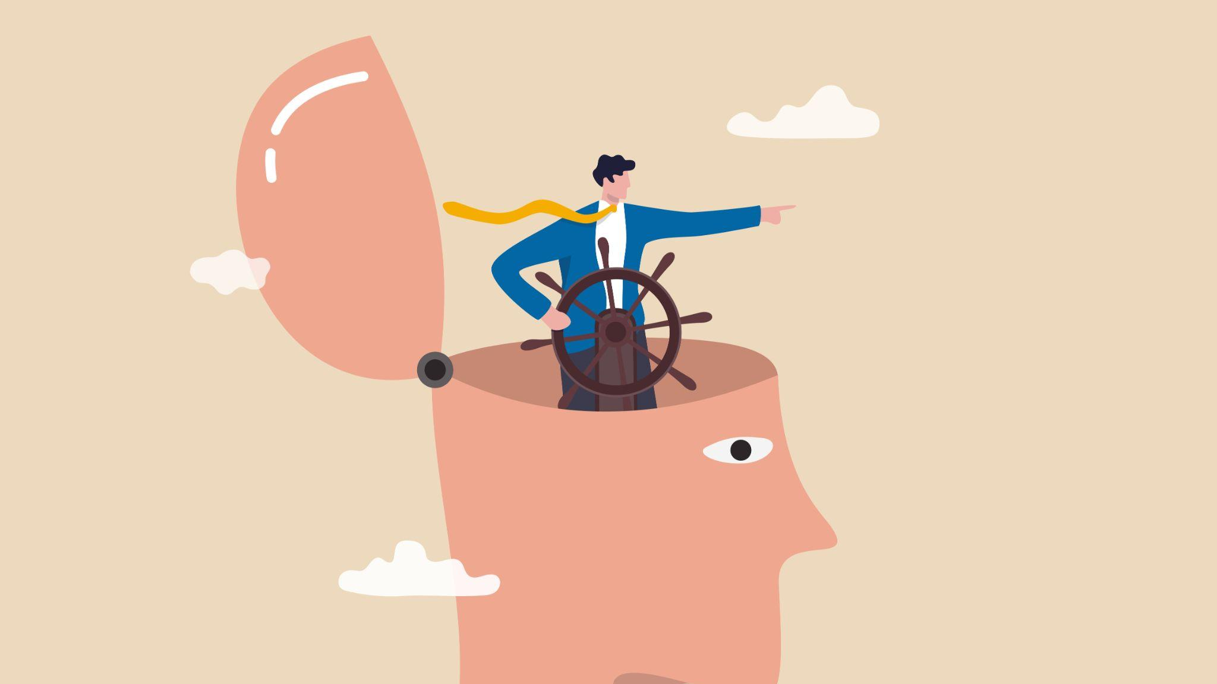
© 2026 Denise Gosnell, All rights reserved.
© 2026 Denise Gosnell, All rights reserved.
© 2026 Denise Gosnell, All rights reserved.
Notes:
convenience conceals control • 3 questions: reason / choices / control • open source = control & freedom of choice • what we miss: control we surrender
• The convenience of AI can conceal a transfer of control. That's the risk.
• Are we asking AI to help us reason or asking it to reason for us?
• Are we using it to expand our choices or allowing it to narrow them without our awareness?
• Are we gaining greater control over our lives or becoming more dependent on systems we cannot inspect, challenge, or leave?
• Open source is one response • not the only one, but one I happen to love
• openness is about control and freedom of choice • understand the system, question it, build on it, create an alternative
• what we miss when we measure everything AI can do for us without quantifying how much control we surrender in return

Slide 42
We risk surrendering our agency to systems we cannot question, change, or leave.
Notes:
WE RISK • surrendering our agency • cannot question, change, or leave • → three questions (Part 4 slides are hidden)
• We risk surrendering our agency to systems we cannot question, change, or leave.

Slide 43
Strategy & Execution
Notes:
HIDDEN IN SF DECK • Strategy & Execution (Amazon section cut from the SF talk)
• skip

Slide 44
Writing is Thinking
Notes:
HIDDEN IN SF DECK • Writing is Thinking (cut from the SF talk)
• skip

Slide 45

© 2026 Denise Gosnell, All rights reserved.
Notes:
HIDDEN IN SF DECK • football play (cut from the SF talk)
• skip

Slide 46
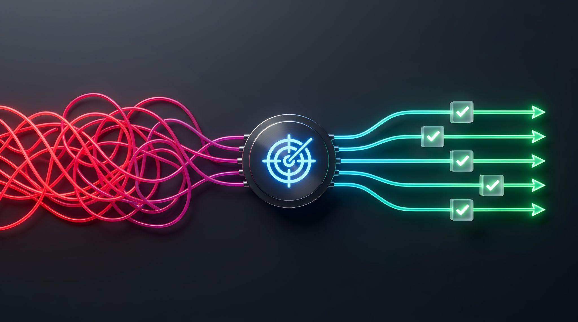
© 2026 Denise Gosnell, All rights reserved.
Notes:
HIDDEN IN SF DECK • back to the present (cut from the SF talk)
• skip

Slide 47
AI Agents are Just Files
Notes:
HIDDEN IN SF DECK • AI Agents are Just Files (cut from the SF talk)
• skip

Slide 48
Three Great Tensions of AI
1
AI will eliminate jobs and create new ones
2
AI will create shared prosperity or extract it
3
AI will democratize control or concentrate it
Notes:
three tensions • cannot make every consequence positive • cannot resolve all • CAN influence how change is experienced
• The leaders in this room cannot make every consequence of AI positive
• We cannot resolve all of these tensions.
• But we can influence how the change is experienced.

Slide 49
© 2026 Denise Gosnell, All rights reserved.
© 2026 Denise Gosnell, All rights reserved.
Notes:
RESOLUTION 1 • jobs disappear, paths narrow • closing off work / lowering the threshold
• Some jobs will disappear. Some career paths will narrow.
• At the same time AI is closing off some forms of work, it is dramatically lowering the threshold for creating others

Slide 50

© 2026 Denise Gosnell, All rights reserved.
© 2026 Denise Gosnell, All rights reserved.
Notes:
who in your organization • insight but not the title • never invited to be a builder • FIRST QUESTION
• Who in your organization could do more meaningful work if someone made these new capabilities accessible to them?
• Who has insight but not the title? Who has never been invited to see themselves as a builder?
• So here is the first question I want you to carry out of this room.

Slide 51
Who gets the tools and a path?
© 2026 Denise Gosnell, All rights reserved.
Notes:
QUESTION 1 • who gets the tools • who gets a path • when their old one closes
• Who gets the tools, and who gets a path when their old one closes?

Slide 52
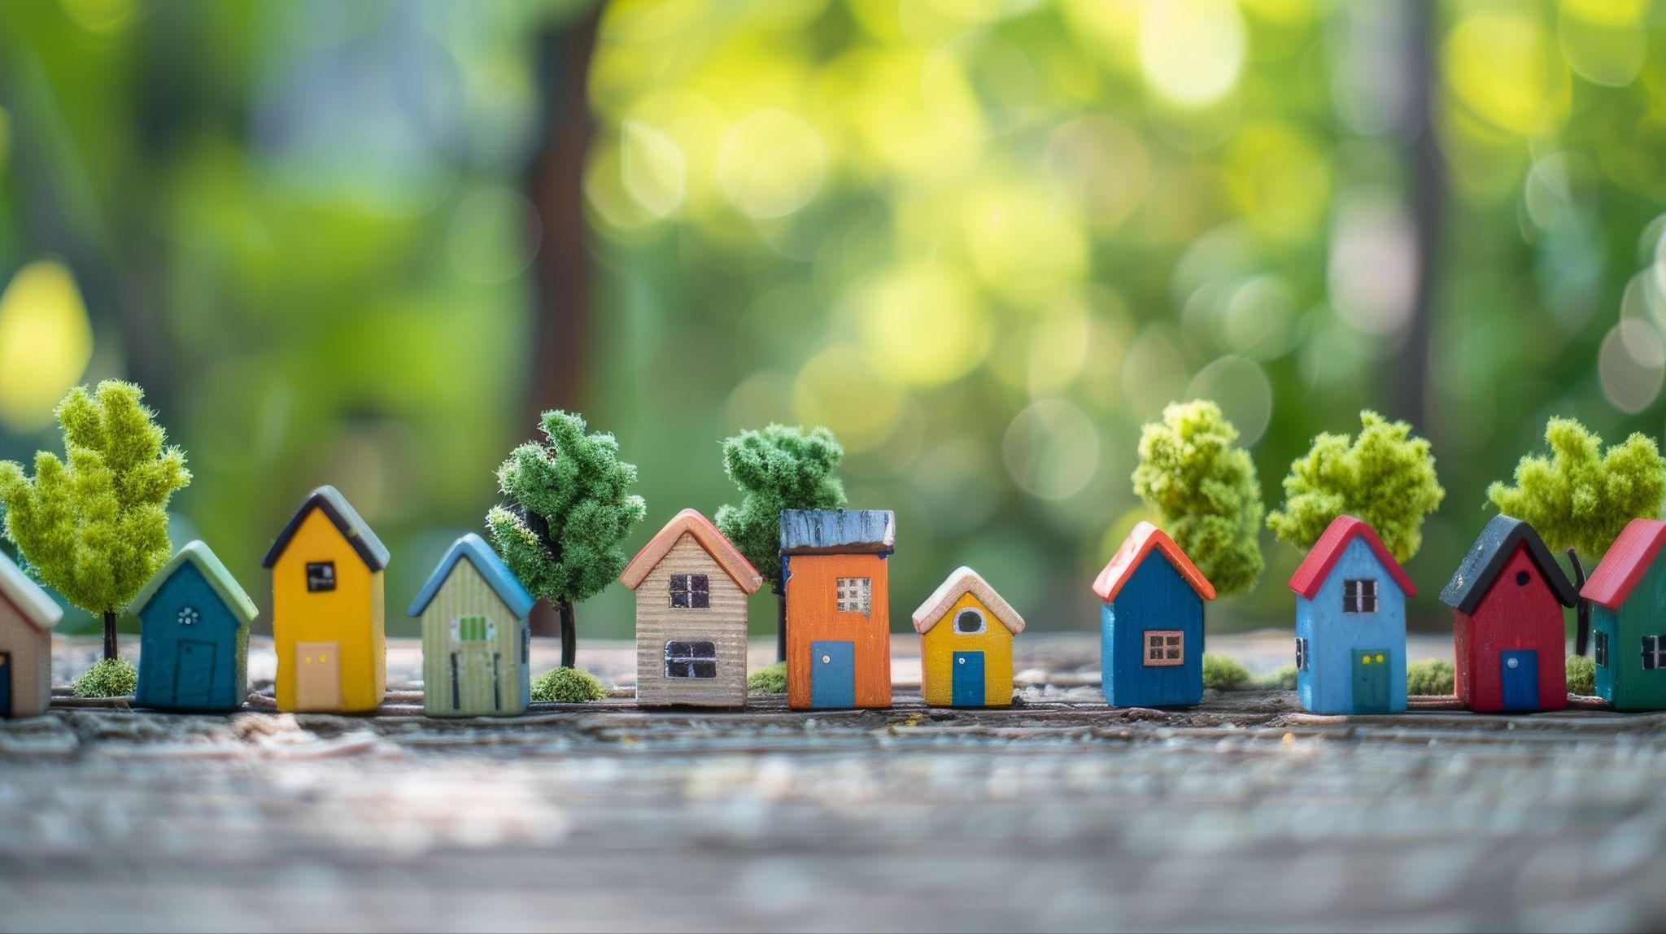
© 2026 Denise Gosnell, All rights reserved.
Notes:
RESOLUTION 2 • value created ≠ where it stays • leave the community more capable • not charity — stewardship • SECOND QUESTION
• AI investment can create enormous value. But where that value is created is not always where it stays.
• The goal is not simply to locate innovation in a community. It is to leave that community more capable than you found it.
• That is not charity. It is stewardship. It is good business.
• So here is the second question I want you to carry out of this room.

Slide 53
Who benefits?
Who pays?
© 2026 Denise Gosnell, All rights reserved.
Notes:
QUESTION 2 • who benefits • who pays
• Who benefits, and who pays?

Slide 54
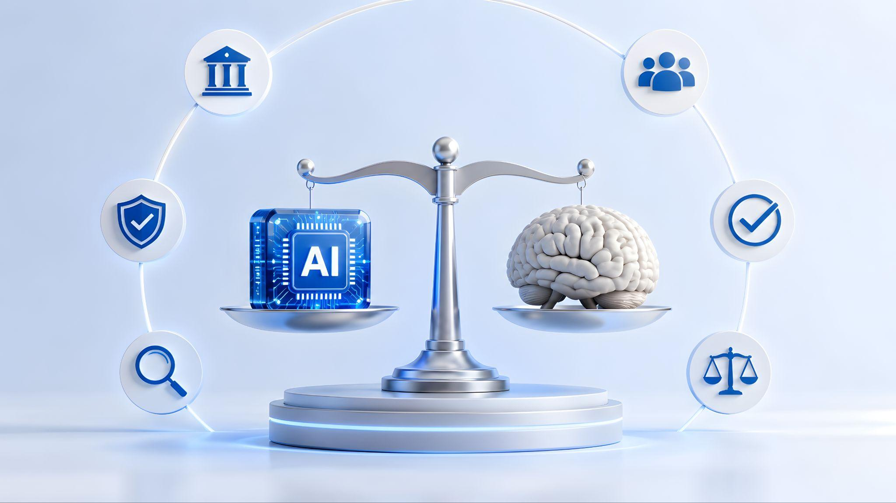
© 2026 Denise Gosnell, All rights reserved.
Notes:
RESOLUTION 3 • understand, decide, act • open or closed — retain agency • employees question it? customers' data? change providers? • THIRD QUESTION
• AI systems will increasingly help us understand information, make decisions, and act
• Some open. Some closed. Either way, the people who depend on them must retain meaningful agency.
• can your employees understand and question it? • can your customers control their data? • can you change providers if the technology, the terms, or the leadership changes?
• So here is the third question I want you to carry out of this room:

Slide 55
Who can understand and question this?
Who can leave?
© 2026 Denise Gosnell, All rights reserved.
Notes:
QUESTION 3 • who can understand and question this • who can leave
• Who can understand and question this, and who can leave?

Slide 56
© 2026 Denise Gosnell, All rights reserved.
© 2026 Denise Gosnell, All rights reserved.
Notes:
run those three questions on every AI decision • OPEN DOOR TEST
• I want you to run those three questions on every single one of your AI decisions
• Call it the Open Door Test.

Slide 57
Door Open Test
1
Opportunity. Who gets the tools and a new path, and whose paths close?
2
Prosperity. Who benefits, and who pays?
3
Control. Who can understand and question this, and who is forced out?
© 2026 Denise Gosnell, All rights reserved.
Notes:
before your next AI decision • vendor contract, reorg, next product you ship • open a door or happen TO them? • 3 checks: Opportunity, Prosperity, Control • answer all three = opening doors • door quietly closing
• Before your next AI decision—a vendor contract, a reorg, or the next product you ship (SF swap for the Working Backwards doc)
• ask yourself: does this open a door for people, or does it just happen to them?
• then apply those 3 simple checks:
• Opportunity. Who gets the tools and a new path, and whose paths close?
• Prosperity. Who benefits, and who pays?
• Control. Who can understand and question this, and who is forced out?
• answer all three = opening doors • cannot answer one = the door that is quietly closing on someone

Slide 58
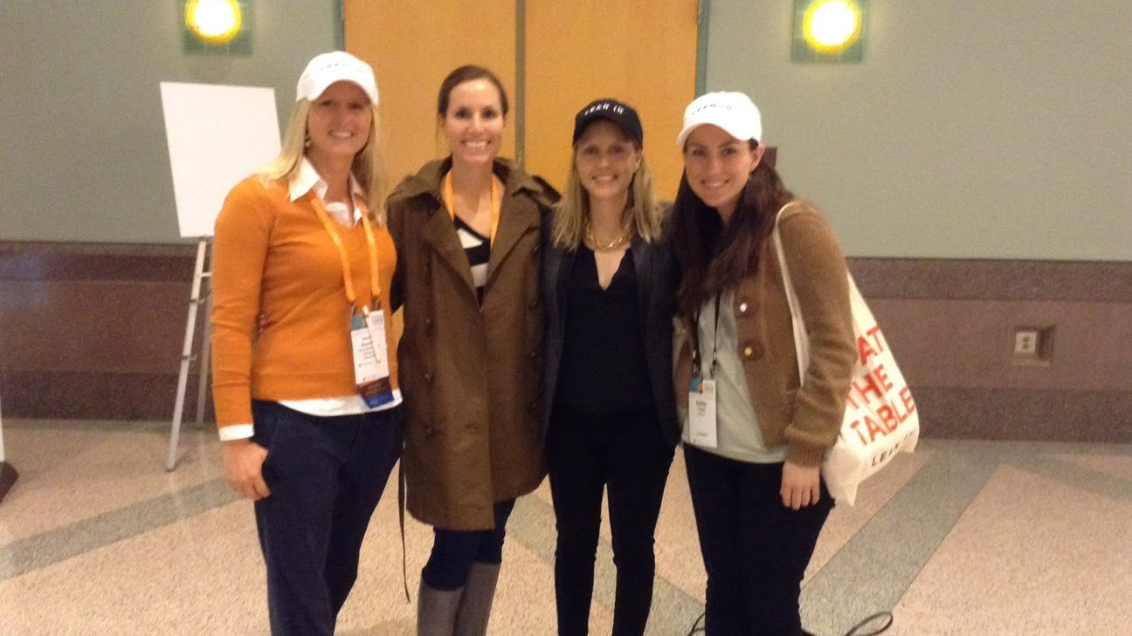
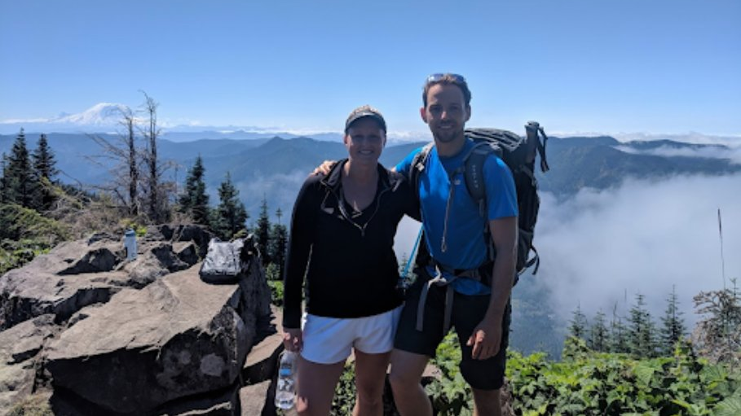
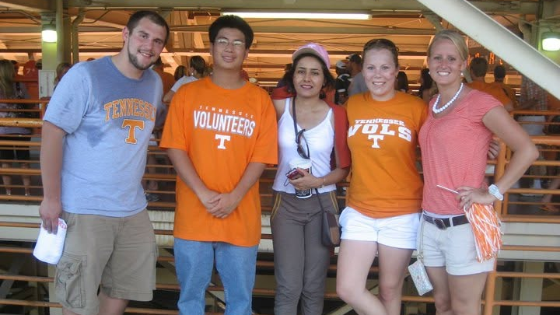
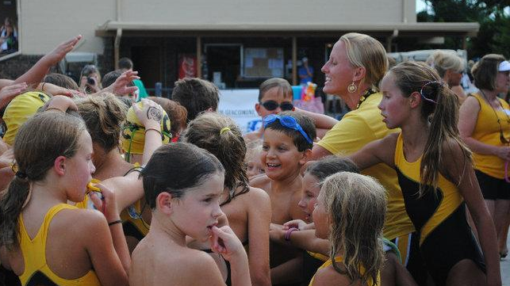
© 2026 Denise Gosnell, All rights reserved.
© 2026 Denise Gosnell, All rights reserved.
Notes:
what lights me up • not the chips • THAT KID • until it did • the Micahs • same choice → happen TO or agency? • fear narrows: pick a side • both sides at once • my challenge
• what is really lighting me up • It isn't the chips. I'd still drop those anyway.
• that kid who sees an open door—a door I helped open—and walks through • hugs me, lifts me off the ground
• Because for her, it didn't. Until it did.
• all she needed was for someone to open the door and show her where it was
• That's it. That's the whole thing. I do what I do for the Micahs of the world. I exist to light somebody else's fire.
• every duality comes back to the same choice: Will AI happen TO people, or will we help people have agency?
• headlines want you to be afraid • fear narrows: acceleration or obstruction, optimism or pessimism, opportunity or danger
• The Duality demands something harder: see both sides at once
• we do not have to choose between a future in which AI succeeds and one in which people do
• So that is my challenge to you.

Slide 59
© 2026 Denise Gosnell, All rights reserved.
Notes:
every month, find your Micah • problem / idea / old path / doesn't look like you • just open the door • tools, threshold, surprise you • AI will open & close • WE WILL • keep it human • hold the door open
• Do not let a month go by when you cannot say, "I opened a door for someone." Every month, find your Micah.
• the problem but not the title • the idea but not the vocabulary • the old path disappearing • does not look like you, think like you, learn like you
• You do not have to carry them through the door. Just open the door and make it visible.
• Give them the tools. Help them reach the threshold. And then let them surprise you.
• AI will open extraordinary doors. AI will close some, too.
• The technology alone will not decide which side of that Duality defines this era. We will.
• So keep it human. And hold the door open.

Slide 60
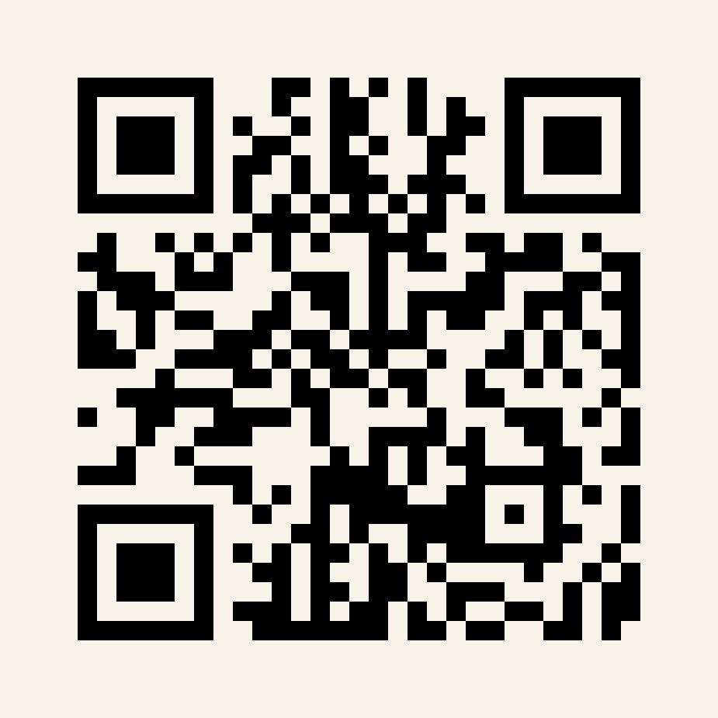



Thank You
Book me in 2027 👇
denise@denisegosnell.ai
@denisekgosnell
@denisegosnell.ai
Notes:
THANK YOU • hold the door open • book me in 2027 • QR code
• Thank you.
• email • LinkedIn • Instagram • QR on the slide

Slide 61
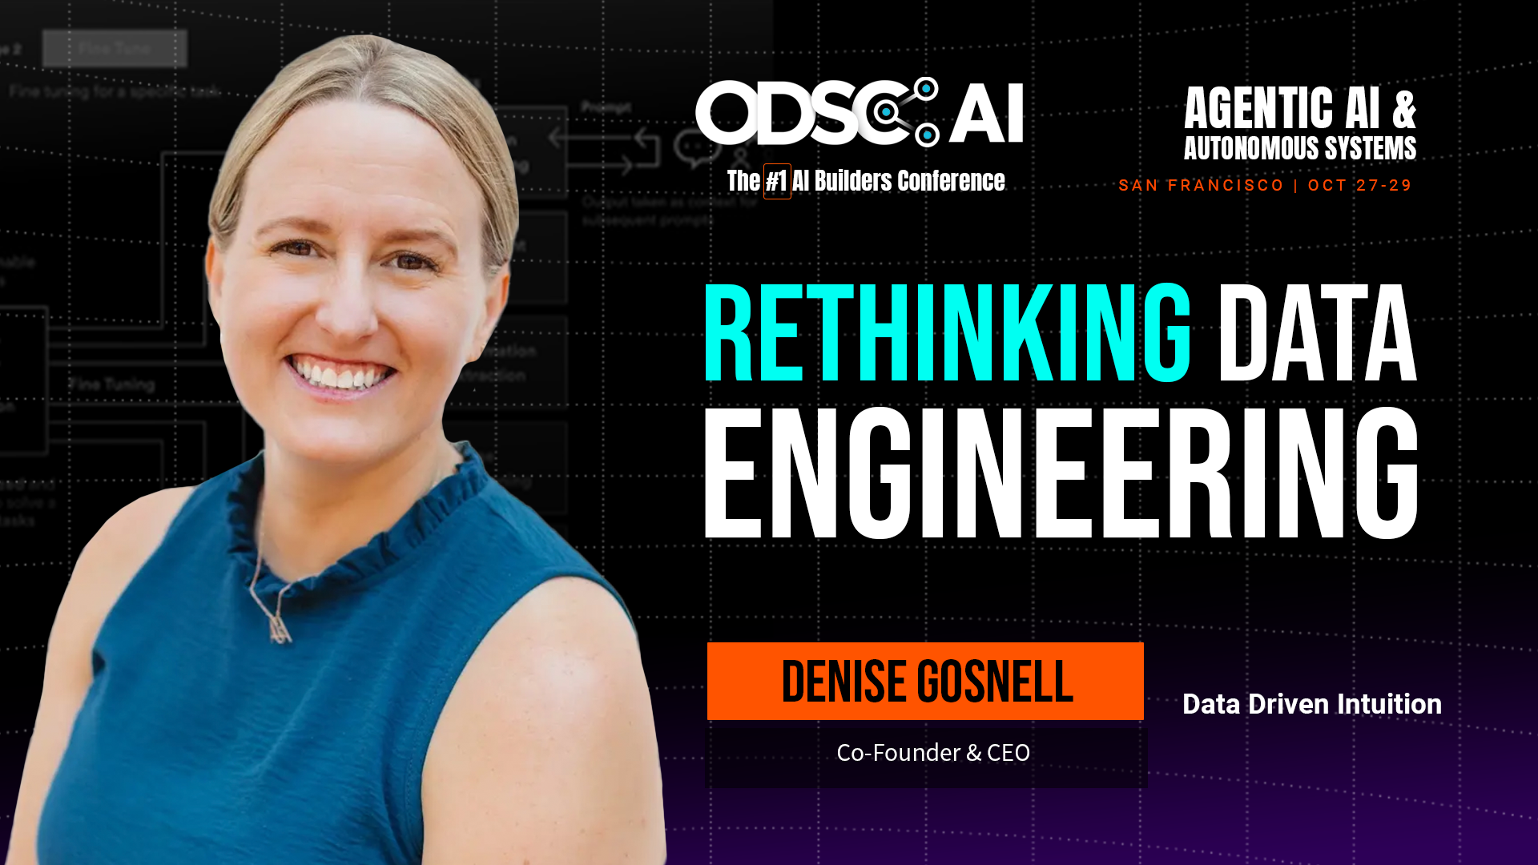
Data Engineering Keynote
Wednesday @ 2pm
Notes:
Data Engineering Keynote • Wednesday @ 2pm • invite them
• no script on this slide
• "If you want the builder's version of this, come find me Wednesday at 2."

