Slide 1
Connecting to Impala with Tableau
Summer Elasady

Slide 2
What is Tableau
Graphically design queries
Visualize query results
Create views

Slide 3
Installing Tableau
Download a free 14 day trial:
http://www.tableau.com/products/desktop

Slide 4
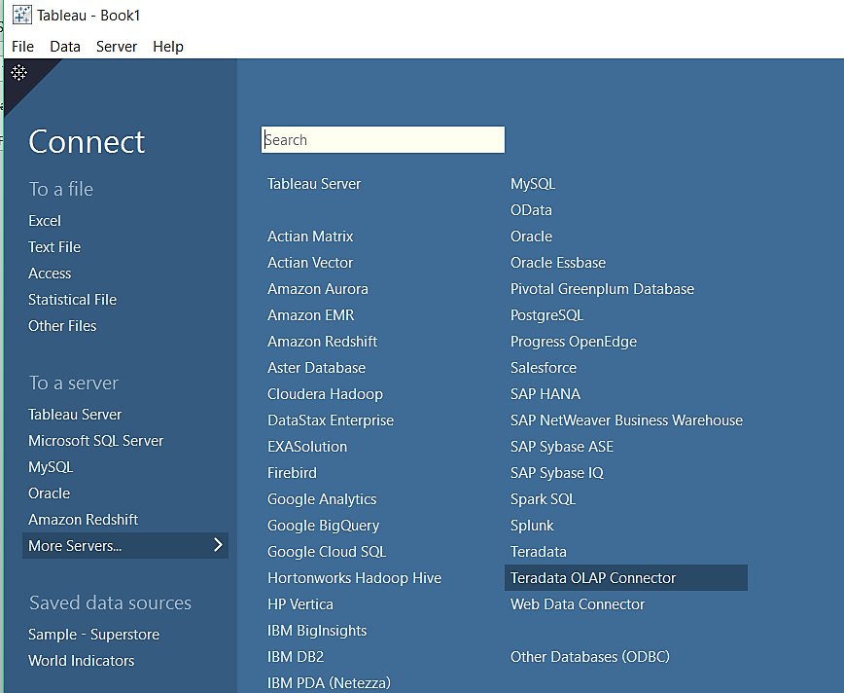
Connect to impala
From the “Connect” menu:
Click on “More Servers”
Select “Cloudera Hadoop”

Slide 5
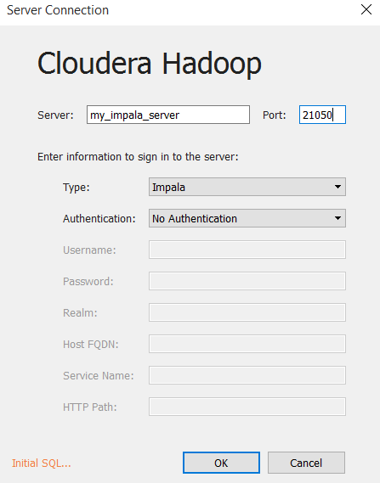
Connect to impala
From the ‘Type’ drop down, select ‘Impala’
Enter your Impala host address
Enter your impala port (default = 21050)

Slide 6
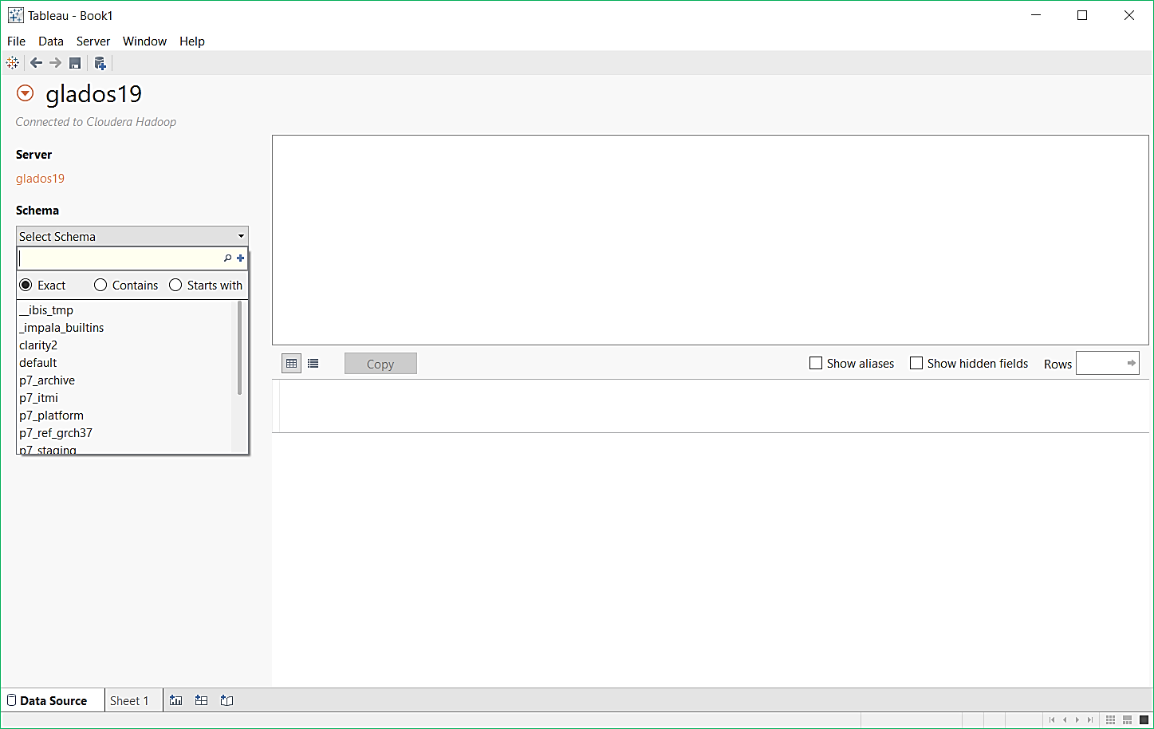
Select a database
From the schema dropdown, select a database

Slide 7
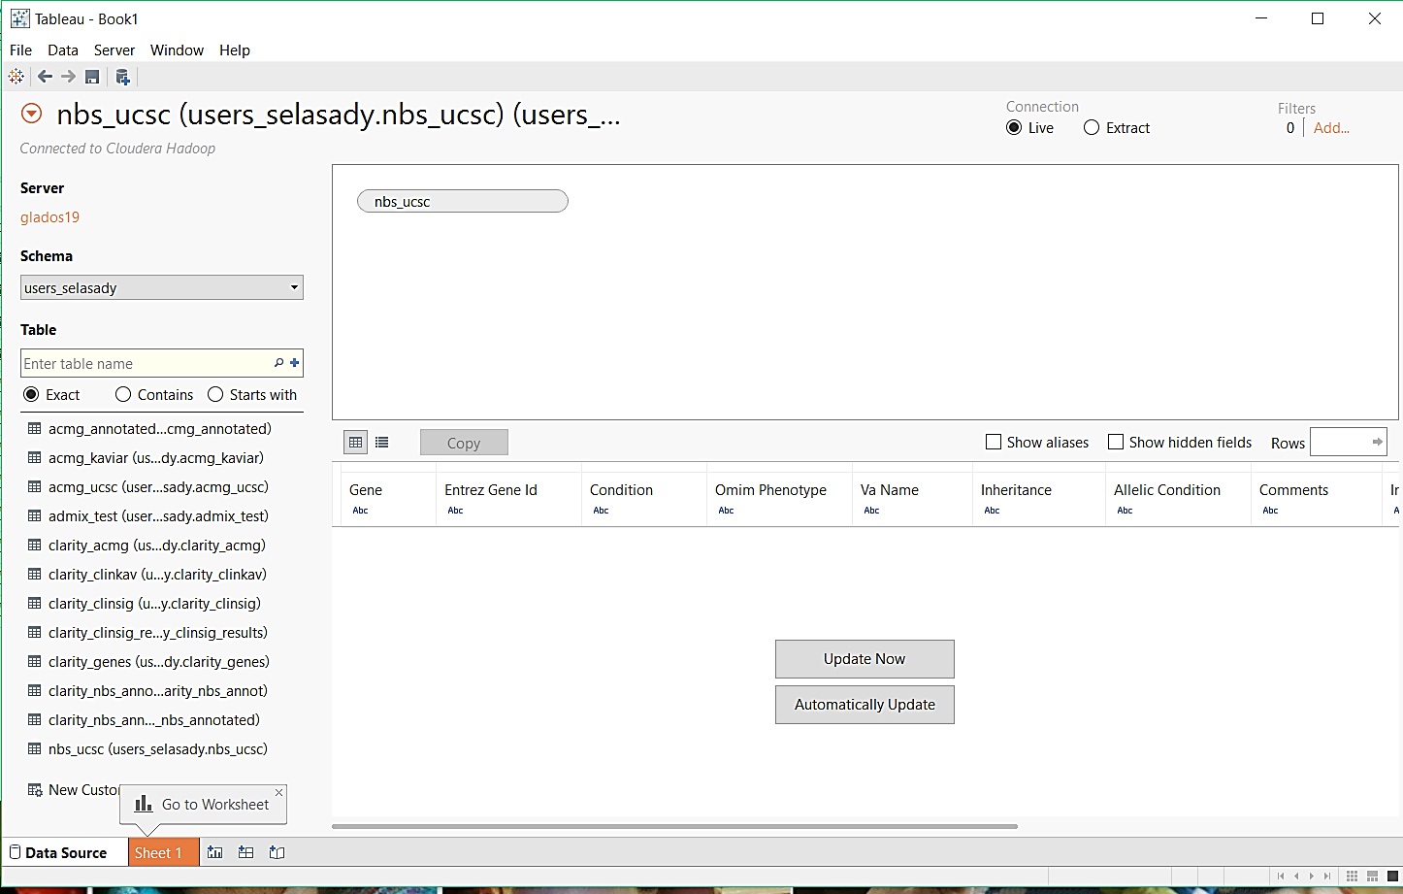
Select a table
From the table dropdown, double-click to select a table

Slide 8
View a table
The table will appear in your query window, with all columns listed below

Slide 9
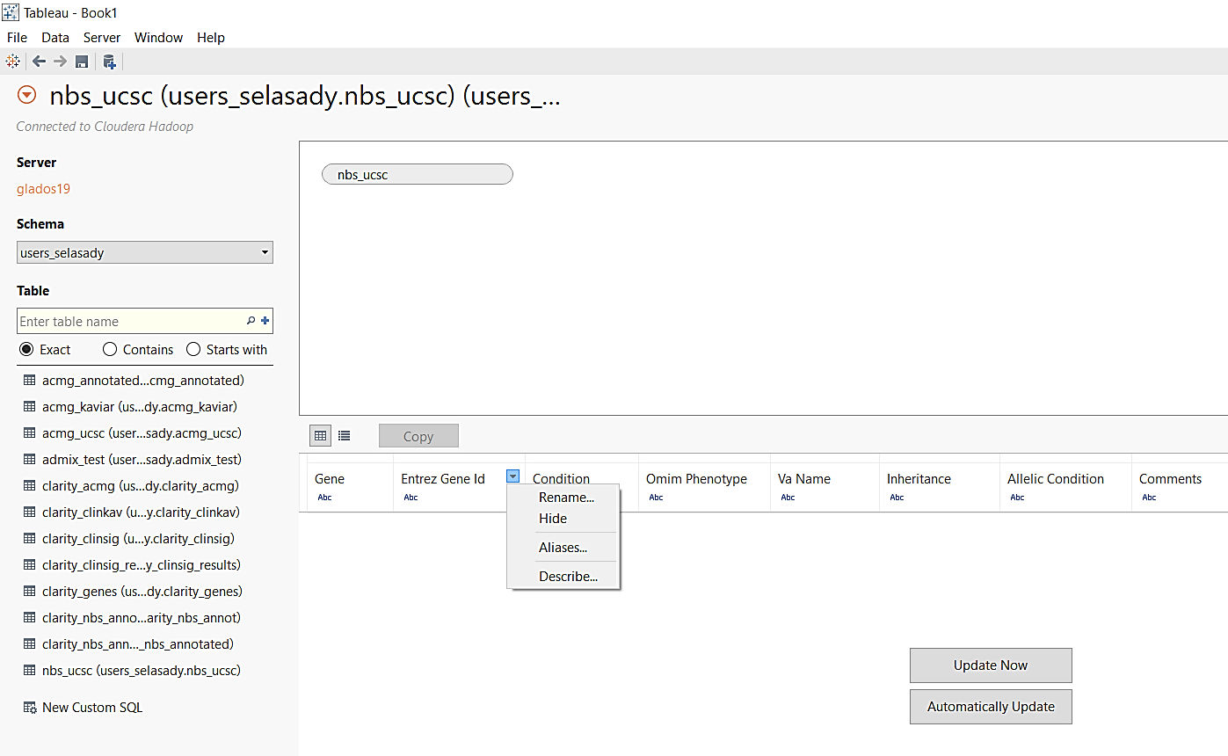
Select, Hide and Describe Rows
Click on the drop-down menu next to each column

Slide 10
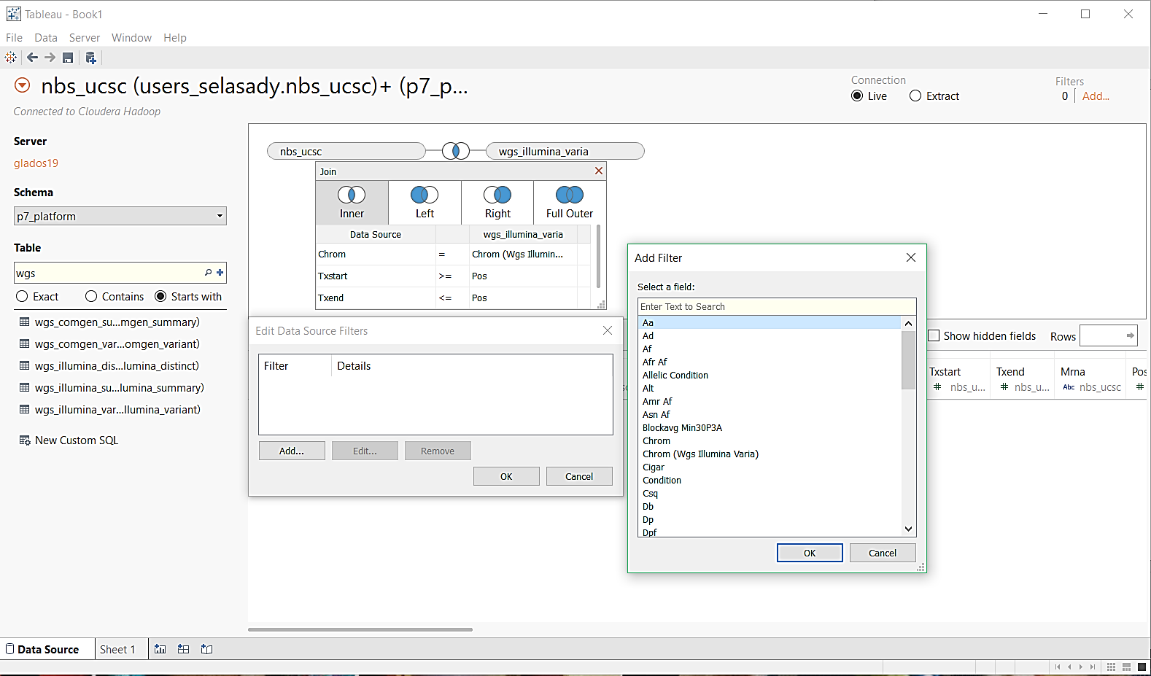
Filter Results
Click on the “Add” from the filters menu on the right
Click on “Add” to add filters to your data set

Slide 11
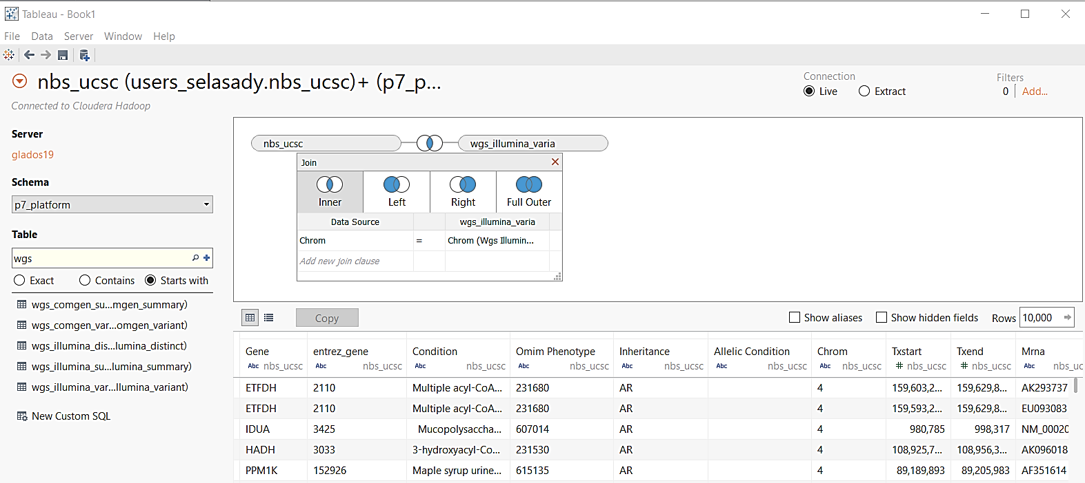
Join Tables
Select another table from the Schema/Table dropdown menus
Click on the ‘Join’ icon to select join type

Slide 12
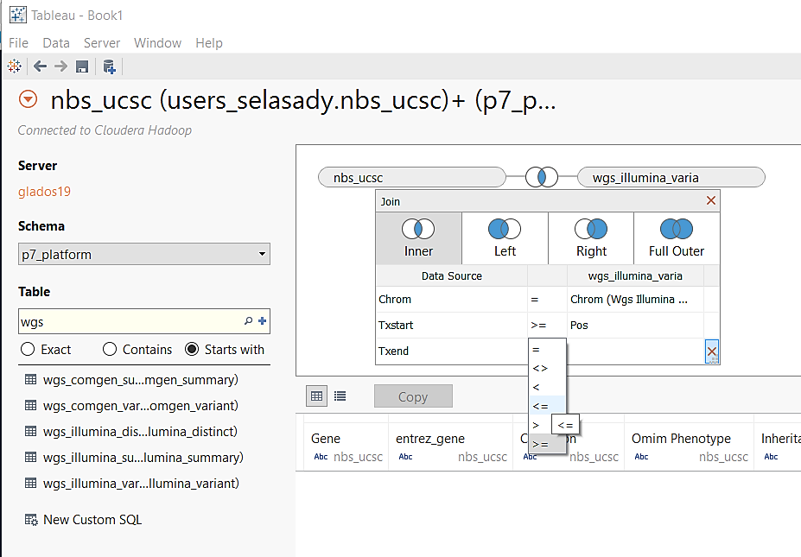
Join Tables
Enter parameters to join the tables on

Slide 13
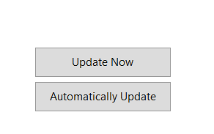
View Results
Select to have results automatically updated, or view updates manually

Slide 14
Save Results
Select to have results automatically updated, or view updates manually

