Slide 1
Using Impala For Variant Pipelines
Summer Elasady and Denise Mauldin
11-19-2015

Slide 2
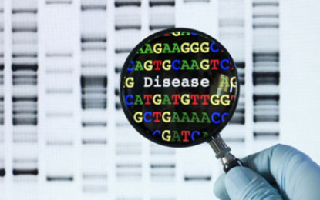
Agenda
What is Impala?
System Structure
What’s available?
Creating Queries
Connecting to Impala
Hue Web Interface
Impala Shell
R
Python
Sample Pipelines
Getting Help

Slide 3
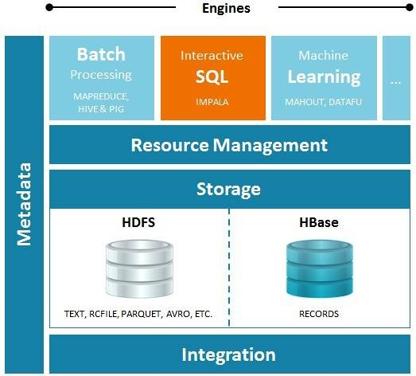
What exactly is impala?

Slide 4
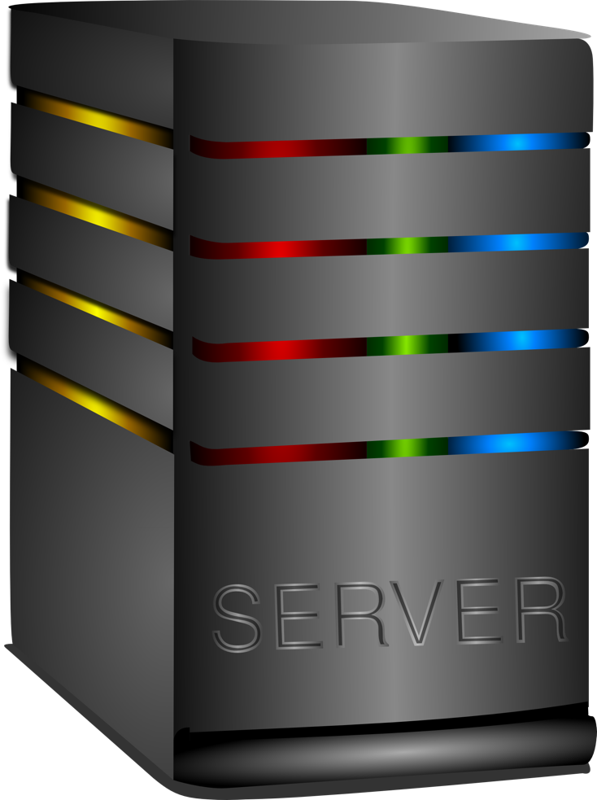
What exactly is impala?
Store Files:
Variants
Ref DB
Analysis Results

Slide 5



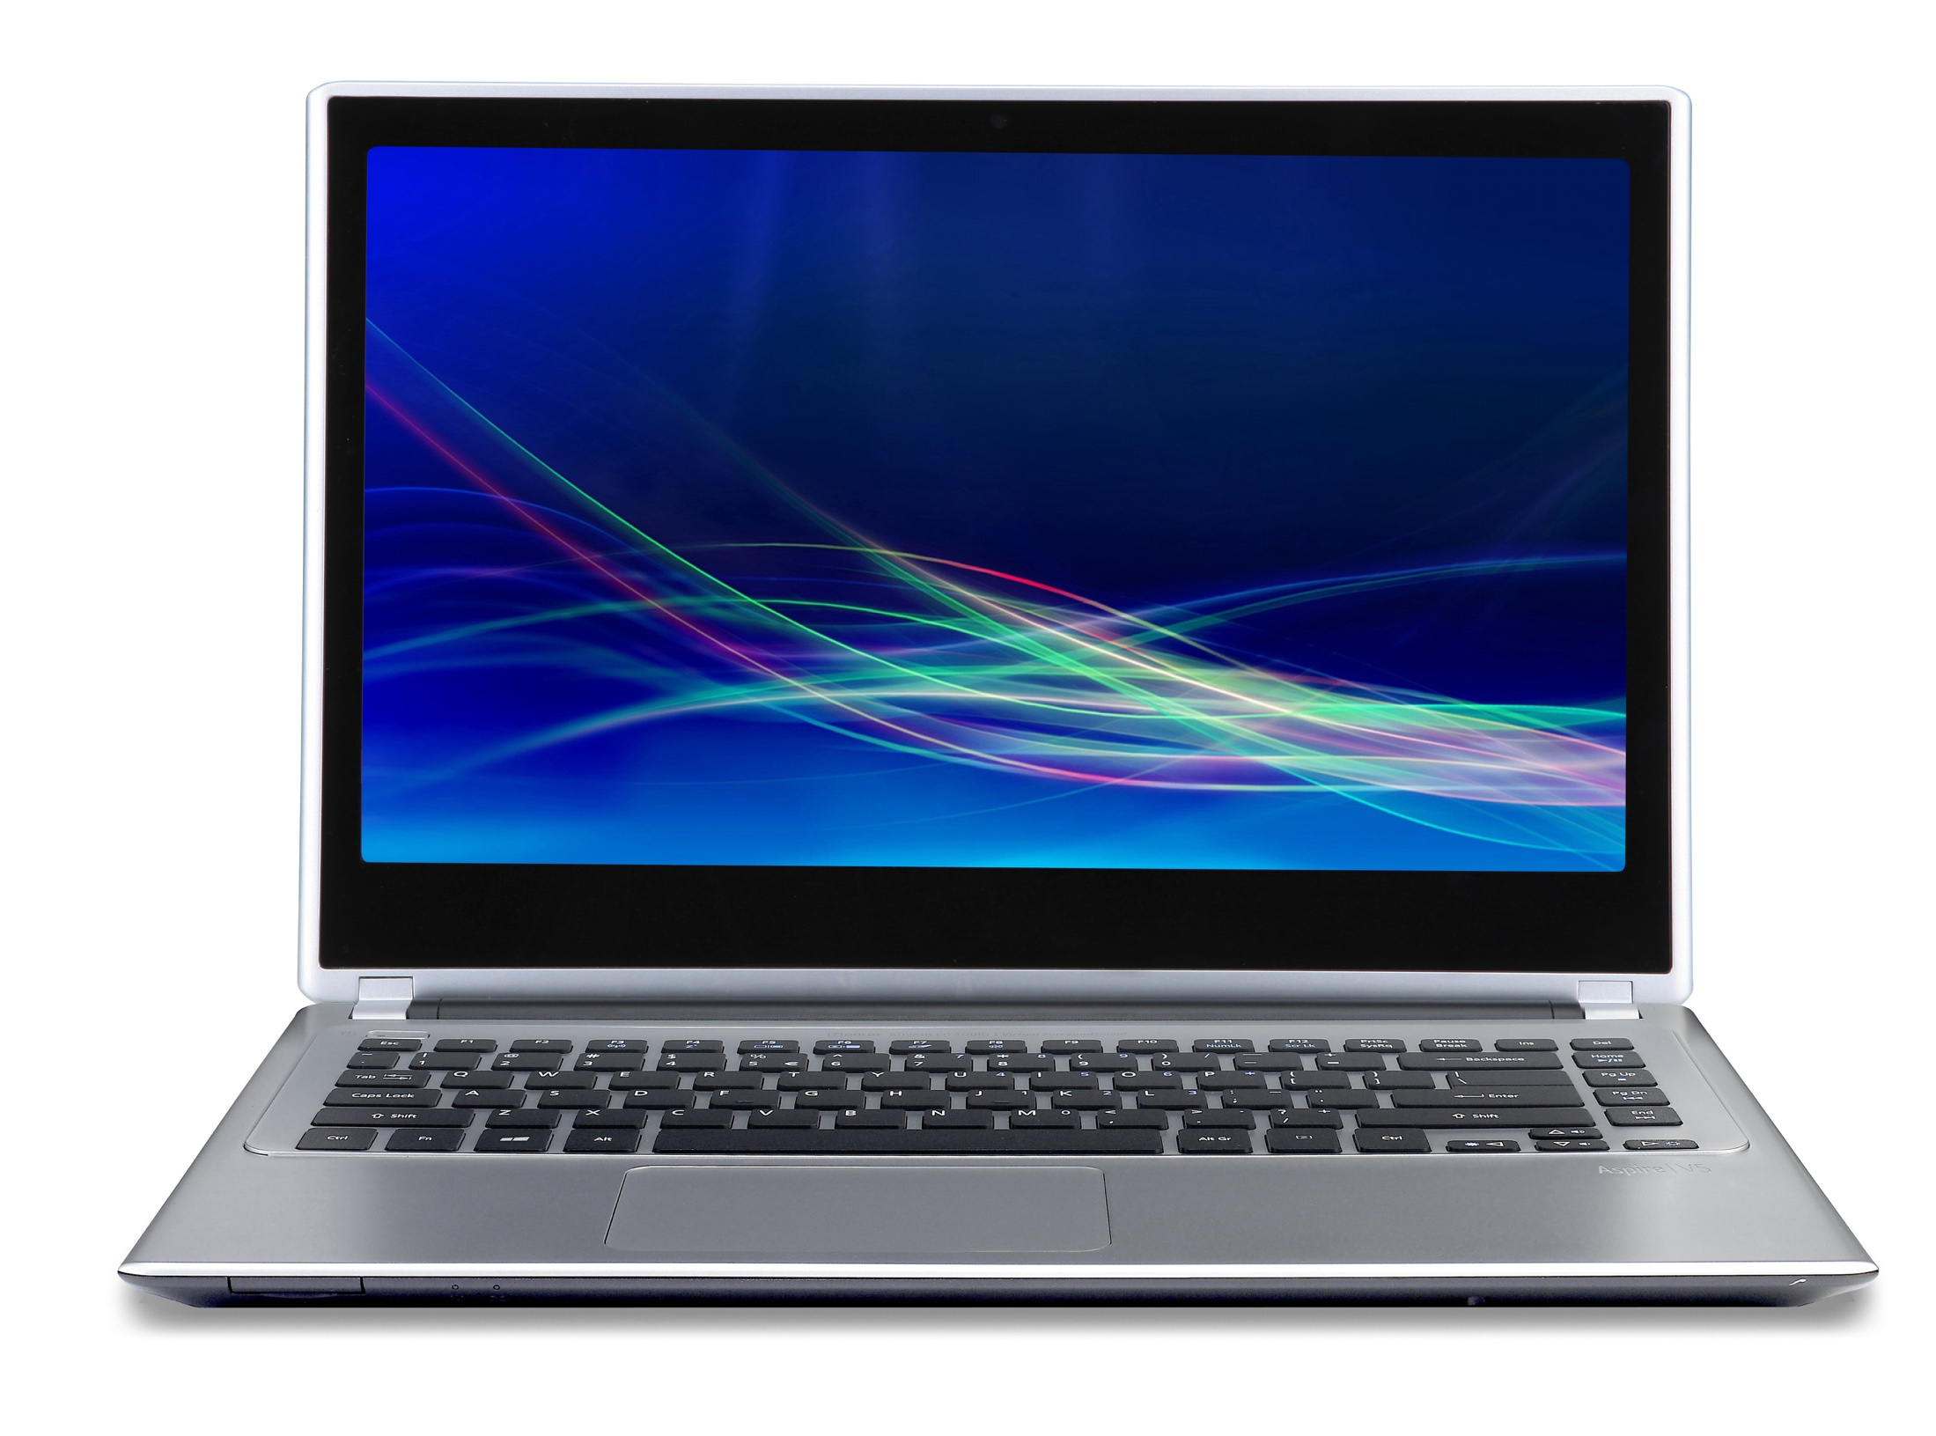
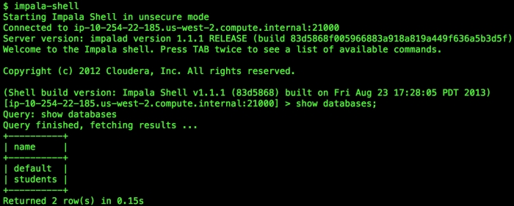
What exactly is impala?
Filter and search variants

Slide 6
What’s Available?
Consistency
Normalized Data
1-based coordinates
Universal Column Names
Universal format: One row per variant

Slide 7
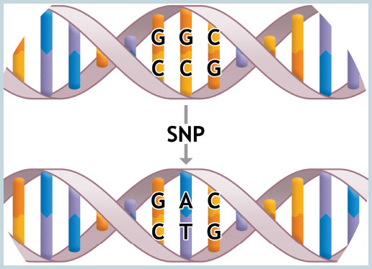


Variants
101
102
103

Slide 8
Annotation Sources
Position Based Annotations:
CADD
ClinVar
DANN
dbSNP
dbNSFP
ESP exomes
Kaviar
Gene/Protein Annotations:
Ensembl
RefSeq
UCSC
Uniprot
Custom Annotations:
Global Distinct Variants
All variants found by position
Kaviar allele frequency
ClinVar significance rating
rsID from dbSNP
DANN and CADD scores
Ensembl gene name and gene ID
SnpEff coding consequence predictions
Regional Annotations:
ACMG actionable genes
Cytoband regions
ESP exomes
GO
miRBase
NBS genes
RepeatMasker
Segmental Duplications (UCSC)

Slide 9

Accessing Impala

Slide 10
Accessing Impala

Slide 11
Accessing Impala

Slide 12
Accessing Impala

Slide 13
Accessing Impala

Slide 14

Accessing Impala

Slide 15

Accessing Impala

Slide 16
Accessing Impala

Slide 17
Accessing Impala

Slide 18
Accessing Impala
ODBC
driver

Slide 19

Accessing Impala
ODBC
driver
Impyla
Ibis
RODBC

Slide 20
Hue Interface
ISB Impala:
http://glados19.systemsbiology.net:8888/impala/#query
ITMI Impala:
http://ec2-54-152-101-80.compute-1.amazonaws.com:8888/accounts/login/
Notes:
Login and update password
File Browser for HDFS
Data Browser to view impala tables
Switching Databases
Writing Queries
Explain Plan
Run Queries
Save Queries
Run Saved Queries (run some examples)
Create tables from HDFS
Create tables from results
Download results

Slide 21
ODBC Driver
Official Definition:
An ODBC driver uses the Open Database Connectivity (ODBC) interface by Microsoft that allows applications to access data in database management systems (DBMS) using SQL as a standard for accessing the data. ODBC permits maximum interoperability, which means a single application can access different DBMS.
Summary:
Driver that allows you to use SQL to access a database

Slide 22
Connecting with impala-shell
Tutorial:
https://github.com/summerela/impala_training/blob/master/impala_shell.ipynb

Slide 23
Connecting with R and Python
Python:
https://github.com/summerela/impala_training
Click on the ‘launch binder’ icon
Click on connect_python.ipynb
R:
https://glados47.systemsbiology.net/
Tutorial:
Script: https://github.com/summerela/impala_training/blob/master/connect_R.R

Slide 24
Building Queries
Choose your interface
Follow along (and copy/paste queries):
https://github.com/summerela/impala_training/blob/master/building_queries.md

Slide 25
Basic Pipeline

Slide 26
Map/Reduce (Hadoop streaming?)

Slide 27
Advanced Pipelines
NBS genes
ACMG genes
?

