Slide 1
Using the Hue Web Interface
Summer Elasady

Slide 2
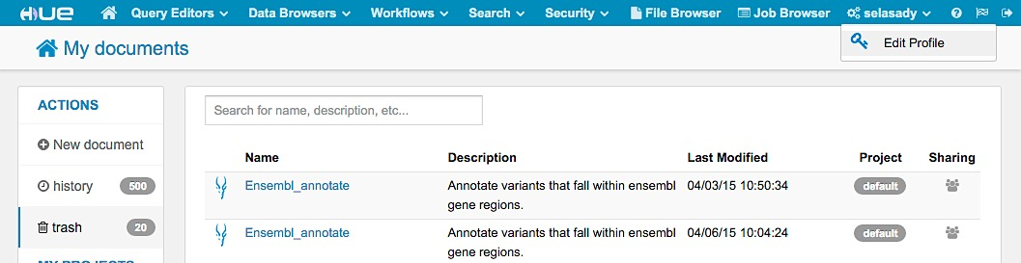
Updating Account Info
Click on your user name
Edit Profile
Follow the steps to update your password and info

Slide 3
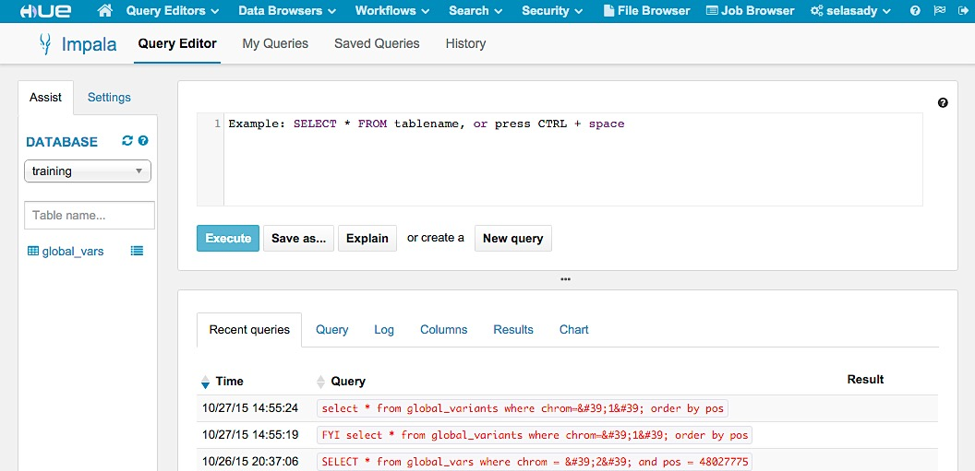
Query Editor- Impala
Click on Query Editor
Click on impala

Slide 4
Query Editor- Impala
Query window where you write and execute queries

Slide 5
Query Editor- Impala
View recent queries and query results

Slide 6
Selecting and Viewing Database
Click on the drop-down menu to view and select databases

Slide 7
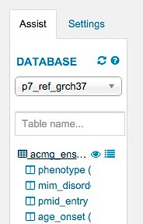
View Database Information
Click on the database icon to view column names and data types

Slide 8
View Database Information
Click on the eye to view information and a data sample in a new window
Click on the list icon to view this information in the same window

Slide 9
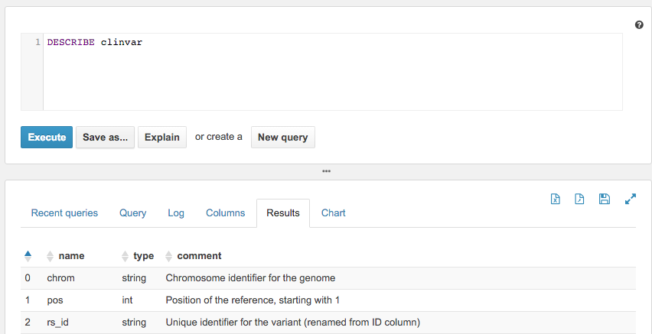
Describe Database Columns
Type DESECRIBE table_name and click on Execute
View descriptions of what is in each column

Slide 10
Create a Query
Select the p7_ref_grch37 database
Enter the query shown
Click on Explain to review the query plan
SELECT chrom, pos, ref, alt, gene
FROM clinvar
WHERE chrom = '1'
GROUP BY chrom, pos, ref, alt, gene
LIMIT 50

Slide 11
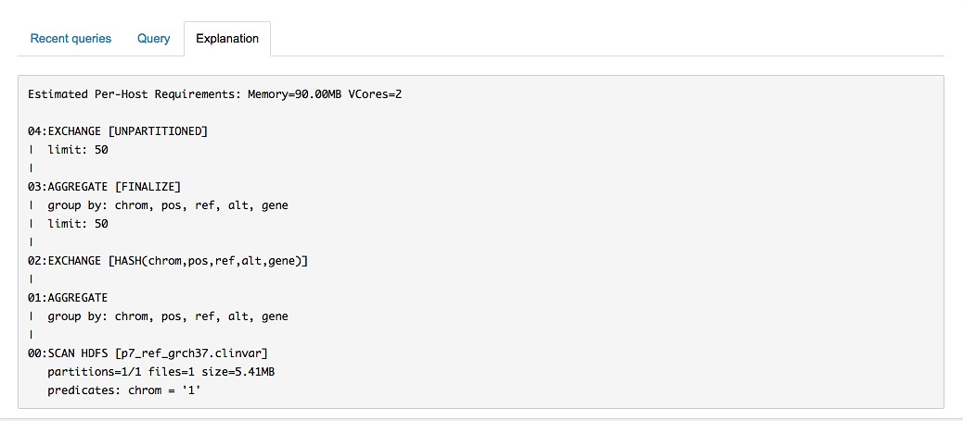
Review Explain Plan and Execute Query
Read in numerical order
Look for ways to optimize
Identify bottlenecks
Click Execute to run the query

Slide 12
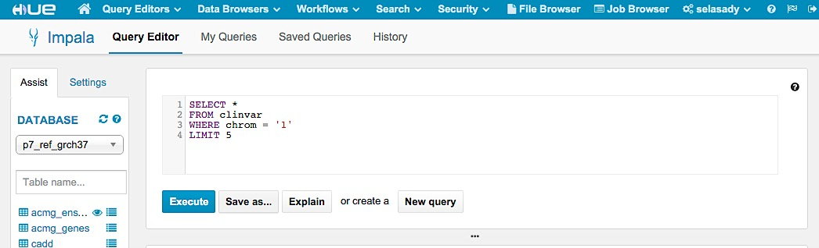
Save Queries
After executing a query click on Save as
Give the query a name and description

Slide 13
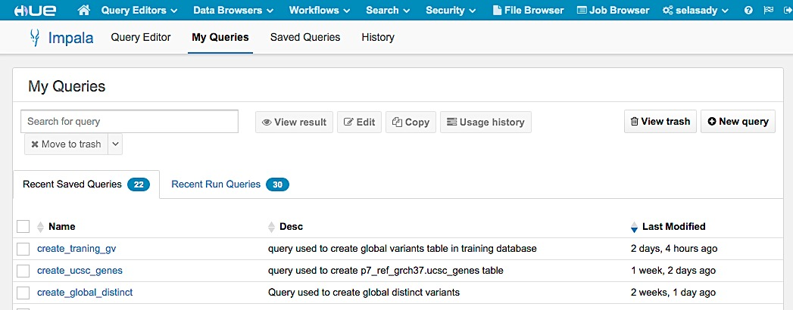
Run Saved Queries
Click on My Queries to view your saved queries
Click on the query name to run it in the impala query editor

Slide 14
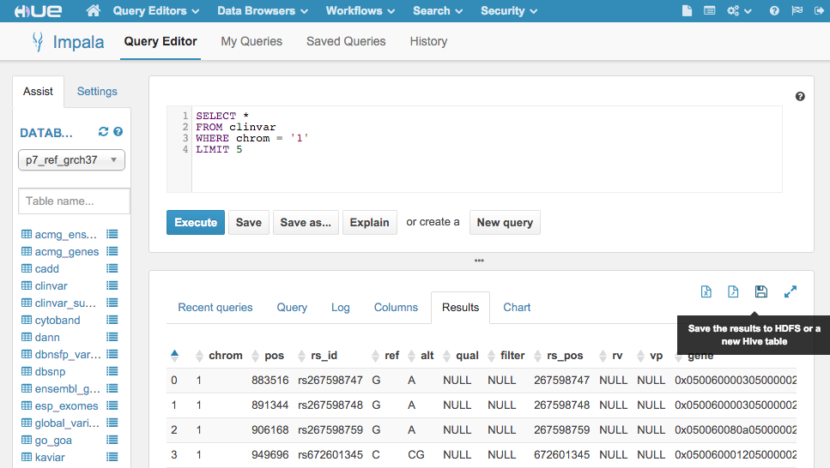
Save Results
Click on one of the icons shown in the red box to save your results as a table on impala, or to download as a csv or excel file

Slide 15
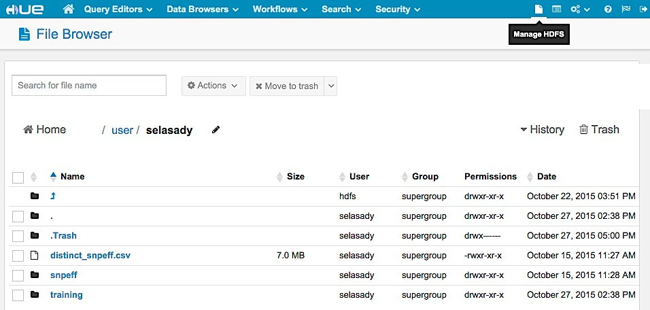
Working with HDFS
Click on the file icon
Click on manage HDFS

Slide 16
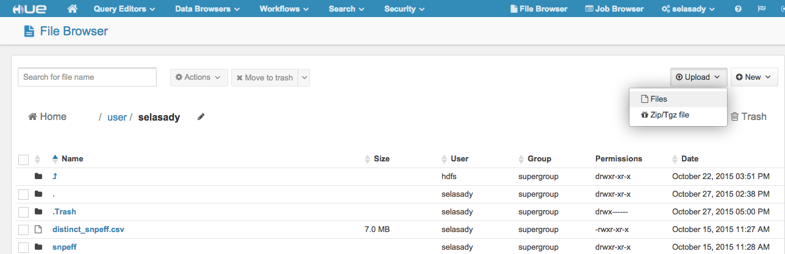
Uploading a TSV/CSV to HDFS
Click on the file icon
Click on manage HDFS

Slide 17
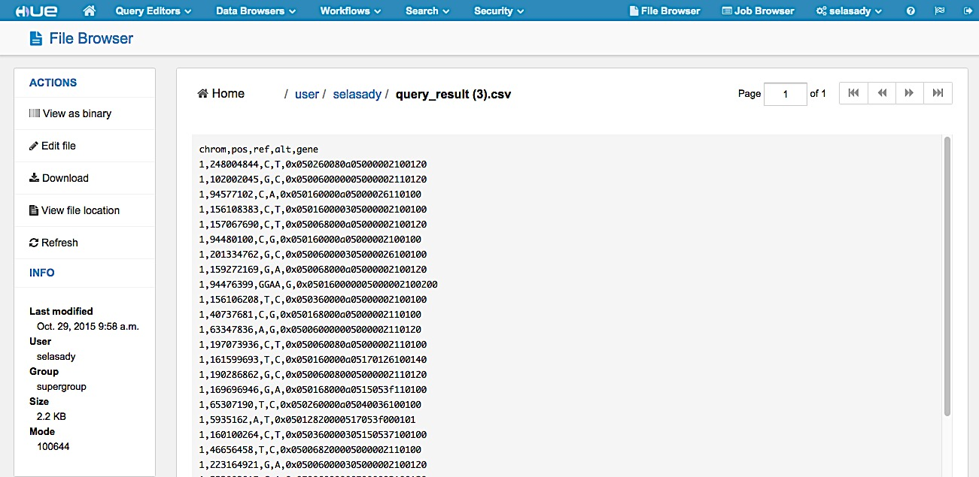
Viewing uploaded files
Once a file is uploaded to HDFS click on that file
Make sure everything looks correct before converting to a table

Slide 18
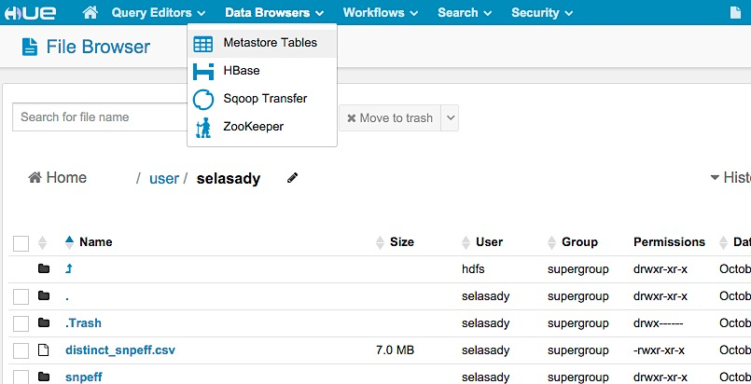
Converting an HDFS file to a table
Once a file has been uploaded to HDFS, click on Data Browses
Click on Metastore Tables

Slide 19
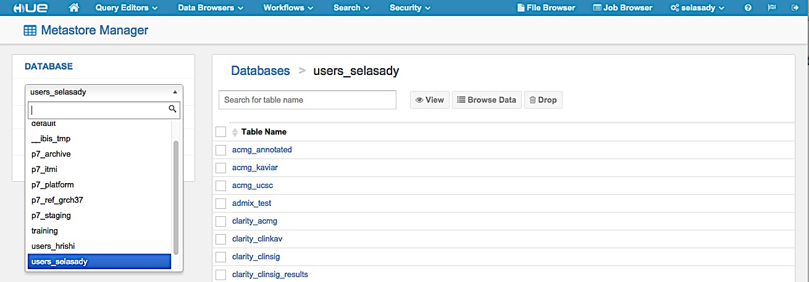
Select a database to place the table
Click on the file icon
Click on manage HDFS

Slide 20
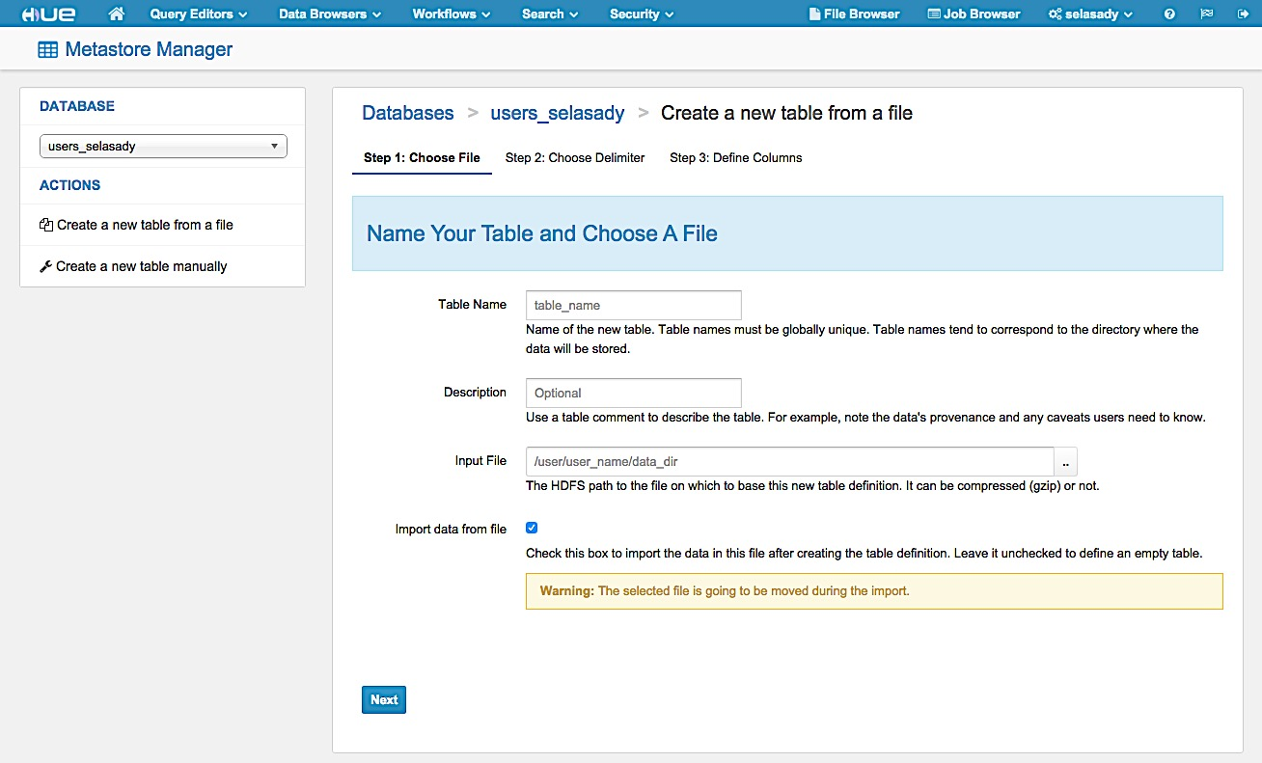
Create a new table from a file
Click on the file icon
Click on manage HDFS

Slide 21
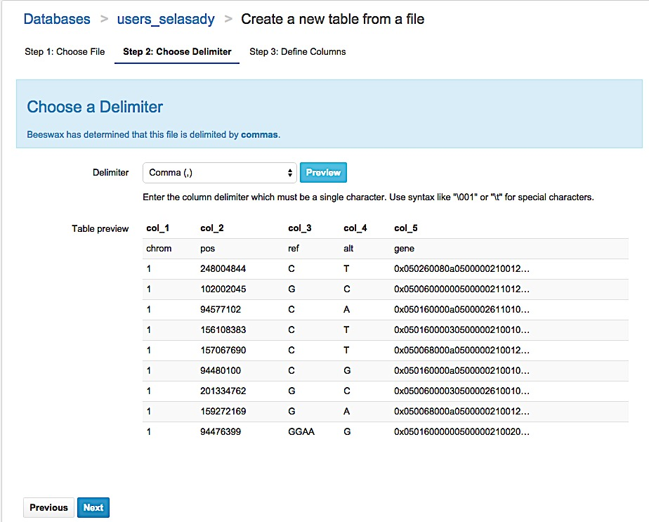
Choose your delimiter
Choose how your file is delimited

Slide 22
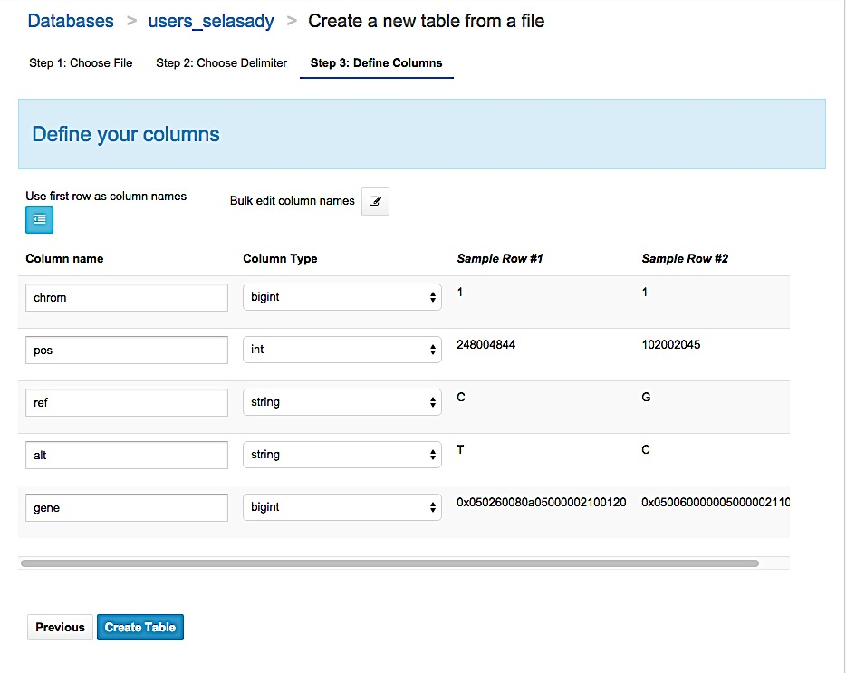
Define your columns
Check that the proper data type is selected for each column

