Slide 1
CHURN
ANALYTICS FRAMEWORK FOR TELECOMMUNICATIONS
- Introduction to Machine Learning (CS484)
Group No: 22
Team Member Name | CWID
Denish Dalsukhbhai Asodariya | A20525465
Prince Jayantbhai Rajodiya | A20536409

Slide 2
OUTLINE
Introduction
Model Evaluation
Overview of the project
Assessing model performance
Dataset
Model Comparison
Source and features description
Comparing different approaches
Methodologies
Conclusion
Techniques and tools used
Key takeaways and insights

Slide 3
INTRODUCTION
Motivation:
Customer churn refers to the likelihood of customers discontinuing their subscriptions with a service provider.
Churn prediction has emerged as a critical challenge due to its direct impact on revenue.
Retaining existing customers is significantly more cost-effective than acquiring new ones, making churn prevention a priority for telecom companies.
Accurate churn prediction enables organizations to identify at-risk customers, mitigate revenue loss, and enhance customer retention through strategic resource allocation.

Slide 4
INTRODUCTION
Objective:
The primary goal is to predict customer churn effectively by identifying the factors influencing it.
This involves leveraging machine learning algorithms to develop a predictive model to analyze customer behavior and deliver reliable predictions.
The model's performance will be evaluated using appropriate metrics, and the objective is to determine the most accurate and efficient model for churn prediction in the telecom sector.

Slide 5
DATASET
The dataset used is sourced from Kaggle and originally compiled by IBM, ensuring high-quality and reliable data.
It provides a regional focus, specifically targeting California and its cities, offering localized insights.
The dataset includes detailed information such as customer demographics and account-related data.
Each customer record is labeled with a variable Churn, indicating whether the customer will likely cancel the service.
An additional label, Churn Reason, specifies the reasons for customer dissatisfaction or service discontinuation.
For more information, access the dataset here.

Slide 6
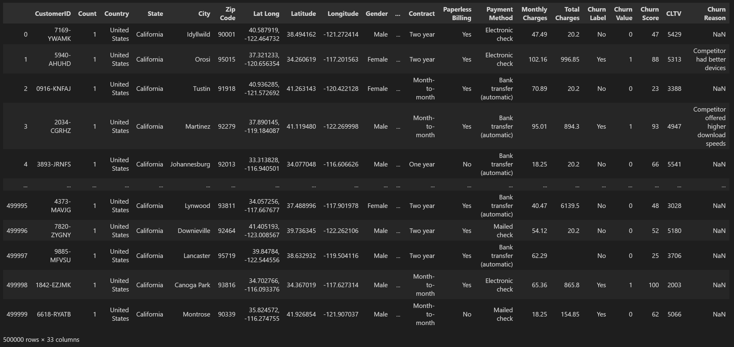
DATASET

Slide 7
METHODOLOGIES
Modeling
EDA (Exploratory Analysis)
Algorithm Selection
Determining the Model
Optimization
Data Preprocessing
Data Augmentation
Data Balancing
Tuning the Parameters to improve the accuracy
Exploring Data using Visuals
Finding Correlation
Feature Extraction
Dataset split for Modelling
Model Evaluation
Accuracy of Model using Evaluation Metrics

Slide 8
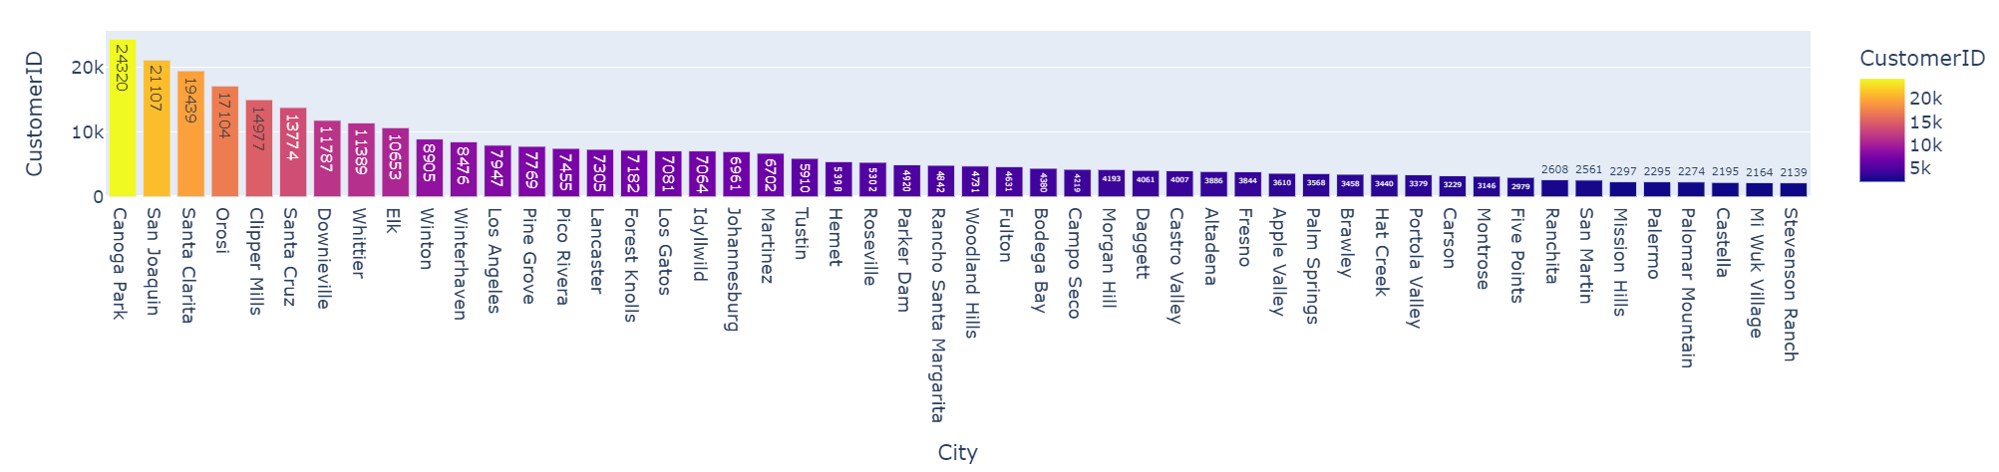
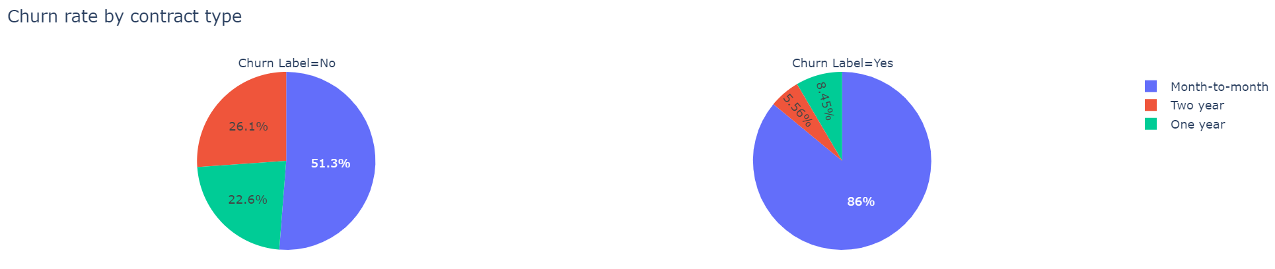
DATA PREPROSSESING & EDA

Slide 9
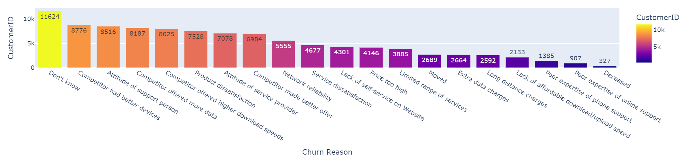
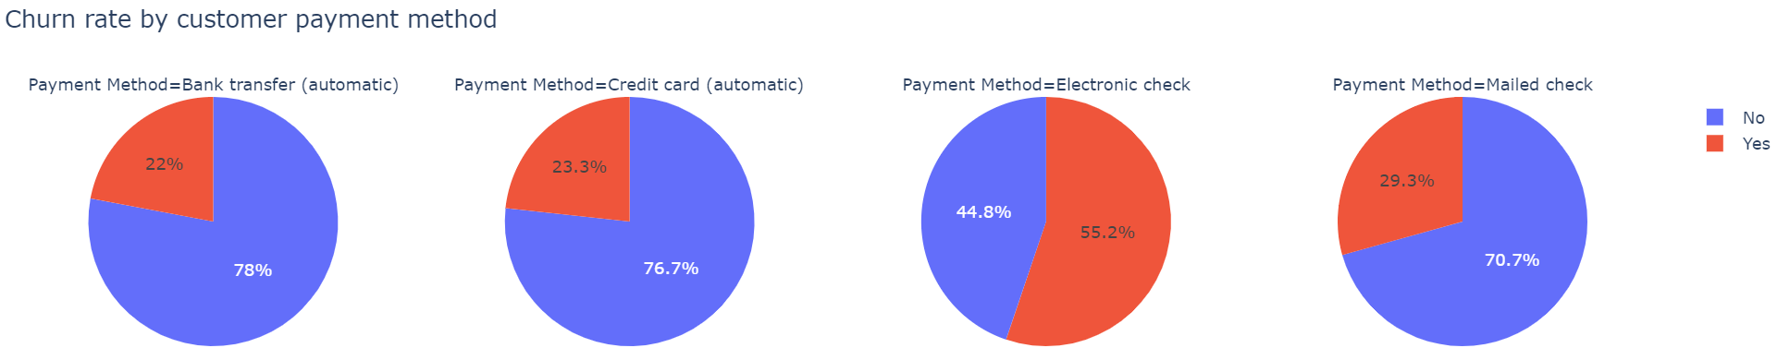
DATA PREPROSSESING & EDA

Slide 10
MODELING: WHY THESE MODELS?
Logistic Regression
A simple and interpretable model ideal for binary classification problems such as churn prediction.
Offers probabilistic outputs, aiding in risk assessment and decision-making.
Random Forest
An ensemble learning algorithm that combines multiple decision trees for robust predictions.
Effectively handles complex non-linear relationships and reduces overfitting.
Provides feature importance scores to identify key factors driving churn.
XGBoost
A powerful and efficient gradient-boosting algorithm suitable for churn prediction.
Excels in handling large datasets and improving accuracy through advanced optimization techniques.
Supports feature importance evaluation for better insights into customer behavior.
Ensemble Models: Used to compare performances and improve predictions.
Model Comparison: Conducted to determine the best model based on evaluation metrics.

Slide 11
MODEL EVALUATION
Accuracy
F1 Score
Measures overall model correctness but may not be reliable for imbalanced datasets.
Provides a balanced measure of precision and recall, particularly useful for imbalanced datasets.
03
04
Precision
Recall (Sensitivity)
Focuses on the accuracy of positive predictions, crucial in scenarios where false positives are costly.
02
05
Evaluates the model's ability to identify actual positives, essential when missing positives has significant consequences.
ROC Curve and AUC
01
06
Confusion Matrix
Assesses model performance across various thresholds.
The AUC quantifies the model’s ability to distinguish between positive and negative classes.
Offers a detailed breakdown of prediction outcomes, displaying true positives, true negatives, false positives, and false negatives.

Slide 12
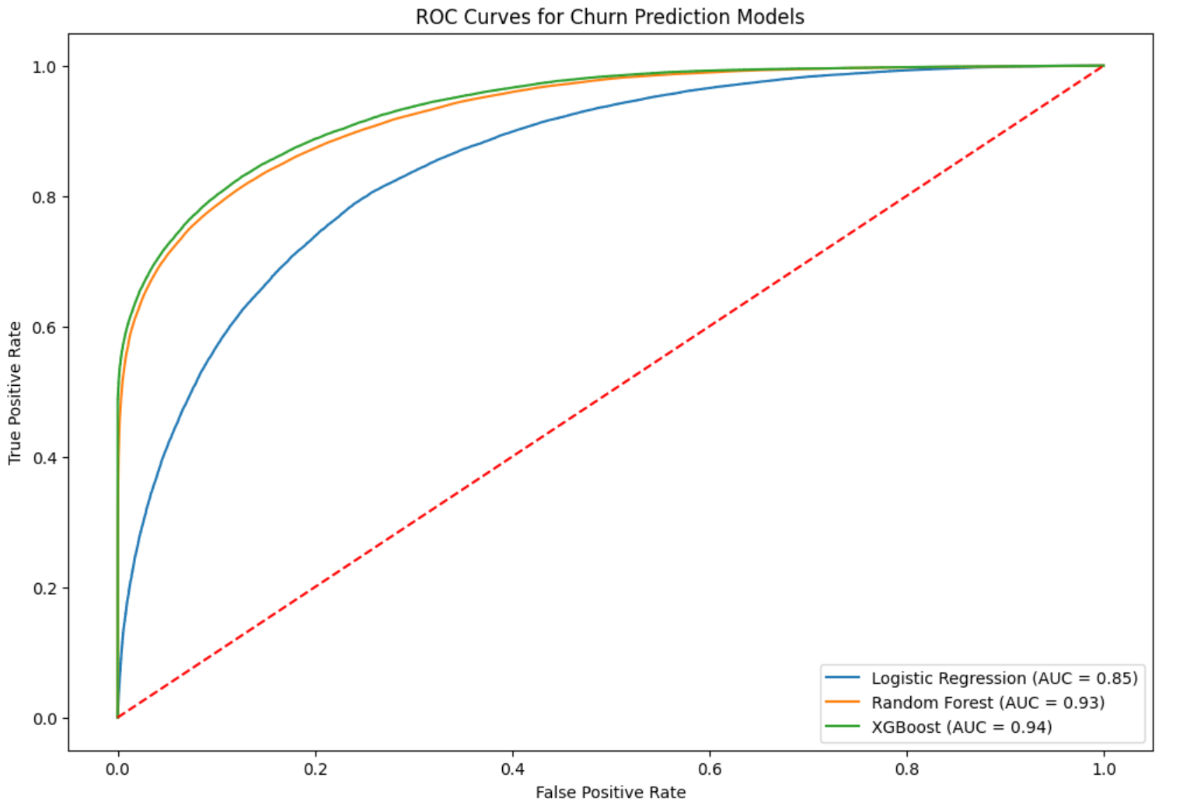

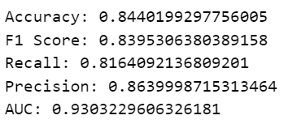

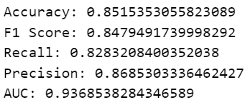

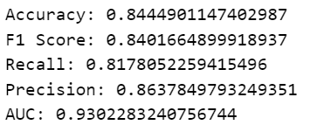

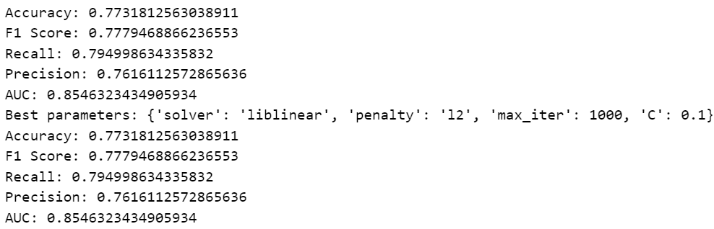

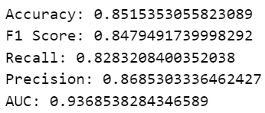
MODEL EVALUATION

Slide 13
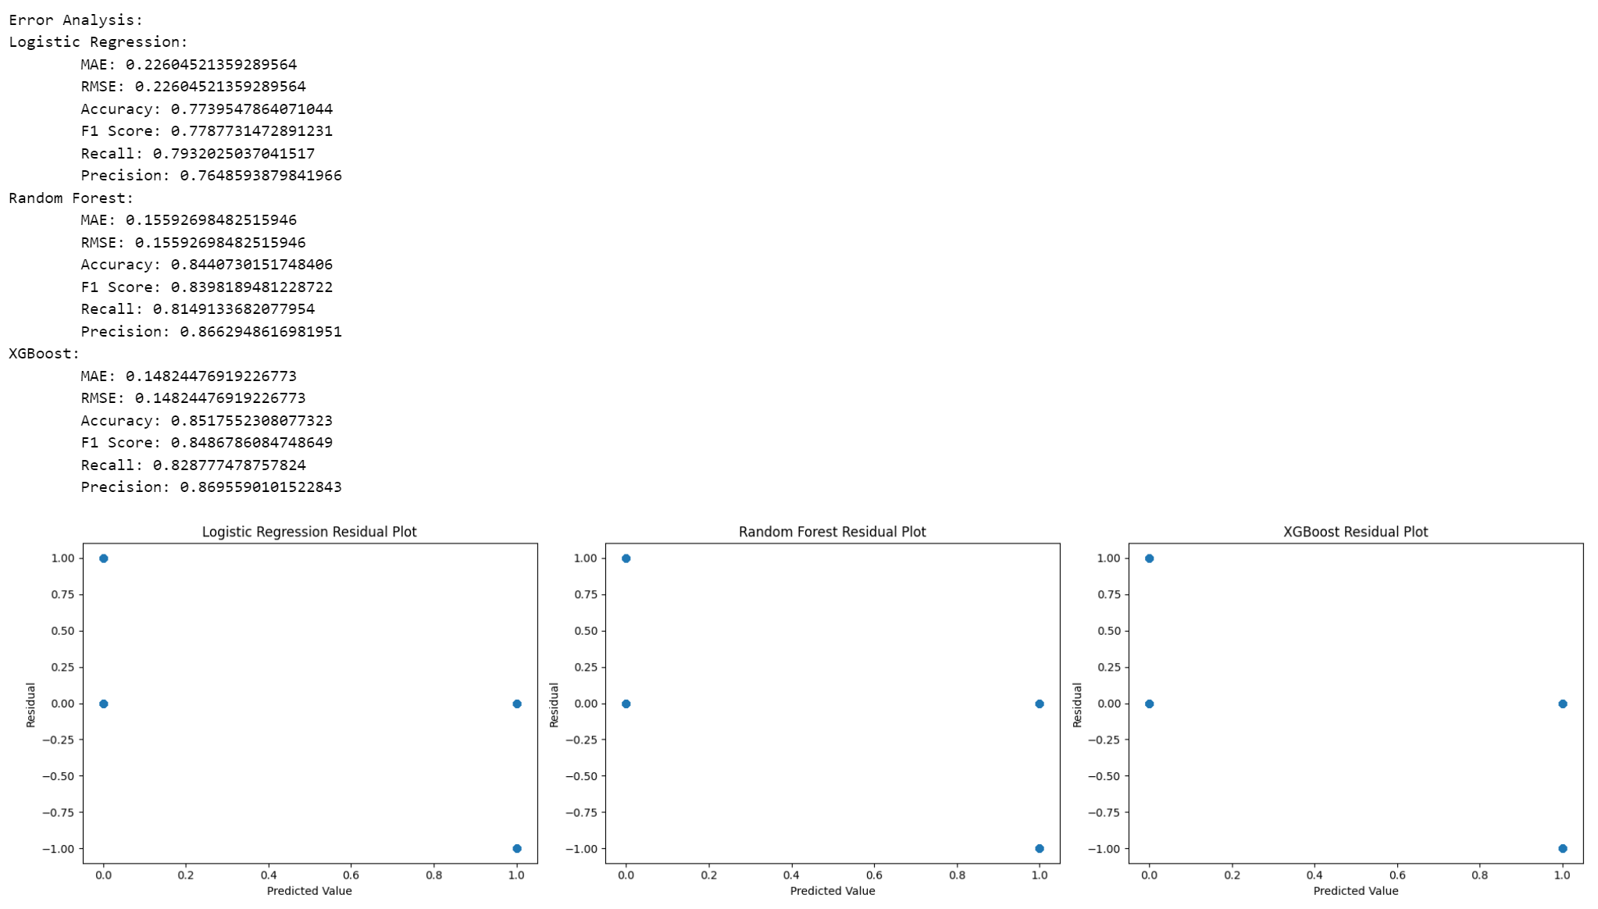
ERROR ANALYSIS

Slide 14
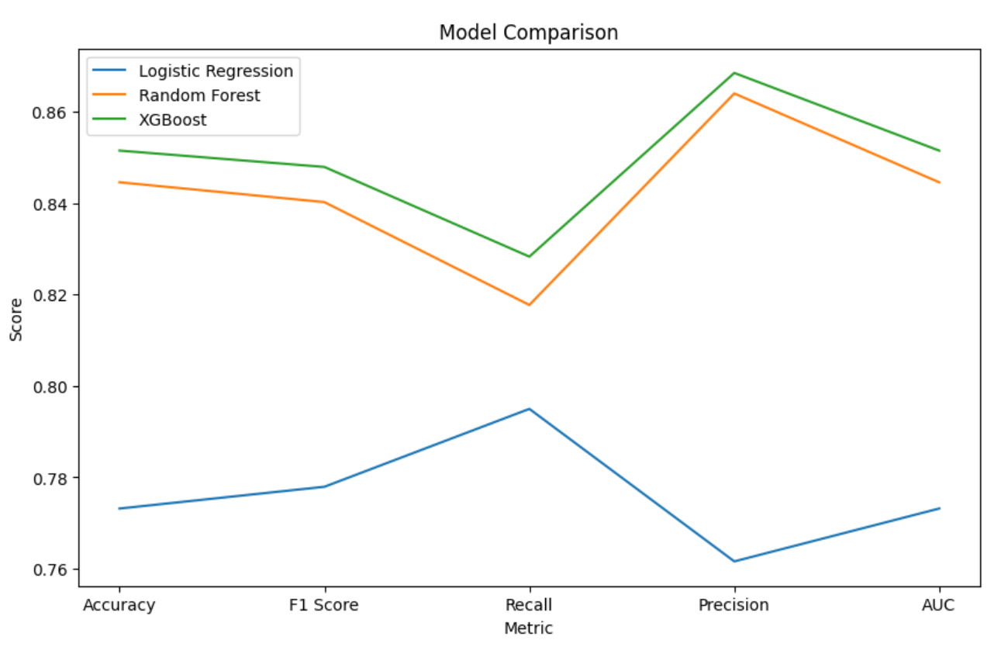
MODEL COMPARISION

Slide 15
CONCLUSION
This project addressed churn prediction in the telecommunications industry using machine learning techniques.
Key steps included dataset analysis, feature engineering, and algorithm comparison (Logistic Regression, Random Forest, and XGBoost).
The XGBoost model delivered the best performance with:
Accuracy: 85.15% | F1 Score: 84.79%
Recall: 82.83% | Precision: 86.85%
AUC (ROC Curve): 0.93,
indicating excellent class discrimination.
Error analysis highlighted common challenges across models, with higher errors for customers exhibiting characteristics like long tenure, low charges, and no online security.
Future improvements could include feature enhancement and further tuning to address these specific patterns.
Overall, the XGBoost model demonstrates significant potential for enabling effective customer retention strategies in the telecom sector.

Slide 16
THANK YOU!

