Slide 1
Prediction of Personal Loan Purchase And Customer Segmentation Analysis
Denish Shrestha
Benoy Thomas
Elly Pham
Notes:
Good morning,
We are group 3. My name is … and my group members are ……The topic for our research project is Prediction of Personal Loan Purchase And Customer Segmentation Analysis.
The dataset we considered for our project is related to the data of Thera Bank.

Slide 2
MOTIVATION
What is Personal Loan?
An amount of money you can borrow to use for a variety of purposes.
Consolidate debt
Pay for home renovations
Offered by banks, credit unions, or online lenders
Repaid over time, typically with interest
- Investopedia
We chose this topic because of our interest in applying predictive and descriptive models in the financial sector
Notes:
Let us introduce the concept of personal loans first before moving forward to our motivation for this project.
According to Investopedia, A personal loan is an amount of money you can borrow to use for a variety of purposes. For instance, you may use a personal loan to consolidate debt, pay for home renovations.
One of the attractions of personal loans is you can use them for practically anything.
It can be offered by banks, credit unions, or online lenders.
The money you borrow must be repaid over time, typically with interest. Some lenders may also charge fees
The reason we chose this topic is because of our interest in the financial sector as it is an exciting global industry with tremendous opportunities Plus
Our interest in creating predictive and descriptive models.

Slide 3

PROJECT GOALS
To analyze the effectiveness of existing marketing strategies
To find the Machine Learning models that help in identifying potential customers
To help financial institution in maximizing the sales performance which helps a strong growth in market share
Notes:
Our project goals are as follows:
1. To analyze the effectiveness of existing marketing strategies
2. To find the Machine Learning models that help in identifying the potential customers
which improves current marketing strategies
3. To help the financial institutions in maximizing the sales performance which helps a strong growth in market share

Slide 4
RESEARCH QUESTIONS
What are the most important features influencing the loan purchasing decision? And why?
How are the features correlated to each other?
What are the key characteristics of each cluster among the sample population?
Which machine learning approach could be best to predict personal loan acceptance rate using the financial sector data?
What are the solutions for the next marketing campaign?

Slide 5

DATA SOURCE
Kaggle: https://www.kaggle.com/teertha/personal-loan-modeling
Notes:
Our main source is from Kaggle. because due to confidentiality issue, we could not obtain real time data

Slide 6
RECORDS AND ATTRIBUTES
The dataset has 5000 Records and 14 Features.
Personal Loan
Securities Account
CD Account
Online
CreditCard
Mortgage
Income
ZIP Code
Family
CCAvg
ID
Education
Age
Experience
Notes:
[ We are trying to predict whether the customer is likely to purchase the personal loan.]
ID: Customer ID
Age: Customer’s age in completed years
Experience: #years of professional experience
Income: Annual income of the customer (in thousand dollars)
ZIP Code: Home Address ZIP code.
Family: the Family size of the customer
CCAvg: Average spending on credit cards per month (in thousand dollars)
Education: Education Level. 1: Undergrad; 2: Graduate;3: Advanced/Professional
Mortgage: Value of house mortgage if any. (in thousand dollars)
Personal_Loan: Did this customer accept the personal loan offered in the last campaign?
Securities_Account: Does the customer have securities account with the bank?
CD_Account: Does the customer have a certificate of deposit (CD) account with the bank?
Online: Do customers use internet banking facilities?
CreditCard: Does the customer use a credit card issued by any other Bank ?
[ We are trying to predict whether the customer is likely to purchase the personal loan]

Slide 7

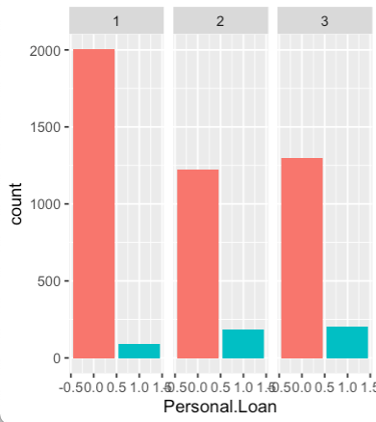
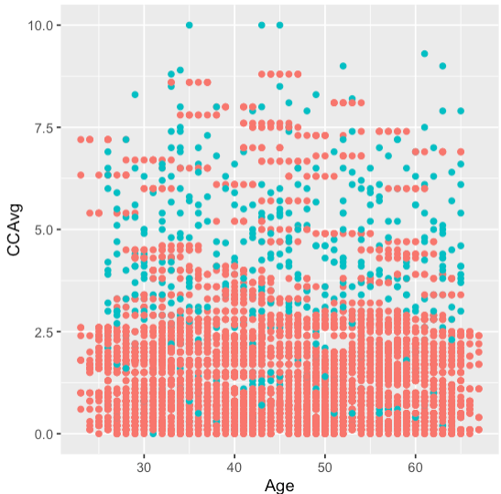
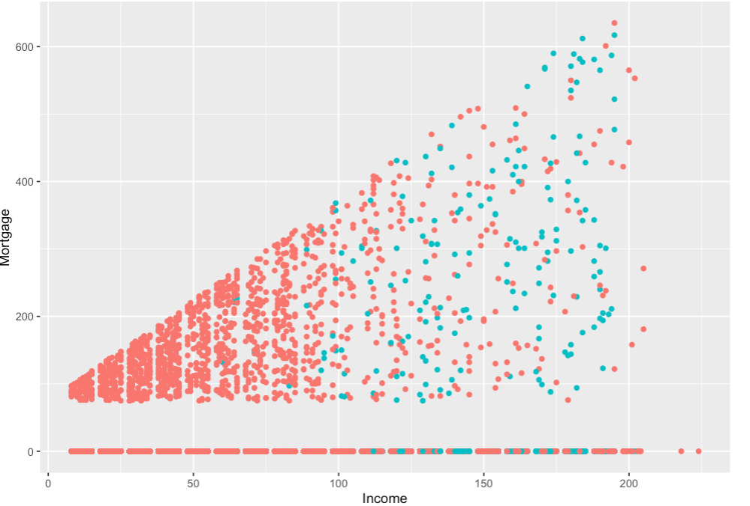
Data Preparation
Import the data in R
Personal Loan
Not accepted
Accepted
Exploratory data analysis
- Visualize data using ggplot package
Advanced education likely to accept the personal loan offer
Higher ccavg tends to say yes to Personal Loan
Higher income -> higher mortgage
Notes:
As part of data preparation, we imported our data into R studio using read.csv().
After that, to get the feeling of the data, we perform exploratory data analysis by visualizing the data using ggplot package.
Average income of who accepted the personal loan is 144.7458

Slide 8

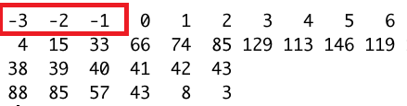
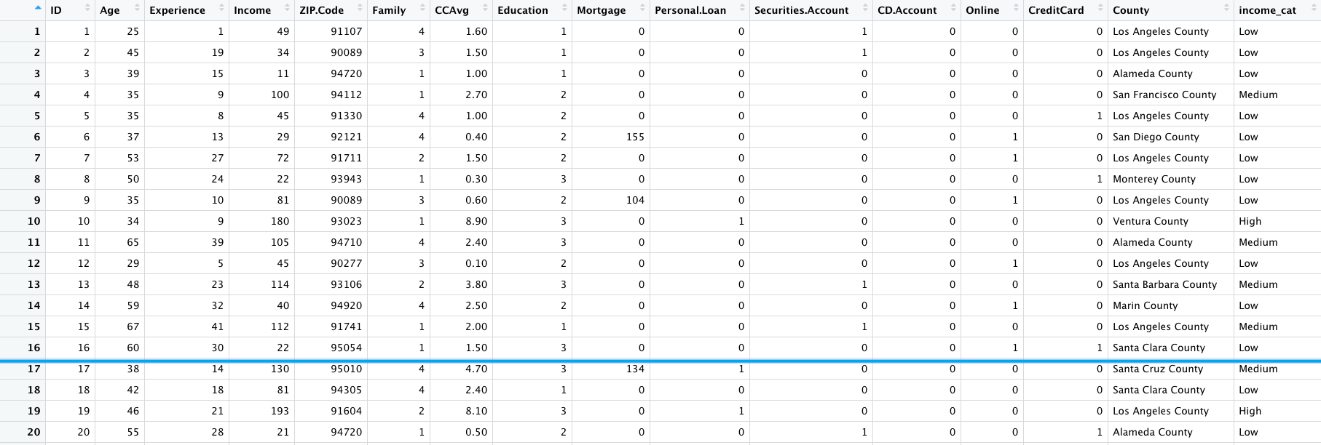
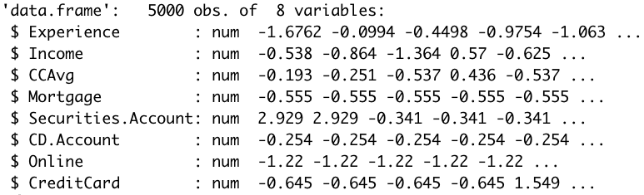
Data Preparation
Check for missing values and inconsistent values:
Divide data into training (80%) and testing datasets (20%)
Normalization
Notes:
After performing EDA, we check for missing and inconsistent values: for example, some values for Experience attribute were negative. Since experience cannot be negative, we transformed it to positive
We randomly divided the data into training (80%) and testing datasets (20%)
We normalized the numeric data using z score method

Slide 9
A. PREDICTIVE ANALYSIS

Slide 10
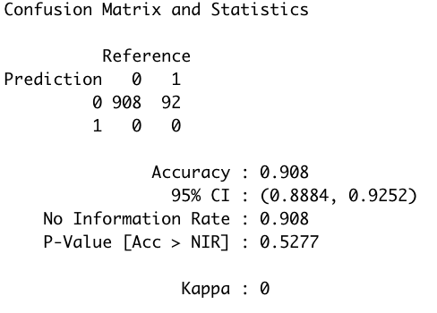
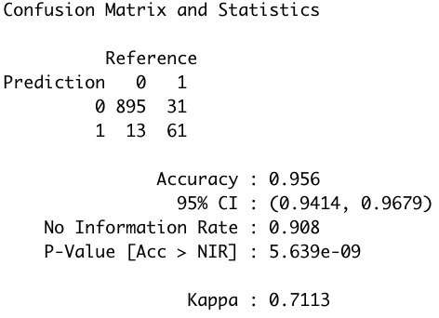
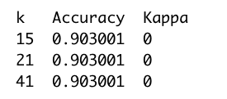
MODEL SELECTION
Candidate 1
k-NN
Candidate 2
Logistic Regression
Automatic Parameter Tuning was used when creating most of the models
Notes:
We started with the model k-NN and the output are given in the left side
We used train() function

Slide 11
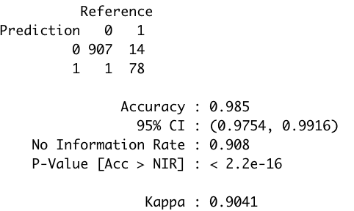
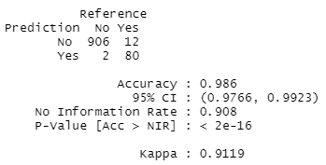
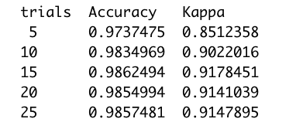

MODEL PERFORMANCE
Candidate 3
Decision Tree
Candidate 4
Random Forest
Notes:
Both of models, we used repeated cross validation resampling method with oneSE for selection function
Decision tree

Slide 12
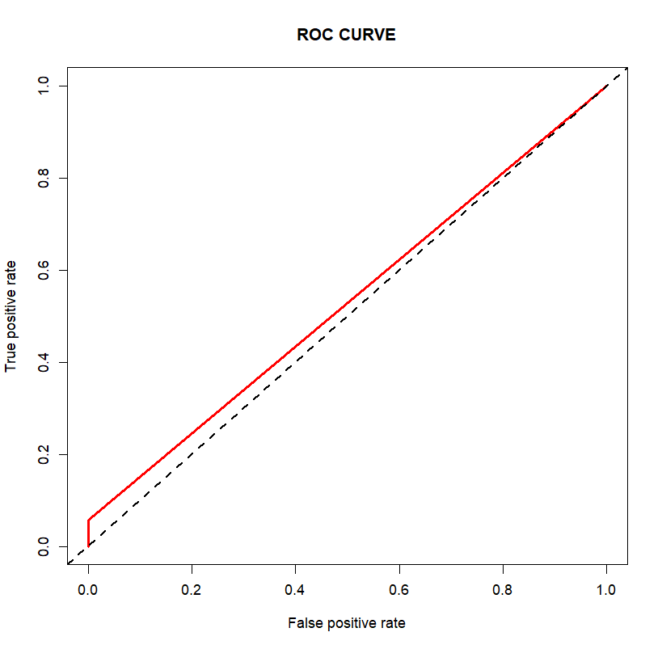
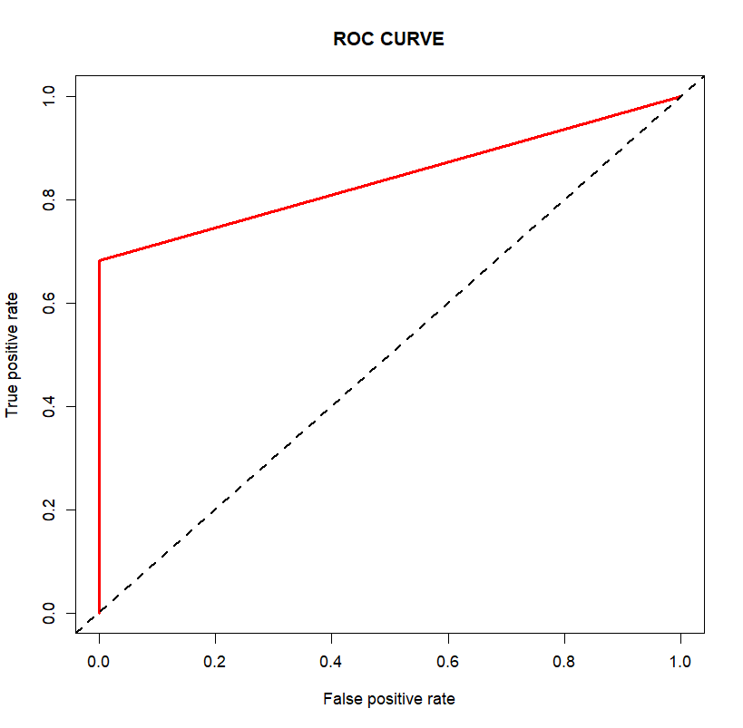
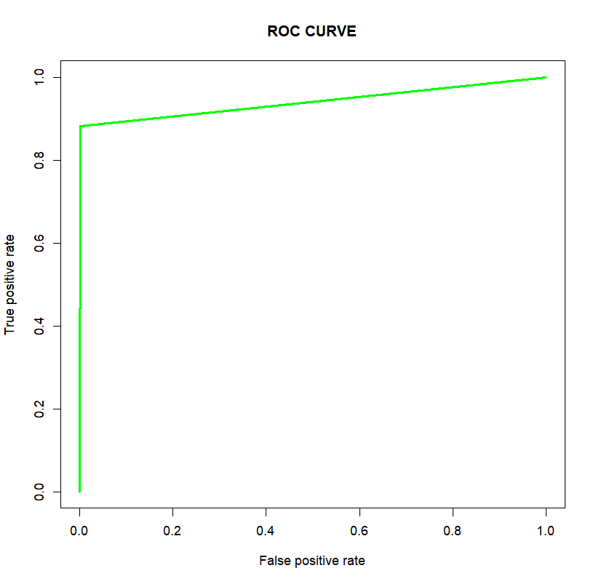
RANDOM FOREST
Automatic parameter tuning
mtry = 2
mtry = 4
mtry = 16
Notes:
Visualize ROC curves with different values of mtry.

Slide 13
EVALUATION
 | k-NN | Logistic Regression | Decision Tree | Random Forest
Parameter Tuning | k = 41 | Threshold = 0.5 | Trials =15 Winnow = False Model = tree | mtry = 16
Accuracy Training Data | 90.3% | 94.98 % | 98.95% | 100%
Accuracy Testing Data | 90.8% | 95.6% | 98.5% | 98.6%
Model for deployment is Random Forest
Notes:
mtry: Number of variables randomly sampled as candidates at each split.
Hyper parameter tuning: repeated cross validation
The top 5 features according to the outcome of the decision tree are Age, income, ccavg, education, mortgage. It makes logical sense and it is concurrent with our exploratory data analysis
Evaluation Metric: Accurary and Kappa

Slide 14
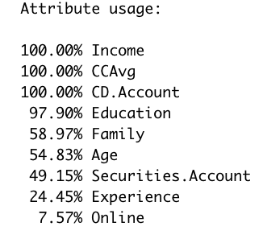
MOST IMPORTANT FEATURES
Income
CCAvg
CD.Account
Education
Our decision tree model indicates these features are the most important deciding factors influencing the loan purchasing decision
Notes:
to answer our first research question, the top 4 features according to the outcome of the decision tree are Age, income, ccavg, education It makes logical sense and it is concurrent with our exploratory data analysis
Evaluation Metric: Accurary and Kappa

Slide 15
B. DESCRIPTIVE ANALYSIS
Notes:
Hi, my name is Elly. The next part is descriptive analysis.

Slide 16
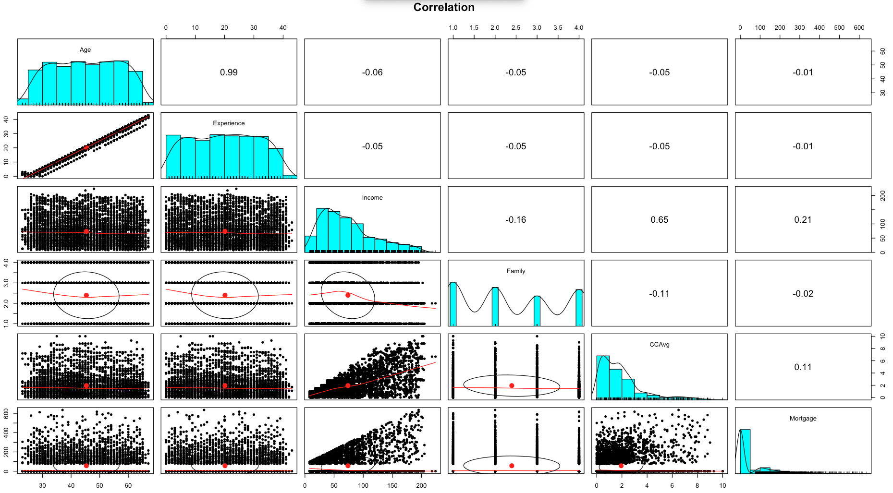
CORRELATION AMONG FEATURES
Age and Experience: a strong positive correlation (r = 0.99)
Income and CCAvg: a moderate positive correlation (r = 0.65)
Age and Mortgage: a weak negative correlation (r = -0.01)
Income and Mortgage: a weak positive correlation (r = 0.21)
Notes:
#Observation:
#Age and Experience: a strong positive correlation --> the professional experience increases with age
#Income and CCAvg: a moderate positive correlation --> as income increases, the credit card spending also moderately increases
#Age and Mortgage: a weak negative correlation --> no matter what the age is, mortgage does not seem to have much of change
#Income and Mortgage: a weak positive correlation --> as income increases, the mortgage tends to increase slightly

Slide 17
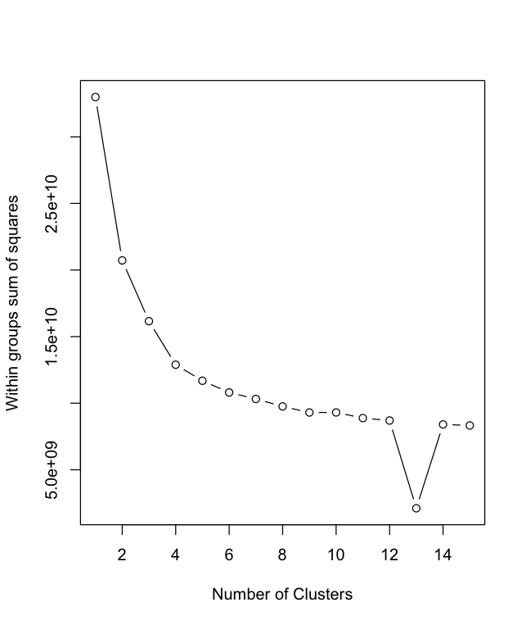
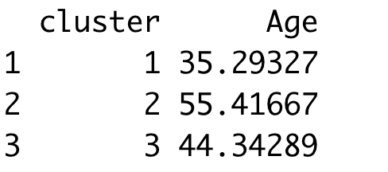
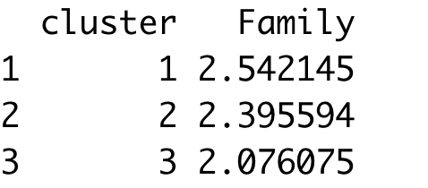
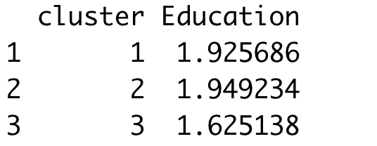
K-MEANS CLUSTERING
Elbow in the sum of squared error (SSE):
Distribution of Age, Family, Education by each clusters:
Notes:
a suitable number of clusters for the kmeans is 3

Slide 18
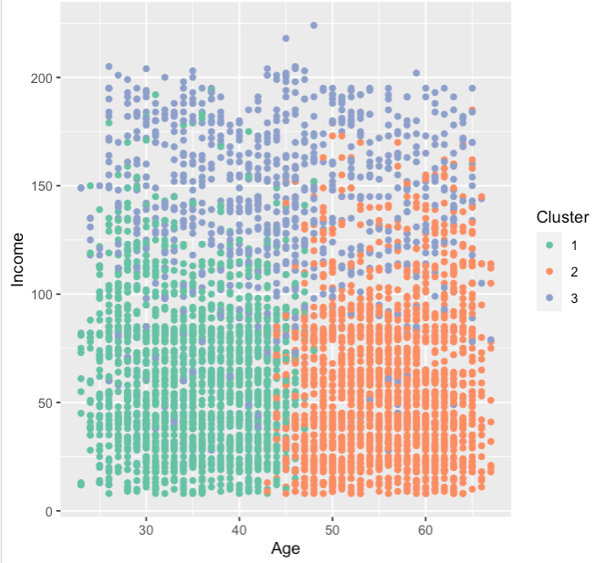
KEY CHARACTERISTICS OF CLUSTERS
Cluster 1: Younger population, lower income
Cluster 2: Older population, mostly lower income
Cluster 3: Mostly middle age population, higher income
Notes:
#Observation:
#Cluster 1 represents younger population with lower income compared to cluster 3
#Cluster 2 represents older population with lower income compared to cluster 3
#Cluster 3 represents middle age population with higher income compared to other clusters
#This visualization shows that as the age increases, the experience increases as well as expected

Slide 19
STRATEGIES FOR NEXT MARKETING CAMPAIGN
Focus more on
CLUSTER 3
Higher Income
CCAVG: Higher spending
Mortgage: Yes
Securities Account: Yes
CD Account: Yes
Online: Active online user
Credit Card with another bank
Reason: features suggest lower default risk
CLUSTER 1
Younger generation
Population density
CCAVG: less spending
Mortgage: lower amount
Reason: large population size with potential of goodwill

Slide 20
CONCLUSION
Target the untapped customer base (cluster 3, cluster 1) for personal loan market
Take age, income, experience, average spending in credit card into consideration when creating a marketing strategy
Decision Tree and Random Forest appeared to be the best models with highest performance in our scenario

Slide 21
FUTURE WORK
Increase the records and attributes of the dataset such as marital status, homeownership, etc.
Apply the model to the unseen data in the financial sector
Discuss with domain experts to collect more information
Include additional machine learning algorithms in the future
for in-depth analysis

Slide 22
THANK YOU!
Q & A

