Slide 1

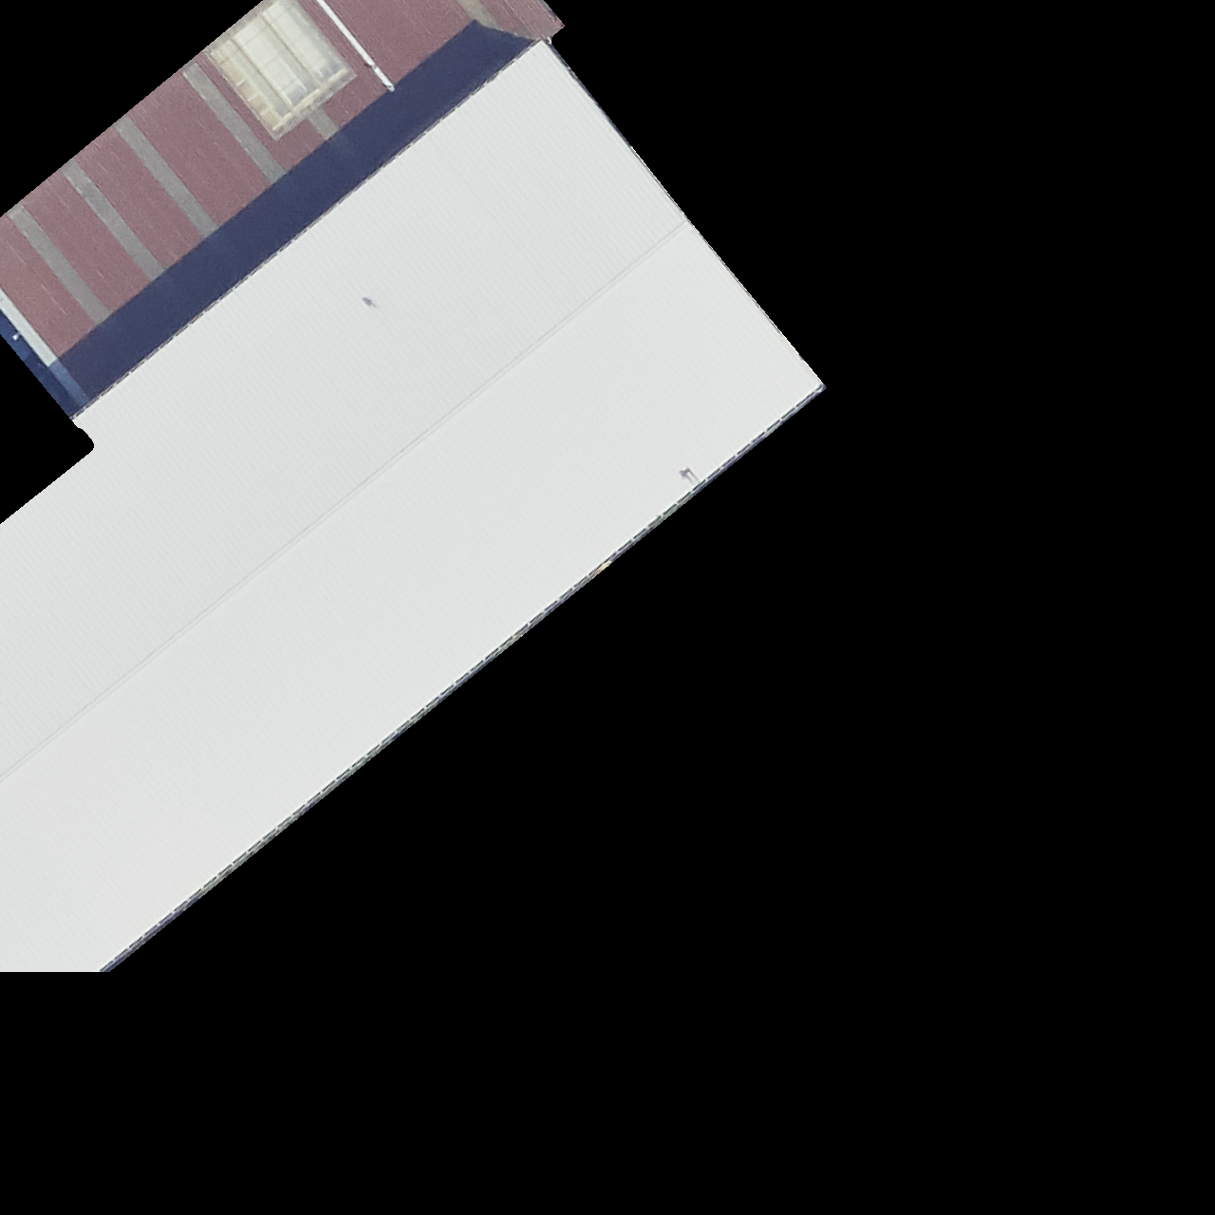
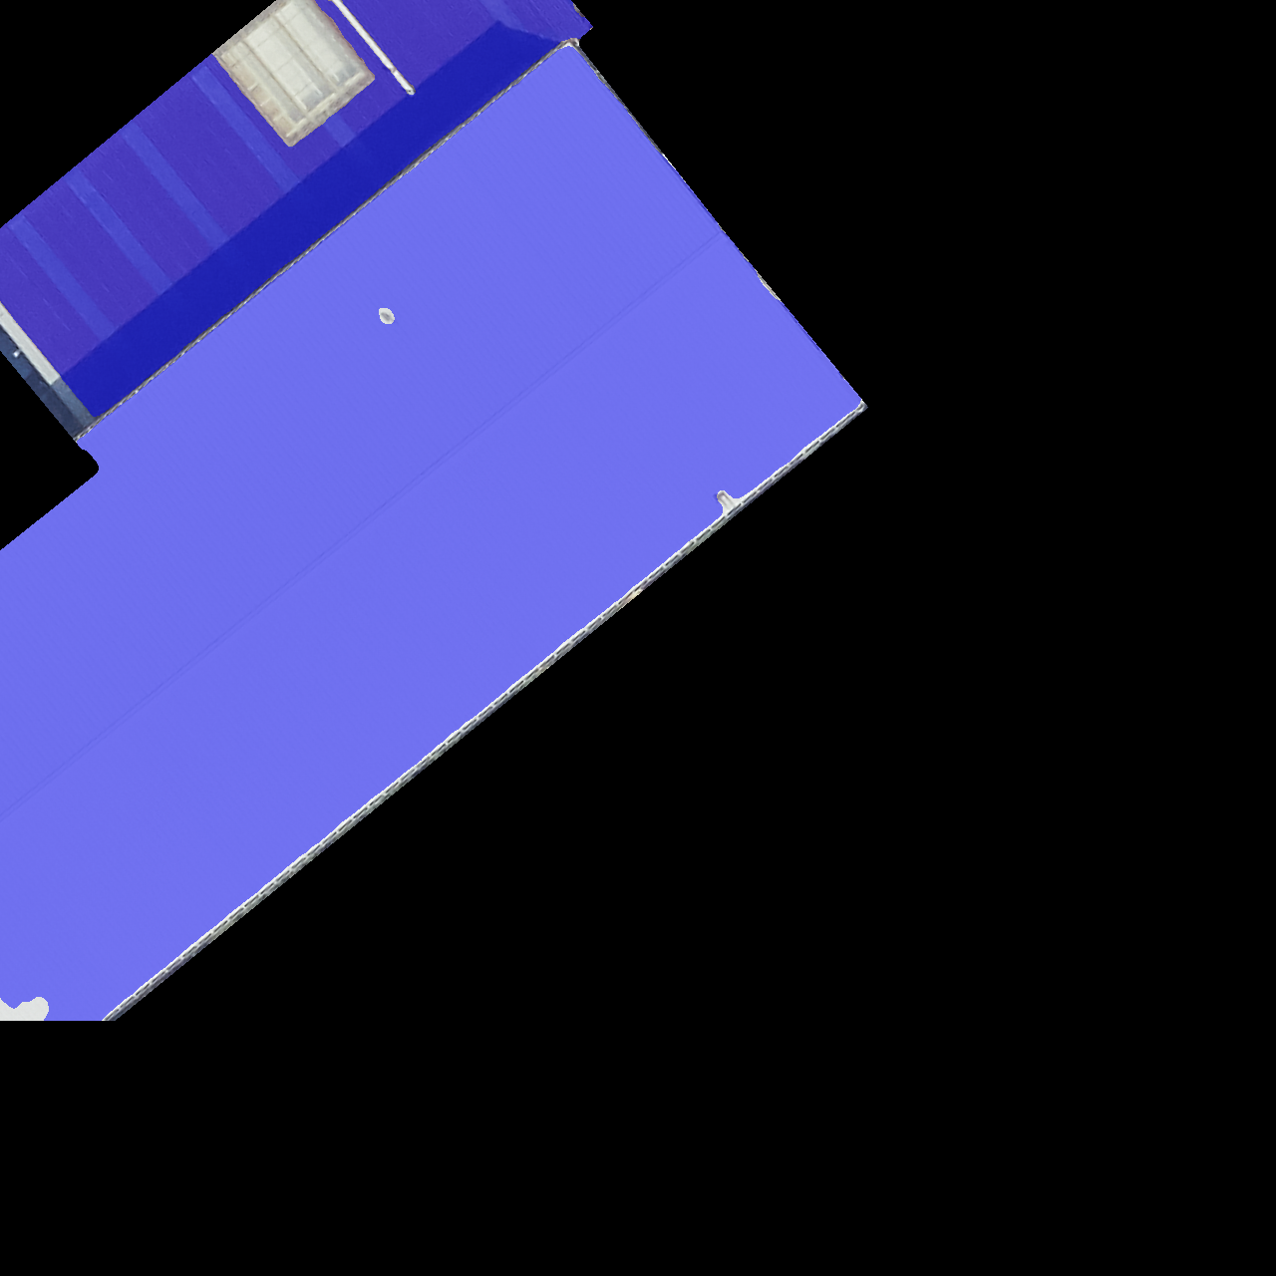
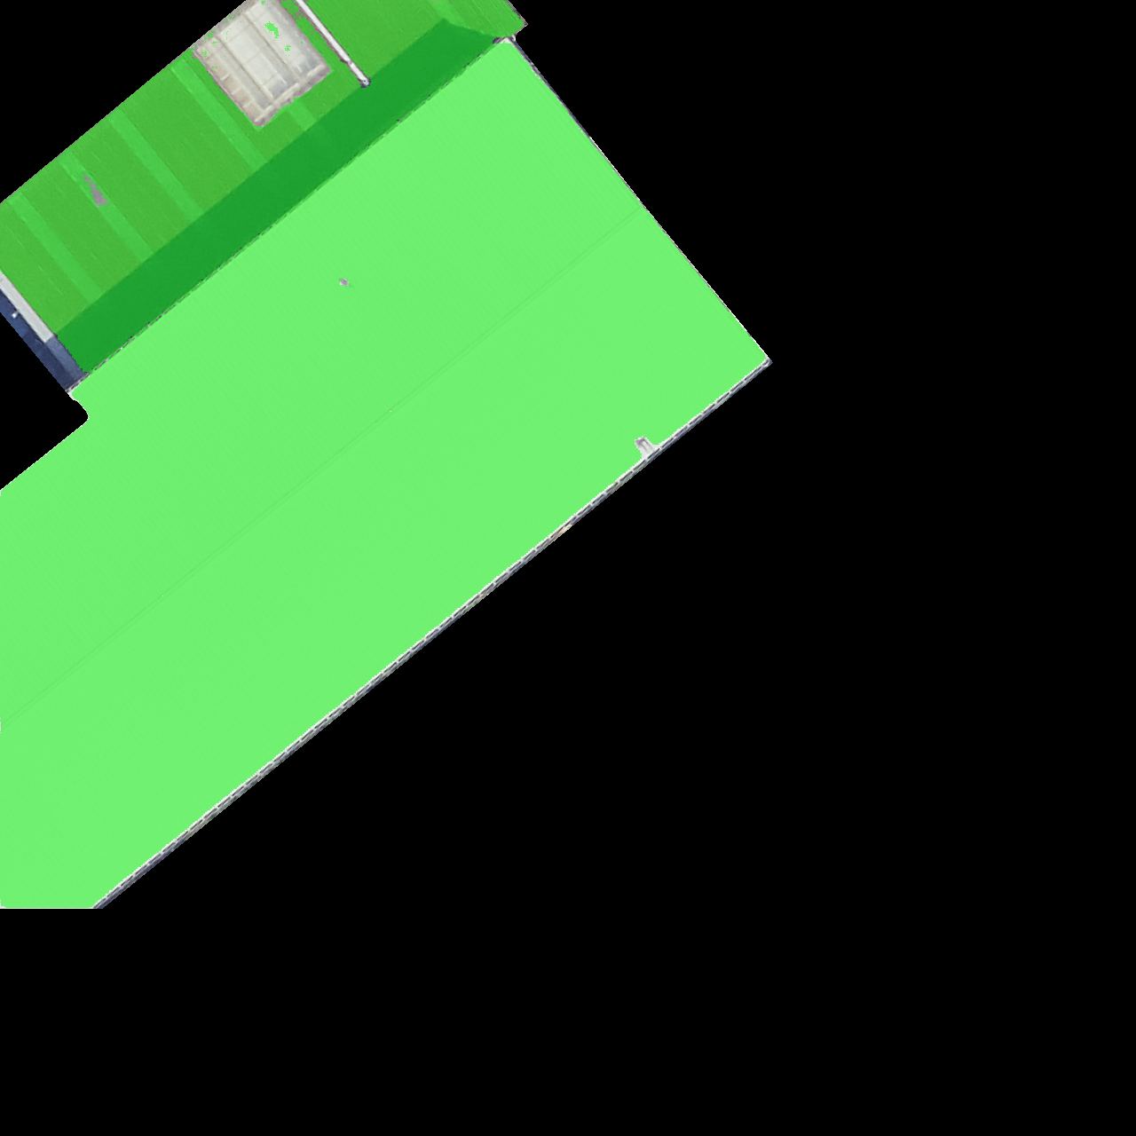
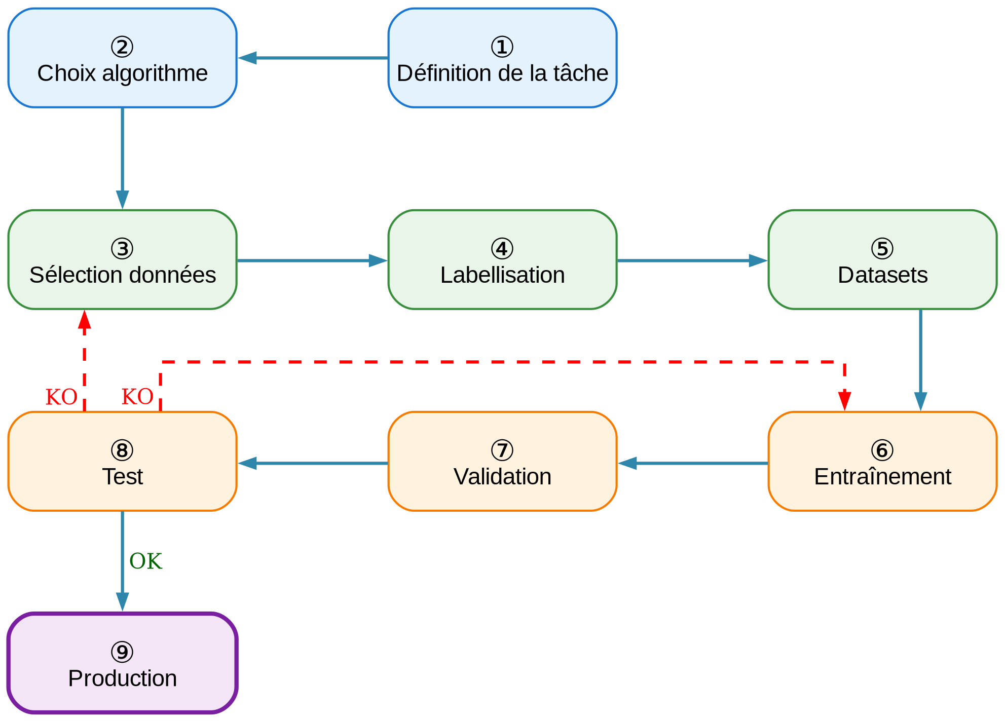

Identification of useful rooftop areas for solar energy using machine learning
Denis Iglesias Garcia
Master of Science HES-SO in Engineering
Major in Data Science
Under the co-supervision of Prof. Dr. Gilles DESTHIEUX and
Prof. Dr. Andres UPEGUI POSADA
In collaboration with:
Office Cantonal de l’Energie du canton de Genève
Introduction The energy transition requires optimizing rooftop use for solar installations. However, the lack of precise inventory of available surfaces complicates energy planning.
Objectives:
Analysis of the similar work made by the Swiss Territorial Data Lab (STDL)
Develop an automatic method to identify free spaces on rooftops in Canton of Geneva
Create a reference dataset for semantic segmentation
Evaluate and compare different deep learning architectures
Validate the approach on real-world data
Results Performance:
Best model (Figure 2): LinkNet + EfficientNet-B5 (mean test IoU = 0.741)
Improvement vs STDL: +85% (IoU 0.40 → 0.74)
K-fold ensemble: gain +0.9% to +2.0%
Pareto front: marginal gains >25M parameters
Qualitative validation (HEPIA area):
✓ Effective detection of classic obstacles
✓ Correct handling of light/moderate shadows
✗ Difficulties with green roofs and accessible terraces
Data and methodology Data sources:
530 georeferenced orthophotos (1280×1280 px) from SITG 2019
Manual annotation (180h) stratified by SIA category and surface area
5-fold cross-validation
Methodology:
Semantic segmentation with 93 encoder-decoder configurations
Tested architectures: U-Net, LinkNet, FPN, SegFormer, UPerNet
Metrics: IoU, mAP@k, F1-score
K-fold ensemble strategy to improve robustness
Figure 2. Original (left) – Ground truth (center) – Prediction (IoU =0.986)
Conclusion Main contributions:
First annotated dataset for Geneva rooftops (530 images)
Robust methodology with IoU > 0.74
Processing time: few seconds vs 7 min (SAM)
Limitations and perspectives:
Enrich dataset (green roofs, intense shadows)
Integrate 3D data (LiDAR) to improve discrimination
Direct connection with Geneva solar cadastre
Acknowledgments
Thanks to Swiss Territorial Data Lab (STDL), Office cantonal de l'énergie (OCEN), Système d'Information du Territoire à Genève (SITG) for data access, and technical teams for computing cluster access.
References
[1] Desthieux G., et al. (2018). Solar cadaster of Geneva.
[2] Krapf S., et al. (2022). Roof Information Dataset for CV-Based PV Assessment.
Figure 1. Methodology
Notes:
Le poster est une obligation pour tous les TM (confidentiels ou non). Il s’agit d’un document public destiné à la communication et donc les aspects confidentiels ne doivent pas figurer. La mise en forme reste assez libre, un arrière plan peut être ajouté, l’utilisation 1-2-3 colonnes, la mise en place de séparateur, cadre, etc. est laissée au libre choix de l’étudiant-e

