Slide 1
minf16 PUF Information system
Nguyen Huu Minh Huy
Vo Hoang Dat
Ngo Thi Thu Trang
Pham Phu Quoc

Slide 2
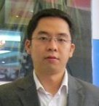




Project Organization Chart
Ho Chi Minh, Vietnam
Bordeaux, France
Huy NGUYEN
Ho Chi Minh, Vietnam
nguyenminhhuy@gmail.com
Quoc PHAM
Ho Chi Minh, Vietnam
quocpp@hotmail.com
Fabien BALDACCI
Bordeaux, France
fabien.baldacci@u-bordeaux.fr
Dat VO
Ho Chi Minh, Vietnam
denislour@gmail.com
Trang NGO
Ho Chi Minh, Vietnam
anna.ngo13@gmail.com

Slide 3

Project Approach
PUF
Information System
Project Implementation approach
Adapting to OpenEduCat if possible
Only customizing OpenEduCat to fit requirements

Slide 4





Product Overview
Internal Users
External Users
Channels
Integration
PUF
Information System
Customized and implemented version of OpenEduCat
Core
Classroom
Timetable
Attendance
Assignment
Exam
Facility
Admission
Fees
Library
Parent
Health
Security
Multi-lingual
Website
Communication
Database

Slide 5
Project Methodology
Sprints
Inception
Prepare
Build
Test
Release
Deploy

Slide 6
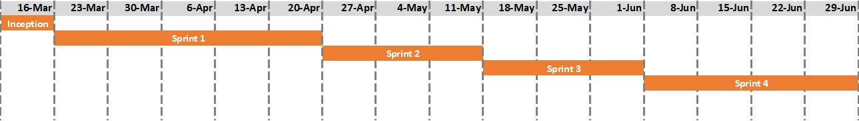
Project Planning

