Slide 1


Smart contracts on Cosmos with CosmWasm
Denis M.
30.06.2022

Slide 2
Cosmos
Cosmos functions as a decentralized network
of interoperable and independent blockchains.
The project uses the Inter-Blockchain Communication
Protocol (IBC) to allow these blockchains
to readily pass tokens and data among each other.
:
:
:
:
. :
'. : .'
'. : .'
'. .-""""""-. .' .'':
'." ".' .-""""-.' .---. .----. .-"""-.
: : _ _ ." .' ". ..." "... ." ". ." ".
......... ......... o (_) (_) () : .' : '..:.......:..' : : : : o
: : : .' : '.....' '. .' '. .'
: : .'.'. .' `''''` `'''''`
'........' '' ``````
.' : '.
.' : '.
.' : '.
.' : '.
:
:
:
:

Slide 3
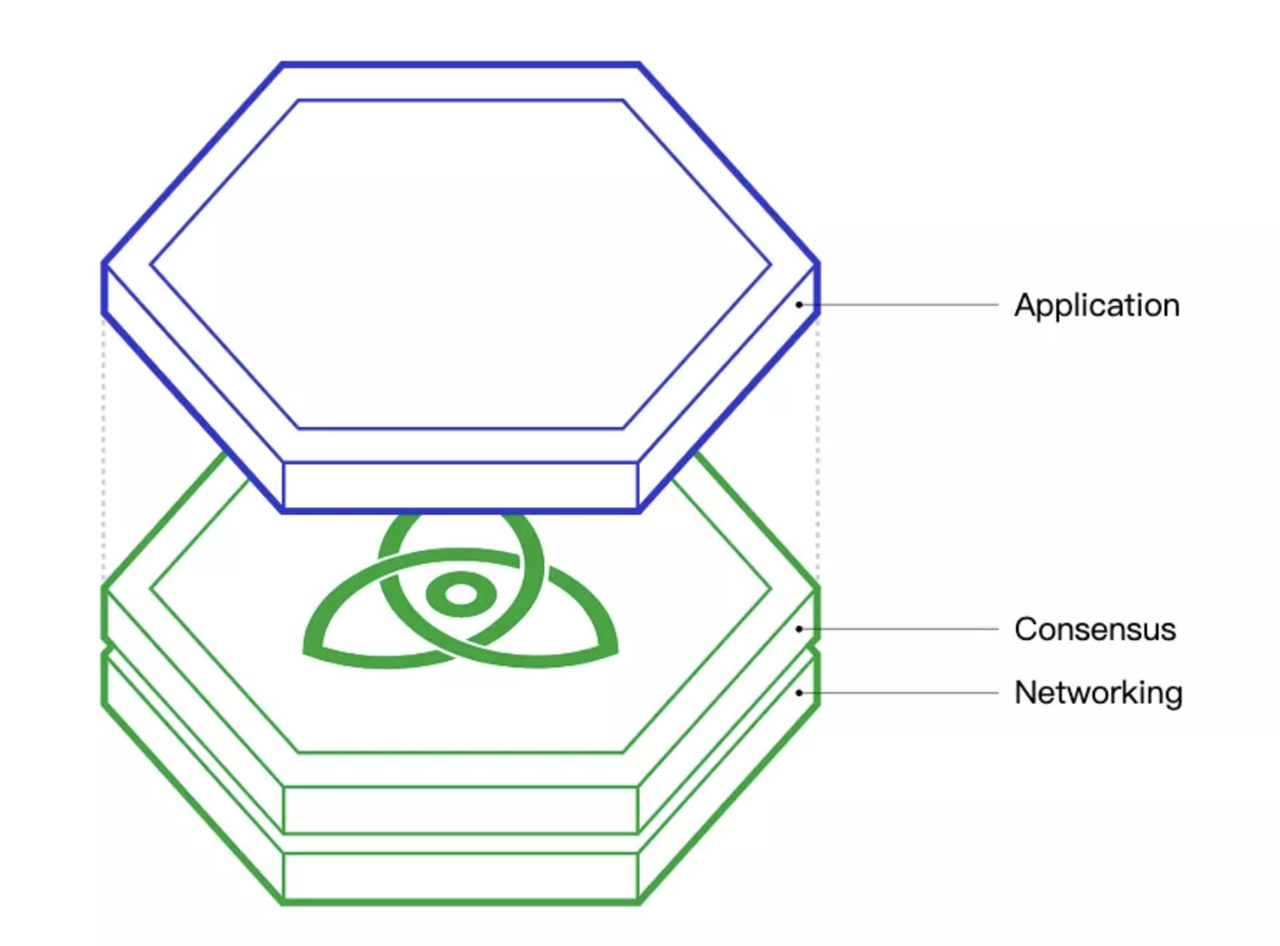
Tendermint
Tendermint BFT is a solution that packages the networking and consensus layers of a blockchain into a generic engine
Byzantine fault tolerant (BFT)
consensus algorithm is used within the Tendermint engine.
The Tendermint BFT engine is connected to the application by a socket protocol called the Application Blockchain Interface (ABCI).

Slide 4
Cosmos-SDK
┌──────────────────────────────────────────────────────────────────┐
│ │
│ ┌────────────────┐ ┌────────────────┐ ┌────────────────┐ │
│ │ Module │ │ Module │ │ Module │ │
│ └────────────────┘ └────────────────┘ └────────────────┘ │
│ │
│ Cosmos-SDK │
└────────────────────────────────┬─────────────────────────────────┘
│
│
│ ABCI
│
│
┌────────────────────┴────────────────────┐
│ │
│ Tendermint │
│ │
└─────────────────────────────────────────┘
Cosmos-sdk is a framework for building multi-asset PoS blockchains.
as well as permissioned Proof-of-Authority blockchains.
SDK-based blockchains are build out of composable modules.

Slide 5
Main components of the Cosmos SDK
+
|
| Transaction relayed from the full-node's
| Tendermint engine to the node's application
| via DeliverTx
|
|
+---------------------v--------------------------+
| APPLICATION |
| |
| Using baseapp's methods: Decode the Tx, |
| extract and route the message(s) |
| |
+---------------------+--------------------------+
|
|
|
+---------------------------+
|
|
| Message routed to
| the correct module
| to be processed
|
|
+----------------+ +---------------+ +----------------+ +------v----------+
| | | | | | | |
| AUTH MODULE | | BANK MODULE | | STAKING MODULE | | GOV MODULE |
| | | | | | | |
| | | | | | | Handles message,|+--------------→ Return result to Tendermint (0=Ok, 1=Err)
| | | | | | | Updates state |
| | | | | | | |
+----------------+ +---------------+ +----------------+ +-----------------+

Slide 6
Connecting blockchains together (IBC)
Tracking
Bonding
Proof Relay
Validation

Slide 7
The Cosmos Hub
The first blockchain deployed on the Cosmos network is the Cosmos Hub.
The “Hub” name derives from the fact that Cosmos powers two fundamental kinds of blockchains, Hubs and Zones.
Hubs function to interconnect Zones.
┌───────────────────────────────────────────────┐
│ COSMOS HUB │
└──────▲────────────────▲────────────────▲──────┘
│ IBC │ │
┌──────┴──────┐ ┌──────┴──────┐ ┌──────┴──────┐
│ │ │ │ │ │
│ │ │ │ │ │
│ ZONE 1 │ │ ZONE 2 │ │ Zone 3 │
│ │ │ │ │ │
│ │ │ │ │ │
│ │ │ │ │ │
└─────────────┘ └─────────────┘ └─────────────┘

Slide 8
Zones
Zones in the Cosmos Ecosysem are independent blockchains that can communicate with each other through a Hub.
Each zone has it's own validator set.
Because each zone has its own validator set, it allows a higher security than pure economic incentives alone
Private chains can interoperate with Public Chains

Slide 9
CosmWasm
CosmWasm is written as a module that can plug into the Cosmos SDK.
Any Cosmos SDK app can embed the wasm module and customize the permissioning or fees as they wish.
First class support for IBC primitives.
It is designed to be adaptable to many environments, and connect blockchains.

Slide 10
CosmWasm Contracts
Required Exports:
// signal for 1.0 compatibility
extern "C" fn interface_version_8() -> () {}
// copy memory to/from host, so we can pass in/out Vec<u8>
extern "C" fn allocate(size: usize) -> u32;
extern "C" fn deallocate(pointer: u32);
// main contract entry points
extern "C" fn instantiate(env_ptr: u32, info_ptr: u32, msg_ptr: u32) -> u32;
extern "C" fn execute(env_ptr: u32, info_ptr: u32, msg_ptr: u32) -> u32;
extern "C" fn query(env_ptr: u32, msg_ptr: u32) -> u32;

Slide 11
CosmWasm Contracts
Optional Exports:
// in-place contract migrations
extern "C" fn migrate(env_ptr: u32, info_ptr: u32, msg_ptr: u32) -> u32;
// support submessage callbacks
extern "C" fn reply(env_ptr: u32, msg_ptr: u32) -> u32;
// expose privileged entry points to Cosmos SDK modules, not external accounts
extern "C" fn sudo(env_ptr: u32, msg_ptr: u32) -> u32;
// and to write an IBC application as a contract, implement these:
extern "C" fn ibc_channel_open(env_ptr: u32, msg_ptr: u32) -> u32;
extern "C" fn ibc_channel_connect(env_ptr: u32, msg_ptr: u32) -> u32;
extern "C" fn ibc_channel_close(env_ptr: u32, msg_ptr: u32) -> u32;
extern "C" fn ibc_packet_receive(env_ptr: u32, msg_ptr: u32) -> u32;
extern "C" fn ibc_packet_ack(env_ptr: u32, msg_ptr: u32) -> u32;
extern "C" fn ibc_packet_timeout(env_ptr: u32, msg_ptr: u32) -> u32;

Slide 12
CosmWasm Contracts
Contract code
#[entry_point]
pub fn instantiate(
deps: DepsMut,
env: Env,
info: MessageInfo,
msg: InstantiateMsg,
) -> Result<Response, ContractError> {}
#[entry_point]
pub fn execute(
deps: DepsMut,
env: Env,
info: MessageInfo,
msg: ExecuteMsg,
) -> Result<Response, ContractError> {}
#[entry_point]
pub fn query(deps: Deps, env: Env, msg: QueryMsg) -> Result<Binary, ContractError> {}
#[entry_point]
pub fn migrate(deps: DepsMut, env: Env, msg: MigrateMsg) -> Result<Response, ContractError> {}

Slide 13
CosmWasm Contracts
Executes
pub fn execute(
deps: DepsMut,
env: Env,
info: MessageInfo,
msg: ExecuteMsg,
) -> Result<Response, ContractError> { }
If it returns Ok, the Response object is parsed and processed. Let's look at the parts here:
pub struct Response<T = Empty>
where
T: Clone + fmt::Debug + PartialEq + JsonSchema,
{
/// Optional list of "subcalls" to make. These will be executed in order
/// (and this contract's subcall_response entry point invoked)
/// *before* any of the "fire and forget" messages get executed.
pub submessages: Vec<SubMsg<T>>,
/// After any submessages are processed, these are all dispatched in the host blockchain.
/// If they all succeed, then the transaction is committed. If any fail, then the transaction
/// and any local contract state changes are reverted.
pub messages: Vec<CosmosMsg<T>>,
/// The attributes that will be emitted as part of a "wasm" event
pub attributes: Vec<Attribute>,
pub data: Option<Binary>,
}

Slide 14
CosmWasm Contracts
Dispatching messages
pub enum CosmosMsg<T = Empty>
where
T: Clone + fmt::Debug + PartialEq + JsonSchema,
{
Bank(BankMsg),
/// This can be defined by each blockchain as a custom extension
Custom(T),
Staking(StakingMsg),
Distribution(DistributionMsg),
Stargate {
type_url: String,
value: Binary,
},
Ibc(IbcMsg),
Wasm(WasmMsg),
}

Slide 15
CosmWasm Contracts
Submessages
pub struct SubMsg<T = Empty>
where
T: Clone + fmt::Debug + PartialEq + JsonSchema,
{
pub id: u64,
pub msg: CosmosMsg<T>,
pub gas_limit: Option<u64>,
pub reply_on: ReplyOn,
}
pub enum ReplyOn {
/// Always perform a callback after SubMsg is processed
Always,
/// Only callback if SubMsg returned an error, no callback on success case
Error,
/// Only callback if SubMsg was successful, no callback on error case
Success,
}
Propagation of context between contracts
To stop reentrancy attacks, CosmWasm does not allow context to be stored in the contract memory. There are two ways to propagate state between contracts:
- All events returned by the submessage can be read from the Reply message
- Storing a temporary state using cw_storage_plus::Item and loading it in the reply handler

Slide 16
CosmWasm Contracts
Queries
#[cfg_attr(not(feature = "library"), entry_point)]
pub fn query(deps: Deps, env: Env, msg: QueryMsg) -> StdResult<Binary> {
match msg {
QueryMsg::ResolveRecord { name } => query_resolver(deps, env, name),
QueryMsg::Config {} => to_binary(&config_read(deps.storage).load()?),
}
}
#[derive(Serialize, Deserialize, Clone, Debug, PartialEq, JsonSchema)]
#[serde(rename_all = "snake_case")]
pub enum QueryMsg {
// ResolveAddress returns the current address that the name resolves to
ResolveRecord { name: String },
Config {},
}

