Slide 1
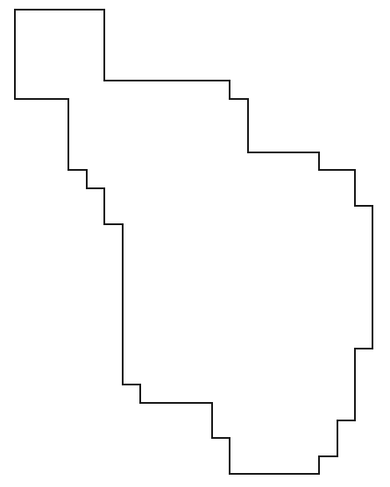
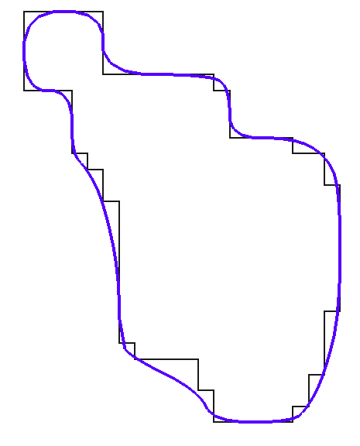

L > SCL
SCL
L > SL
SL

Slide 2
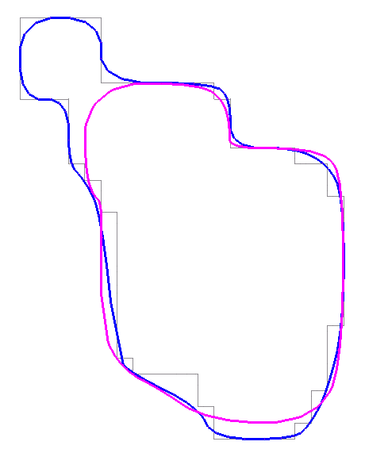
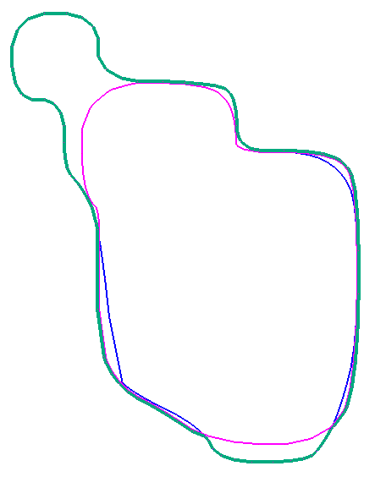
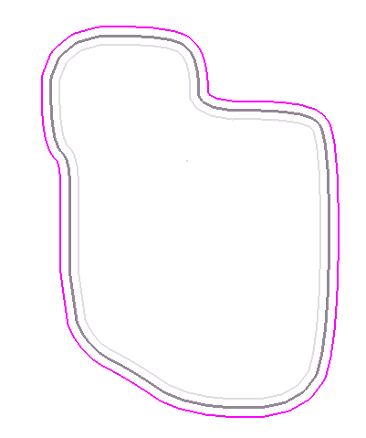
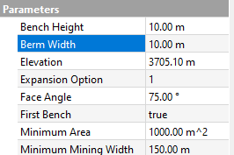
Purple – PB Crest offset equal to berm width parameter
Blue – optimization shell intersection interpretation (see previous graphics)
Purple – PB Crest offset equal to berm width parameter
Blue – optimization shell intersection
Green – final toe
Grey – Previous bench (PB)
Dark grey – PB Crest
Purple – PB Crest offset equal to berm width parameter

Slide 3
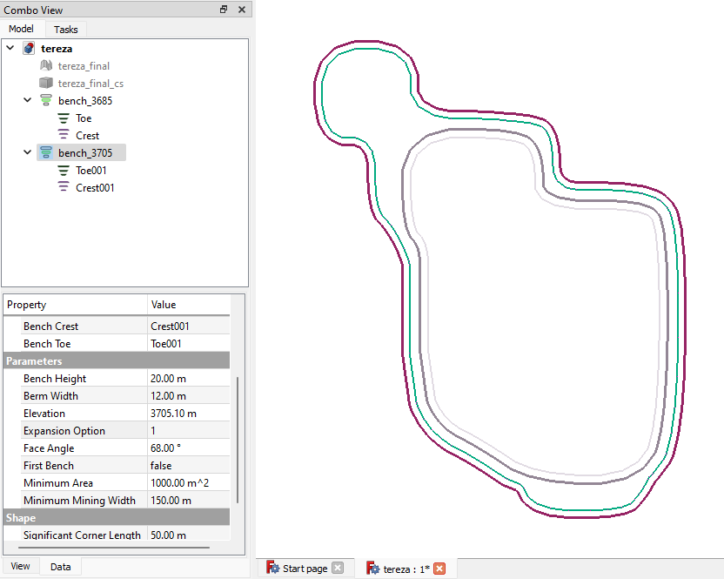
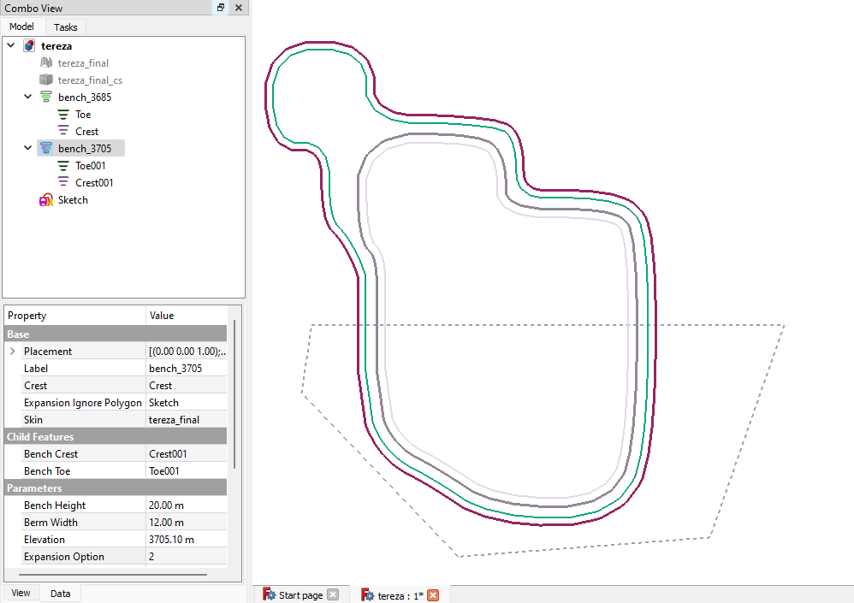

Slide 4
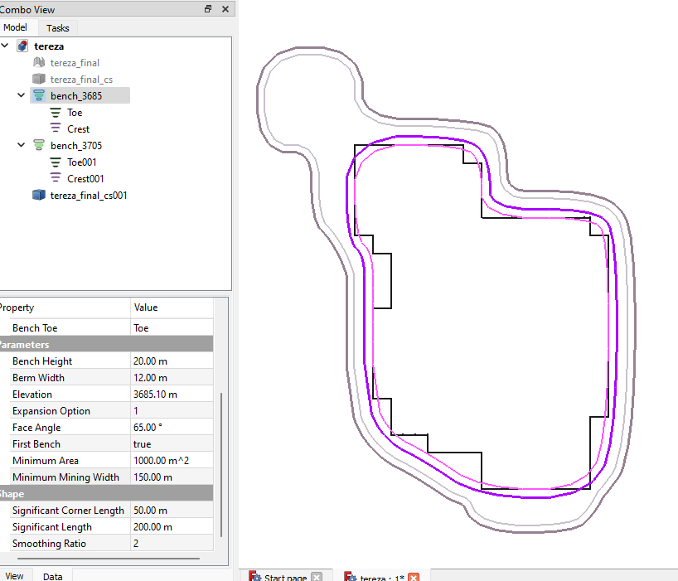
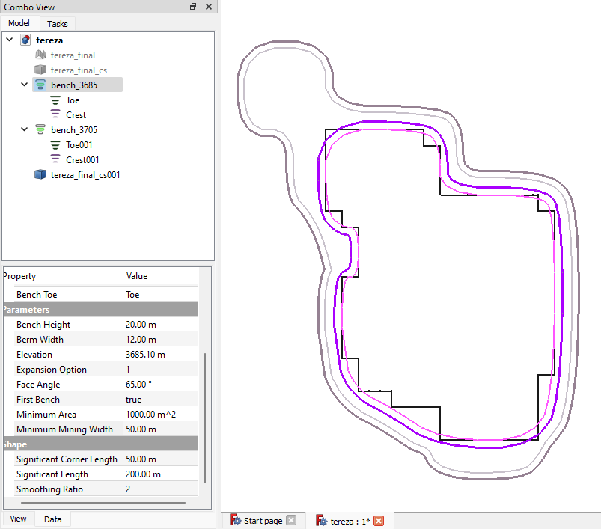
L < MMW
L >= MMW
MMW

Slide 5
